Slide 1



STRUBI Facilities Talks 2023 -
Diamond and eBIC
Christian Siebold

Slide 2
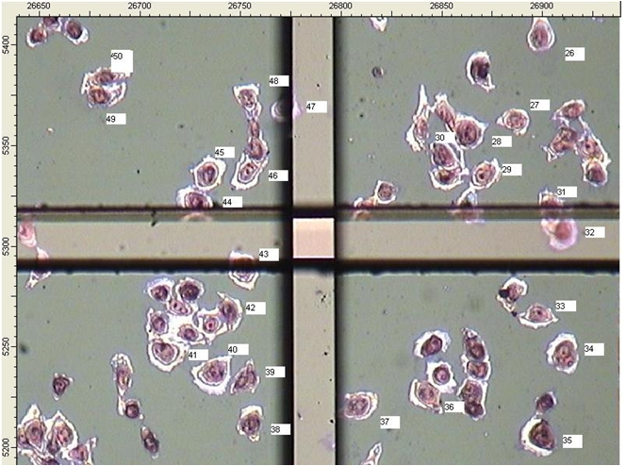
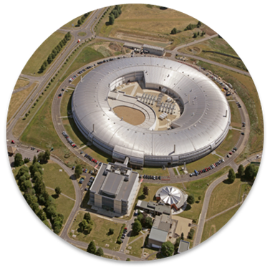
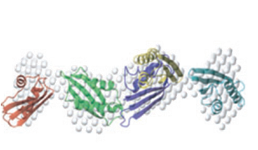
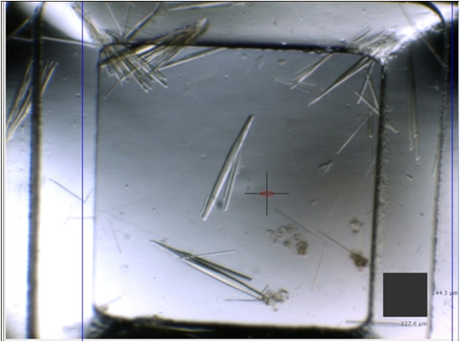
Life Sciences @ DIAMOND LIGHT SOURCE
Biological Cryo-Imaging
  eBIC – National Centre for EM
  B24 Cryo X-ray microscopy
Soft Condensed Matter
  B21 SAXS
  B23 CD
Macromolecular Crystallography
  The MX village
  ( I03, I04)
  (I24, I04-1)
  (I23, VMXi/VMXm)

Slide 3
Biological Cryo-Imaging
eBIC (Electron Bio-Imaging Centre)
  Five Titan Krios microscopes, a Talos Arctica, two Glacios, a Scios and an Aquilos cryo-FIB/SEM, and a Leica CryoCLEM.
  BAG access (more later and OPIC talk)
B24
  Correlative 3D imaging with soft X-ray tomography (cryoSXT) complemented by super resolution fluorescence structured illumination microscopy (cryoSIM).
  Rapid or Standard Access route to beamtime

Slide 4
Soft Condensed Matter
  B21 SAXS
    SEC/MALS SAXS is provided Wyatt multi-angle light scattering instrument inline with an Agilent 1200 HPLC system
      Access via BAG (mail-in system)
  B23 CD
    Circular Dichroism (CD) of proteins in solution. Improved signal to noise
      Access via Rapid or Standard Access

Slide 5
Macromolecular Crystallography
I03 & I04 – Highly automated beamlines for M/SAD experiments.
I04-1 – XCHEM experiments
I23 – Long wavelength beamline for weak phasing
I24 – Microfocus high flux beamlines
VMXi - in-situ beamline
VMXm - micro/nanofocus MX beamline
BAG access or standard access
Google Diamond MX for more details on beamline specs and detectors

Slide 6
How do we access
We have 2 “BAG” (Block Allocation Group) at the DLS - one for MX - one for EM
This means we get awarded time per allocation period (normally 6 months) spread over the beamlines and microscopes
For MX ~ 20 days over 6 months
For EM Bag ~40 days over 6 months
CHECK ISPYB.diamond.ac.uk FOR UPCOMING TIME

Slide 7
Getting access
DIAMOND: Fill in a Registration form (use Google)
http://www.diamond.ac.uk/Home/ForUsers/academics/UserGuide/Before-you-Arrive/Registration-Process.html
OR: http://uas.diamond.ac.uk/uas/
  You will then get a FED_ID username and password that allows you
  Access to DIAMOND
  to log on to machines

Slide 8
Samples
Samples need to be declared!
  PIs can create samples in the User Administration system (if you have problems contact christian@strubi.ox.ac.uk)
    SO get your supervisor to register samples at http://uas.diamond.ac.uk/uas/

Slide 9
If you have purified samples
Is it big enough to do EM ?? ~100kDa ??
  Prepare EM grids (neg stain and cryo) see Loics talk
Is there enough to set-up crystallisation
  Go and talk to Tom Walter/Karl Harlos

Slide 10
If you have crystals
Telling your supervisor is a good idea
Please email christian@strubi.ox.ac.uk and provide information on sample details:
  What is the protein?
  Number of crystals
  Crystal size
  Previous data??
  What do you want to achieve!
This will help us plan how you can best do your experiment

Slide 11
MX Access
Local access – control experiment at beamline
  Remote access – control experiment from STRUBI or Unattended Data collection (UDC)
  Contact me, Karl or Guido if you require time (christian@strubi.ox.ac.uk)

Slide 12
ISPYB – Overview of features
ISPyB is a LIMS combining sample tracking and experiment reporting at synchrotron beamlines.
Management of Shipments, Sample, Crystal and Protein information
Real time monitoring of your data collections (Diffraction images and Crystal snapshots, harvesting of output from data reduction programs...)
View experiment related information and export your experiments' meta-data back to your home lab
ISPyB can be found at https://ispyb.diamond.ac.uk. (DLS username)
Notes:
LIMS: Laboratory Information Management System

Slide 13
ISPYB – What we need to do
Dewar shipments need to be prepared using the online registration forms (Guido/Karl will normally do this)
A shipment needs to be created – this enables Diamond staff to track where our DEWARS are.
Enter puck details on ISPYB as soon as the shipment is created. Guido or Karl can advise. This will then write your sample info into the latest instance of the puck.
THIS IS IMPORTANT especially for UDC

Slide 14
MX-GDA – Collecting your data
Samples need to be registered in ISPYB
  LOOK AT MX webpages for online manual and videos
  http://www.diamond.ac.uk/Beamlines/Mx.html

Slide 15
Unattended Data Collection (UDC)
Rapid scheduling
No user input required during the beamtime - ship and forget until you get your results back
Uses standardised data collection protocols which have been optimised for each Diamond beamline
https://www.diamond.ac.uk/Instruments/Mx/I03/I03-Manual/Unattended-Data-Collections.html

Slide 16
Unattended Data Collection (UDC) – when to use
Use with single crystals
  Best diffracting crystal ?
  Ligand studies ?
  Standard phasing with sufficient number of crystals
DON’T use when manual input required
  Split or multiple crystals
  Line scans etc
https://www.diamond.ac.uk/Instruments/Mx/I03/I03-Manual/Unattended-Data-Collections.html

Slide 17
Monitoring data collections - ISPYB
Real time monitoring of your data collections (Diffraction images and Crystal snapshots, harvesting of output from data reduction programs...)
View experiment related information
ISPyB can be found at https://ispyb.diamond.ac.uk.
http://diamondlightsource.github.io/SynchWeb/
Log on using your DIAMOND username

Slide 18
Processing your data
If you are collecting at DIAMOND
  Your data will automatically be processed by FASTDP and XIA2/DIALS/AUTOPROC (within 2 mins you should get a scaled data set).
  For the beamlines to run optimally the automatic data processing is required

Slide 19
EM Access
PIs - if you need EM ebic access please contact Jon Grimes (jonathan.grimes@strubi.ox.ac.uk).
Dewars need to be couriered or driven down to Diamond.
Samples must be registered in iSPYB (similar to MX access)
Samples and users will be defined in the UAS for each visit (Jon Grimes does this)
Local contacts will do basic microscope alignments, K3 tuning and K3 gain reference collection.
USERS need to know how to collect their data

Slide 20
Any questions
Feel free to email Jon, Guido, Karl or myself if you have any questions
MX Bag training is three times a year …Karl has just sent an email about this.
Training and courses for on-site and remote EM SPA and tomography data collection are available.

