Slide 1
STRUBI Facilities Talks
01/02/23
Instruct-ERIC
Claudia Alen Amaro
Marcus Povey

Slide 3

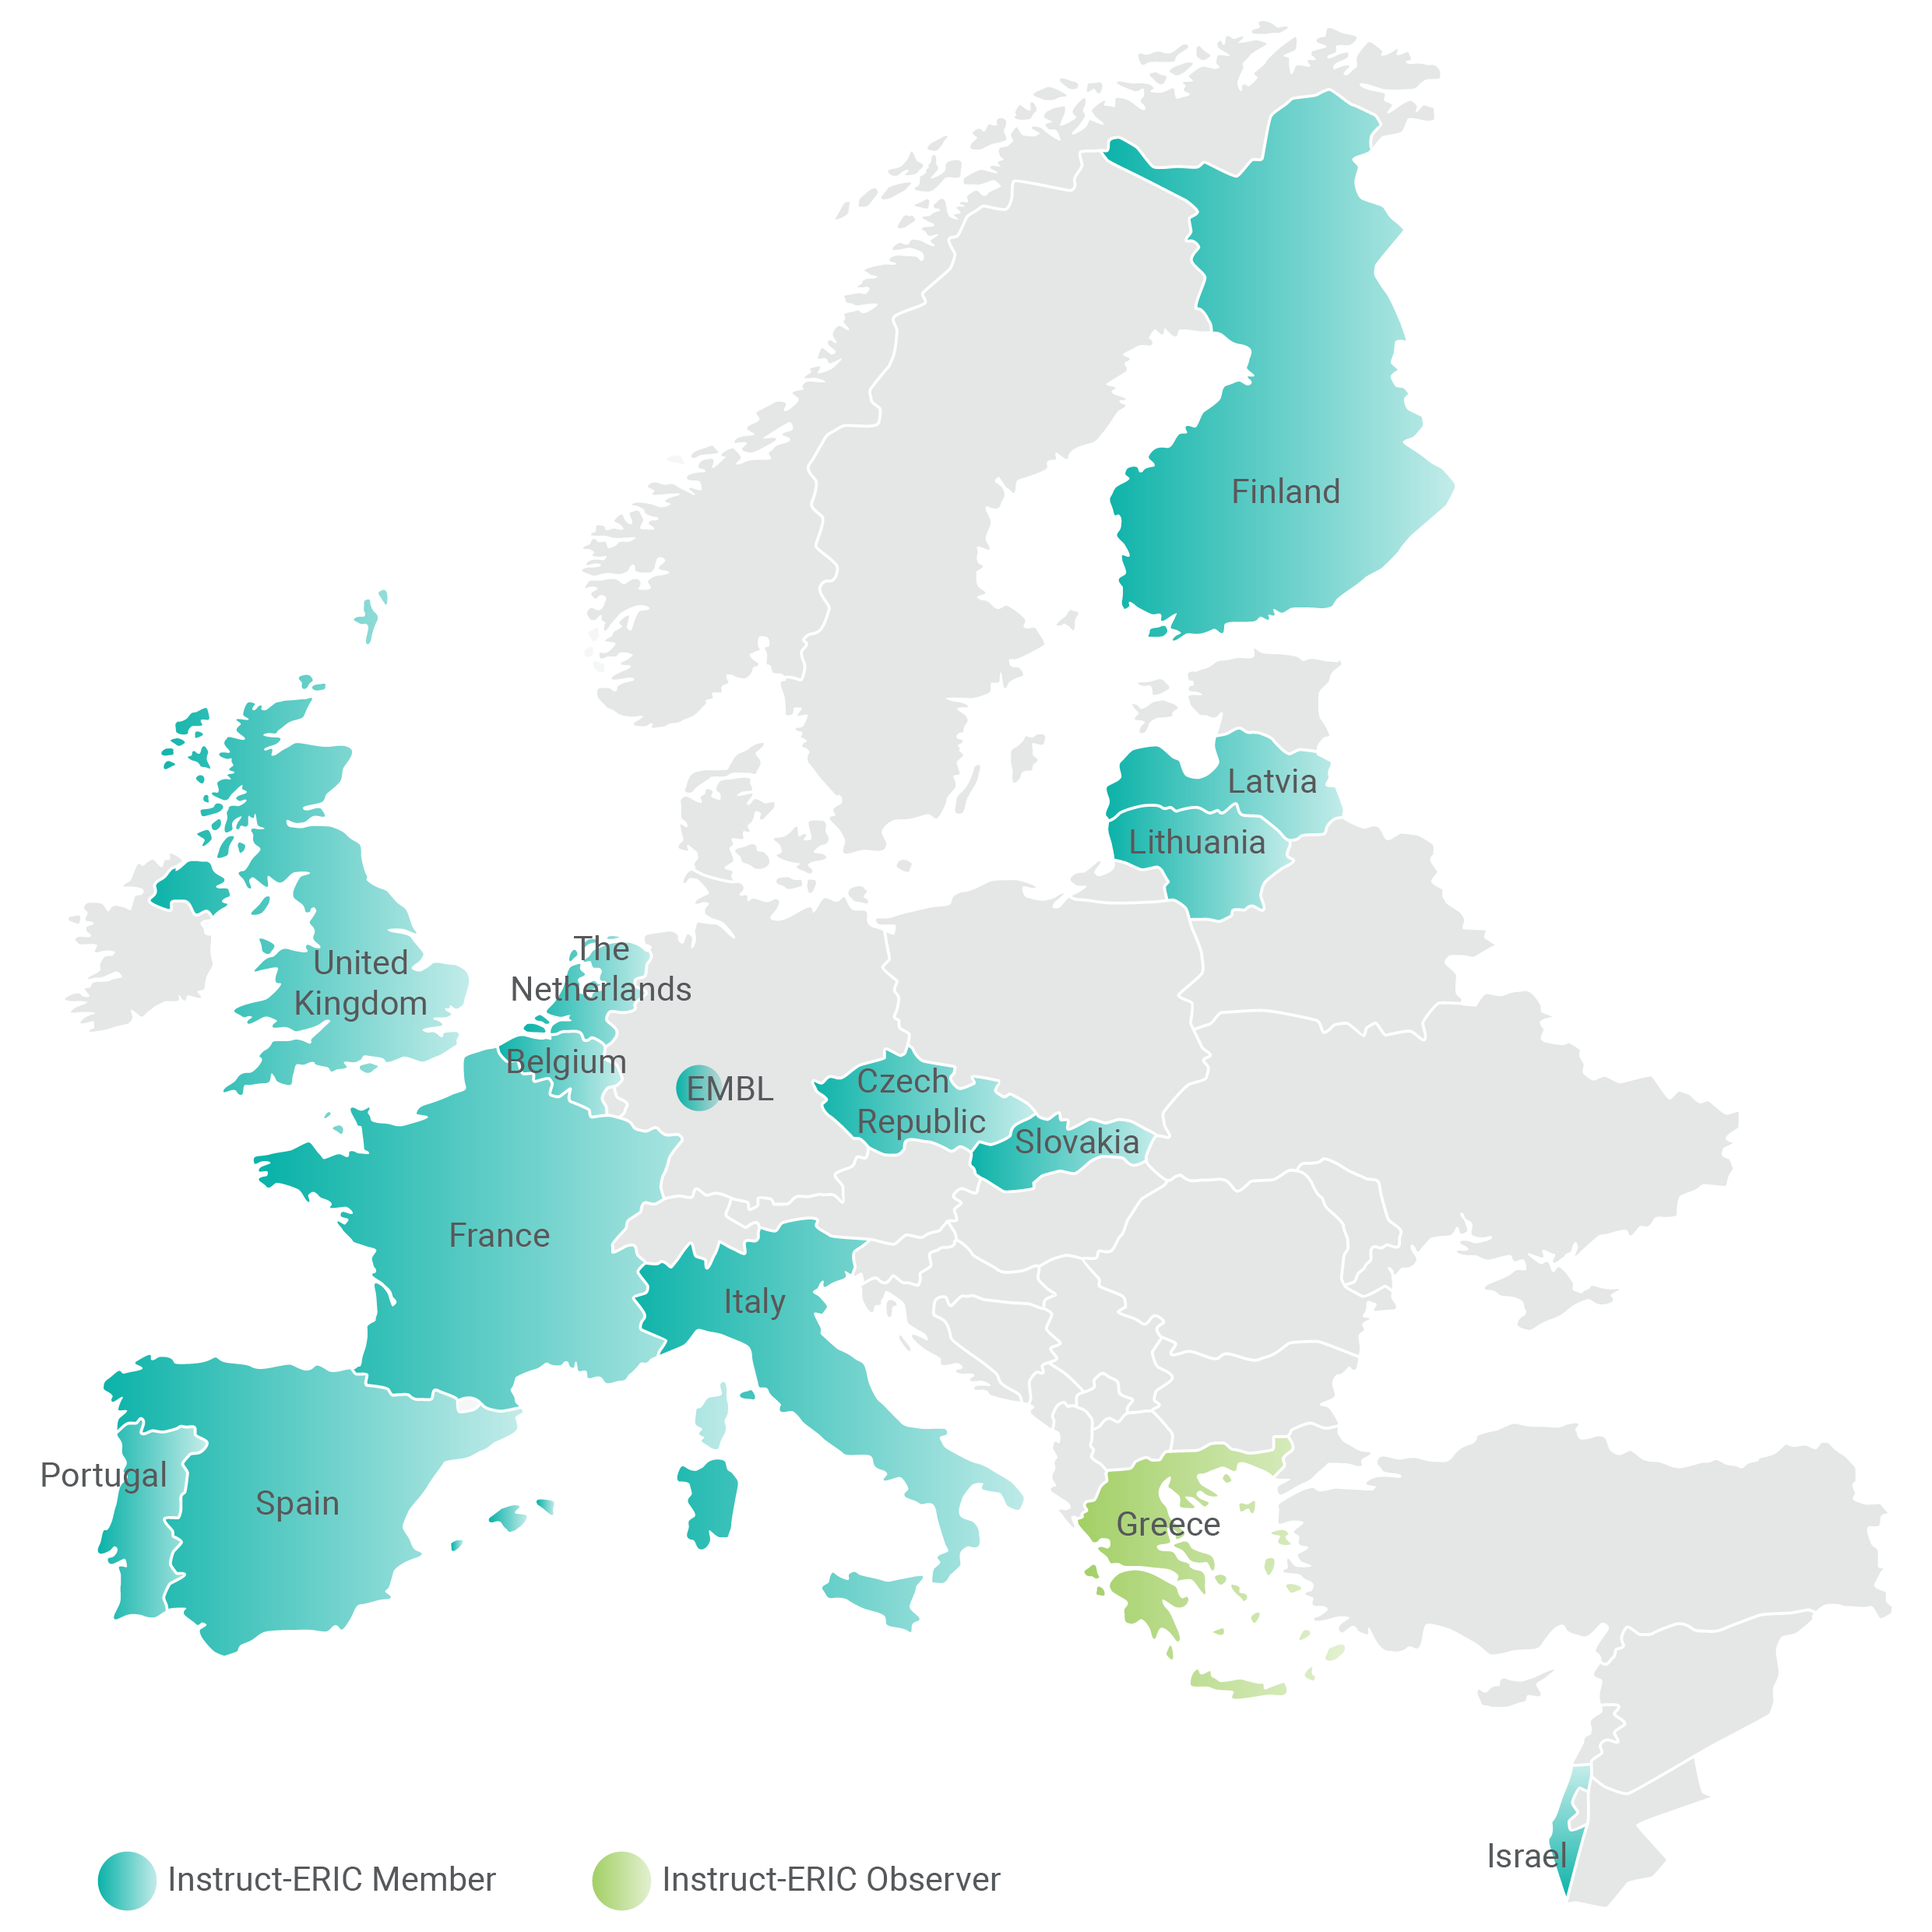













What is Instruct-ERIC? Members
Instruct-ERIC is the single point of access to technology and expertise for structural biology research.
Instruct has 15 Members that each pay an annual subscription to allow their scientists to access the range of services that are available through Instruct.
Belgium
Czech Republic
EMBL
Finland
France
Israel
Italy
Latvia
Lithuania
Netherlands
Portugal
Slovakia
Spain
UK

Slide 4
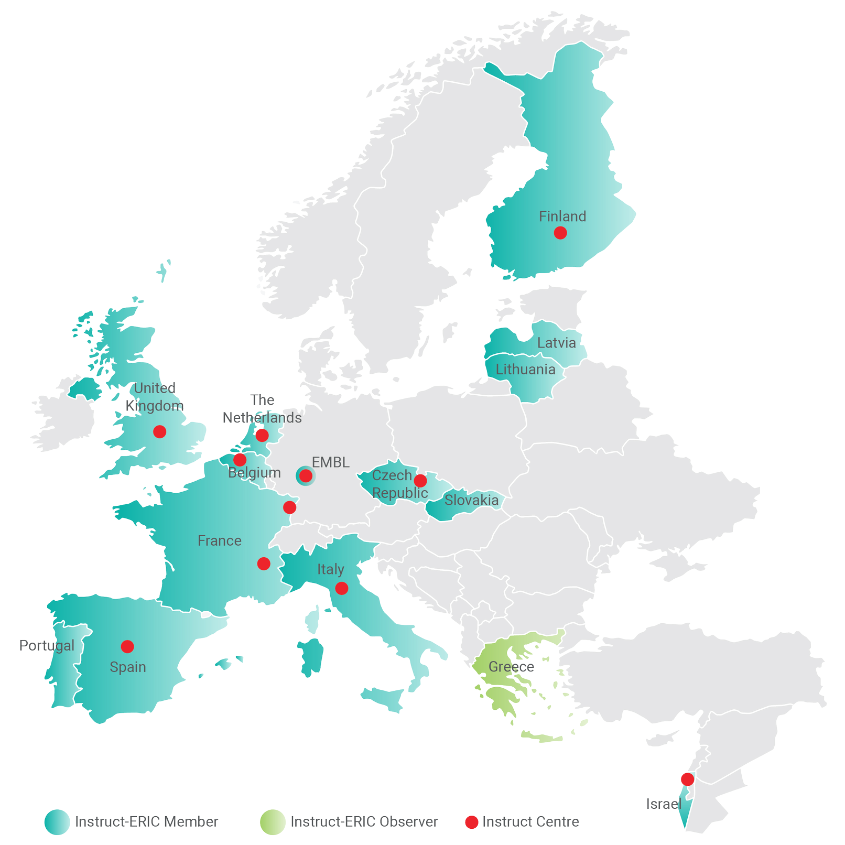
What is Instruct-ERIC? Centres
Instruct-ERIC is the single point of access to technology and expertise for structural biology research.
The Instruct consortium comprises eleven Instruct Centres that offer access to 27 facilities across Europe.
Instruct Centre BE Nanobodies4Instruct, Robotein
Instruct Centre CZ BIOCEV, CEITEC
Instruct Centre EMBL EMBL Grenoble, EMBL Hamburg, EMBL Heidelberg
Instruct Centre ES Instruct Image Processing Centre I2PC, CNB-CSIC
Instruct Centre FI University of Eastern Finland, University of Helsinki,
University of Oulu
Instruct Centre FR1 IGBMC
Instruct Centre FR2 IBS-ISBG
Instruct Centre IL Centre for Bioinformatics Tel Aviv, ISPC (WIS) Israel
Instruct Centre IT CERM
Instruct Centre NL Bijvoet Centre, NeCEN, NKI
Instruct Centre UK Astbury, Diamond, Molecular Biophysics Suite, Oxford Mass Spec, Oxford Particle Imaging, Harwell, STRUBI

Slide 5
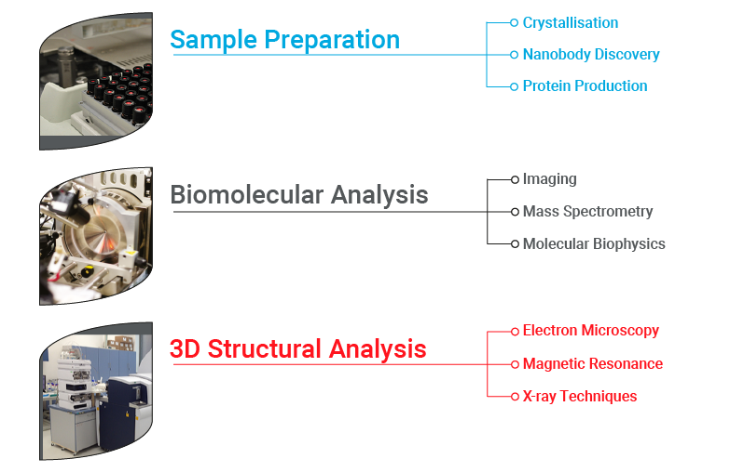
Instruct-ERIC Catalogue
Macromolecular Crystallisation and Molecular Biophysics available to access at STRUBI via Instruct-ERIC
Electron Microscopy available to access at OPIC via Instruct-ERIC

Slide 6
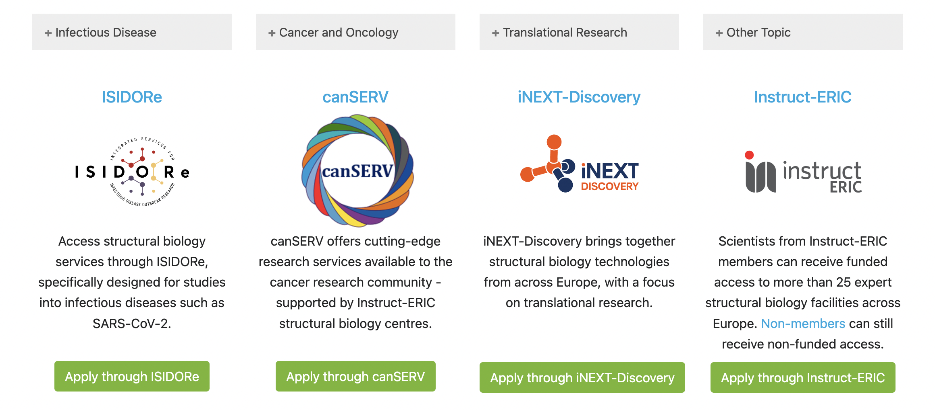
Access Funding Through Projects

Slide 7

What is ARIA?
ARIA is a cloud platform provided by Instruct
  It offers a range of different RI services for different users
Provides a singular hub for all Instruct users, as well as non-Instruct RIs
Microsoft Office 365 for Research Infrastructures
The most state of the art tool for managing research infrastructures
  Used by 5 RIs
  Used in 14 European Commission funded projects
Notes:
ARIA Is a cloud platform, providing a range of services for RIs to offer their users. A one-stop shop for users to carry out and manage access proposals, websites, facilities and so on

Slide 8
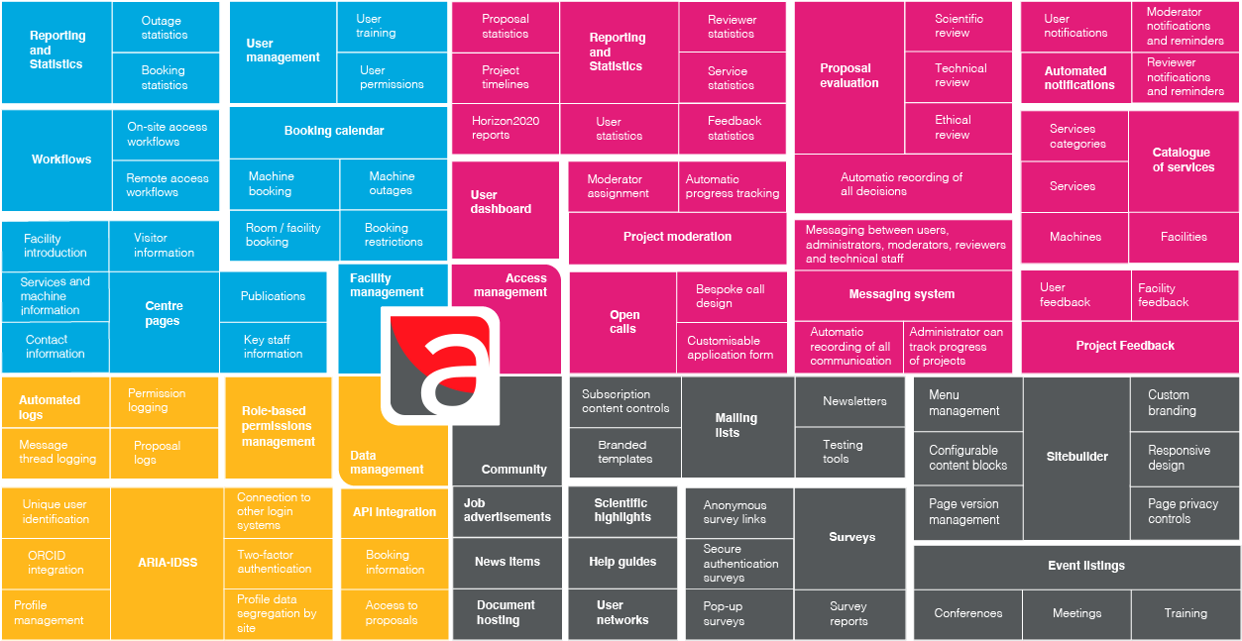
What is ARIA?
Notes:
Pillars, cores, tenets. NOT services

Slide 9
What is ARIA?
Notes:
Services

Slide 10
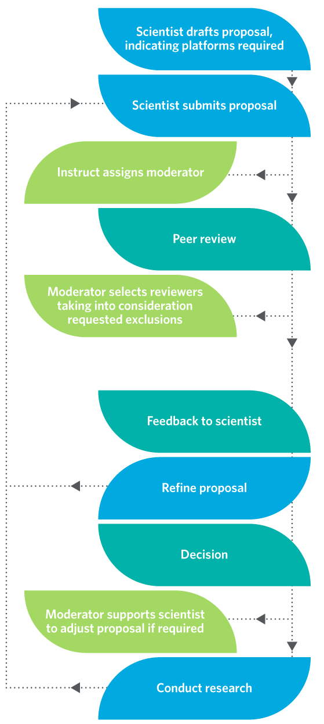
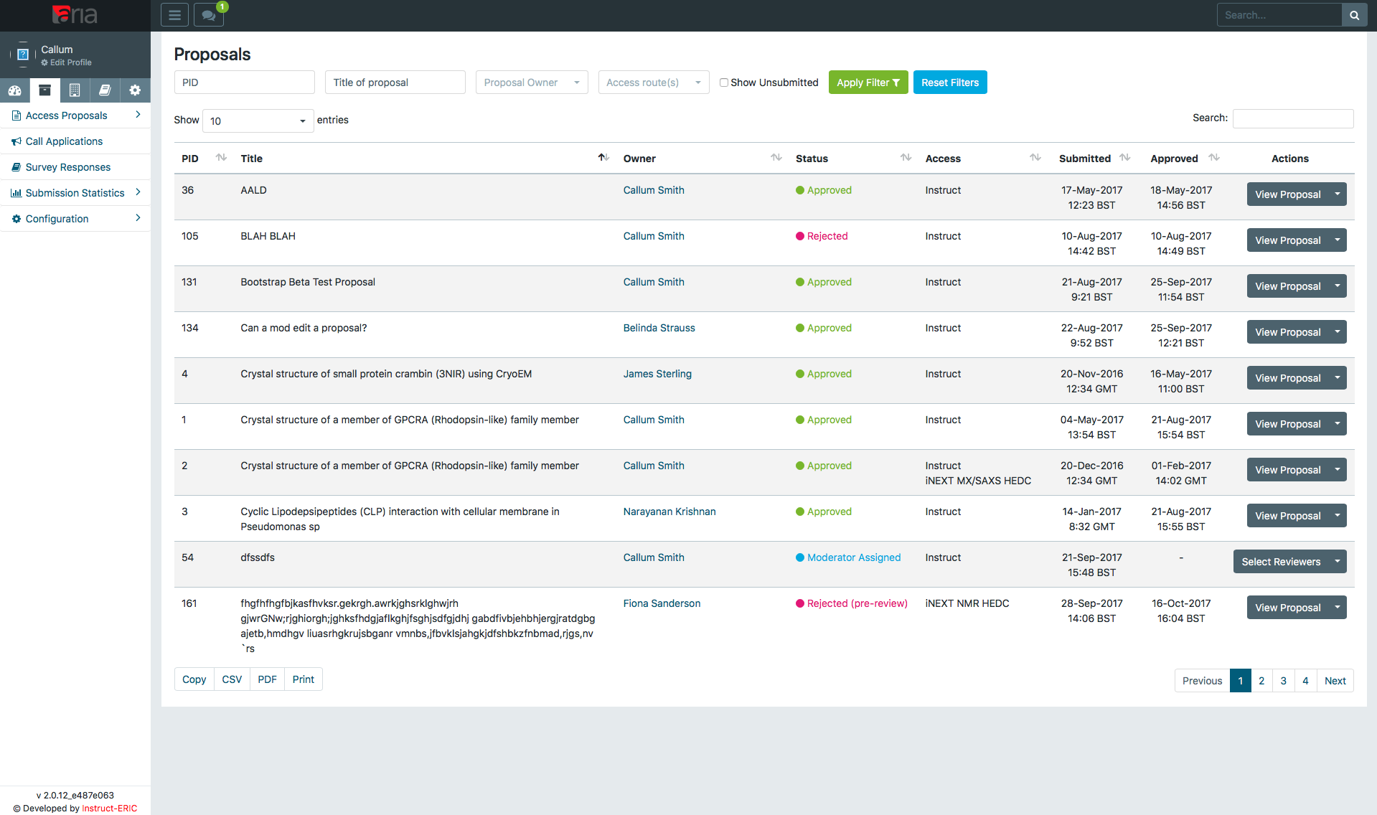
Access Management

Slide 11
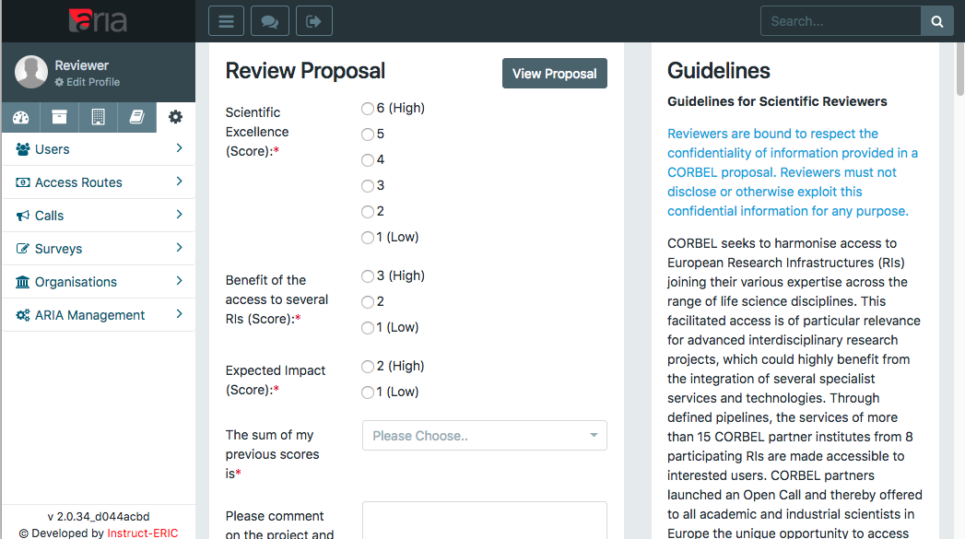
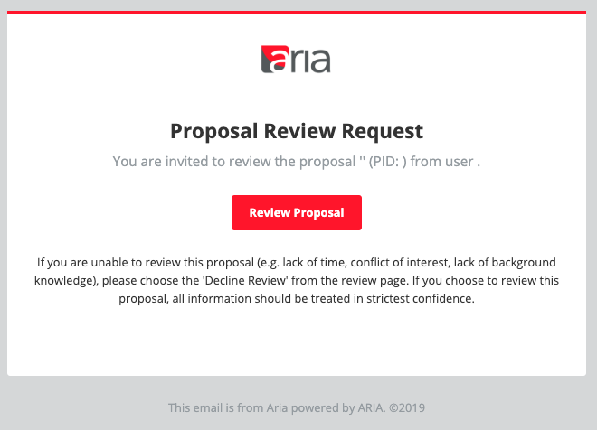
Automated Peer Review

Slide 12
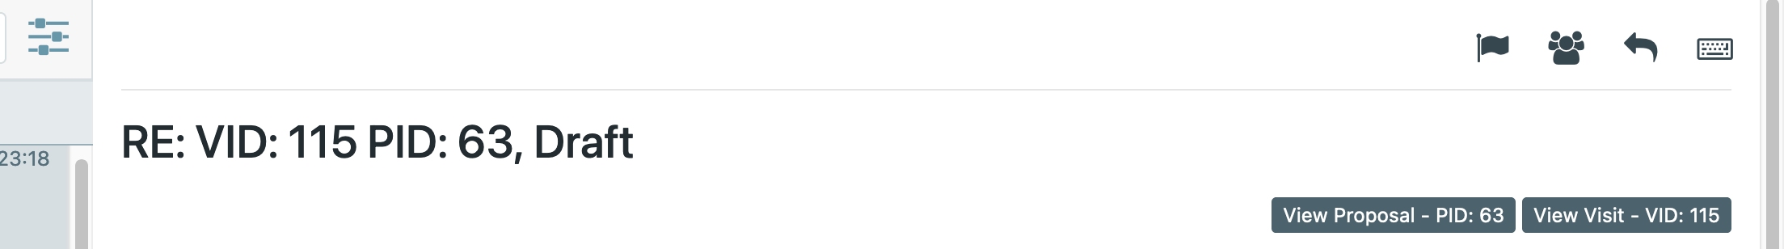
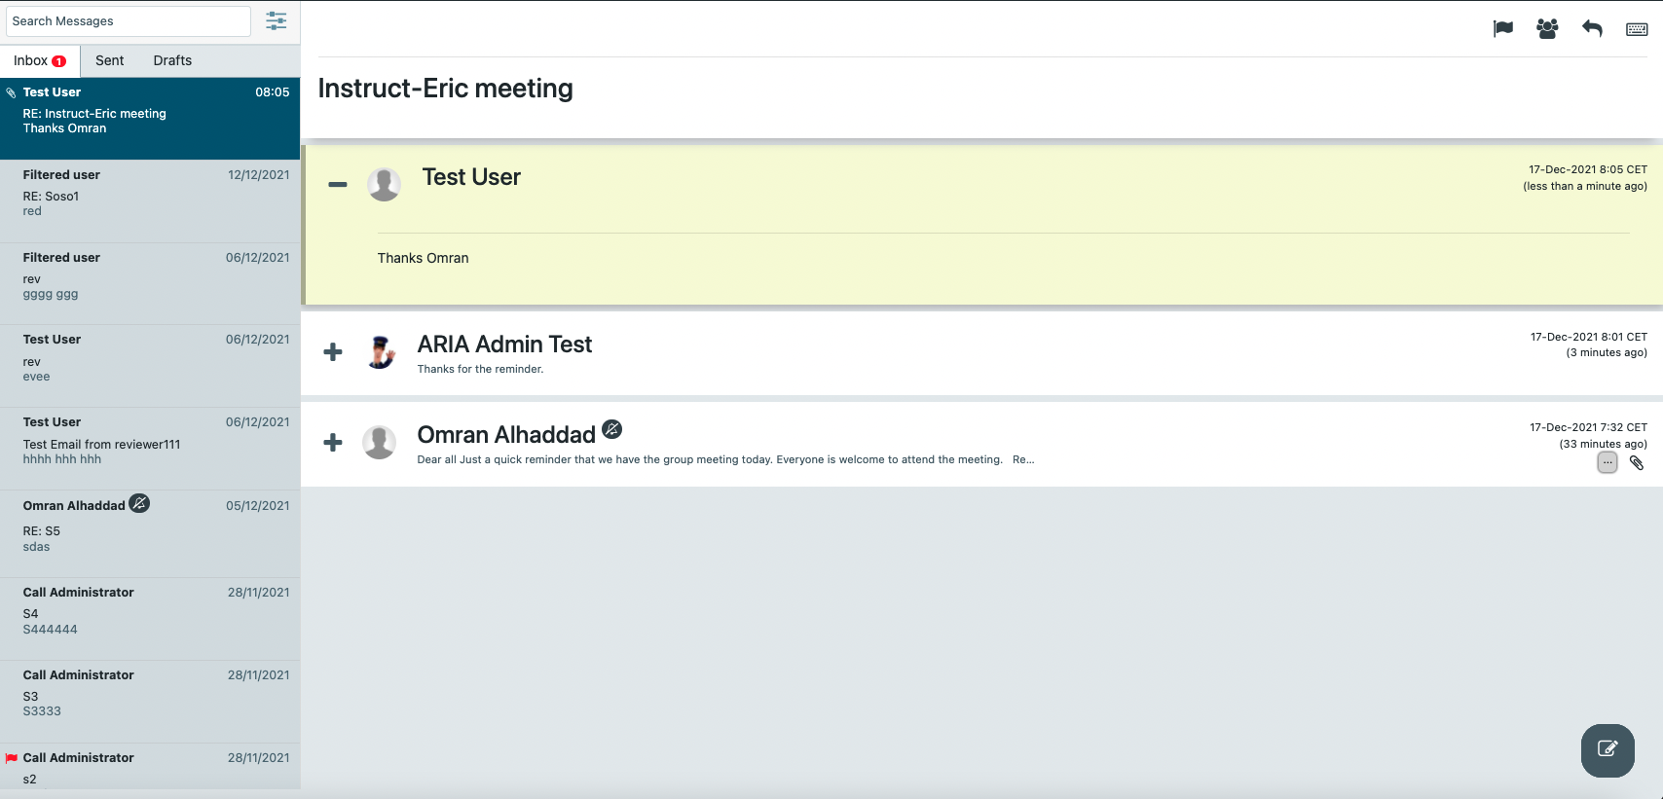
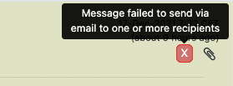
Integrated Messaging
GDPR compatible
Know who is involved in conversation
Keep messages in one place
Links to related Proposal or Visit
Expand and highlight unread messages
Show user icons
Email notifications off

Slide 13
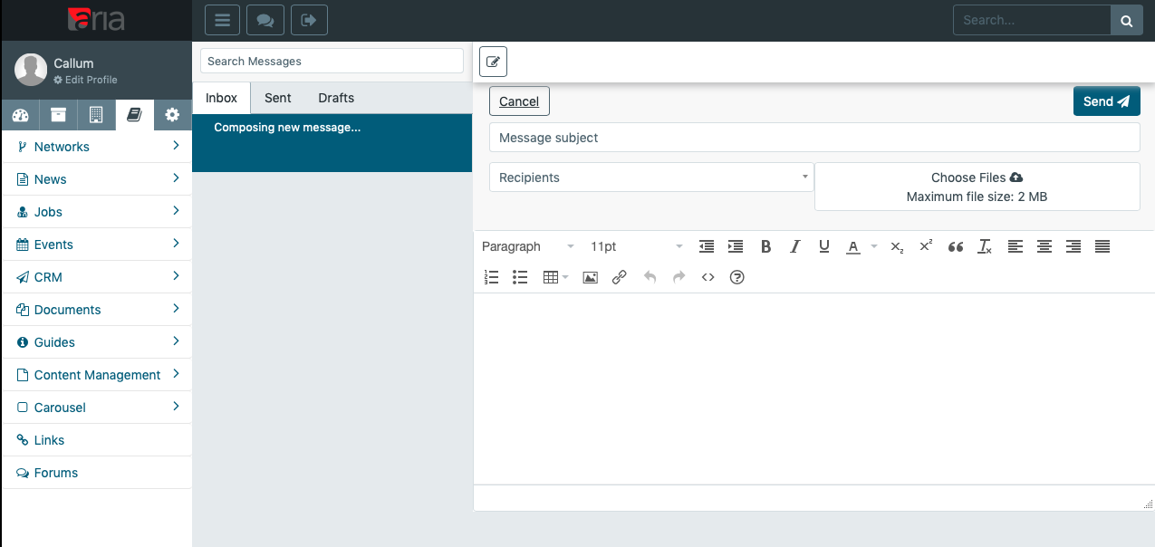
Integrated Messaging

Slide 14
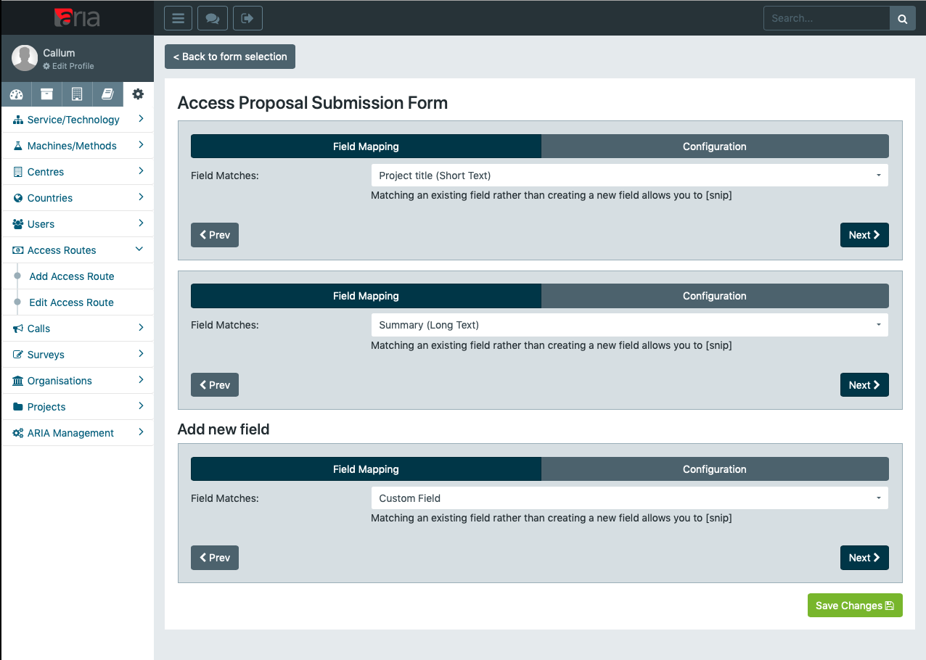
Autonomous Management
Power to configure all aspects of access management:
  Moderator & Reviewer Lists
  Participating countries
  Access administrators
  Submission forms
  Email templates and content

Slide 15
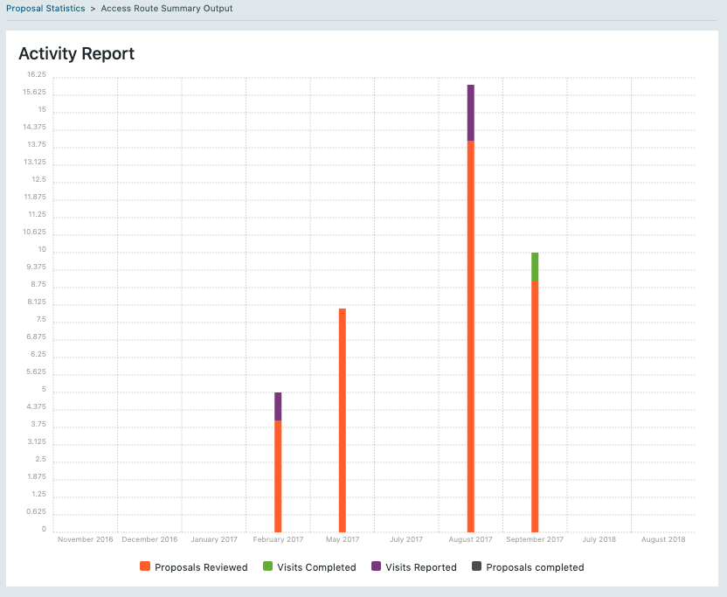
Reporting
Access to a huge number of reporting tools and metrics
Pre-defined templates and outputs
Custom reporting with customizable criteria

Slide 16
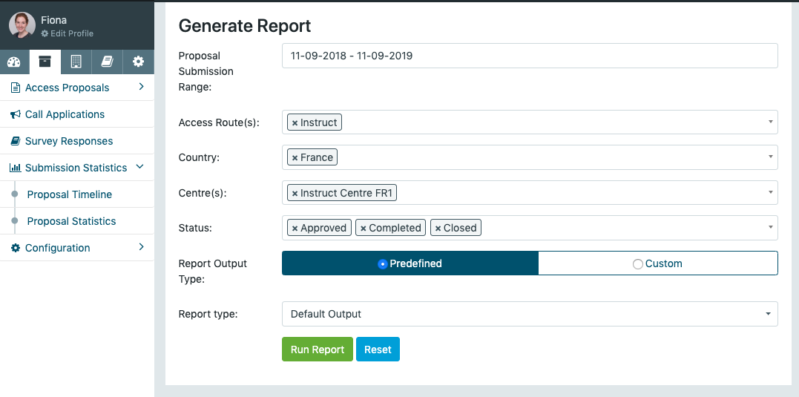
Submission Statistics

Slide 17
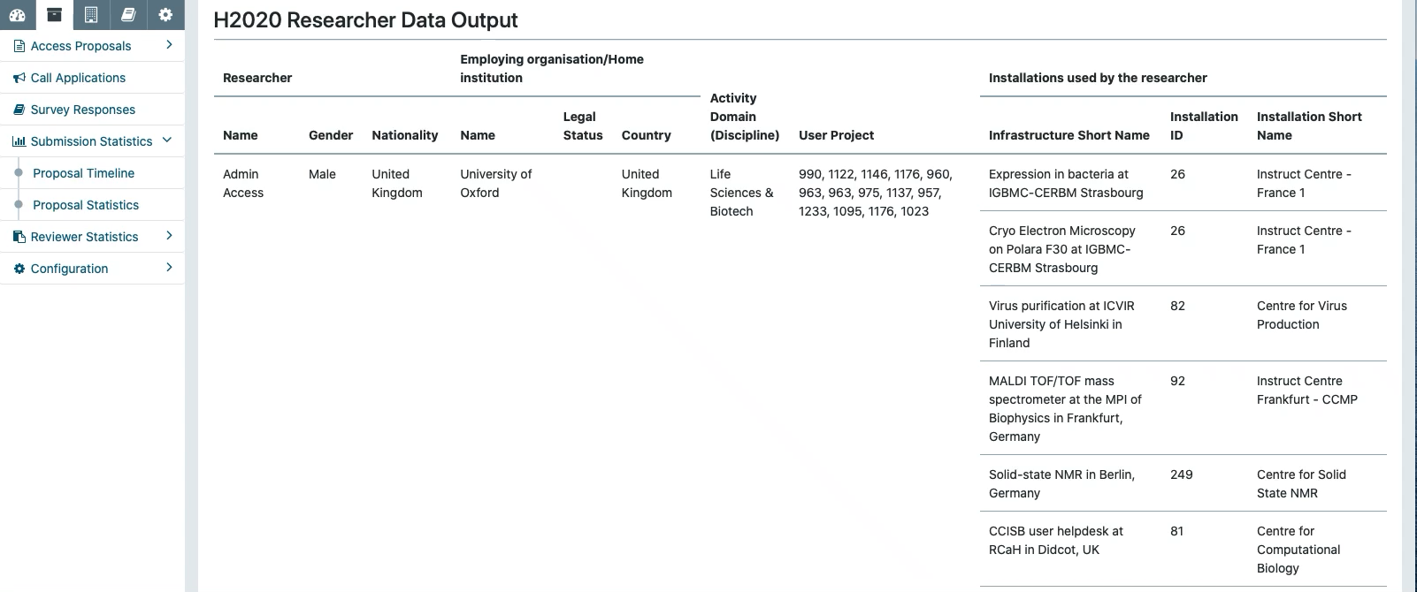
Generating Reports

Slide 18
External Access Management
External access approved through peer review
Assign multiple sessions against a single visit
Report units of access for each session
Checkpointed workflows for access sessions
Integrated scheduling system for physical visits

Slide 19
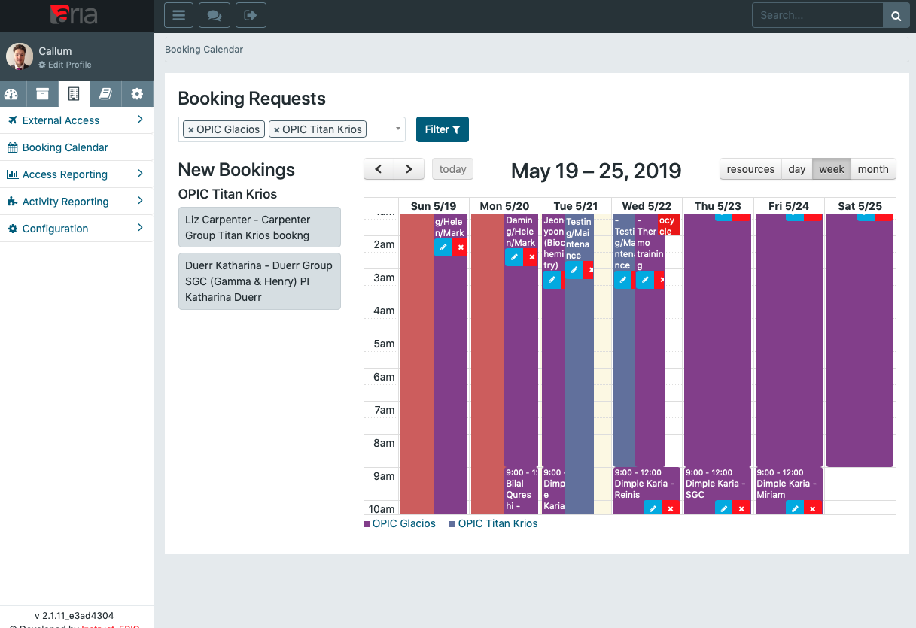
Internal Access
Can be done through normal access procedures
Direct access to scheduling through booking calendar
Machine training status management

Slide 20
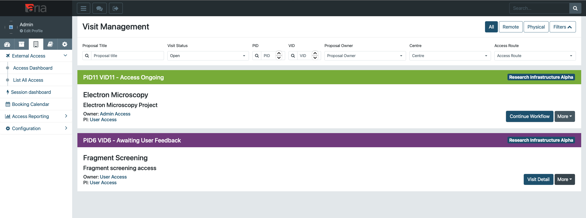
Unified Access Workflow
Single unified management for remote/physical access
Integrated notebook for sessions (message thread)
Checkpoint-initiated scheduling
Customisable checkpoints
Per-session feedback (facility configurable)

Slide 21
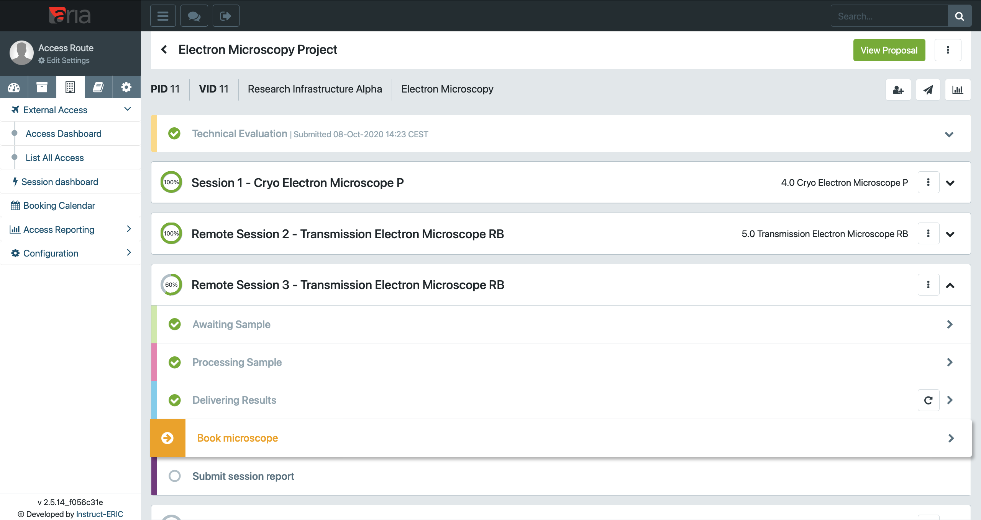
Unified Access Workflow
External and internal access handled through the same unified workflow
Multiple sessions per visit/experiment
Integrated cost tracking and consumable logs
All optional features that can be enabled per-machine

Slide 22
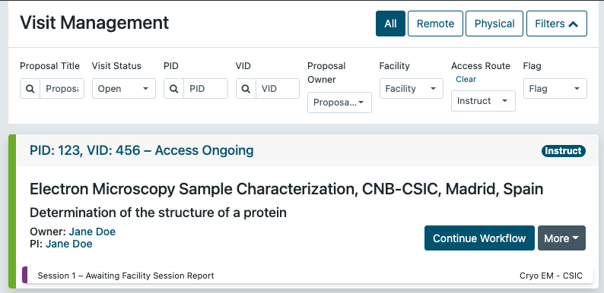
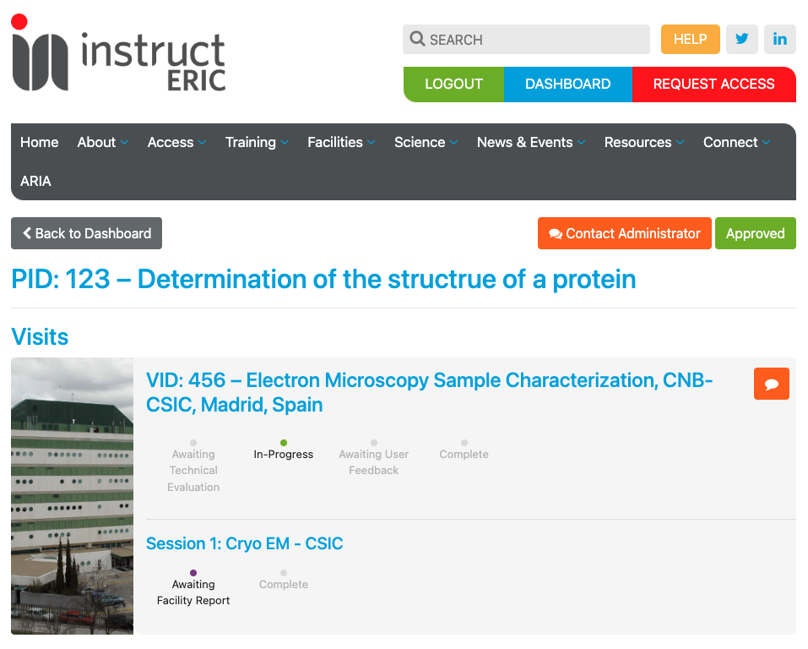
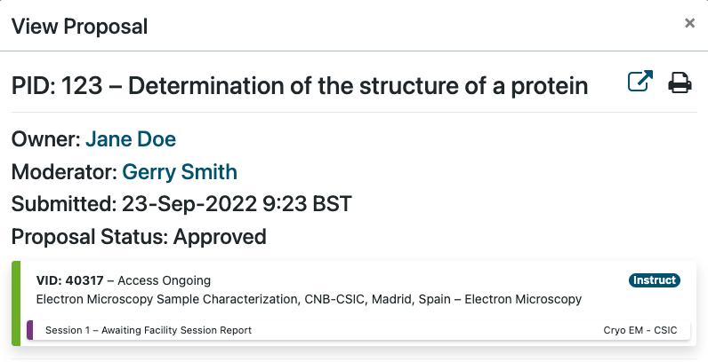
Admin and User dashboard progress tracking

Slide 23


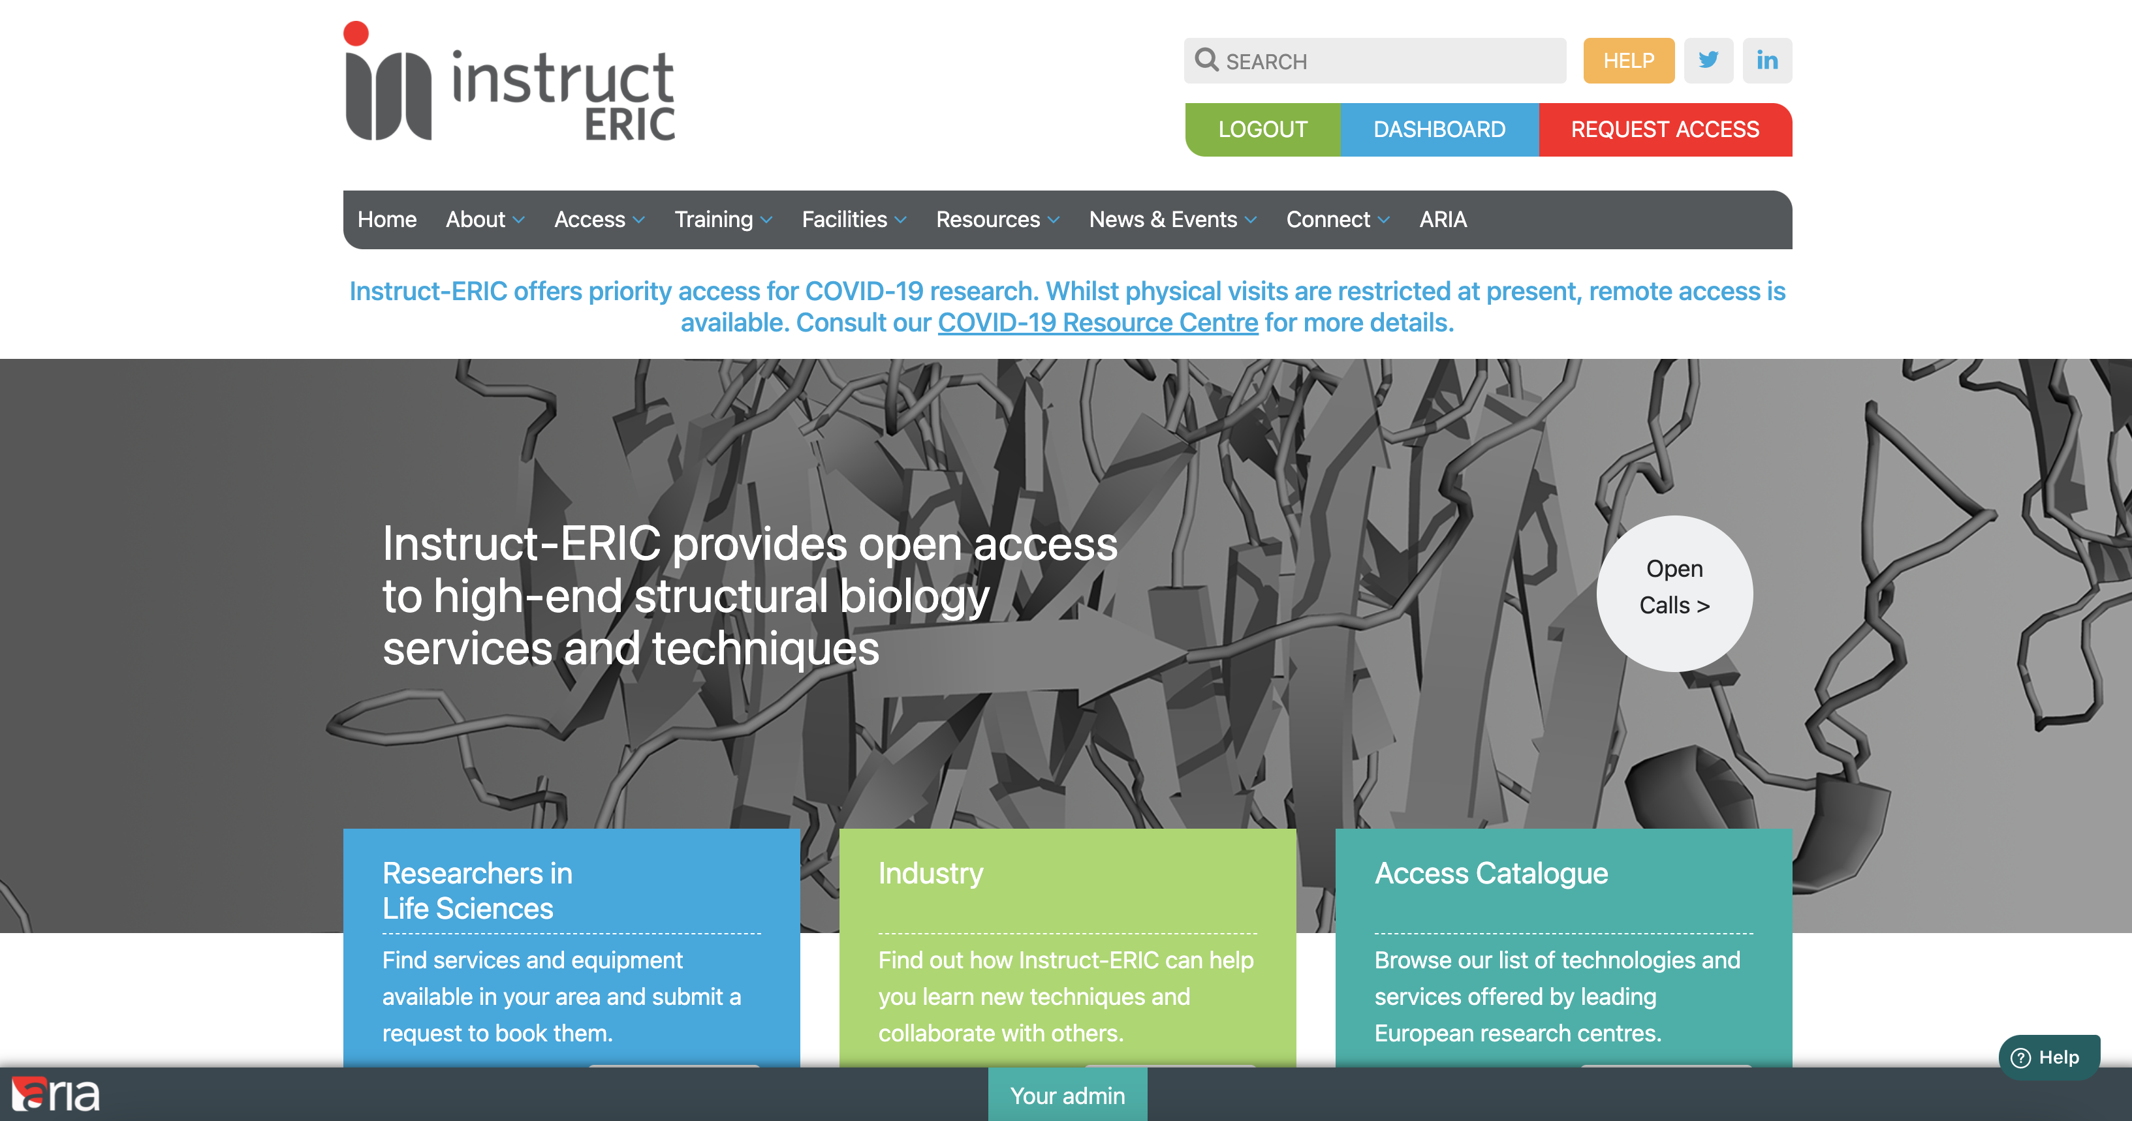
ARIA Help Guides

Slide 24
ARIA: An Overview
ARIA is a single-point platform, a hub for a variety of users to conduct a variety of activities
Streamlines the proposal submission process – a key part of RI management
In addition to Instruct, it is used by a number of RIs and EU projects
It is an ever-increasing presence within the research community, and has the potential to raise Instruct’s profile even further as a result
Notes:
What are some top level ARIA stats? Can we get all these Year on Year?

Slide 25
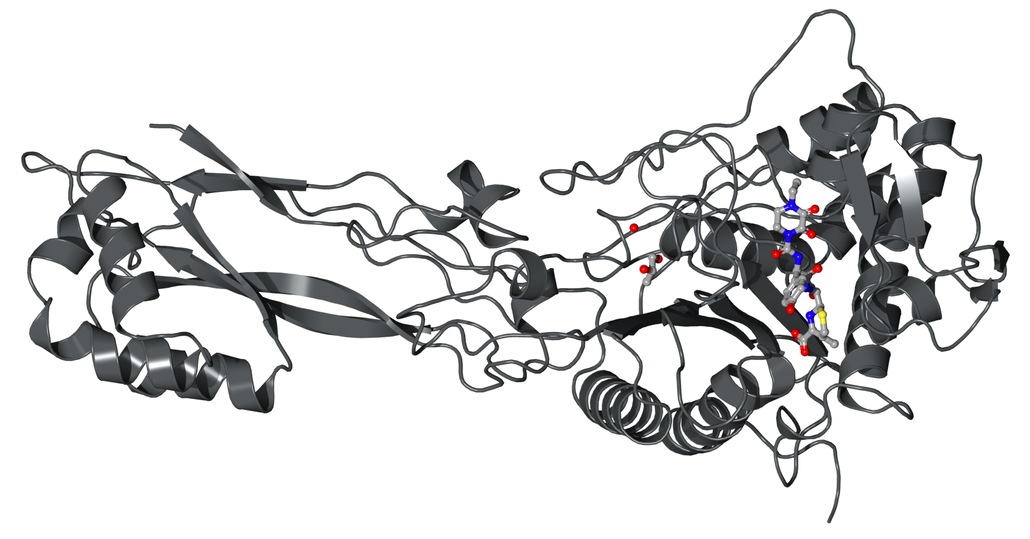
For more information about funded research opportunities, visit the Instruct-ERIC website.
instruct-eric.org
To stay informed of the latest opportunities and open calls from Instruct, register for an ARIA account at:
instruct-eric.org/register

