Slide 1



STRUBI Facilities Talks 1 February 2023:
STRUBI Computing and Biomedical Research Computing (BMRC)
Jun Dong – jun.dong@strubi.ox.ac.uk
Generic email: support@strubi.ox.ac.uk
MSD-IT Generic email: ithelp@medsci.ox.ac.uk
Robert Esnouf – robert.esnouf@ndm.ox.ac.uk
BMRC support email: bmrc-help@medsci.ox.ac.uk

Slide 2





Computing organisation reflects Oxford…

Slide 3

University ICT regulations/policies apply to you!
The University network is a private network:
  You have no automatic right to connect to it!
  You cannot just do anything you want!
  You must not connect to the network without permission!
Use of ICT facilities is bound by University rules:
  Three actionable events per day across the University.
  Potential per incident maximum ICO fine >£50M.
Information Security Awareness training:
  https://www.infosec.ox.ac.uk/training-and-awareness
  You have already agreed to repeat this course every year!
You have already agreed to abide by the University ICT policies:
  See https://governance.admin.ox.ac.uk/legislation/it-regulations-1-of-2002
  Laptops / memory sticks / USB disks are big security threats!
  You must have up-to-date antivirus software installed!
  Never share usernames or passwords, they are yours.
  Passwords must be 16+ characters (and complex).
  Two-factor authentication (2FA) coming in – already for Office365, email and BMRC!
  Downloading/sharing music, films & TV is usually illegal and violates University policy.
  Beware of phishing emails. Never follow links to enter passwords. Just ask Jun!
  Beware of email attachments which may install ransomware, malware & key
  loggers that can affect the whole University not just your machine.

Slide 4
Central ICT facilities
University Subscription to Microsoft Office365
Email and Calendar (Nexus)
  Login https://www.office.com/
  Emails first.last@strubi.ox.ac.uk
Mail lists now use central list servers, but “old” short forms still work:
  all@strubi.ox.ac.uk (all-strubi@maillist.ox.ac.uk)
  emsupport@strubi.ox.ac.uk (emsupport_strubi@maillist.ox.ac.uk)
  embookings@strubi.ox.ac.uk (embookings_strubi@maillist.ox.ac.uk)
  emusers@strubi.ox.ac.uk (emusers_strubi@maillist.ox.ac.uk)
  wetlab@strubi.ox.ac.uk (wetlab_strubi@maillist.ox.ac.uk)
  social@strubi.ox.ac.uk ( social_strubi@maillist.ox.ac.uk)
  Contact support@strubi.ox.ac.uk to be added to these mailing lists
For official University business you can use:
  Teams (preferable and shares files using SharePoint online)
  Zoom has no official agreement with the University

Slide 5
STRUBI IT accounts
University SSO
  Nexus, Teams, Office365 (2FA enabled)
  R12 (ordering), SharePoint on-premise (just password)
  University VPN (remote access password)
MSD-IT account
  Local Windows and Linux machines
  MSD-IT VPN
BMRC account
  All accounts 2FA-enabled
  High-performance research computing
  Direct links to data from electron microscopes

Slide 6
STRUBI networked printers
imc300.strubi.ox.ac.uk | STRUBI Office | Ricoh IM C300 MFP
pc600-wetlab.strubi.ox.ac.uk | Wet Lab | Ricoh P C600
pc600-opic.strubi.ox.ac.uk | OPIC Office | Ricoh P C600
Windows or Mac (OSX): navigate to http://iprint.imsu.ox.ac.uk and download and install via link at top. Double click on either:
Strubi_offices_Ricoh_IM_c300, STRUBI_OPIC_PC600 or STRUBI_Wetlab_PC600
For wireless connections (e.g. laptops) you need to connect to MSD-IT VPN first!

Slide 7


STRUBI wireless & external access
Wireless access in most areas
  Eduroam
  OWL – once connected, staff can connect directly to VPN (vpn.ox.ac.uk – Oxford SSO remote access password)
University and MSD-IT VPN
  Both use Cisco AnyConnect VPN client
  vpn.ox.ac.uk – Oxford SSO remote access password
  vpn.medsci.ox.ac.uk – MSD-IT username and password
Mac/iPad/iPhone users must not enable “Sharing” when connected to any university network

Slide 8
STRUBI file systems
Linux file system
  262TB NFS-served network storage mounted on all Linux desktops as /strubi
  Software 2TB NFS-served network storage mounted on all Linux desktops as /sw source /sw/strubi.bashrc
  Not currently backed up
Windows file systems (~10TB, hosted by MSD-IT)
  Network drive H: home directory – old CUPPA/COCOA files
  Network drive Z: old \\COCOA\COMMON files
  Some lab machines also have labdata as a network drive
  Backed up by MSD-IT

Slide 9
STRUBI Linux workstations
You can do most crystallographic computing on your own desktop or laptop
Most electron microscopy computing requires the use of BMRC facilities
STRUBI now offers a Linux alternative to using your own desktop or laptop:
  The STRUBI NoMachine server
  When on STRUBI network or MSD-IT VPN
  Navigate to http://lenovo645.strubi.ox.ac.uk:4080
  Log in using your MSD-IT credentials
  Gives a remote Linux desktop within your browser (so you can use a Windows or Mac PC or any tablet)
  When you finish your job then log out to release the 10 virtual desktop licenses.

Slide 10
STRUBI software
Microsoft Windows, Microsoft Office 365
  University-owned and privately-owned machines for University-related use https://www.office.com sign in with SSO@ox.ac.uk
Sophos, Endnote, Cisco AnyConnect VPN
  Download via https://register.it.ox.ac.uk
Origin, Sigmaplot, CorelDraw, ChemBioOffice and Matlab
  University site license
Adobe Creative Cloud (annual subscription)
Pymol and Scrubber2 (STRUBI site licence)
SnapGene (£100 per license per year)
GraphPad Prism (contact ithelp@well.ox.ac.uk)
STRUBI-specific scientific software
  https://www.strubi.ox.ac.uk/internal/computing/documents

Slide 11
WHG support for STRUBI
Centre-wide administrative Windows support
  HR, accounting and facilities computing
  Currently STRUBI and WHG networks are on different firewall segments
If you need to contact WHG IT Core
  Greg Jennings, Mark Gibbons & Ruth Porter
  New generic email address ithelp@well.ox.ac.uk

Slide 12



How is research computing provided?

Slide 13
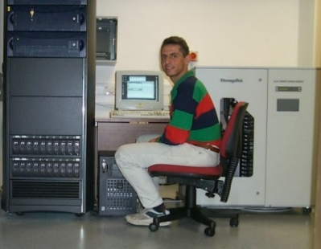
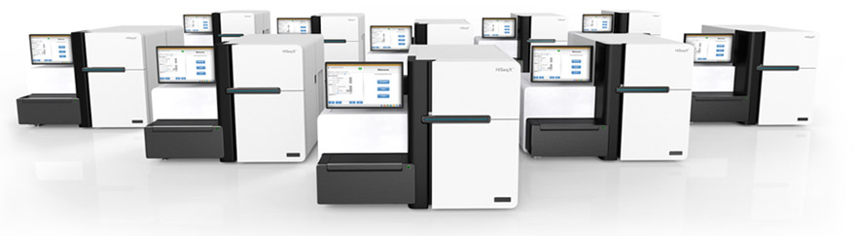
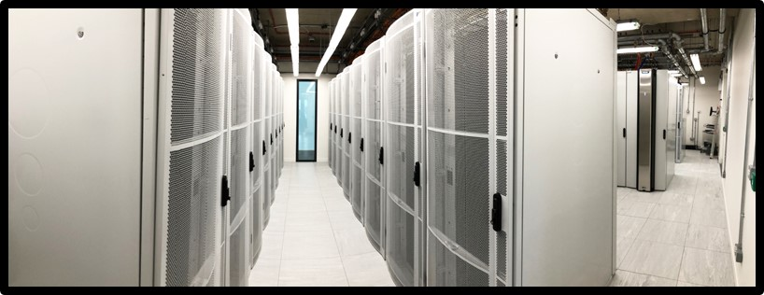
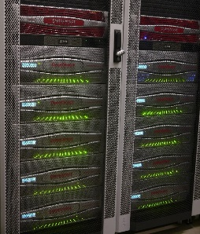
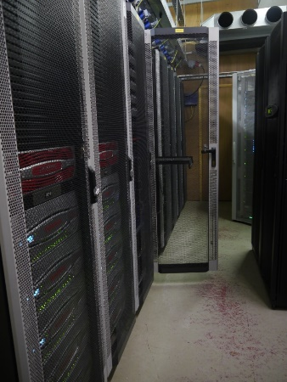
Computing growth at STRUBI and WHG
In 1999, genetics was a lab-based science
with compute servers for each research group.
STRUBI was the biggest setup with 360GB
storage and three Linux servers!
Next-generation sequencing
(~2007) changed all that. In
2009 I started to build a shared
Research Computing Core for the Centre
BMRC now has an HPC cluster of >7500
cores; a ~1800 core OpenStack cloud;
~180 GPU cards; 15PB raw GPFS storage;
12PB other storage; 0.5PB S3 object storage;
2PB multi site Ceph; high-compliance cloud;
100Gbit/s and EDR/HDR networks;
800Gbit/s WHG↔BDI link

Slide 14
BMRC is much more than WHG and BDI
We currently support the research of ~190 PIs and have >900 active user accounts. We store ~1.7 billion files on high performance storage
Departments with significant accounts
  WHG, BDI, Kennedy, NDPH, NPEU, CCMP, Statistics, COI
  fMRIB, Psychiatry, NDSS, Exp. Psychology, OBHA, NDCN & WIN
  Oncology, Ludwig, WRH, MMM, TDI, Jenner
  DPAG, Biochemistry, Trop. Med., Sociology, (Zoology)
  Engineering/IBME, Computer Science
  Test beds: Materials Science, Robotics
Departments potentially interested in merging platforms
  CMD (SGC), TDI, WIMM
Covid-19 pandemic has shown the value in being able to buy shares in an existing managed platform

Slide 15
How do you access BMRC computing?
You just need to ask!
Send an email to bmrc-help@medsci.ox.ac.uk & support@strubi.ox.ac.uk
We’ll do the rest: check with your PI and give you an account
Users have no special rights, all access is pooled by group
Bills are split between the WHG core grant (until Nov 23) and your PIs
Nothing comes for free! Use space well! PIs must pay bills!
There is help available:
On line introductory courses (recently delivered), including videos
WHG- and BDI-delivered training courses
Self-paced workshops: Introduction to Unix/bash; Programming with Python; Using the Research Computing Cluster
Email bmrc-help@medsci.ox.ac.uk
Ask your colleagues – they do similar things just with different data
But… there are only six (soon eight???) of us… we do out best!
Charles Roberts has a specific (part) STRUBI focus

Slide 16
Types of research computing storage
BMRC manages more data than most of the rest of the University combined (~5000 data disks, ~27PB storage)
Home directory:
/users/strubi/<username>; 10GB personal quota, usually ignored
High-performance storage (/well), £60 per TB per year
/gpfs2 (3658 TB “RAID60”) & /gpfs3 (7380TB “RAID60”): /well
Use: /well/<group>/users/<username> & /well/<group>/projects/<project> (or /well/strubi/<username>)
Storage for EM data as it is being collected (no charge)
“bowmore” 466TB RAID60 (to be retired)
“bowmore2” 1043TB RAID60
Archive grade storage, £15.06 per TB per year
Have developed a three-site, secure, encrypted, Ceph-based system. Fast Oxford-wide data moving networking. Designed to scale to >200PB capacity

Slide 17
BMRC filesystem (lack of) backup
NO BMRC STORAGE IS BACKED UP!
We look after storage obsessively
We get an email within 10 minutes if a disk fails
We have shelf spare disks waiting to go
We come in late at night to replace failed disks
…but there is no backup of anything!
You need to keep a copy of essential raw data and final results
Keep stuff on archive as well
Deposit in other repositories
NO BMRC STORAGE BACKUPS!

Slide 18
BMRC cluster compute environment
We try to provide a standard, stable, well defined environment for computation:
CentOS 7.9 (kernel 3.10.0) – moving to Rocky Linux 9.2 this year (?)
Fast, parallel access to large storage
SLURM job scheduler (was UGE until last summer)
Thousands of preinstalled software modules
Multiple versions of key packages such as R and python
Monitoring of load to prevent crashes and allow users to share nodes
We try to make it simple for groups to get users on the system
All quotas, shares etc. are handled at the group/project level
No users have individual quotas or shares
Reduces administration overhead and makes charging simpler
Charge by quota/share not by use, so no unexpected bills!

Slide 19
How to access the cluster
Get an account with BMRC
Email bmrc-help@medsci.ox.ac.uk & support@strubi.ox.ac.uk
University members and valid visitor agreements only
Be on the University networks or VPNs
Login nodes (cluster[1-2].bmrc.ox.ac.uk)
Use an ssh client to connect to cluster[1-2].bmrc.ox.ac.uk
Follow special setup for accessing CryoSPARC web login
Use the Open-on-Demand service for remote (Linux) desktops
Submit batch jobs to the scheduler
Create a script file, or use a GUI to create one for you (relion)
Submit the job to the cluster
Wait for the job to run
There is much, much more behind the scenes…

Slide 20
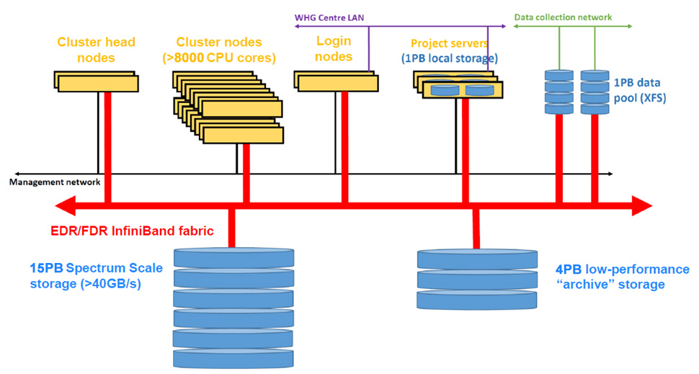
The BMRC UGE cluster in 2020
month | Jan 20 | Feb 20 | Mar 20 | Apr 20 | May 20
# jobs | 1,899,015 | 2,298,113 | 3,007,470 | 3,465,836 | 3,525,590

Slide 21
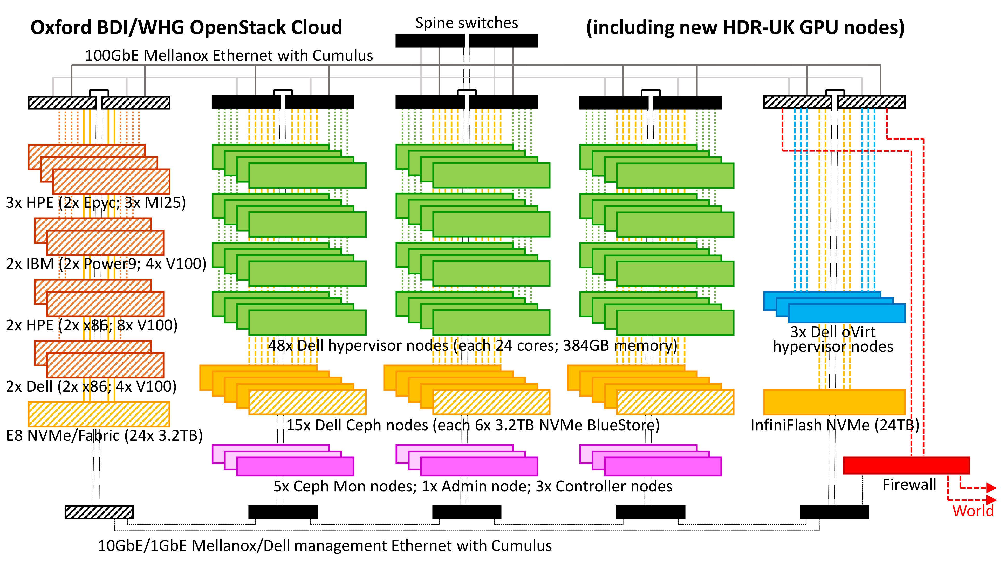
The BMRC OpenStack cloud in 2020

