Slide 1
STRUBI FACILITY TALK
David Staunton
1st February 2023

Slide 2
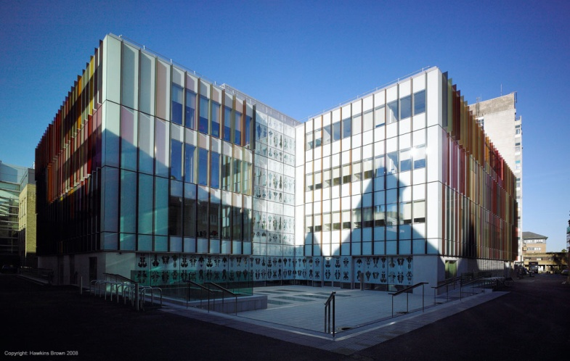
Molecular Biophysics Suite
Organised by Dept and STRUBI and funded by Fell Fund in 2008
Brought together equipment from various sites to one location in New Biochemistry
Set up booking system and charging
Maintenance and servicing
Training and workshops

Slide 3
Molecular Biophysics Suite
Since March 2022 relocated to Phase 2 (40 105 to 107) while basement renovated
Returning to the basement in Summer 2023 to new space

Slide 4
Instrument | Technique | Abbreviation
Wyatt HELEOS | Size exclusion chromatography Multiple Angle Light Scatter | SEC MALS
Beckman XL-I | Analytical ultracentrifugation | AUC
Viscotek 802 | Dynamic light scatter | DLS
Malvern Vcap | Differential scanning calorimetry | DSC
JASCO 815 | Circular Dichroism | CD
Stratagene MC3005PCR | Differential scanning fluorimetry | Thermofluor
Monolith 11.5 | Microscale Thermophoresis | MST
Biacore T200 | Surface plasmon resonance | SPR
Malvern PEAQ ITC | Isothermal titration calorimetry | ITC
Horiba FluoroMax 4 | Fluorimetry | Fluorimetry
Applied Photophysics SX | Stopped flow | Stopped flow
OctetRed 384 | Biolayer interferometry | BLI
Agilent Q-TOF | Electrospray ionisation mass spectrometry | ESI-MS

Slide 5
AFFINITY
BLI
SPR
MST
Stopped flow
ITC
KINETICS
ThermoFluor
AUC
CD
Fluorimetry
DSC
DLS
ESI-MS
SEC MALS
STABILITY
CHARACTERISATION

Slide 6
Analytical Ultracentrifugation XL-I
Absolute measurement of mass and protein conformation in solution
Sedimentation equilibrium gives the true MW of the macromolecule, and information on solution behaviour e.g. polydispersity
Sedimentation velocity gives information on mass, shape and size distribution
Require 100-400ul of sample and buffer control.
Concentration range uM (230nm) to mM (interference)
Can identify complex formation for weak interactions

Slide 7
Booking
Through website
Need nexus username, instruments required, supervisor/group to set up individual accounts
Charges made on basis of bookings

Slide 8
http://www.bioch.ox.ac.uk/molecular_biophysics_suite/

Slide 9
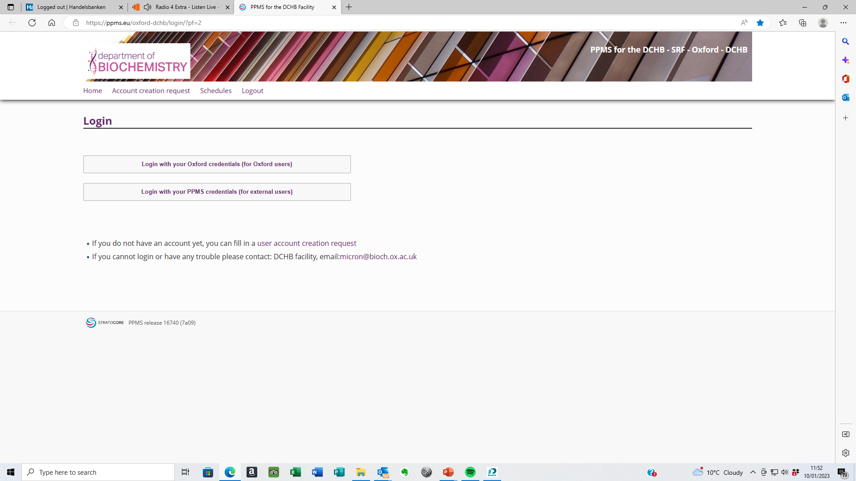

Slide 10
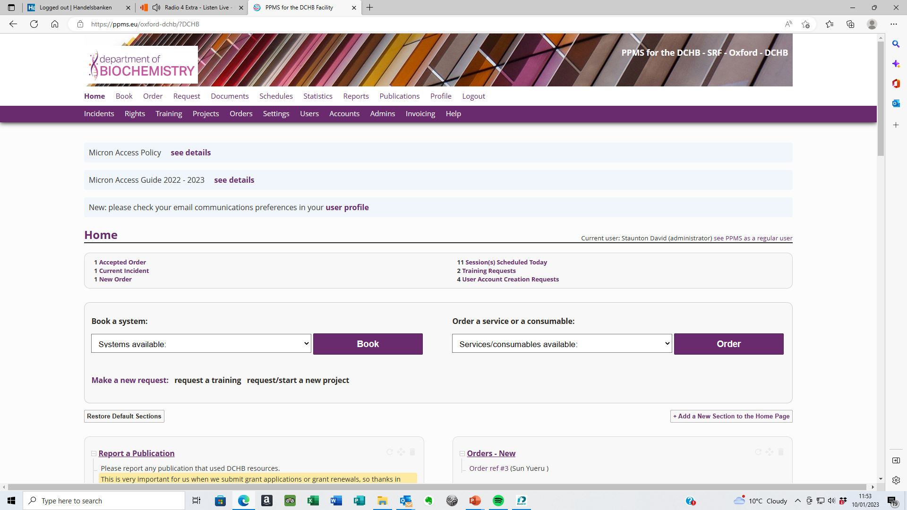

Slide 11
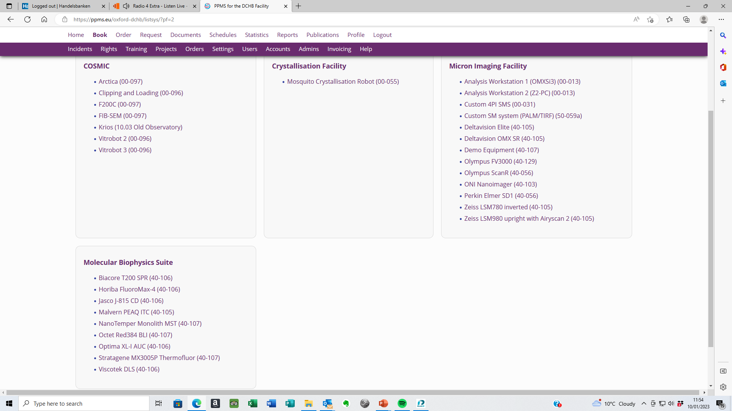

Slide 12
Charges now mostly hourly rather than daily

Slide 13
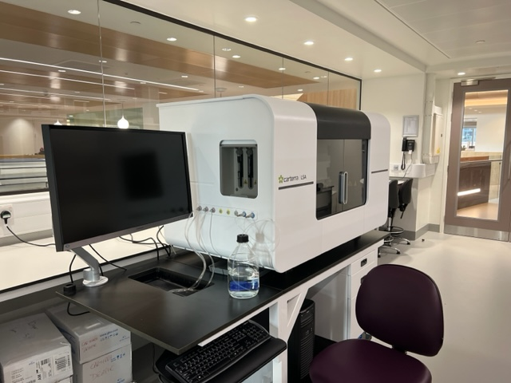

Slide 14
To enquire about availability please contact David Staunton
david.staunton@bioch.ox.ac.uk
Telephone 613327

