Slide 1



STRUBI Facilities Talks 27 January 2022:
STRUBI Computing and Biomedical Research Computing (BMRC)
Jun Dong – jun.dong@strubi.ox.ac.uk
Generic email: support@strubi.ox.ac.uk
MSD-IT Generic email: ithelp@medsci.ox.ac.uk
Robert Esnouf – robert.esnouf@ndm.ox.ac.uk
BMRC support email: bmrc-help@medsci.ox.ac.uk

Slide 2





Computing organisation reflects Oxford…

Slide 3

University ICT regulations/policies apply to you!
The University network is a private network:
  You have no automatic right to connect to it!
  You cannot just do anything you want!
  You must not connect to the network without permission!
Use of ICT facilities is bound by University rules:
  Three actionable events per day across the University.
  Potential per incident maximum ICO fine >£50M.
You must complete Information Security Awareness:
  https://www.infosec.ox.ac.uk/training-and-awareness
  You must repeat this course every year!
You should read the University ICT policies:
  Check with https://governance.admin.ox.ac.uk/legislation/it-regulations-1-of-2002
  Laptops / memory sticks / USB disks are big security threats!
  You must have up-to-date antivirus software installed!
  Never share usernames or passwords, they are yours.
  Passwords must be 16+ characters (and complex).
  Two-factor authentication (2FA) coming in – already for Office365, email and BMRC!
  Downloading/sharing music, films & TV is usually illegal and violates University policy.
  Beware of phishing emails. Never follow links to enter passwords. Just ask Jun!
  Beware of email attachments which may install ransomware, malware & key
  loggers that can affect the whole University not just your machine.

Slide 4
Central ICT facilities
University Subscription to Microsoft Office365
Email and Calendar (Nexus)
  Login https://www.office.com/
  Emails first.last@strubi.ox.ac.uk
Mail lists now use central list servers, but “old” short forms still work:
  all@strubi.ox.ac.uk (all-strubi@maillist.ox.ac.uk)
  emsupport@strubi.ox.ac.uk (emsupport_strubi@maillist.ox.ac.uk)
  embookings@strubi.ox.ac.uk (embookings_strubi@maillist.ox.ac.uk)
  emusers@strubi.ox.ac.uk (emusers_strubi@maillist.ox.ac.uk)
  wetlab@strubi.ox.ac.uk (wetlab_strubi@maillist.ox.ac.uk)
  social@strubi.ox.ac.uk (  wetlab_strubi@maillist.ox.ac.uk)
  Contact support@strubi.ox.ac.uk to be added to these mailing lists
For official University business you can use:
  Teams (preferable and shares files using SharePoint online)
  Zoom has no official agreement with the University

Slide 5
STRUBI IT accounts
University SSO
  Nexus, Teams, Office365 (2FA enabled)
  R12 (ordering), SharePoint on-premise (just password)
  University VPN (remote access password)
MSD-IT account
  Local Windows and Linux machines
  MSD-IT VPN
BMRC account
  New accounts all 2FA enabled
  High-performance research computing
  Electron microscopy

Slide 6
STRUBI networked printers
xerox8900 | 00/126 | Xerox ColorQube 8900 MFP
pc600-wetlab.strubi.ox.ac.uk | Wet Lab | Ricoh P C600
pc600-opic.strubi.ox.ac.uk | OPIC Office | Ricoh P C600
Windows or Mac (OSX): navigate to http://iprint.imsu.ox.ac.uk and download and install via link at top. Double click on either:
STRUBI_OPIC_PC600 or STRUBI_Wetlab_PC600
For wireless connections (e.g. laptops) you need to connect to MSD-IT VPN first!

Slide 7


STRUBI wireless & external access
Wireless access in most areas
  Eduroam
  OWL – once connected, staff can connect directly to VPN (vpn.ox.ac.uk – Oxford SSO remote access password)
University and MSD-IT VPN
  Both use Cisco AnyConnect VPN client
  vpn.ox.ac.uk – Oxford SSO remote access password
  vpn.medsci.ox.ac.uk – MSD-IT username and password
Mac/iPad/iPhone users must not enable “Sharing” when connected to any university network
Notes:
VPN connection allows you to connect securely to STRUBI network from any location across the public Internet. This is particularly useful for users working from home or abroad needing access our network facilities. it creates a network link back to your device that allows it to reach STRUBI network resources -- e.g., file servers, printers and intranets -- as though it was on STRUBI network locally. By establishing a secure encrypted VPN connection you can directly access your data on cuppa or cocoa, send and receive email messages directly using your preferred email programme and view electronic journals like Nature, cell, Science etc which are normally restricted to STRUBI network.

Slide 8
STRUBI file systems
Linux file system (262TB, NFS-served disks)
  Mounted on all Linux desktops as /strubi
  Not currently backed up
Windows file systems (~10TB, hosted by MSD-IT)
  Network drive H: home directory – old CUPPA/COCOA files
  Network drive Z: old COCOA/COMMON files
  Some lab machines also have labdata as a network drive
  Backed up by MSD-IT
Notes:
We have about 500TB NFS served linux disks. From Windows PC, you can access your linux files via our samba server fsc.
We have about 9TB on Windows servers cuppa and cocoa. From Windows, you can Map Network Drive on cuppa or cocoa. \\cuppa\username is your private folder which means only you can access. \\cuppa\common\username is shared by everyone which means you can share your files with other people. From MAC or Linux computer, you can access your Windows files by samba server cuppa or cocoa.

Slide 9
STRUBI Linux workstations
You can do most crystallographic computing on your own desktop or laptop
Most electron microscopy computing requires the use of BMRC facilities
STRUBI now offers a Linux alternative to using your own desktop or laptop:
  The STRUBI NoMachine server
  When on STRUBI network or MSD-IT VPN
  Navigate to http://lenovo645.strubi.ox.ac.uk:4080
  Log in using your MSD-IT credentials
  Gives a remote Linux desktop within your browser (so you can use a Windows or Mac PC or any tablet)
  When you finish your job then log out to release the resource

Slide 10
STRUBI software
Microsoft Windows, Microsoft Office 365
  University-owned and privately-owned machines for University-related use https://www.office.com sign in with SSO@ox.ac.uk
Sophos, Endnote, Cisco AnyConnect VPN
  Download via https://register.it.ox.ac.uk
SigmaPlot, Origin, CorelDraw, ChemBioOffice and Matlab
  University site license
Adobe Creative Cloud (annual subscription)
Pymol and Scrubber2 (STRUBI site licence)
SnapGene (£70 per license per year)
GraphPad Prism (contact ithelp@well.ox.ac.uk)
STRUBI-specific scientific software
  https://www.strubi.ox.ac.uk/internal/computing/documents
Notes:
Limited number of licenses for Adobe, STRUBI site licensed for pymol and scrubber2. We just bought 12 licenses of SnapGene.

Slide 11
WHG support for STRUBI
Centre-wide administrative Windows support
  HR, accounting and facilities computing
  There are firewalls between STRUBI and WHG networks
If you need to contact WHG IT Core
  New generic email address ithelp@well.ox.ac.uk
Notes:
We have about 500TB NFS served linux disks. From Windows PC, you can access your linux files via our samba server fsc.
We have about 9TB on Windows servers cuppa and cocoa. From Windows, you can Map Network Drive on cuppa or cocoa. \\cuppa\username is your private folder which means only you can access. \\cuppa\common\username is shared by everyone which means you can share your files with other people. From MAC or Linux computer, you can access your Windows files by samba server cuppa or cocoa.

Slide 12



How is research computing provided?

Slide 13
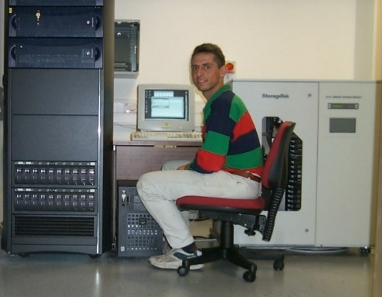
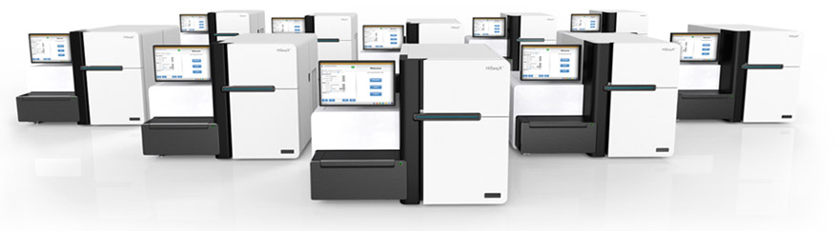
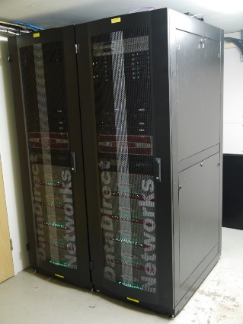
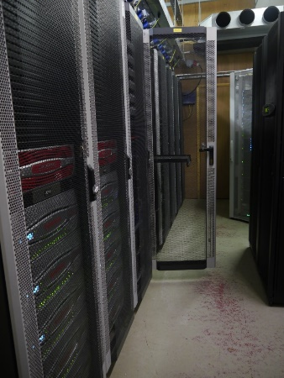
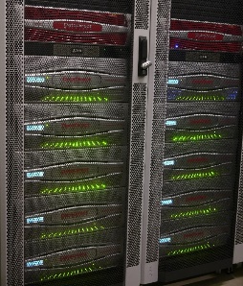
Computing growth at STRUBI and WHG
In 1999, genetics was a lab-based science
with compute servers for each research group.
STRUBI was the biggest setup with 360GB
storage and three Linux servers!
Next-generation sequencing
(~2007) changed all that. In
2009 I started to build a shared
Research Computing Core for the Centre
Biomedical Research Computing (BMRC)
now has an HPC cluster of >7500 cores; a
~1800 core OpenStack cloud; ~180 GPU
cards; 15PB raw GPFS storage, 12PB other
storage, 0.5PB S3 object storage; a high-
compliance Novartis cloud; 100Gbit/s Ethernet;
HDR/EDR InfiniBand; 800Gbit/s WHG↔BDI link.

Slide 14
BMRC is much more than WHG and BDI
We currently support the research of ~140 PIs and have ~1300 active user accounts, doubled over the past 18 months. We store ~1.3 billion files on GPFS
Departments with significant accounts
  WHG, BDI, Kennedy, NDPH, CCMP, Statistics
  fMRIB, Psychiatry, NDSS, NDCN & WIN
  Oncology, Ludwig, WRH, MMM, TDI, Jenner
  DPAG, Biochemistry, Trop. Med., Sociology, (Zoology)
  Engineering/IBME, Computer Science, Exp. Psychology
Departments we have supported (e.g. test-bed platforms)
  Materials Science, Robotics
Departments potentially interested in merging platforms
  CMD (SGC), TDI, WIMM
Covid-19 pandemic has shown the value in being able to buy shares in an existing managed platform

Slide 15
How do you access BMRC computing?
You just need to ask!
Send an email to bmrc-help@medsci.ox.ac.uk & support@strubi.ox.ac.uk
We’ll do the rest: check with your PI and give you an account
Users have no special rights, all access is pooled by group
Your bills are split between the WHG core grant and your PIs
Nothing comes for free! Use space well! PI must pay bills!
There is help available:
On line introductory courses (recently delivered), including videos
WHG and BDI delivered training courses
Self-paced workshops: Introduction to Unix/bash; Programming with Python; Using the Research Computing Cluster
Email bmrc-help@medsci.ox.ac.uk
Ask your colleagues – they do similar things just with different data
But… there are only six of us… we do out best!
Charles Roberts has a specific (part) STRUBI focus

Slide 16
Types of research computing storage
BMRC manages more data than most of the rest of the University combined (~5000 data disks, ~27PB storage)
High-performance storage (GPFS), £60 per TB per year
/gpfs2 (3658 TB “RAID60”) & /gpfs3 (7380TB “RAID60”): /well
You usually ignore /users/strubi/<username>, 10GB personal quota
You use /well/strubi/<username> or /well/<group>/<username>
STRUBI currently uses ~1.5PB storage on GPFS systems
Storage for EM data as it is being collected (no charge)
“bowmore” 466TB RAID60
Archive grade storage, £15.06 per TB per year
Trial of new archive system underway – three-site, secure, encrypted, Ceph-based system. Fast Oxford-wide data moving networking. Designed to scale to >200PB capacity

Slide 17
BMRC filesystem (lack of) backup
NO BMRC STORAGE IS BACKED UP!
We look after storage obsessively
We get an email within 10 minutes if a disk fails
We have shelf spare disks waiting to go
We come in late at night to replace failed disks
…but there is no backup of anything!
You need to keep a copy of essential raw data and final results
Keep stuff on archive as well
Deposit in other repositories
NO BMRC STORAGE BACKUPS!

Slide 18
BMRC cluster compute environment
We try to provide a standard, stable, well defined environment for computation:
CentOS 7.9 (kernel 3.10.0)
Fast, parallel access to large storage
Univa Grid Engine job scheduler (version 8.6.8)
Preinstalled applications in /apps/well, /apps/strubi & /apps/htseq
Multiple versions of key packages such as R and python
Monitoring of load to prevent crashes and allow users to share nodes
We try to make it simple for groups to get users on the system
All quotas, shares etc. are handled at the group/project level
No users have individual quotas or shares
Reduces administration overhead and makes charging simpler
Charge by quota/share not by use, so no unexpected bills!

Slide 19
Project servers and management nodes
Cluster head nodes (head1 and head2)
Manage the BMRC HPC cluster including Univa and imaging
Not for general users!
Login nodes (cluster[1-2].bmrc.ox.ac.uk)
For general user use, ssh access from University networks/VPNs
For testing and submission of jobs to the cluster
For monitoring jobs
Project servers
Only ssh access from STRUBI network and STRUBI VPN
Similar to login nodes, but group-restricted login & queues, local storage
…but, of course, all that needs to be backed by something a bit more powerful – the cluster!

Slide 20
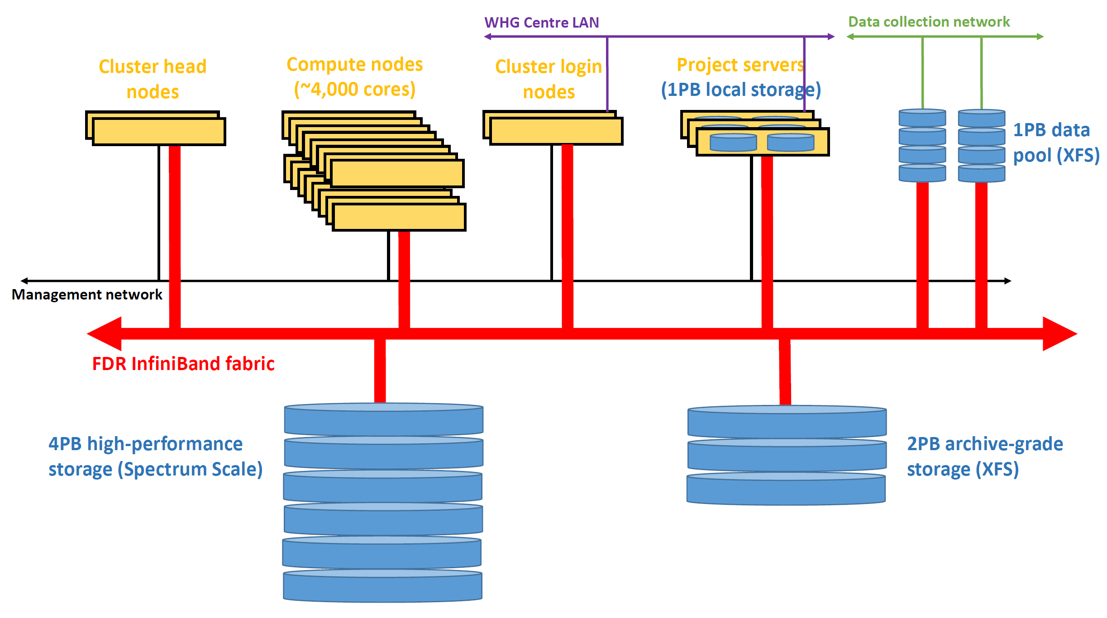
How is the HPC cluster wired up?

Slide 21
The BMRC HPC cluster
“A” nodes (compA[000-047])
48x dual 24-core Intel Cascade Lake 6240R 2.6 GHz, 768GB 3200MHz memory
2304 cores at 16GB per core
“D” nodes (compD[000-031])
32x dual 12-core Intel Haswell 2.6GHz, 384GB 2133MHz memory
768 cores at 16GB per core
“E” nodes (compE[000-103])
104x dual 12-core Intel Skylake 6126 2.6GHz, 384GB 2666MHz memory
2496 cores at 16GB per core
“F” nodes (compF[000-015])
16x dual 20-core Intel Skylake 6148 2.4GHz, 192GB 2666MHz memory
640 cores at 4.8GB per core
“H” nodes (compH[000-002])
3x quad 12-core Intel IvyBridge 3.0GHz, 2048GB 1600MHz memory
144 cores at 42.66GB per core

Slide 22
BMRC GPU machines (e.g. AI and EM)
“G” nodes – containing NVidia GPU cards
compG[004,013]: quad P100 SXM2
compG[005-008]: quad GTX 1080Ti
compG[009-011]: quad P100 SXM2
compG012: quad RTX 2080Ti
compG[014-015]: quad RTX 2080Ti
compG[016-017]: dual 32GB V100 PCIe
compG[018-024]: quad 24GB Quadro RTX 6000
compG025: quad 48GB Quadro RTX 8000
compG026: quad 16GB P100 PCIe
compG027: quad 32GB V100 SXM2
compG[028-030]: quad 48GB Quadro RTX 8000
compG[031-033]: quad 40GB A100 PCIe
compG[034-035]: quad 80GB A100 PCIe
compG[036-039]: quad 80GB A100 PCIe???

