Slide 1
STRUBI general lab

Slide 2
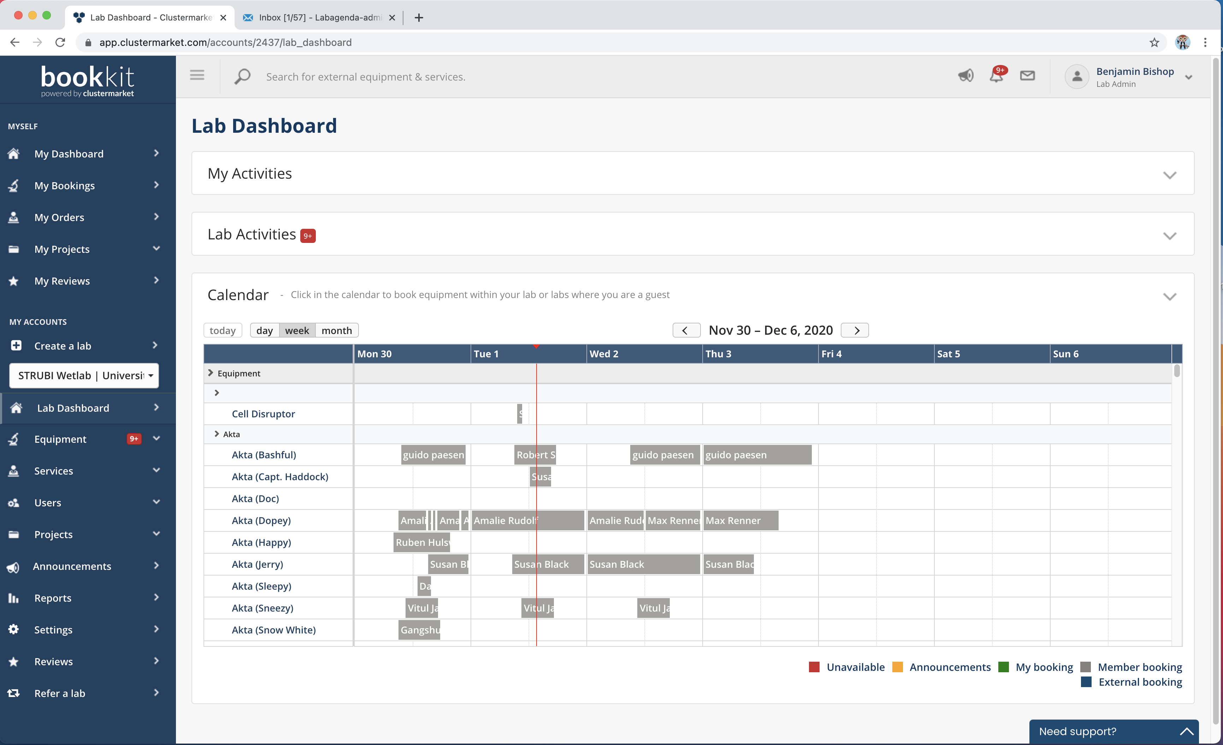
Email labagenda-admin@strubi.ox.ac.uk to be added as a user

Slide 3
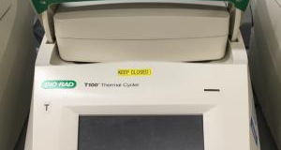
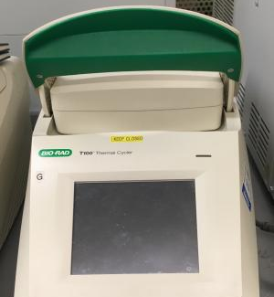
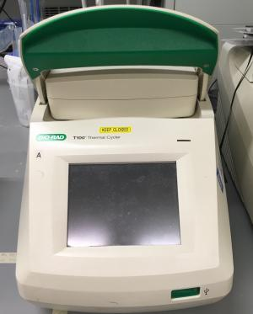
Molecular Biology
Notes:
We have four PCR machines in STRUBI, A,T, C and G.

Slide 4
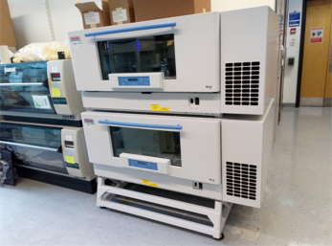
E.Coli shaker incubator

Slide 5
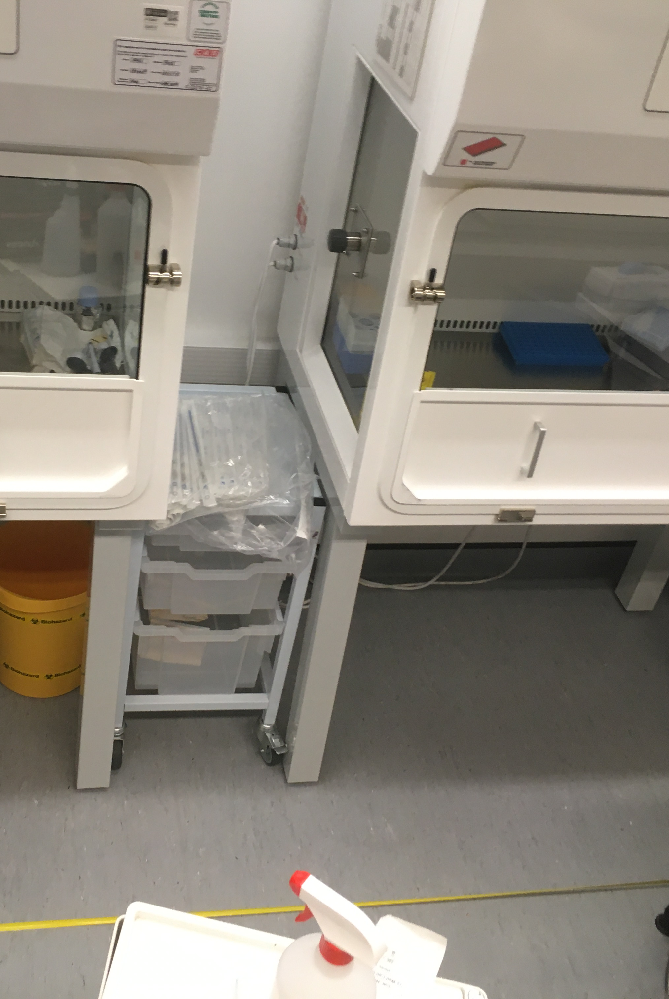
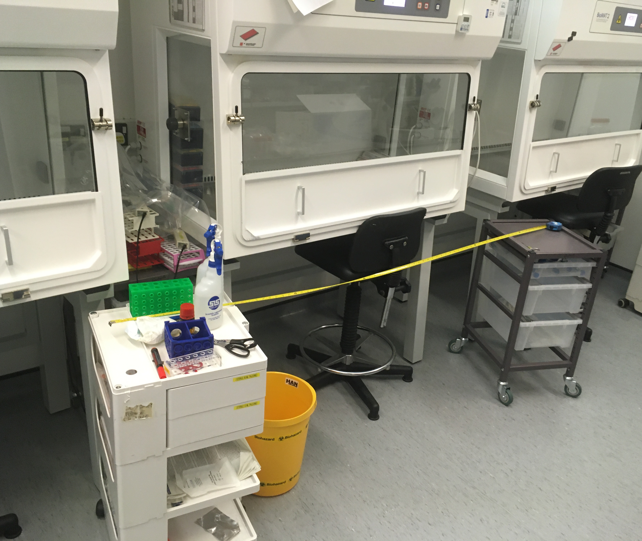
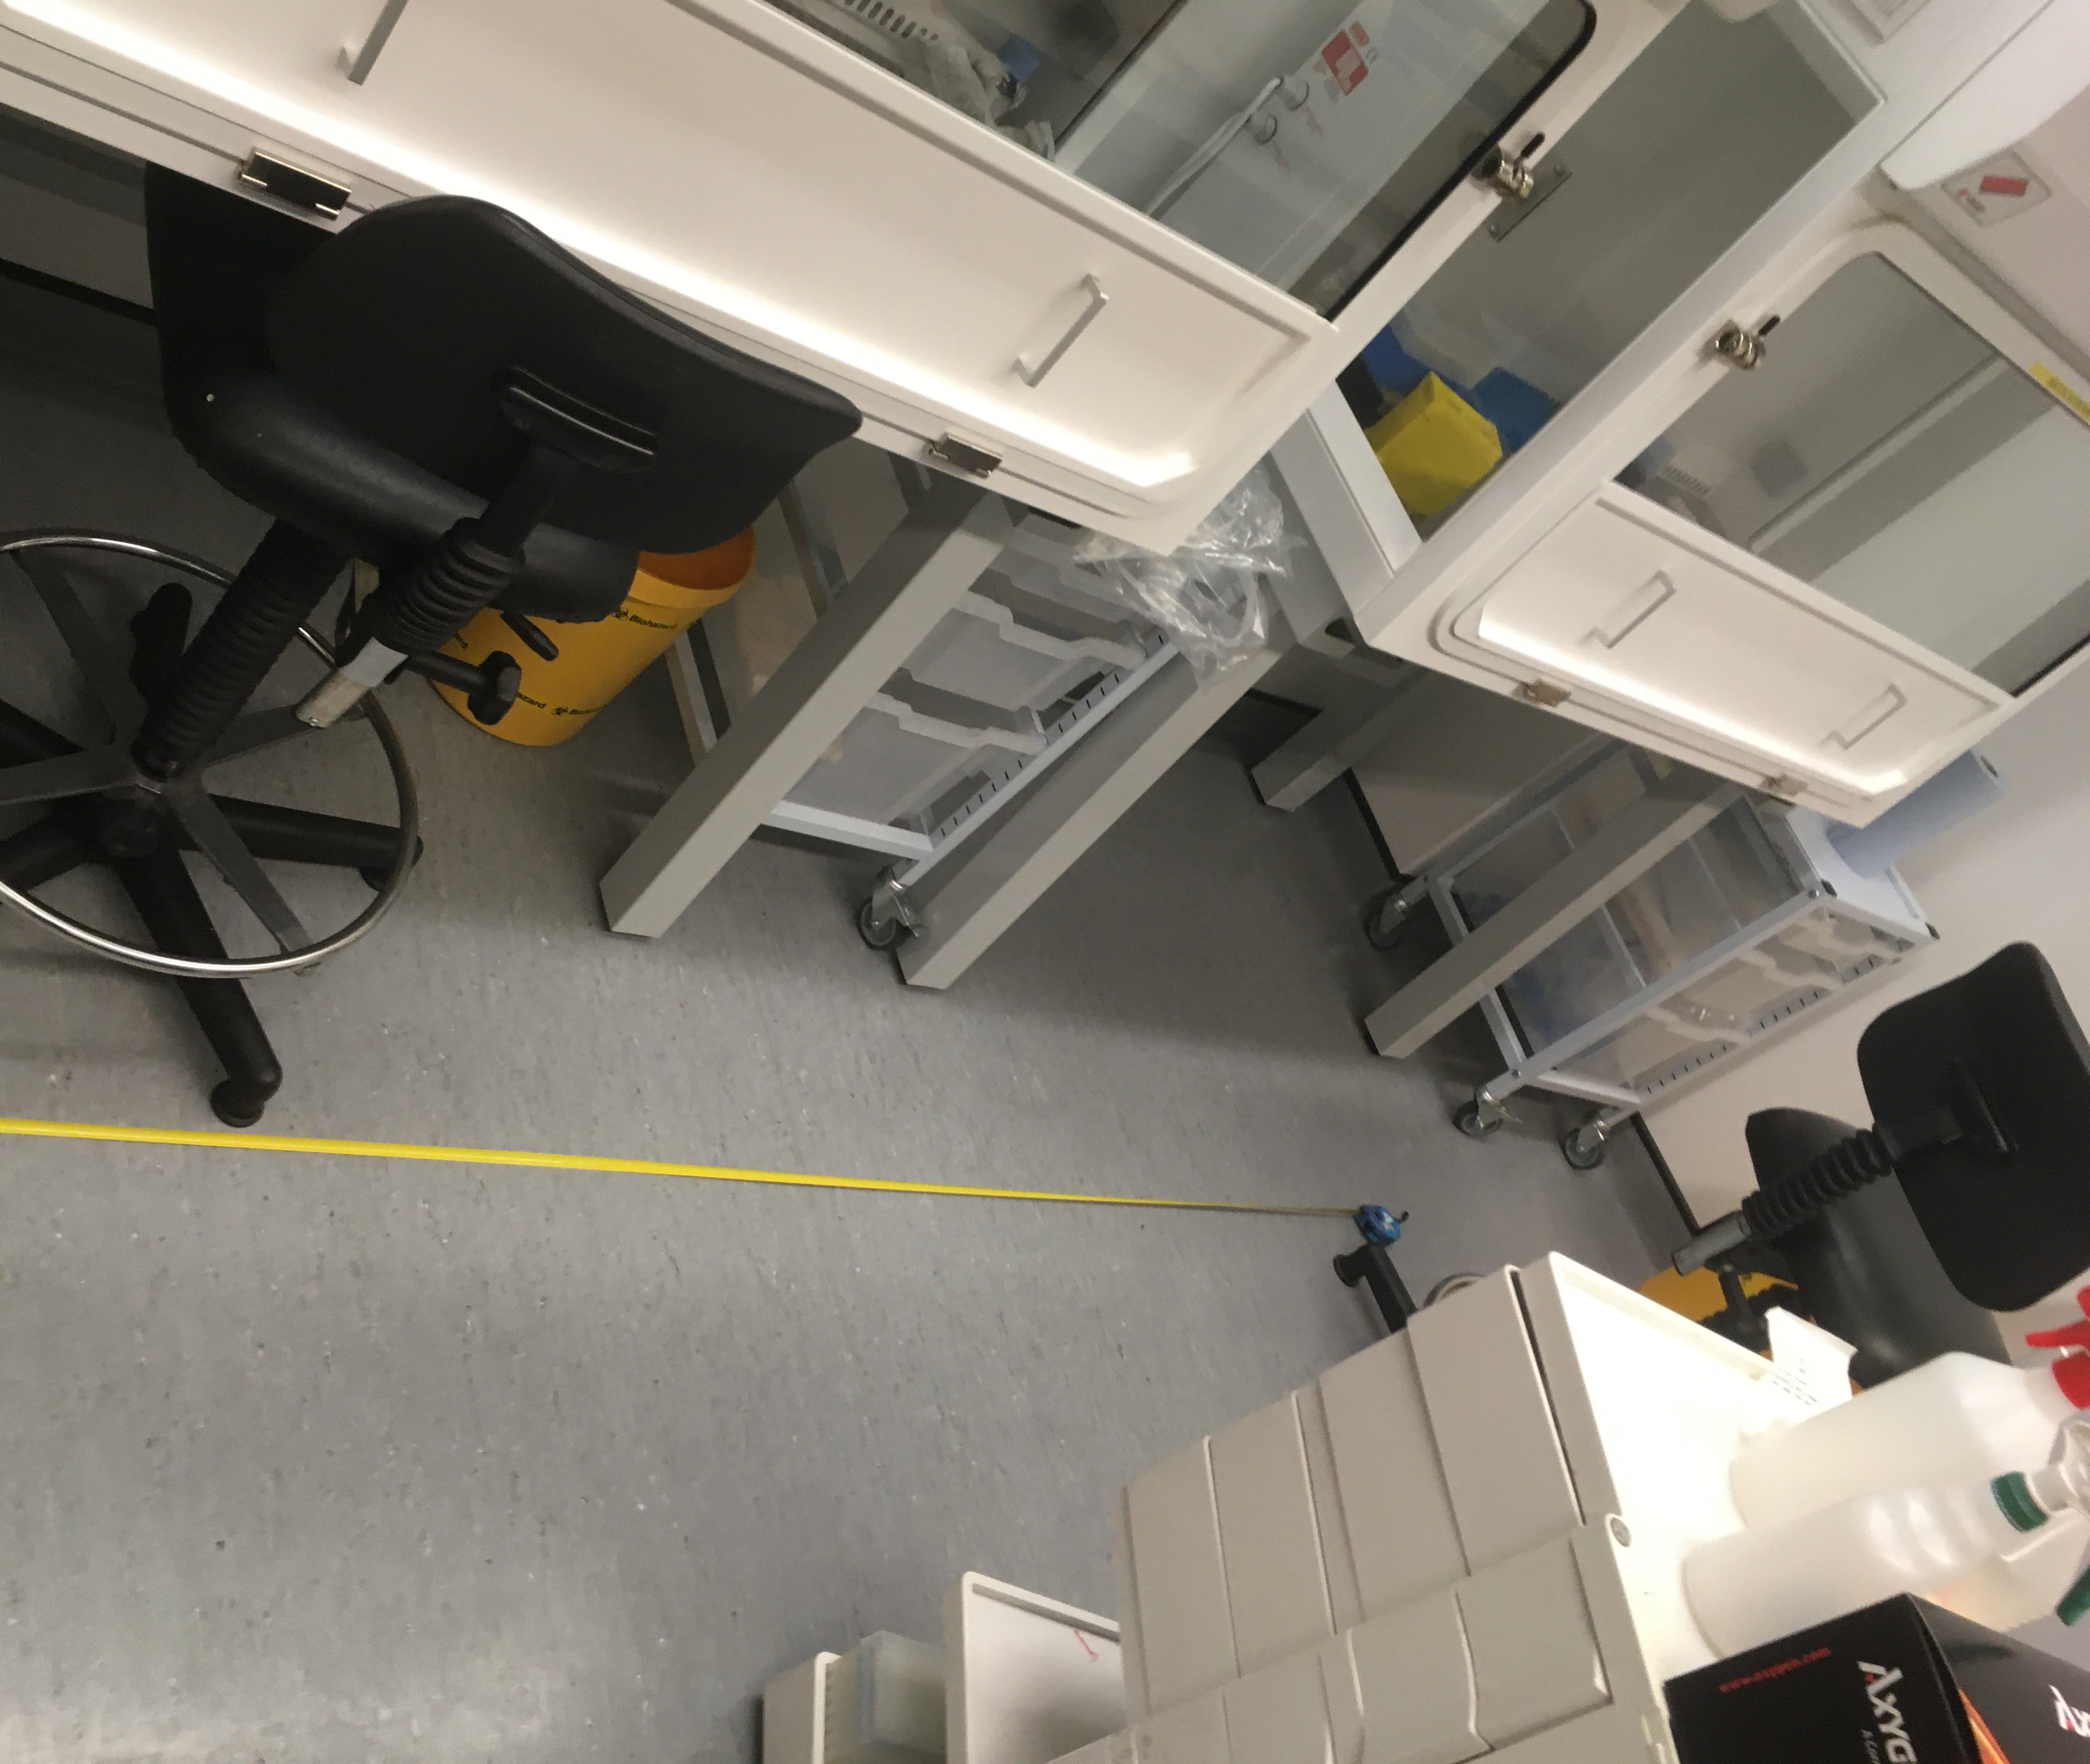
Tissue Culture Hoods
Notes:
Under COVID restrictions, we have 8 hoods: two Insect, one mammalian suspension and five general mammalian of which four are bookable. One is labelled a lenti hood. This is the one closest to the incubators to minimize travel of virus-bearing media

Slide 6
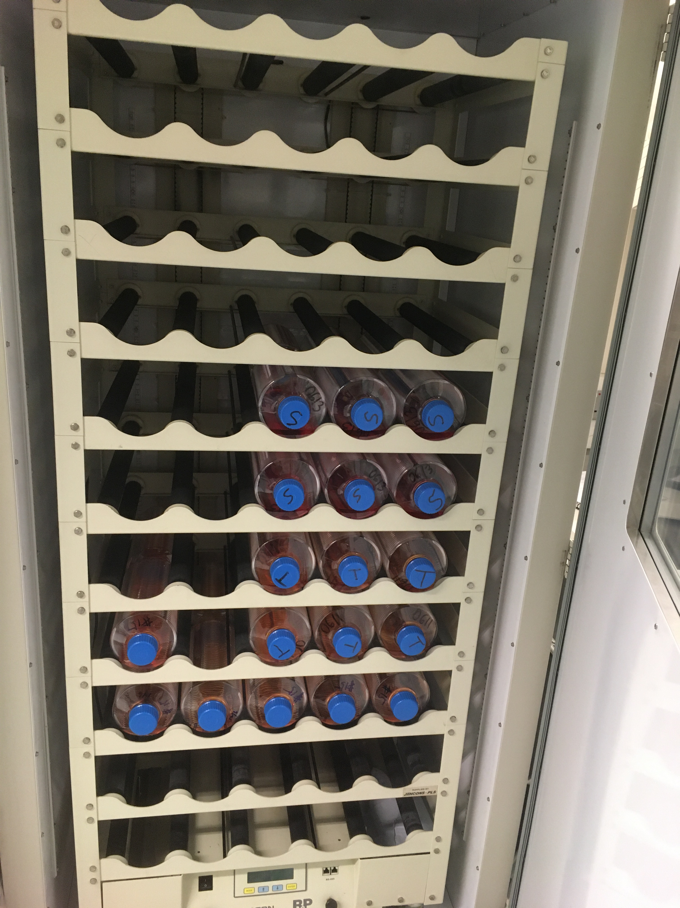
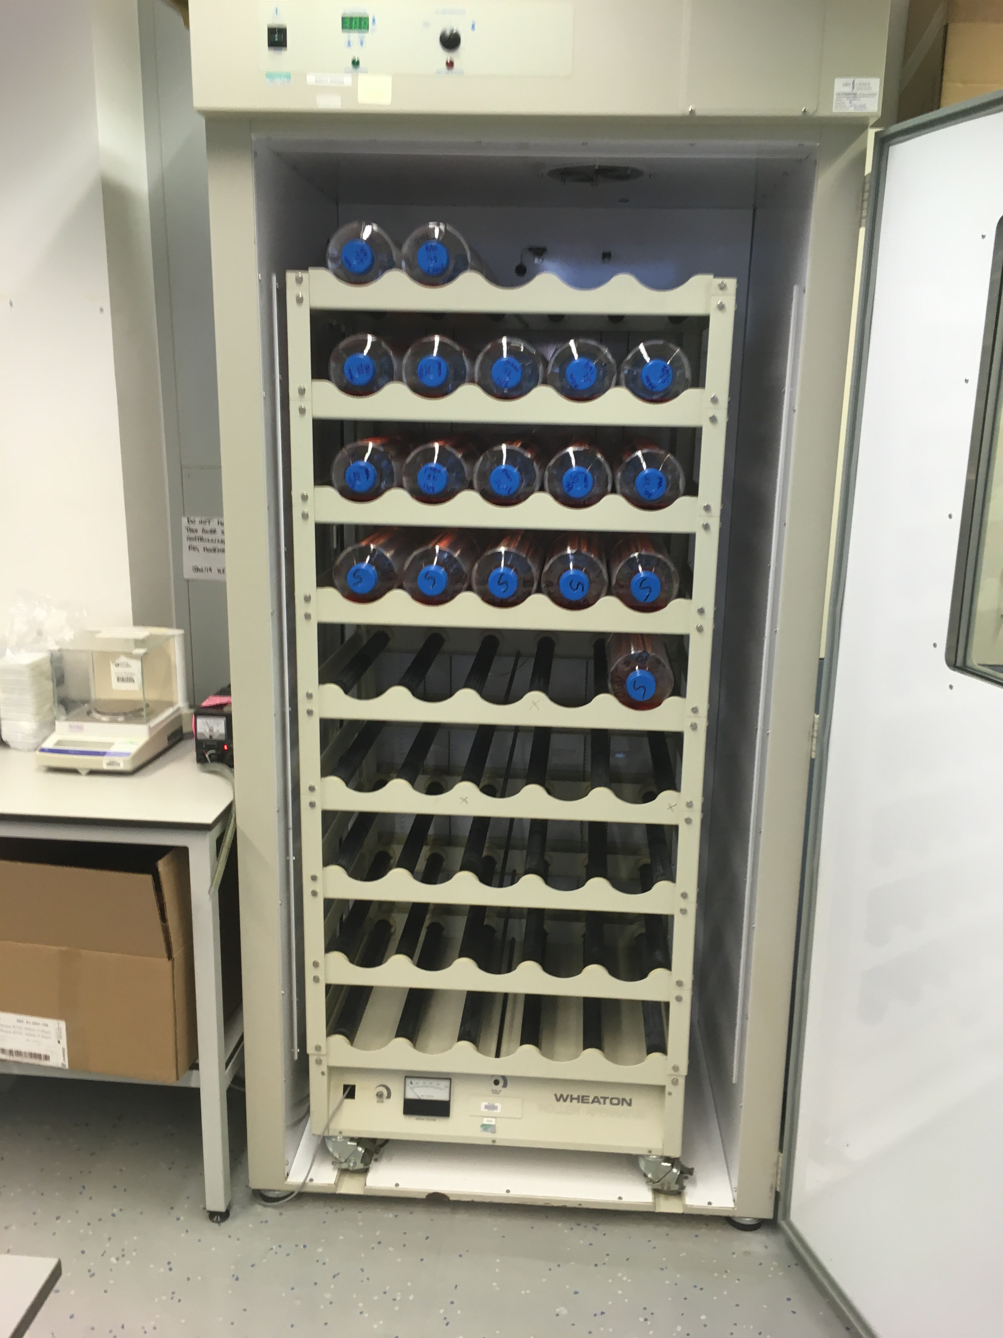
Roller Rigs

Slide 7
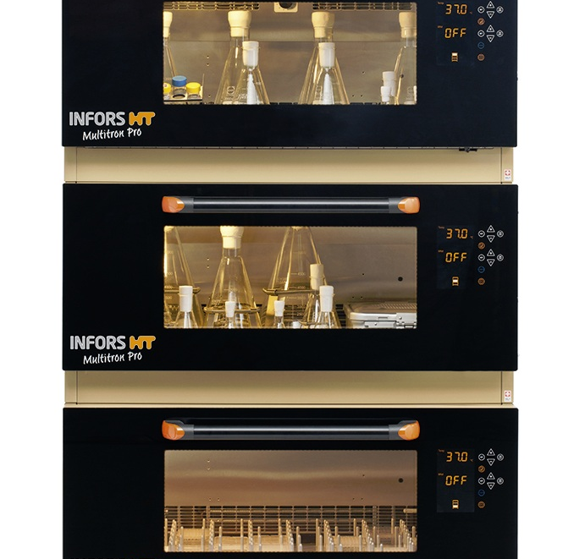
Mammalian Suspension Incubators
Notes:
We currently have three Infors incubators, but will be taking delivery of two more on 21st December 2020

Slide 8
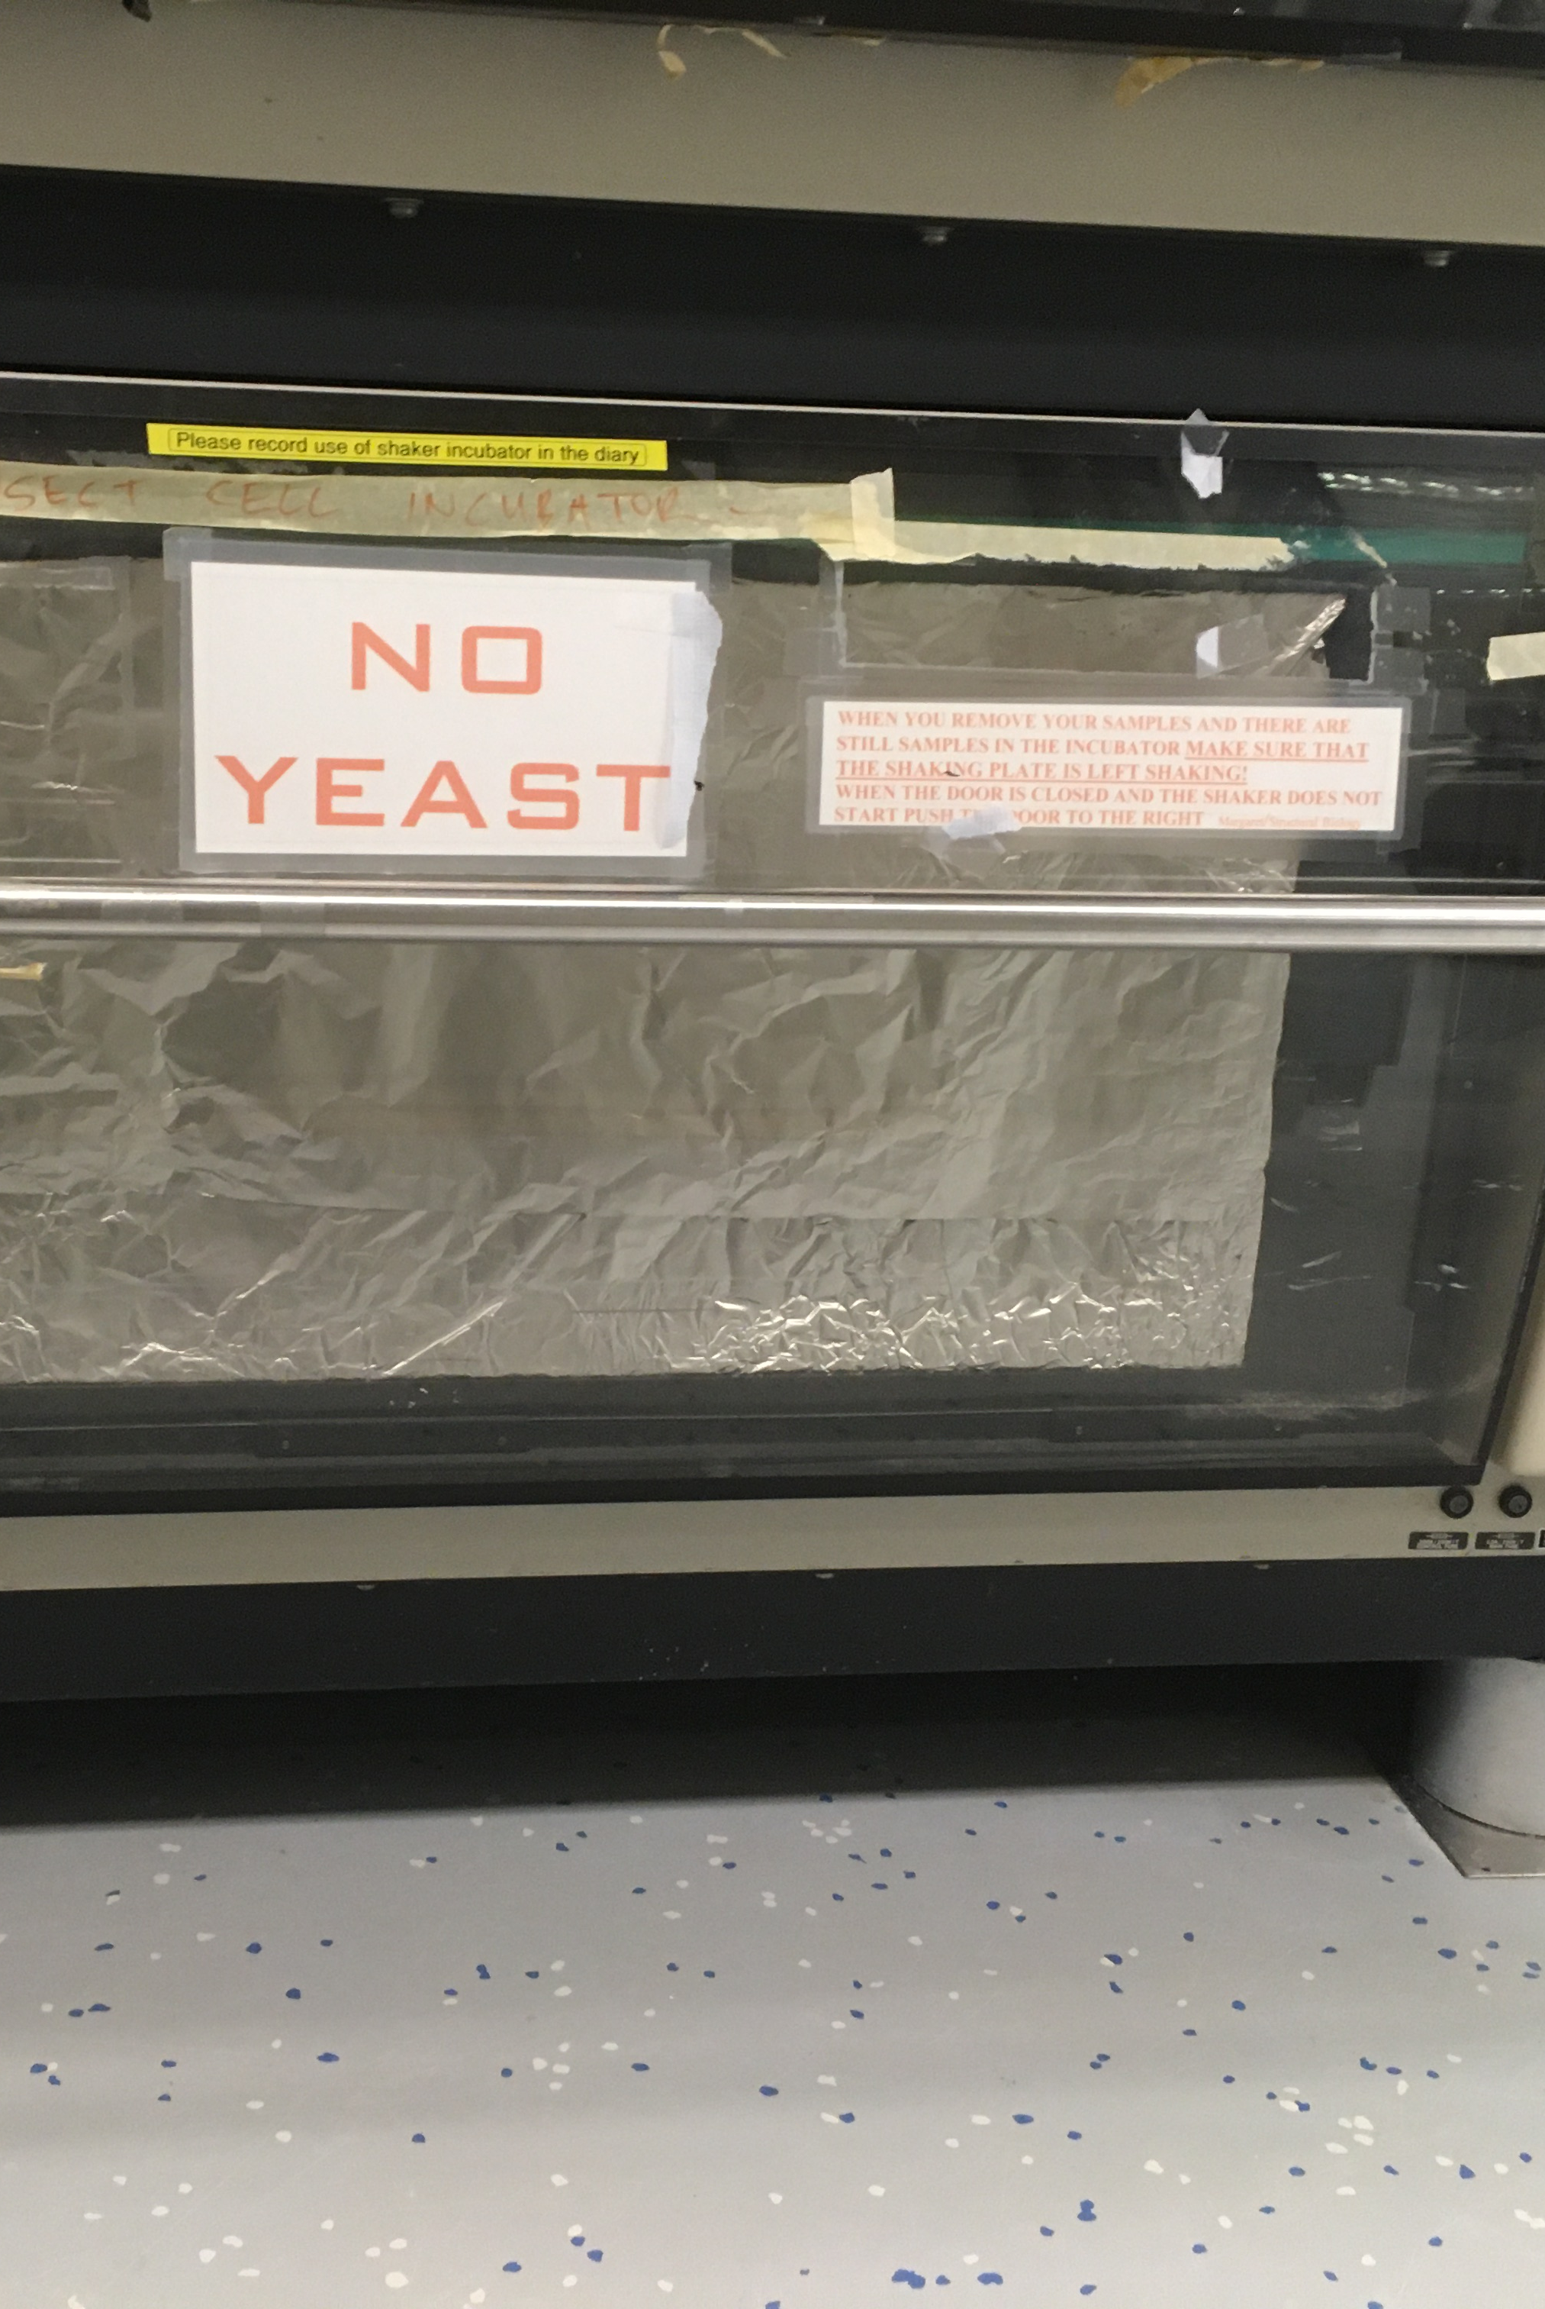
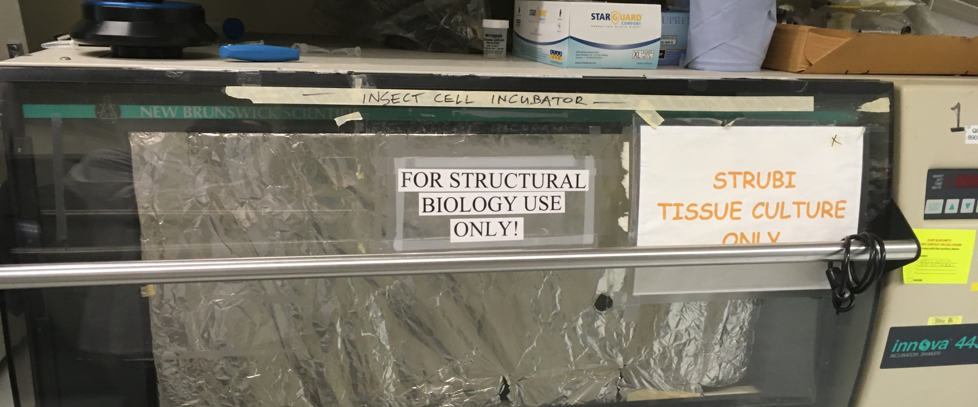
Insect Incubators

Slide 9
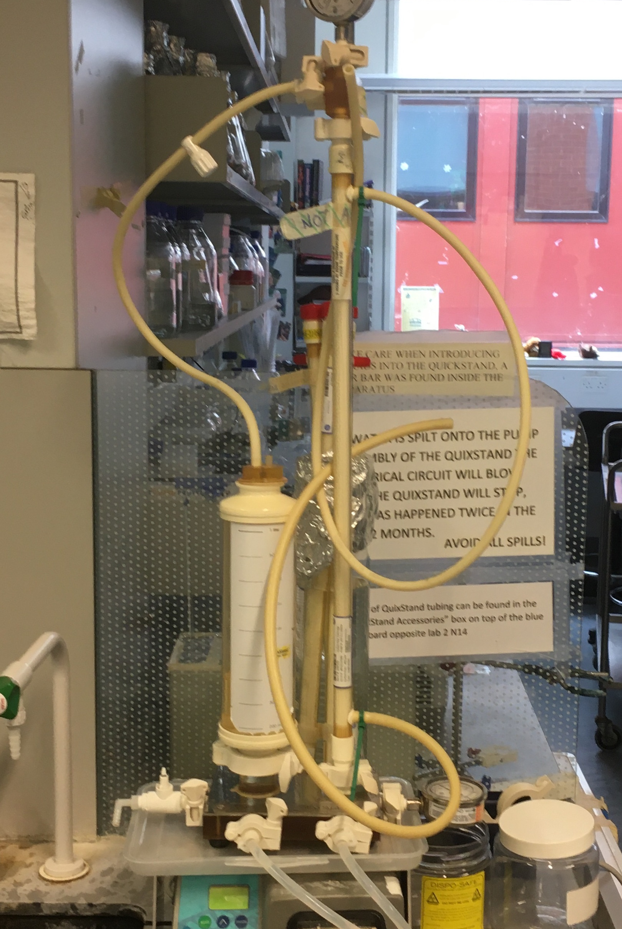
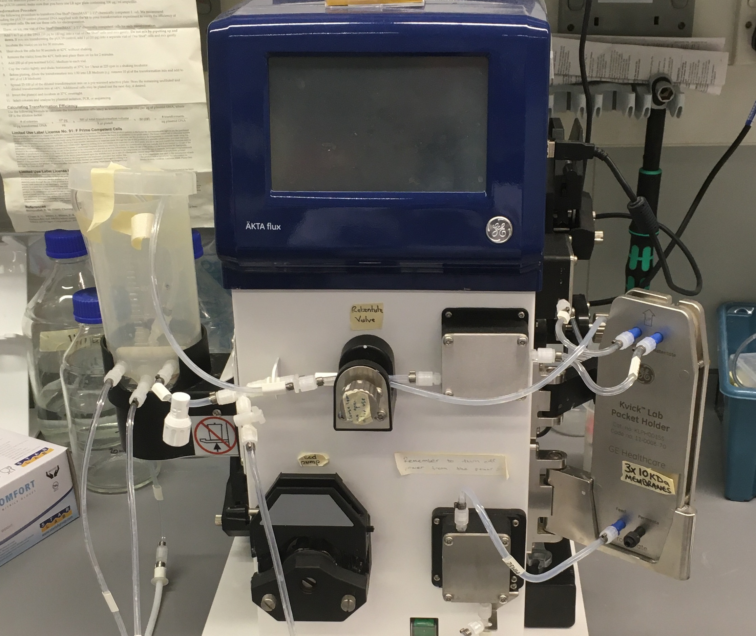
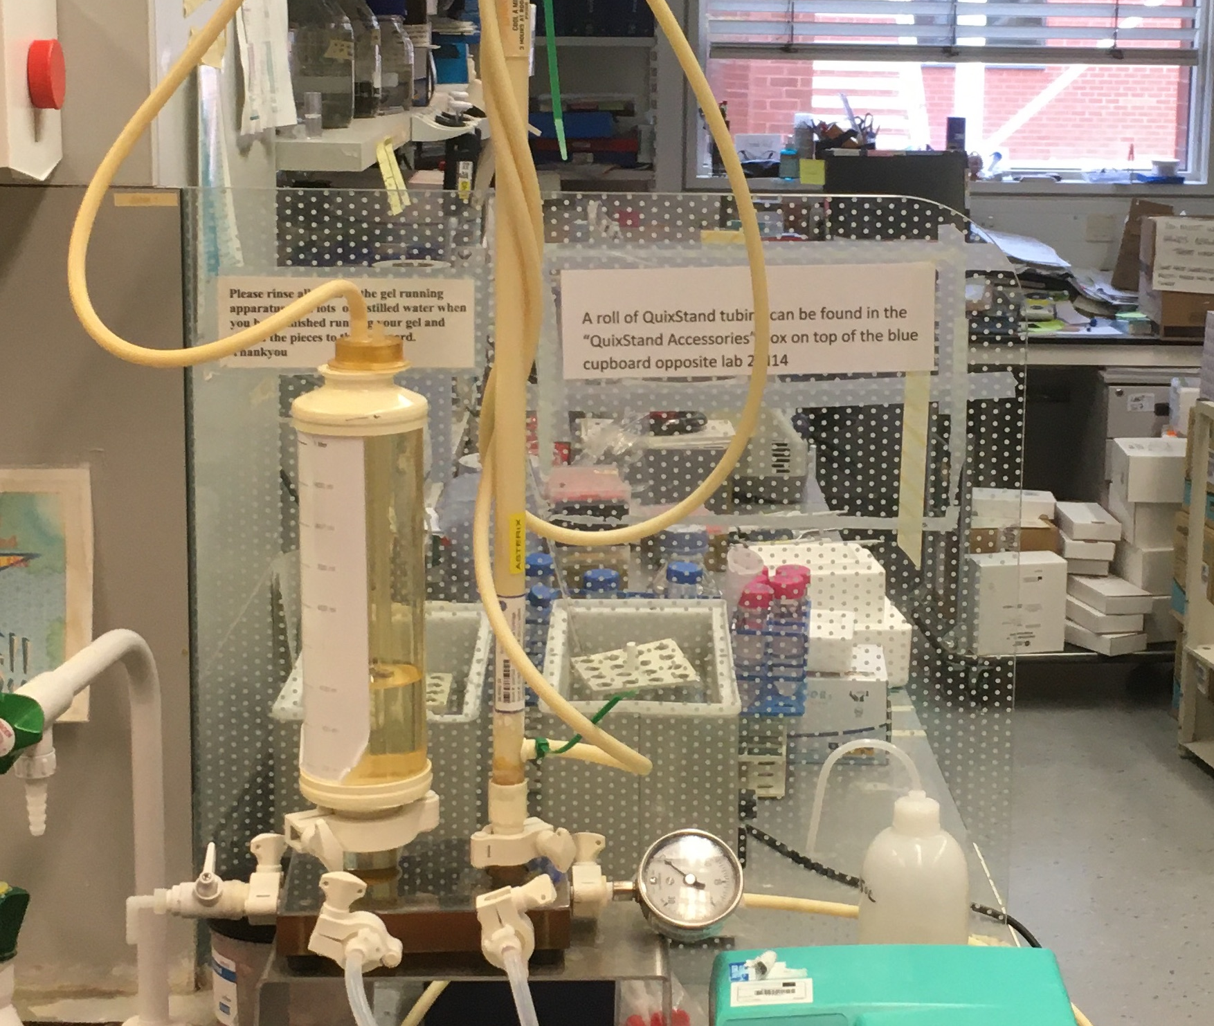
Buffer Exchange

Slide 10
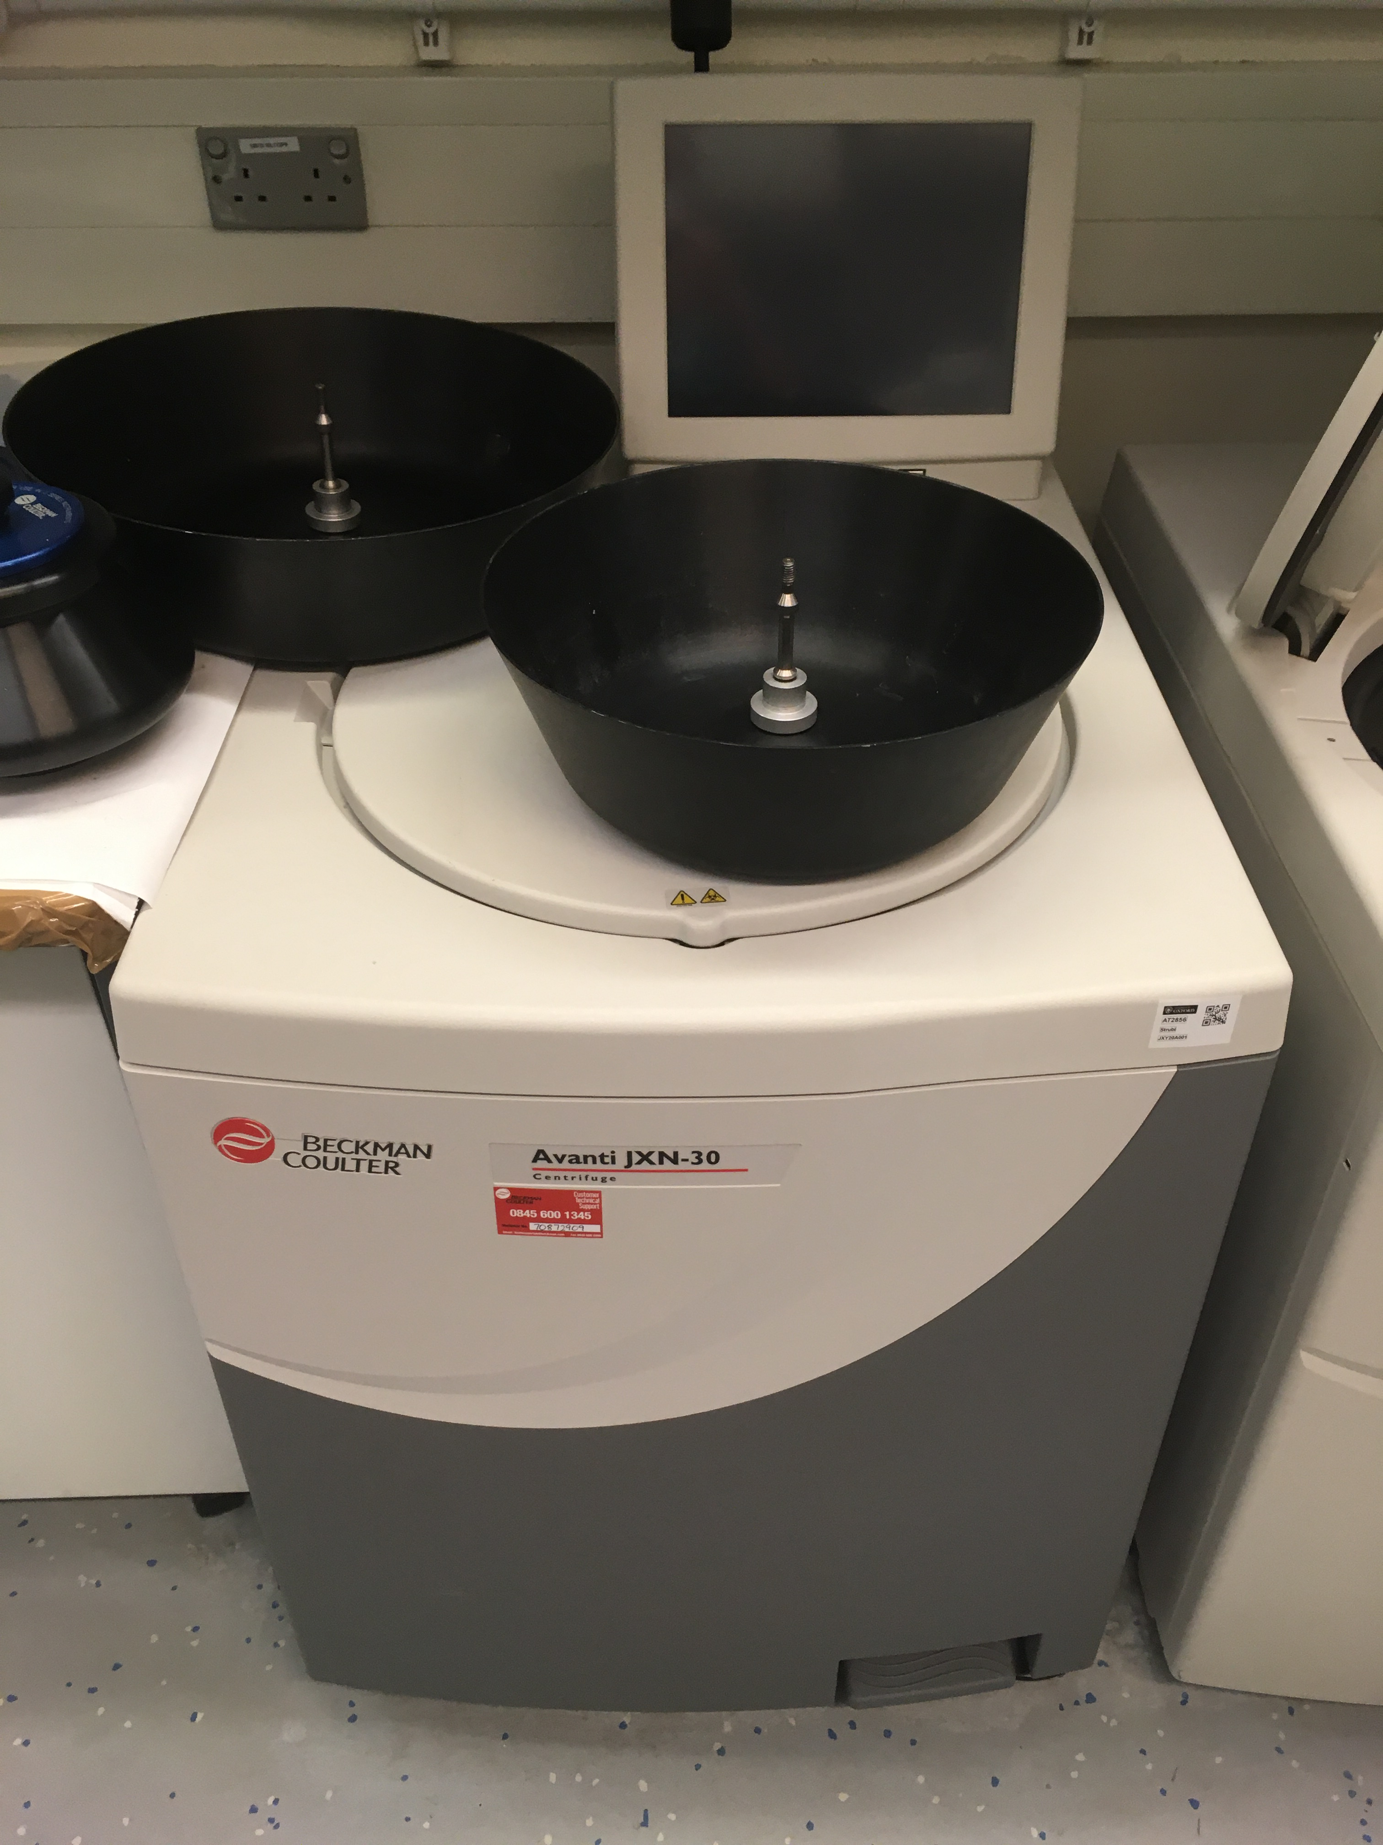
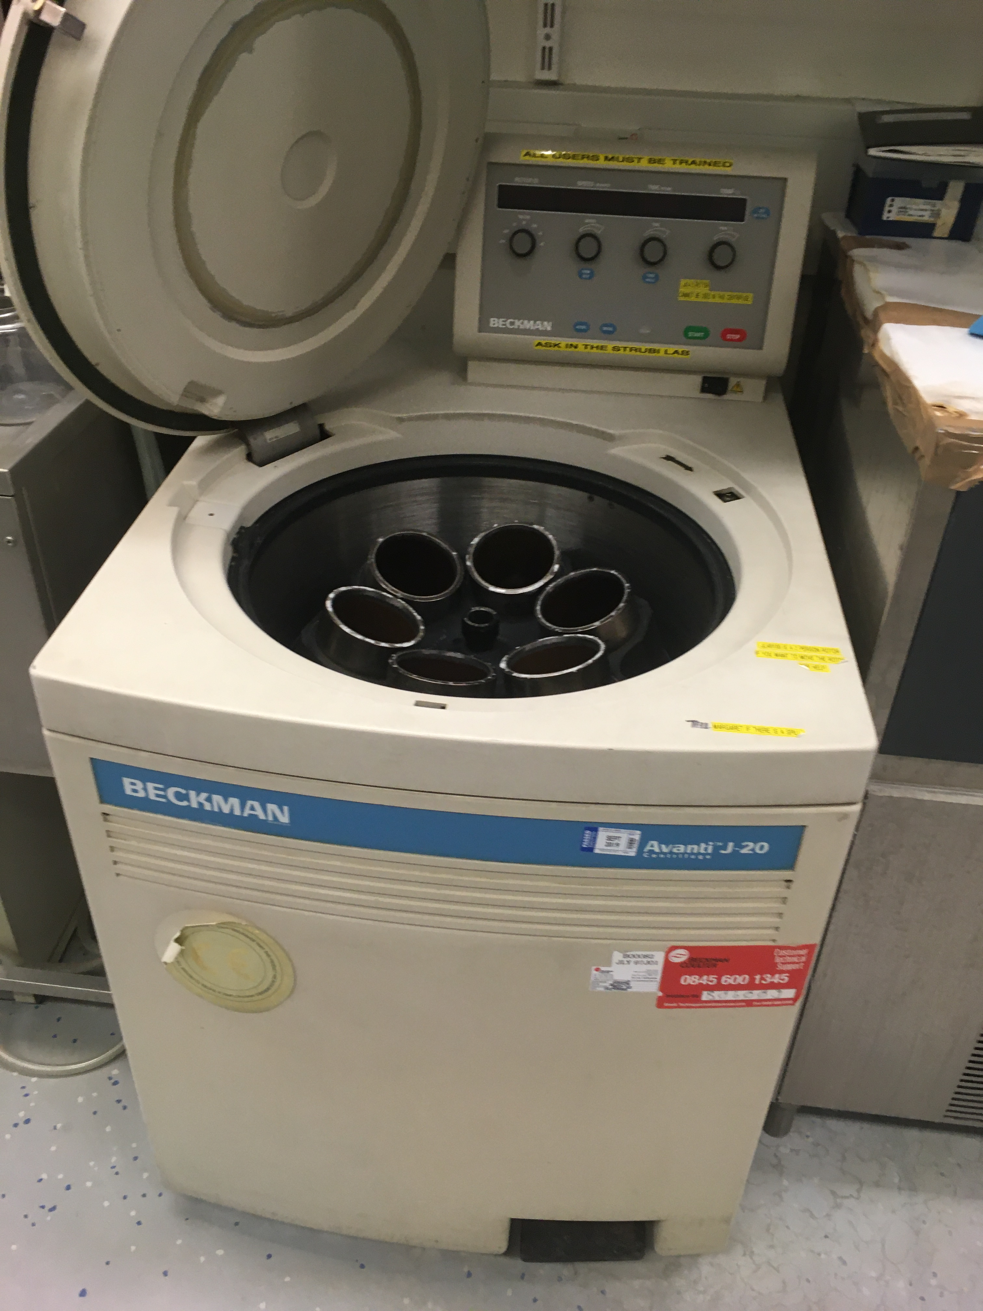
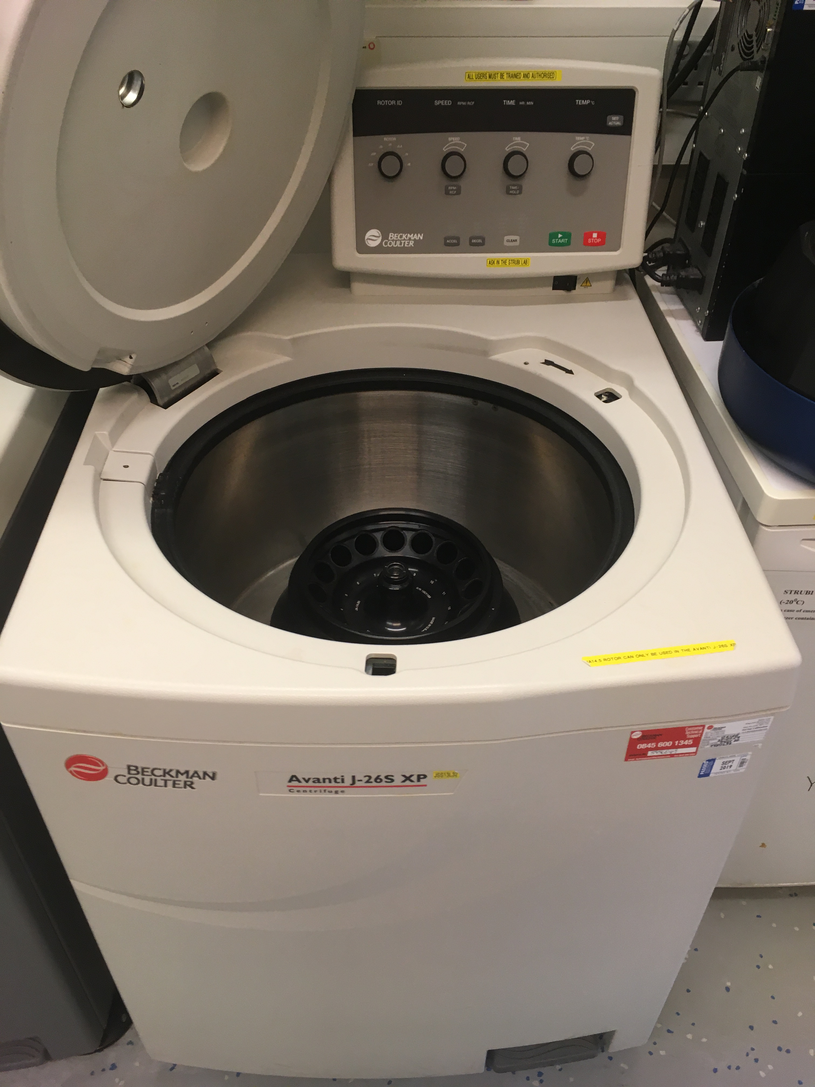
Floor-Standing Centrifuges

Slide 11
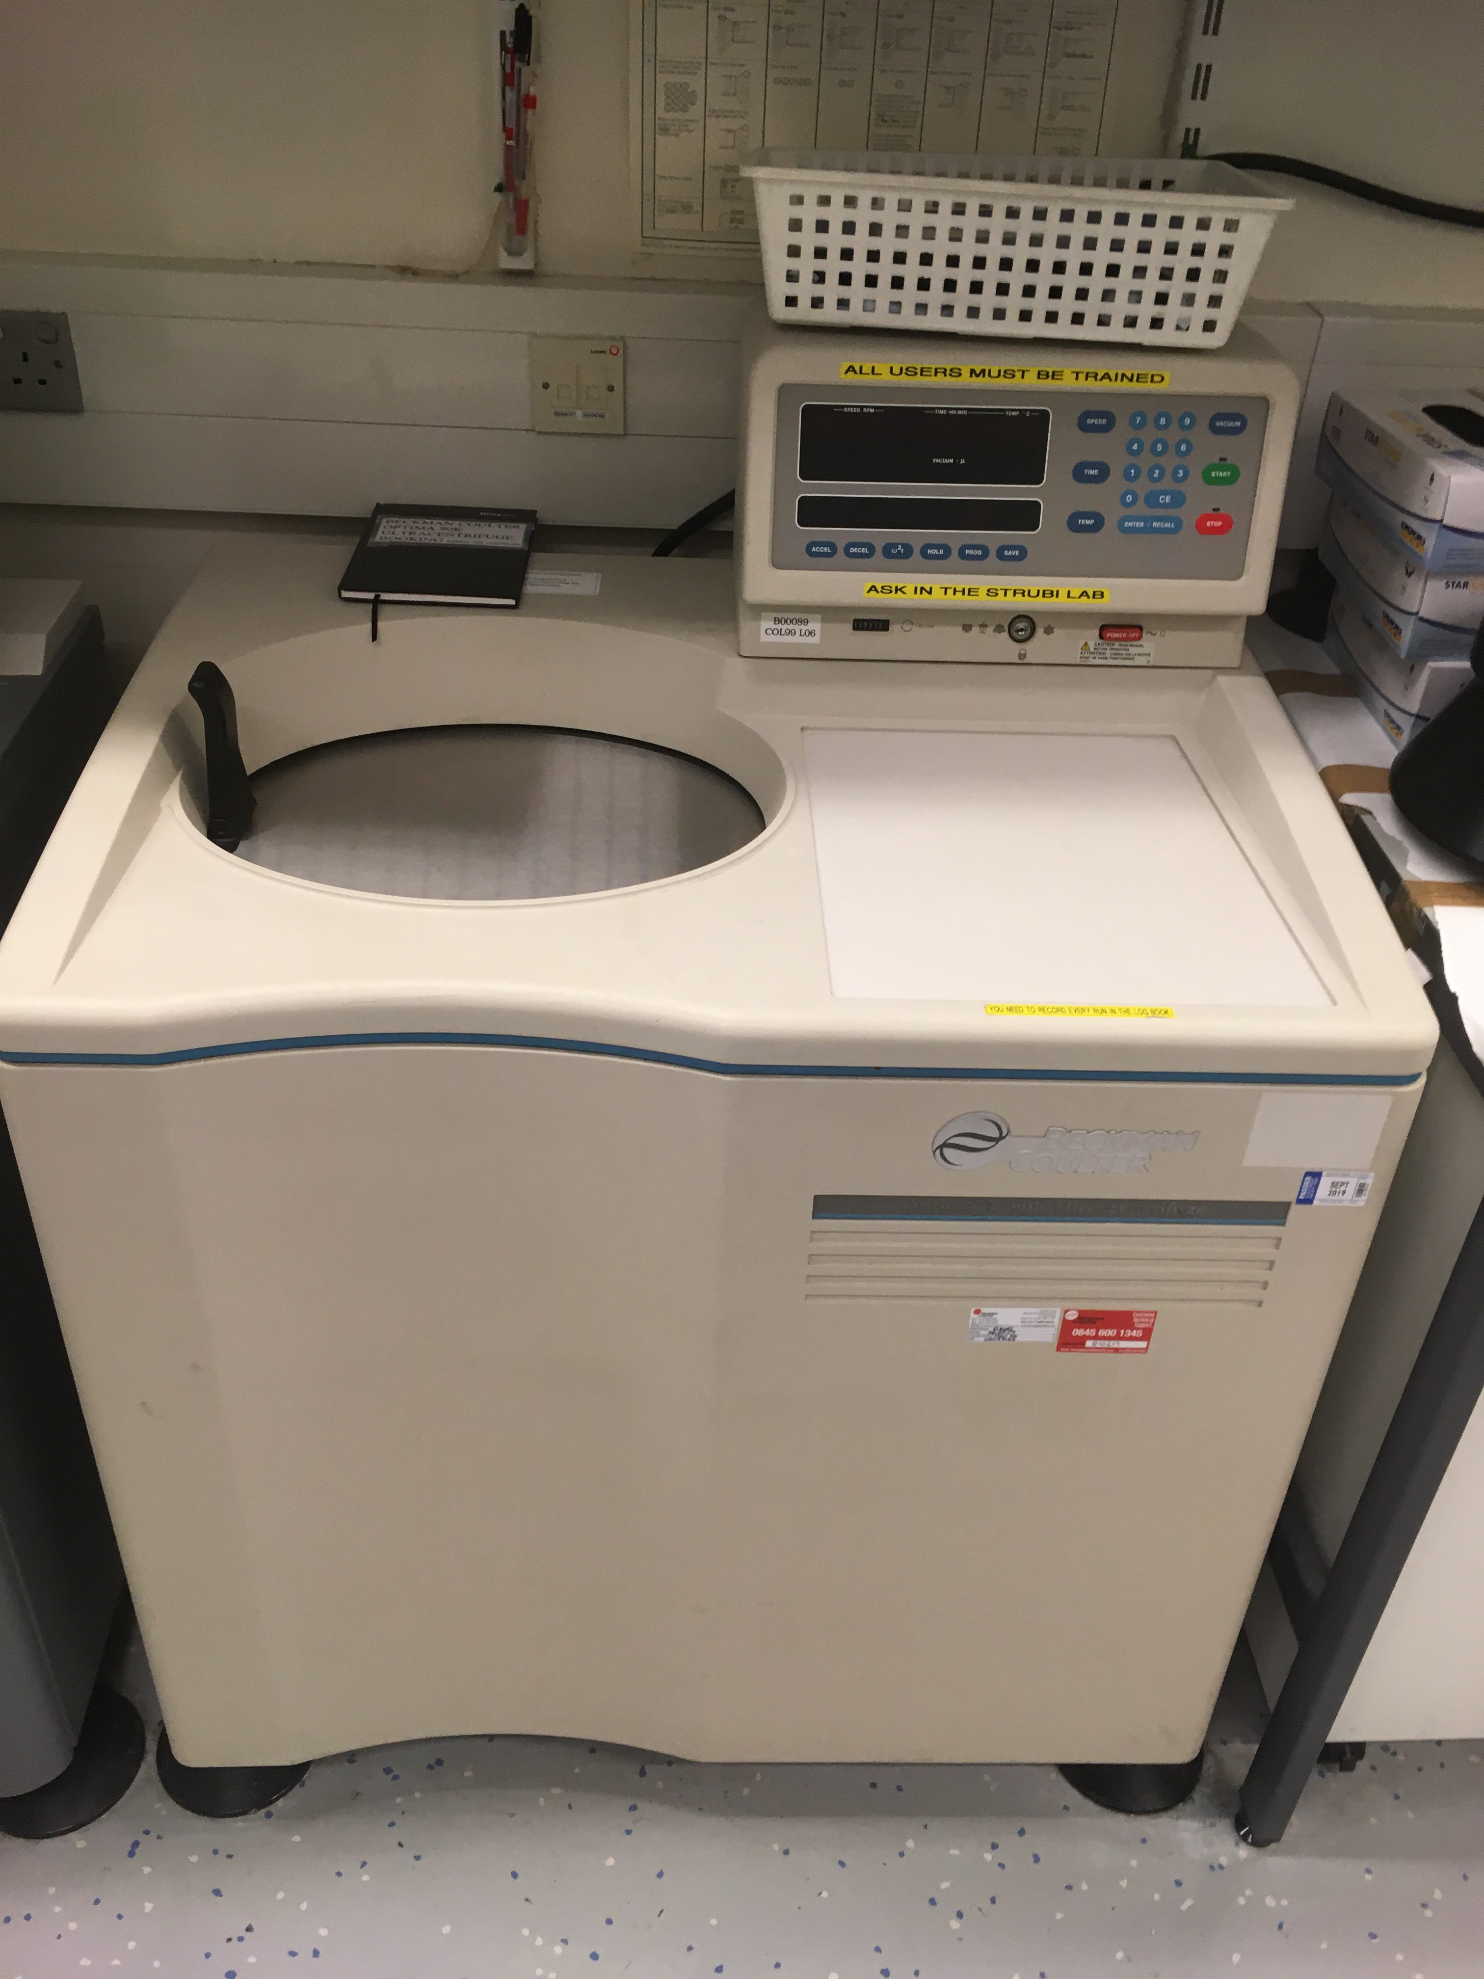
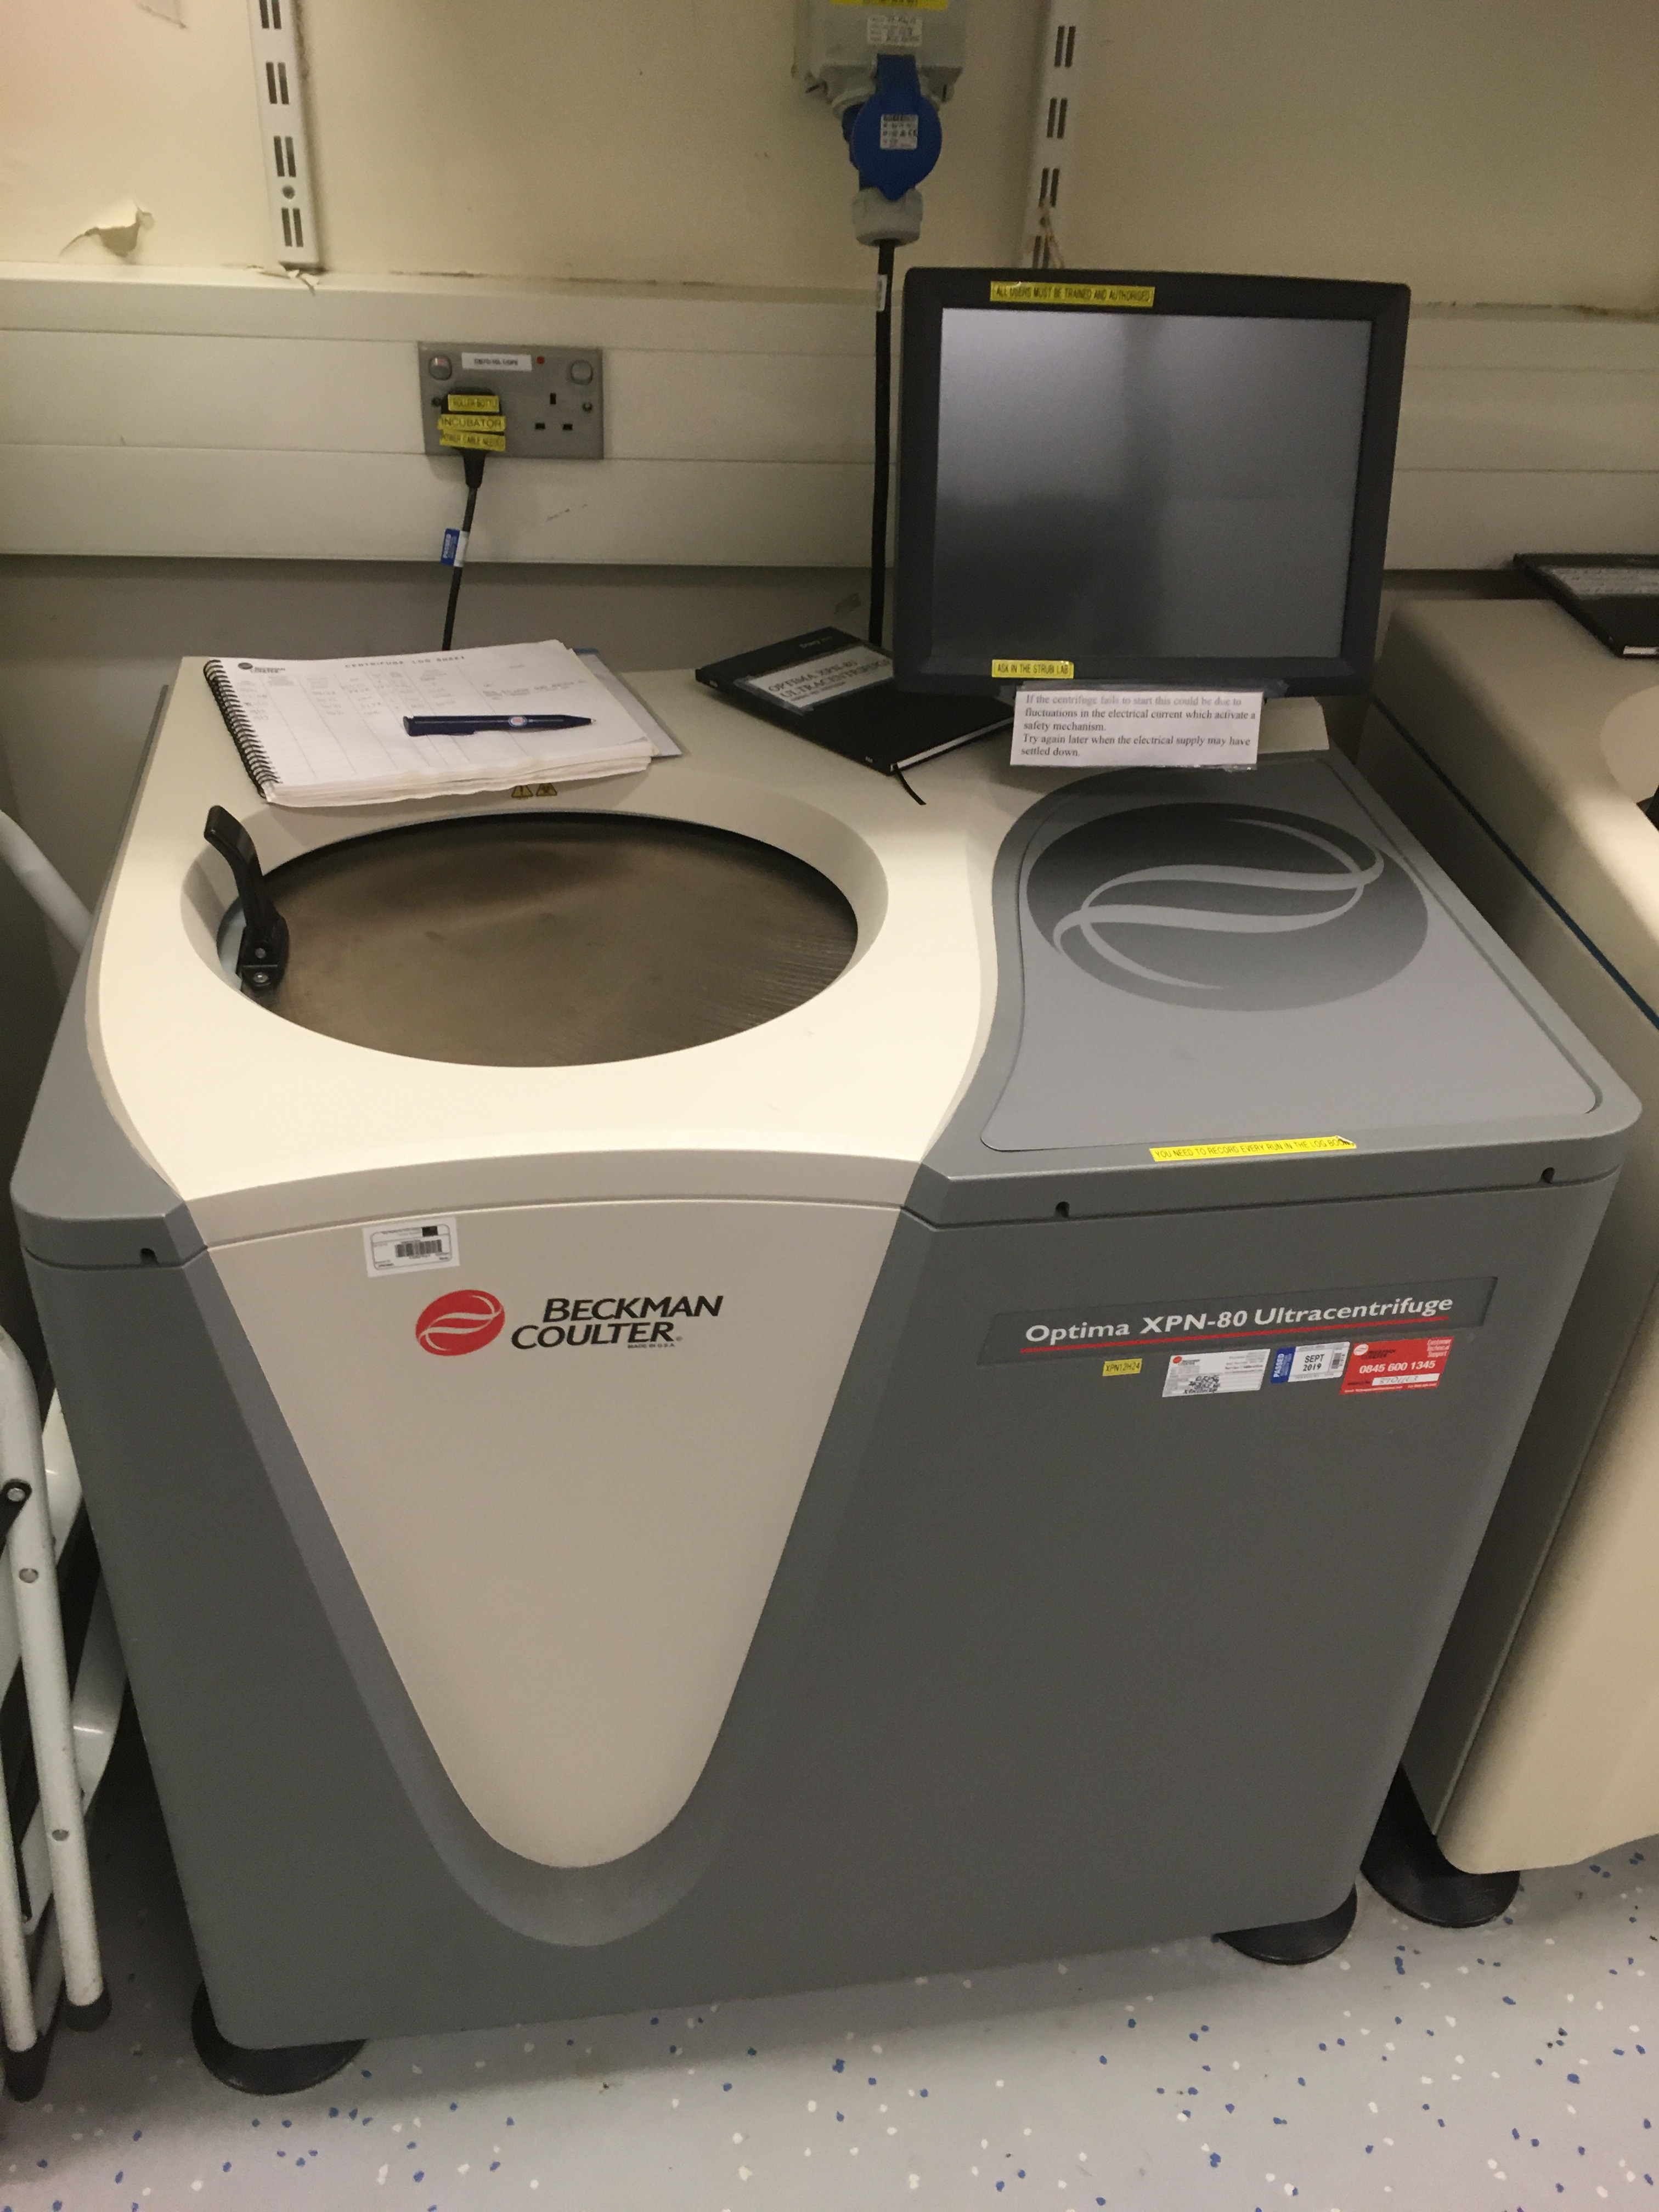
Ultracentrifuges

Slide 12
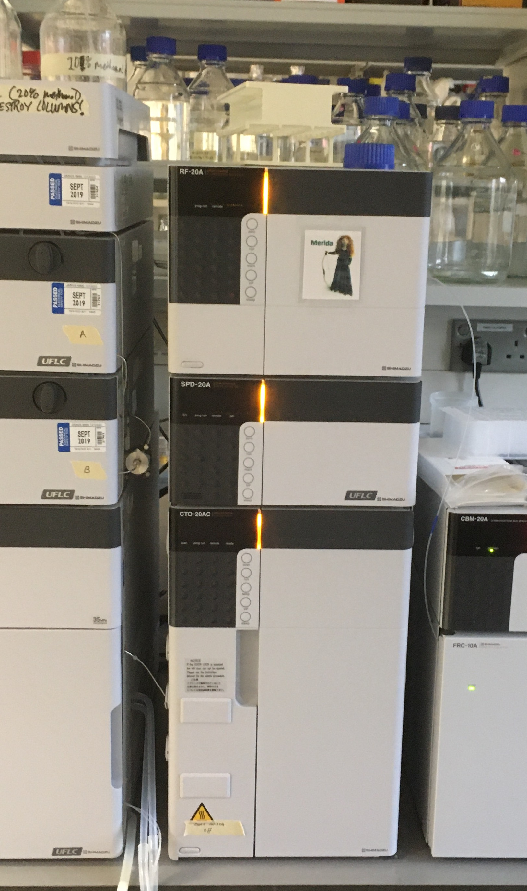
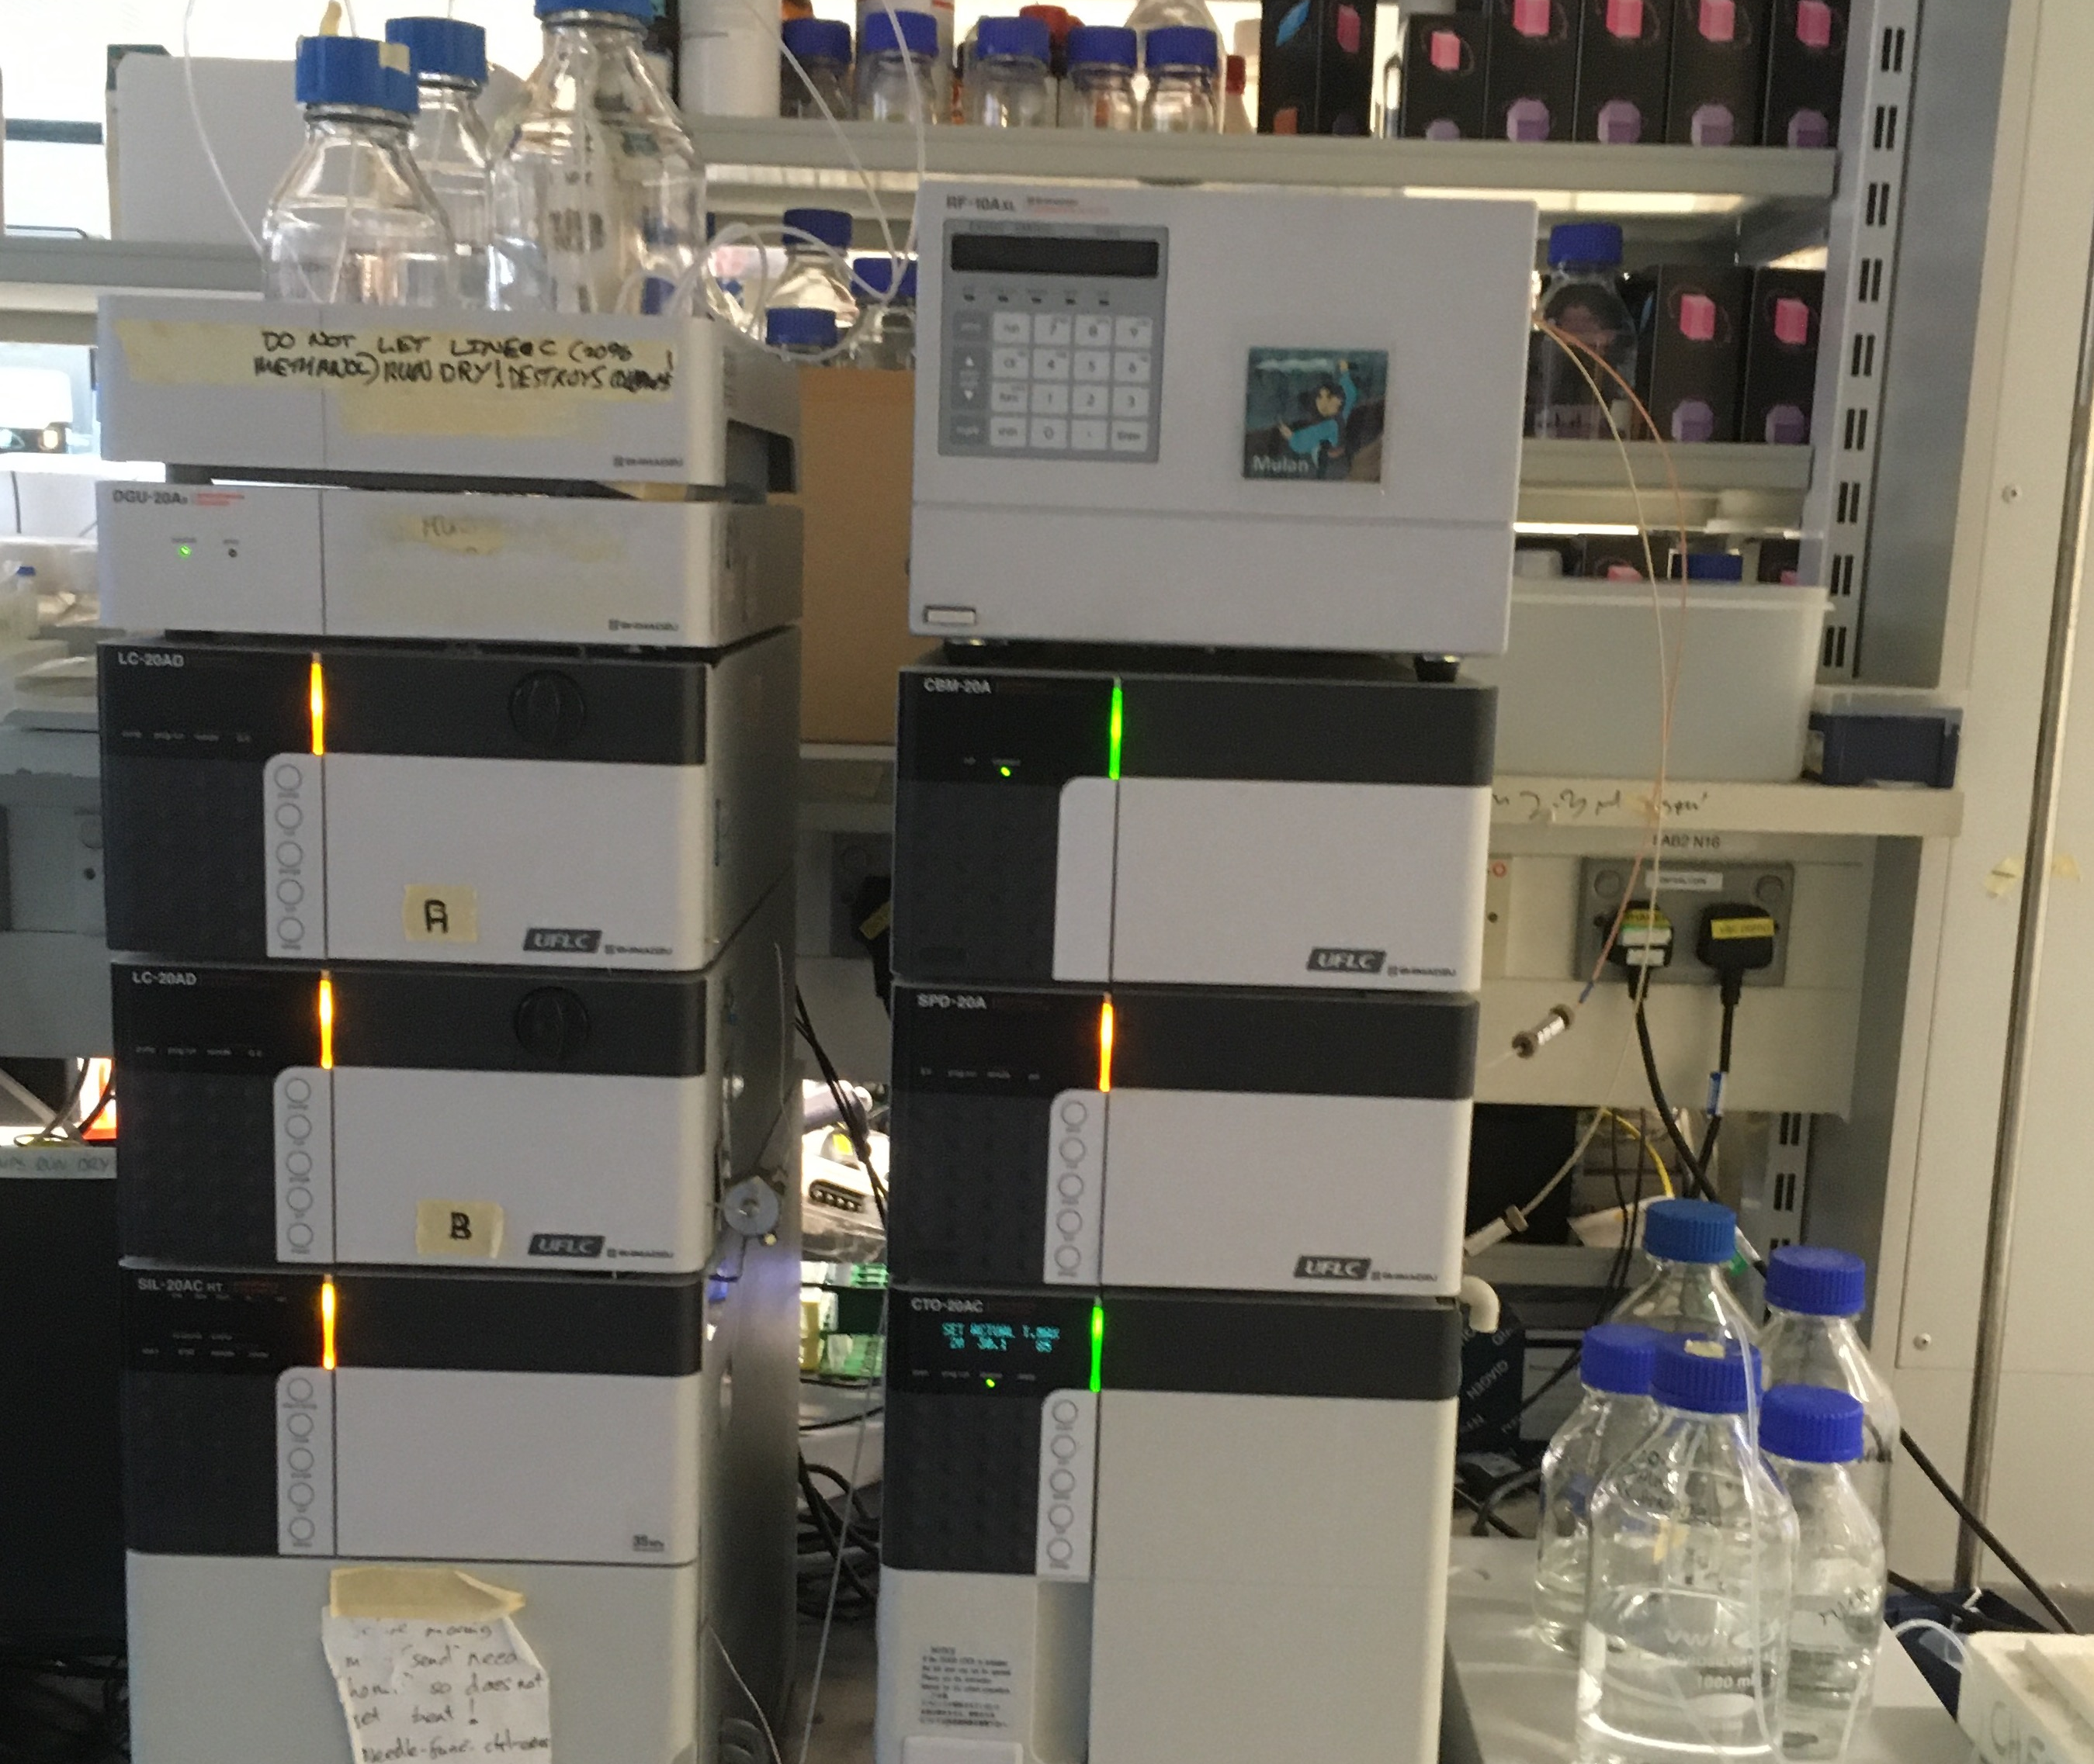
Shimadzu

Slide 13
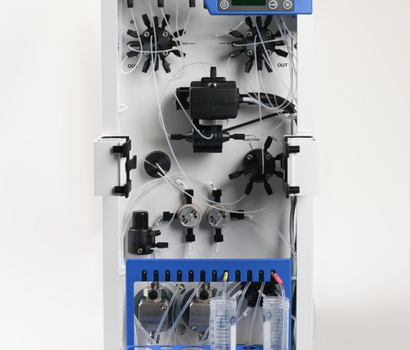
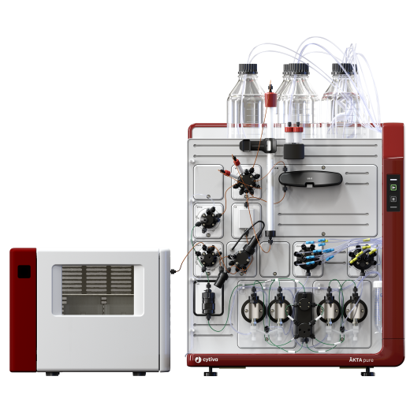
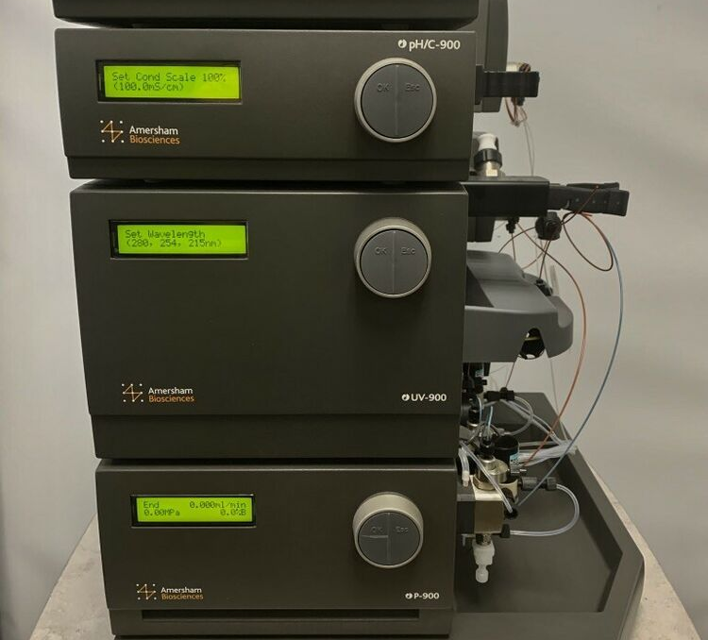
Aktas
Pure
Express
Purifier

Slide 14
