Slide 1

Crystallization Facility
and use of Liquid Nitrogen
Tom Walter
(with many thanks to Karl Harlos)
27-January-2022

Slide 2
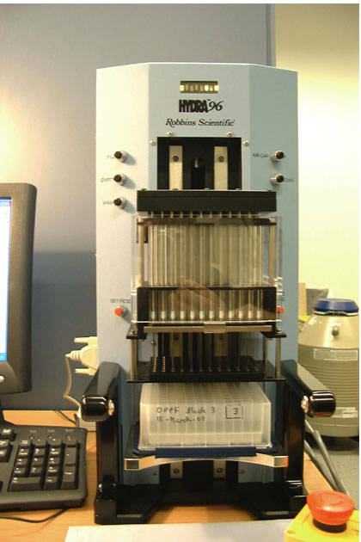
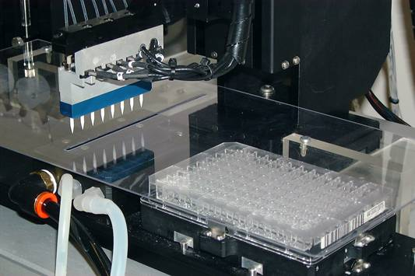
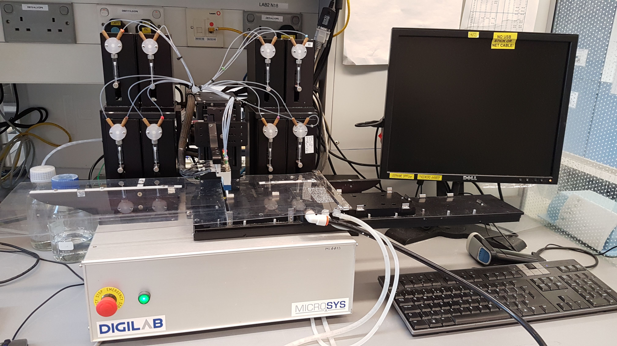
Setting up Crystallization Plates
Sitting-drop vapour-diffusion method
The protein concentrates up in the presence of different components (pH, salts, polymers, etc) to encourage crystal nucleation and growth
Hydra transfers reservoir solutions
From Deepwell Plates
To the 96-well crystallization plates (up to 3 at a time)
Adaptors for different crystallization plate types
Over 1200 different conditions to try
Cartesian dispenses nano-litre drops
Non-contact dispensing
typically 100 nL + 100 nL for screening, 15 uL protein per plate
Also does basic optimization experiments
  Additive and detergent screens
  Grids based on “hit” condition
  Grids varying multiple components

Slide 3
Access (post-IT disruption)
Crystallization is now (temporarily) on an isolated IT network
To use the facility you need to register as a user (on the isolated network)
Strubi – xtalPIMS – Login – Register
Before experiment you need to register sample and aliquot :
Strubi – Internal – Sample Registration- login – click on the name of your project – Add New Sample or click on existing Sample – Add new aliquots
NOTE “Sample” = construct(s), “Aliquot” = prep
For access and instructions contact Tom Walter ‘walter@strubi.ox.ac.uk’ or Karl Harlos ‘karl@strubi.ox.ac.uk’
NEW in 2022! A major rewrite and upgrade of the crystallization IT to (re)enable remote monitoring of the crystallization experiments

Slide 4
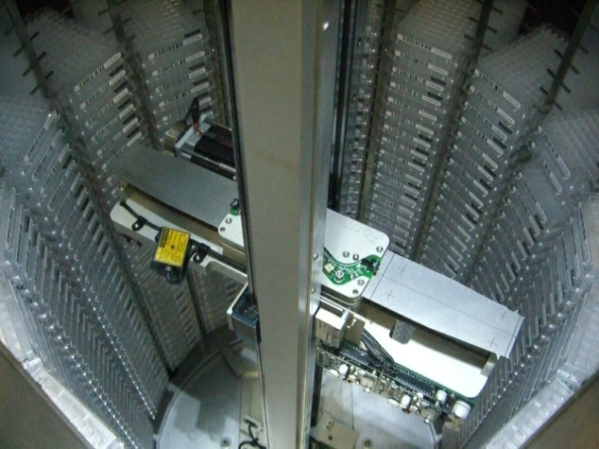
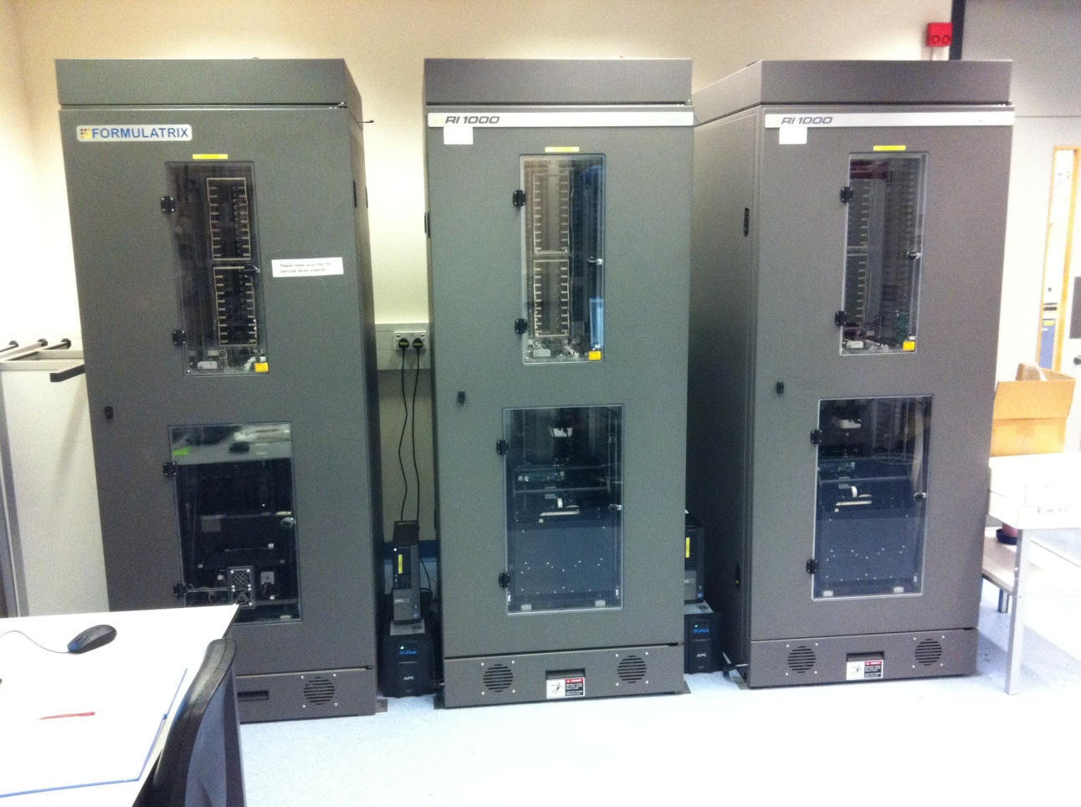
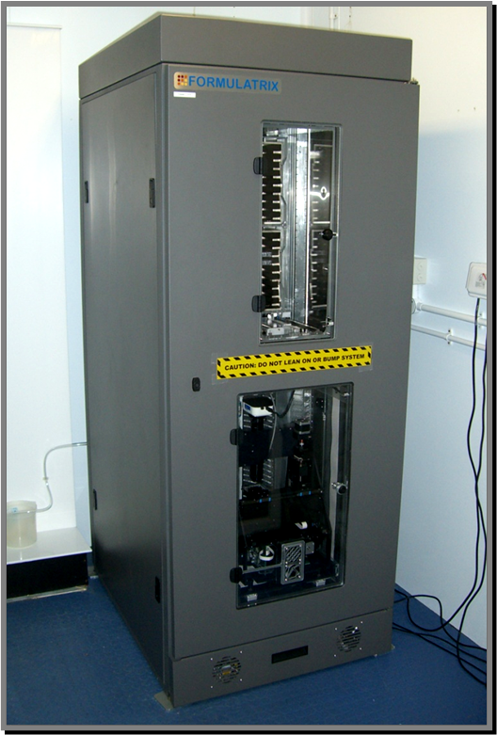
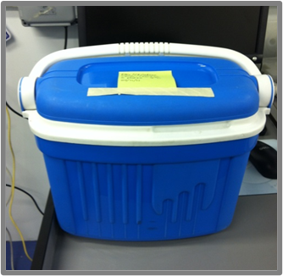
Monitoring your experiments
@20 ºC
3 x RI1000 systems (Formulatrix)
in the former X-ray room
total capacity is 3000 plates,
Plates can be imaged for at least 12 months and are then stored on open shelves for another 4-6 months.
Cold room (6.5 ºC)
1 x Formulatrix RI1000-0014
Lab2 large cold room
capacity 1000 plates
Plates can be imaged in the system for at least 1 year and are then stored in the cold room for another year.
Plates are transferred in a cool-box and left to equilibrate. Please label box with name and date.
Please do not leave cold room door open to keep humidity low.
Contact Tom Walter or Karl Harlos to retrieve plates
Please do not try and operate the system yourself, unless authorized by Tom Walter or Karl Harlos.

Slide 5
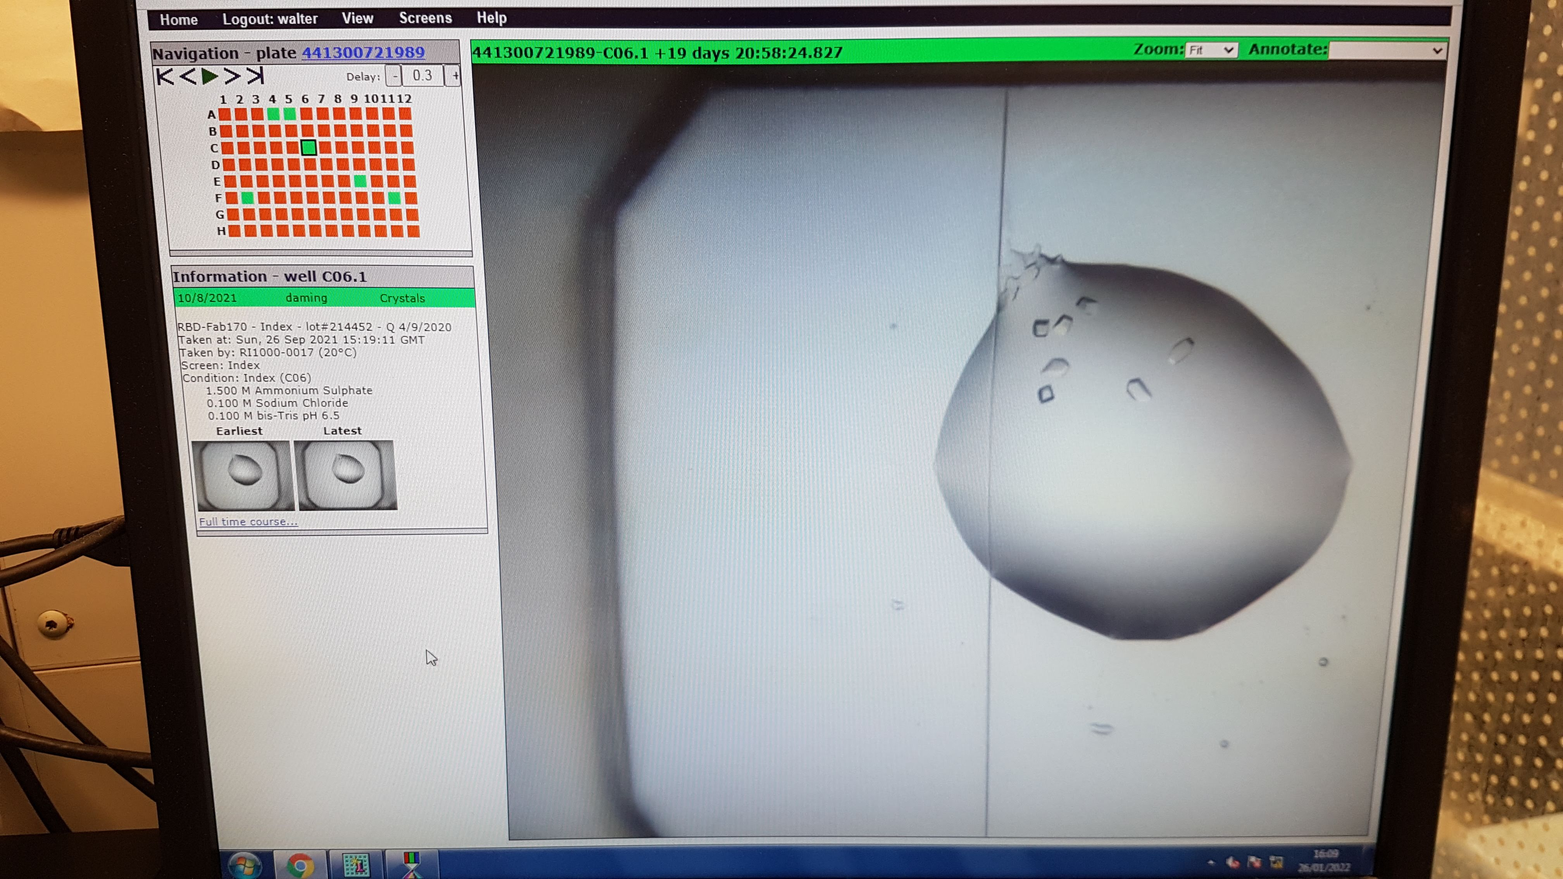
Images of your drops can be viewed in ‘xtalPIMS’ currently only available on the isolated IT network
Look up conditions, mark drops, view timecourses, etc

Slide 6
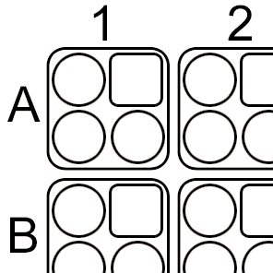
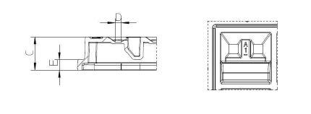
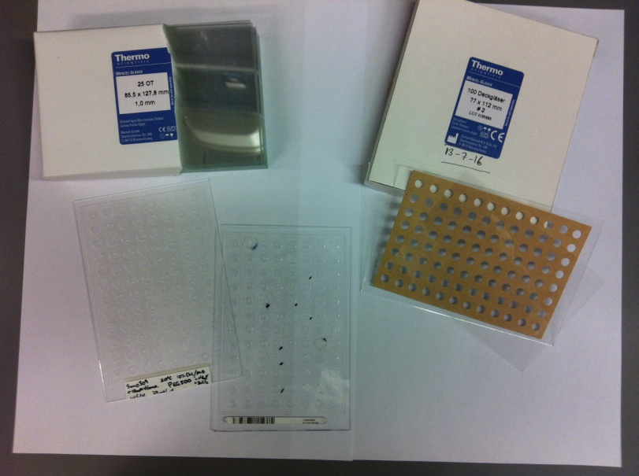
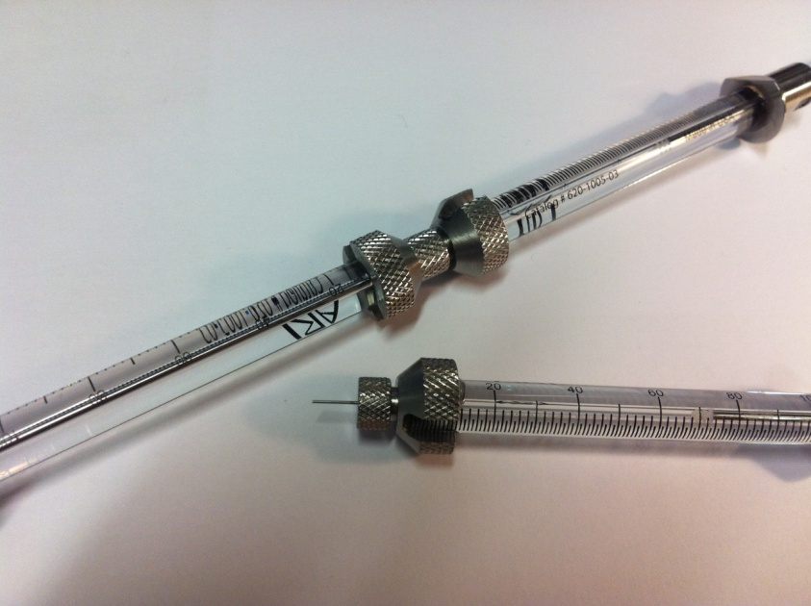
Other plates and crystallisation methods
(1) Swissci-plates – 3 drops, preferred by Diamond for eg Xchem fragment screening
(2) Hydrophobic and round bottom Greiner plates – for detergents
(3) X-ray-plates for in situ
diffraction
low background scattering
need special sealing tape
(4) Lipidic Cubic Phase (LCP) Crystallisations
Basic set of tools and consumables are available from Karl’s office and Christian Siebold’s group
“Gryphon” instrument for automated LCP
Glass plates and tapes
Syringes to mix mono-olein
with sample
Notes:
6

Slide 7
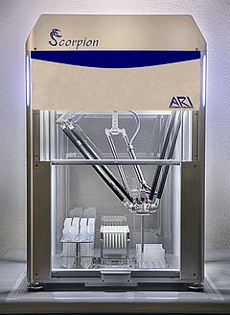
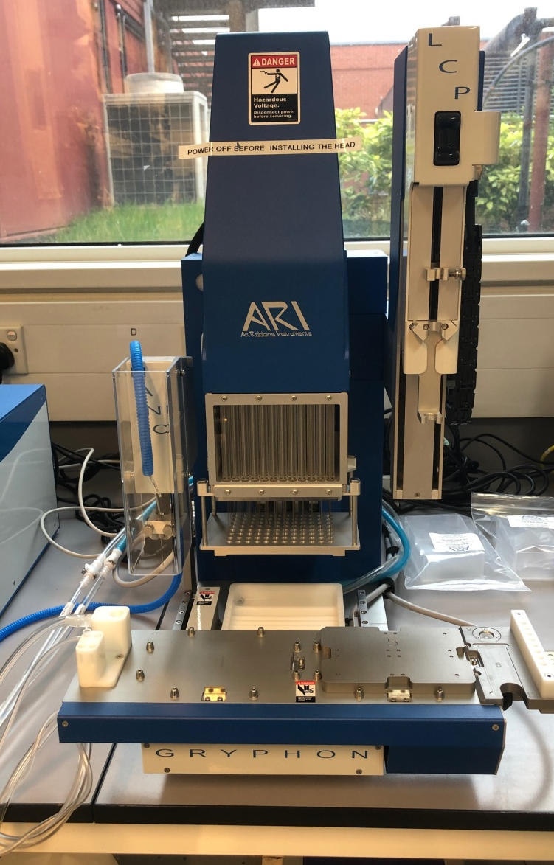
New Instruments
Crystal Gryphon for LCP crystallisations – (for advice be nice to the Siebold group!)
Scorpion for optimisations and making deep-well blocks (In progress)

Slide 8
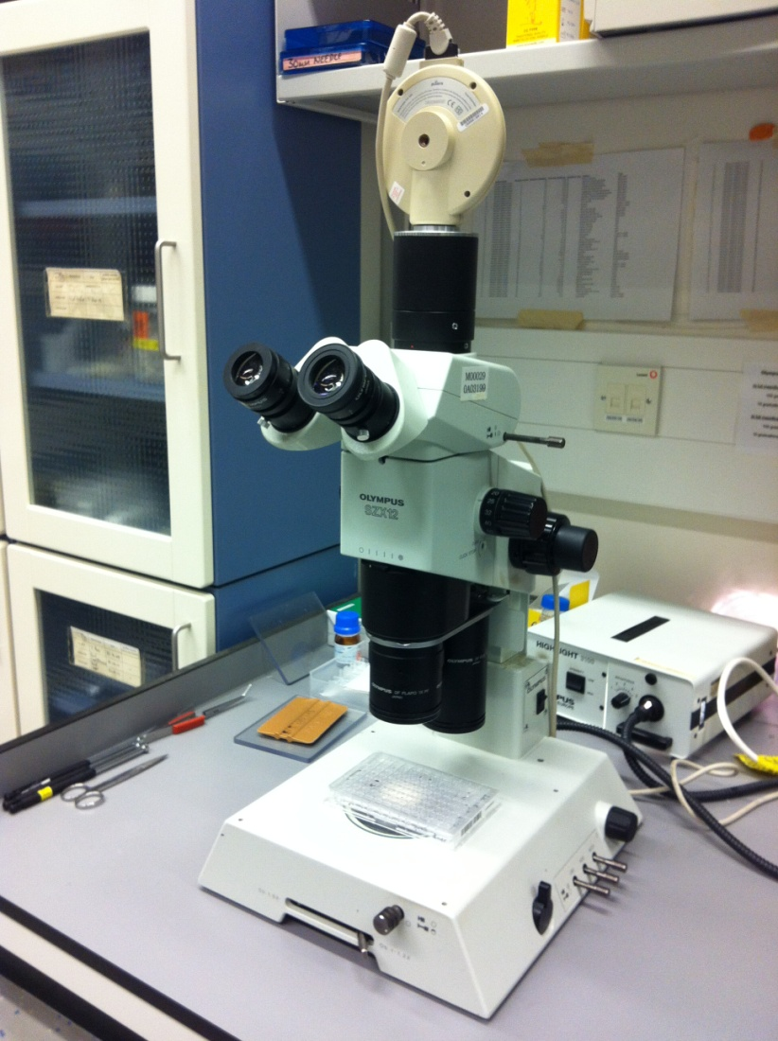
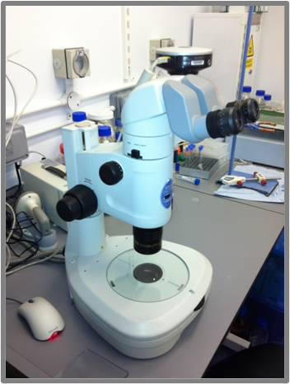
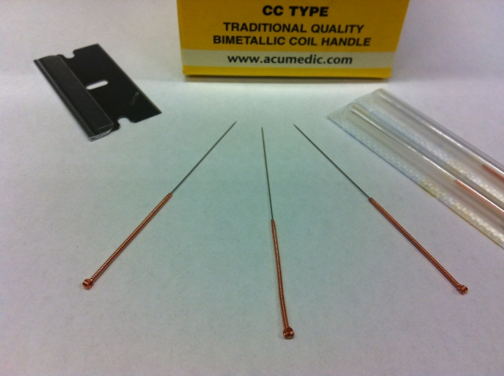
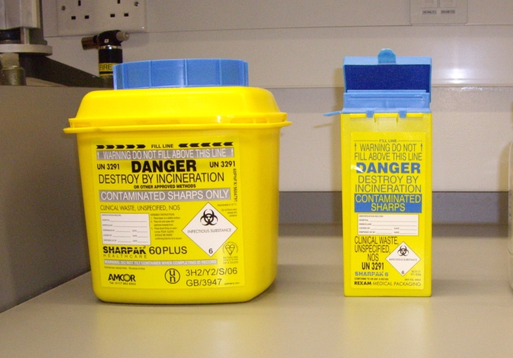
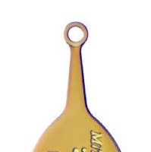
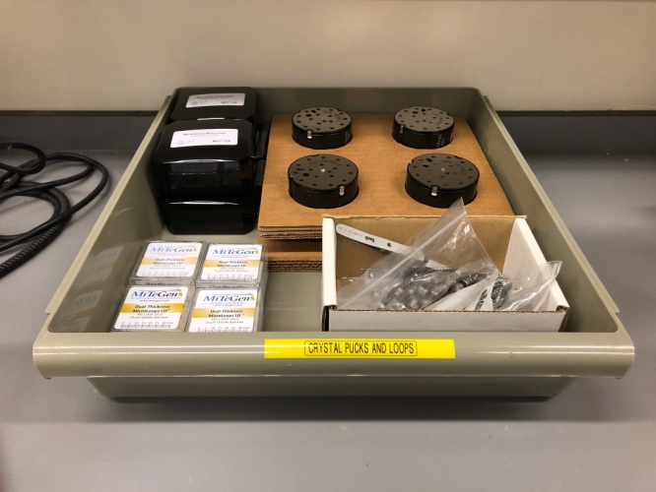
Looking-at, Manipulating and Freezing Crystals
Razor blades
and needles
Cold room Nikon stereo-microscope
Please use sharps bins
Olympus stereo-microscope
Mitegen dual thickness loops
(See Karl)
SPINE-standard UNIpucks, pins and caps

Slide 9
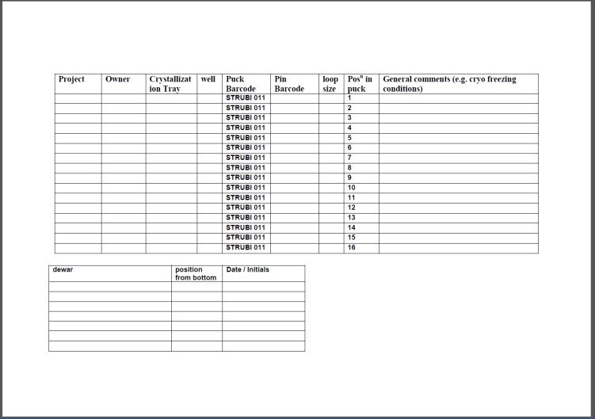
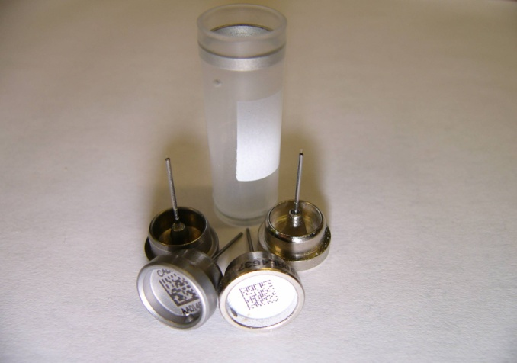
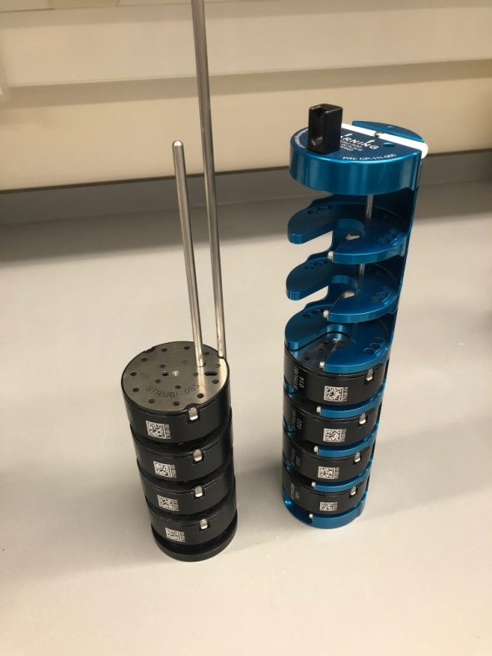
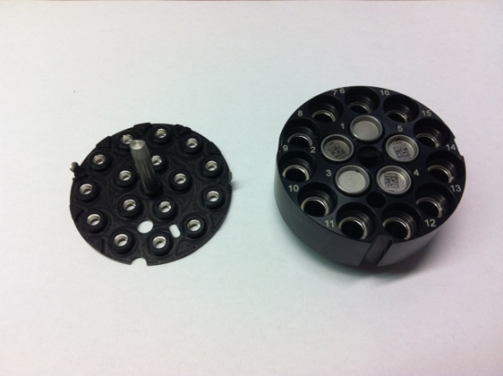
Pins and Pucks
Write details of crystals on
puck-sheet and copy information to ISPyB. (The hard-copy is often useful during screening and to make notes!)
SPINE standard pins
Uni-pucks,
when freezing crystals try to avoid build up of ice.
Puck canisters
Please check that puck is not damaged,
i.e. that all magnets and clips are in place
Please, where possible, recycle pins and re-use loops, and re-use your grid boxes

Slide 10
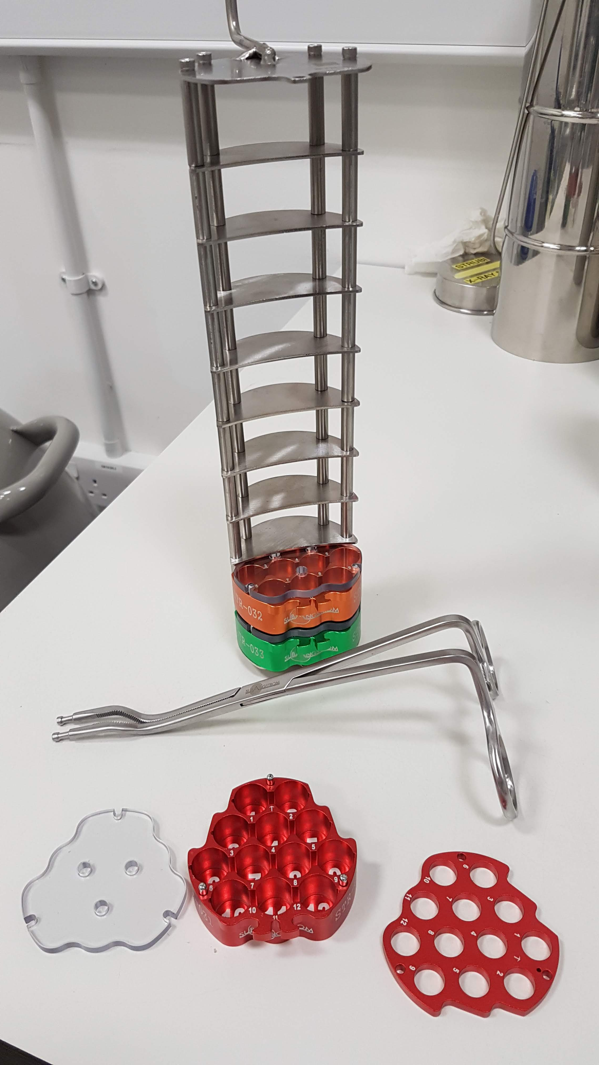
Future = pucks for EM-grids
12 grid boxes per puck
10 pucks per cannister (but best to avoid the top position)
Karl is overseeing the transition to this system – please cooperate!

Slide 11
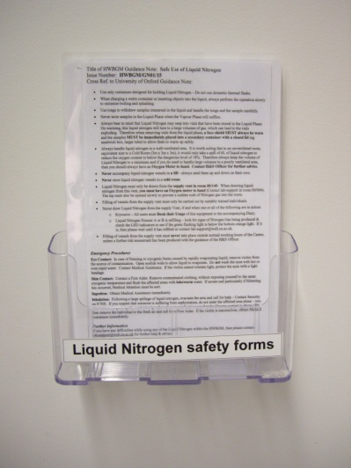
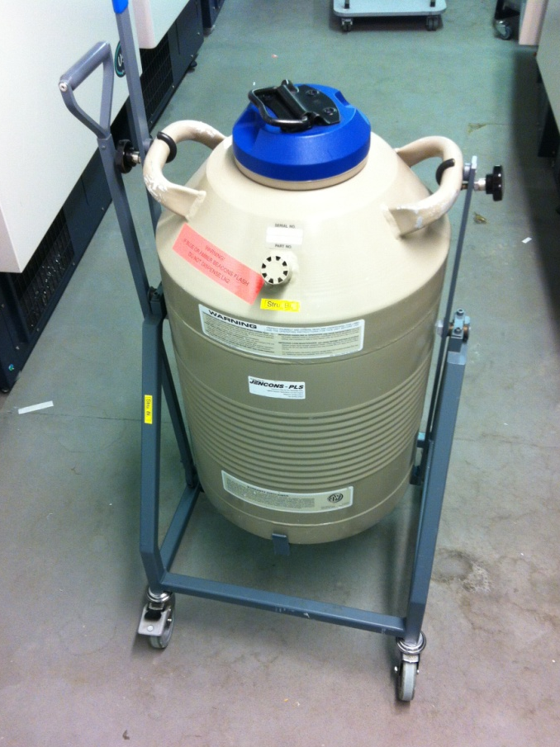
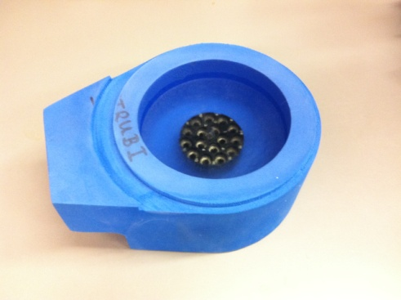
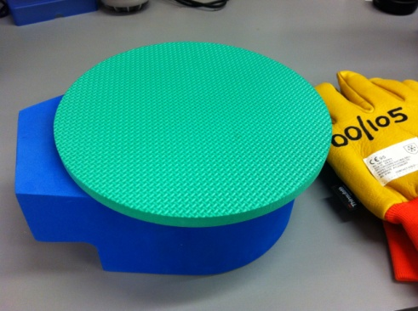
Liquid Nitrogen Safety-1
Follow local rules:
read safety sheets displayed outside former X-ray room, wear cryogloves and safety glasses,
Liquid nitrogen can be taken from
(a) small dewars in the former X-ray room or
(b) from the tipper in room 1.04A.
You need to attend the ‘Cryo-safety workshop’
organised by WCHG Safety Officer
before you are given card access to 1.04A.
NEXT COURSE 10th FEBRUARY
Take extra care when taking a foam dewar with LN2 through the lab
Tipper in room 1.04A

Slide 12
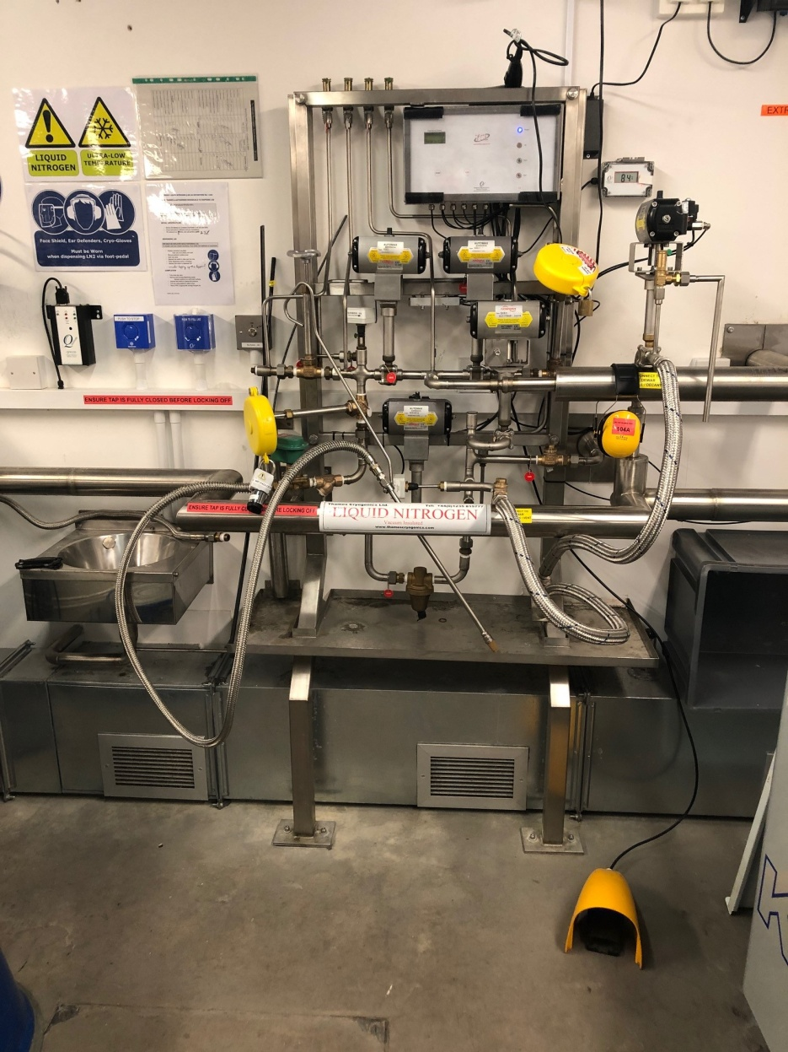
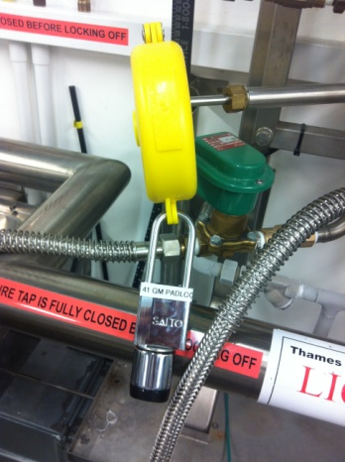
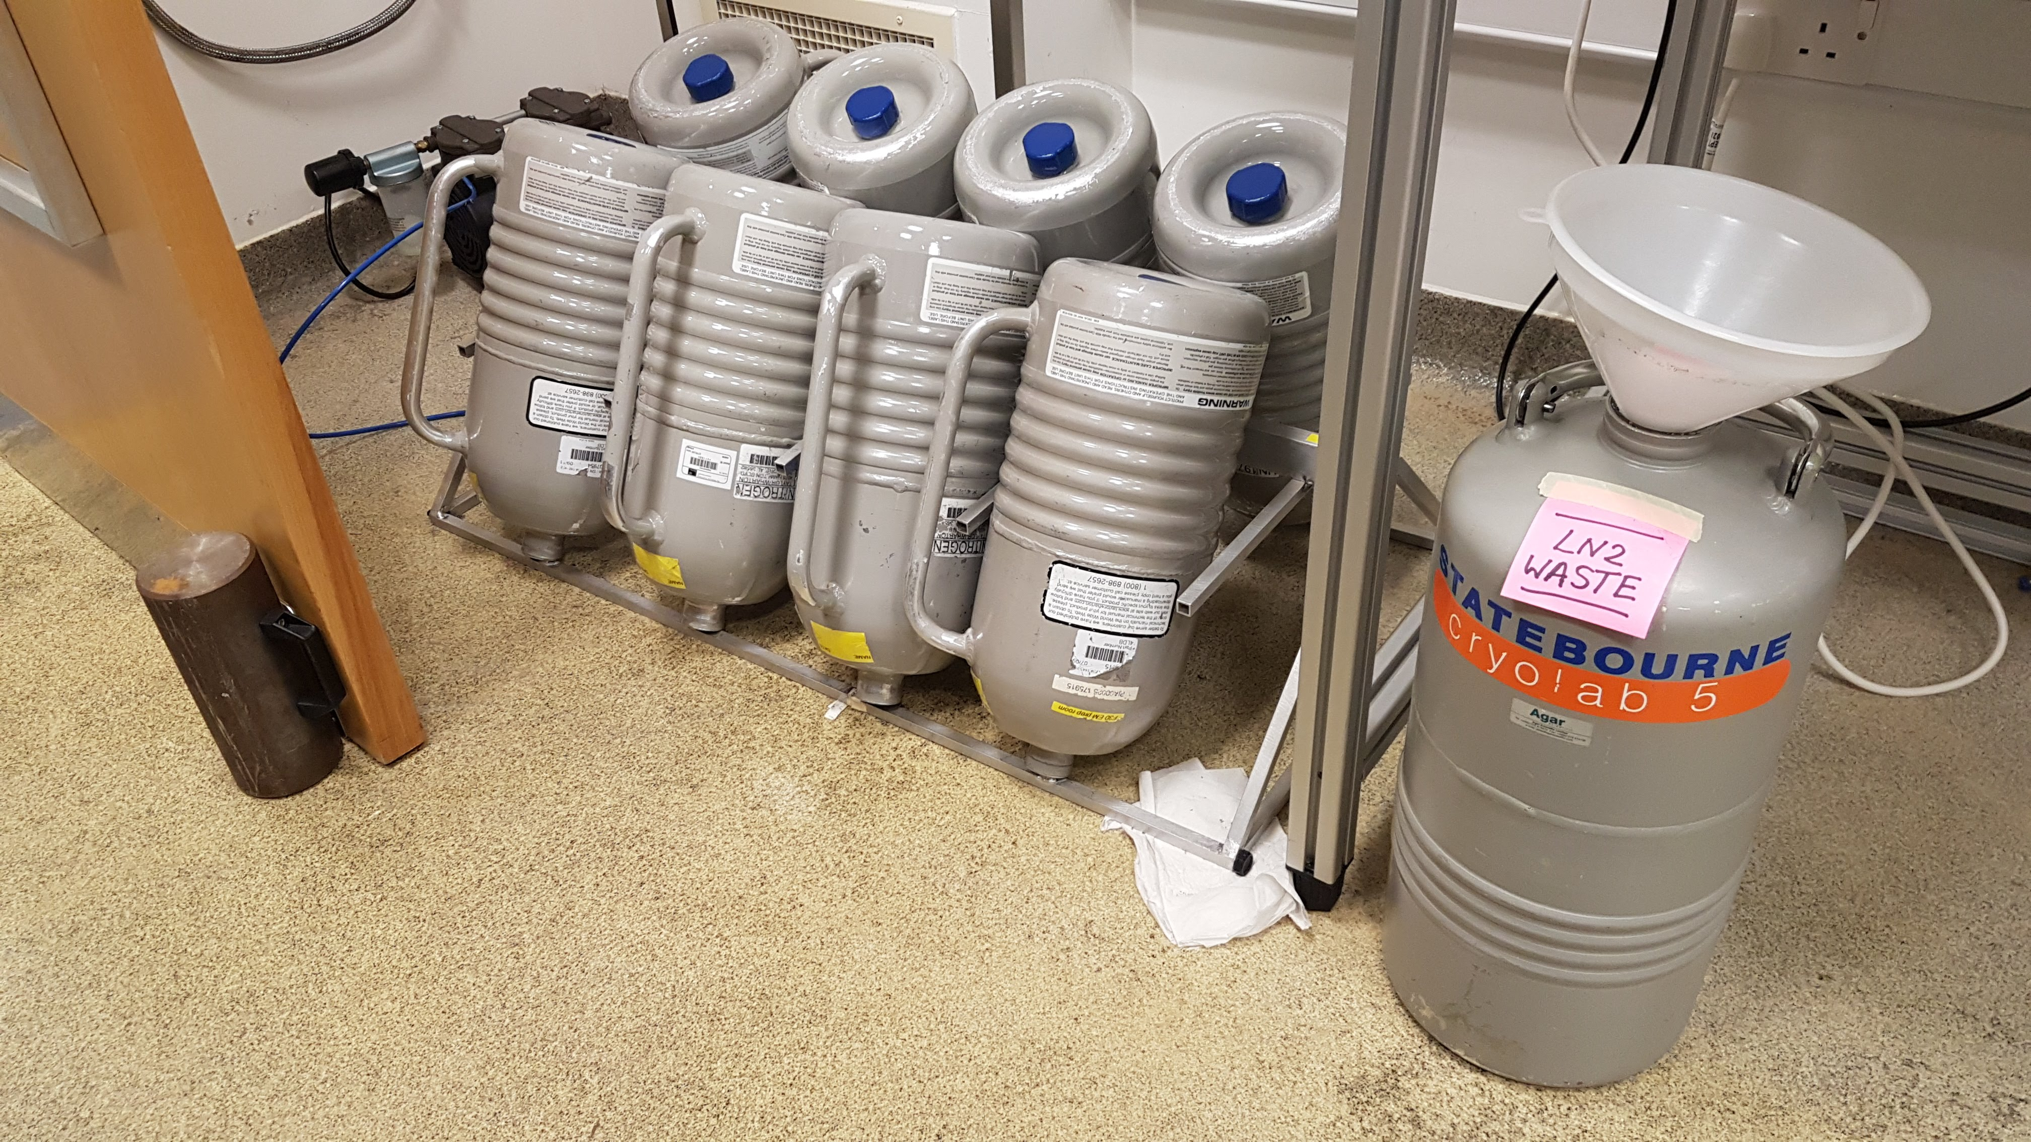
‘Dry’ Liquid Nitrogen for EM-grids
SALTO lock operates with swipe card, please contact Karl or Tom if you want to be trained and have access.
F30 EM prep room
NO ACCESS TOMORROW (28th)!
LN2 takeoff point in room 1.04A

Slide 13
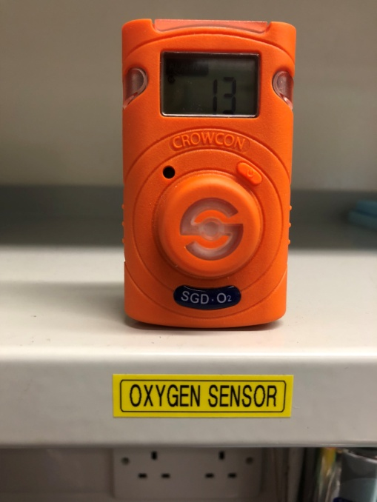
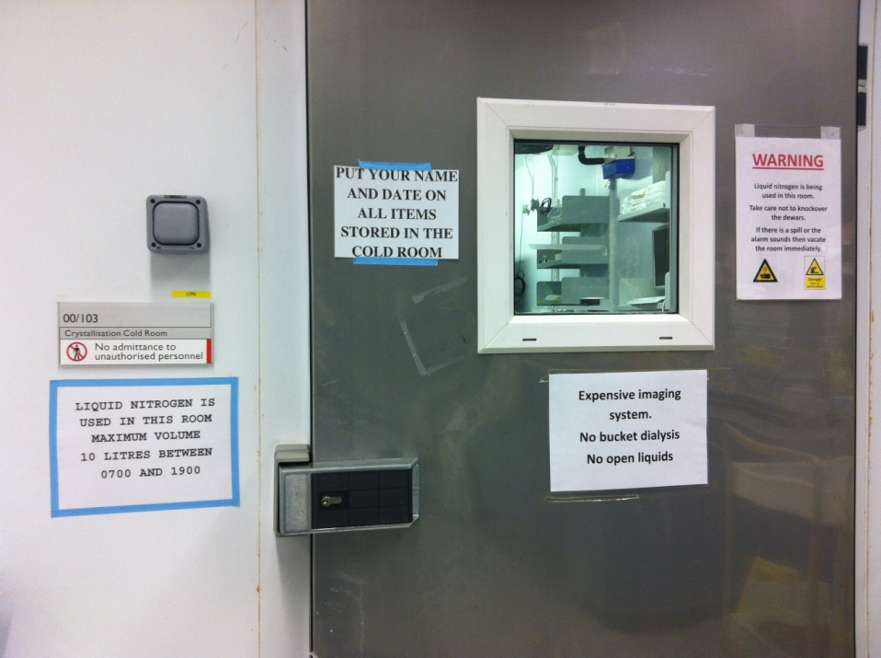
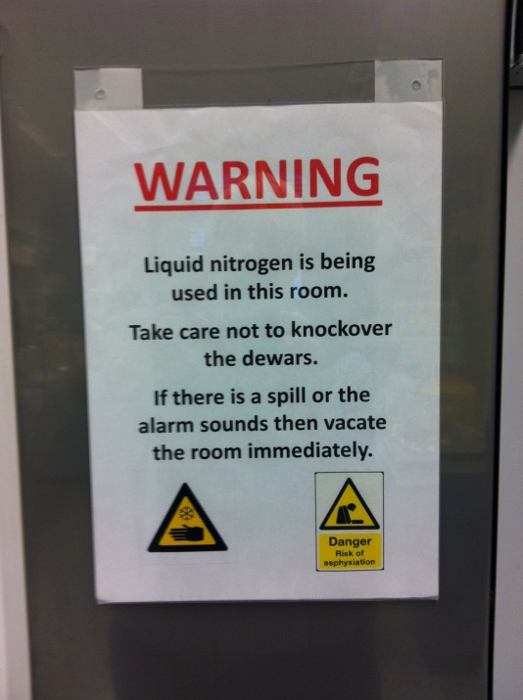
Liquid Nitrogen Safety-2
Freezing Crystals in Cold Room
(a) put up warning notice on cold room door
(b) use Oxygen sensor on bench near working area at all times
Portable Oxygen sensor
Similar procedures will be put in place in crystallization room if there are AHU works

Slide 14
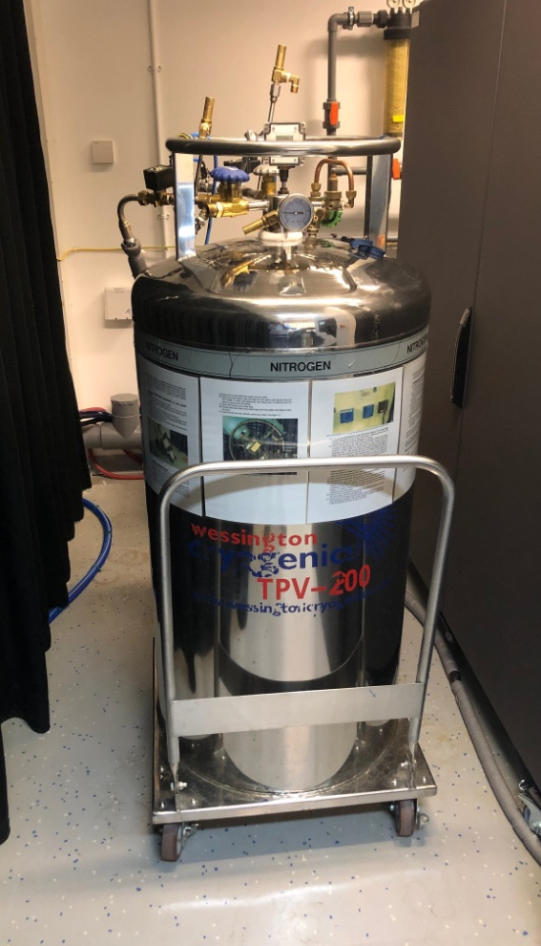
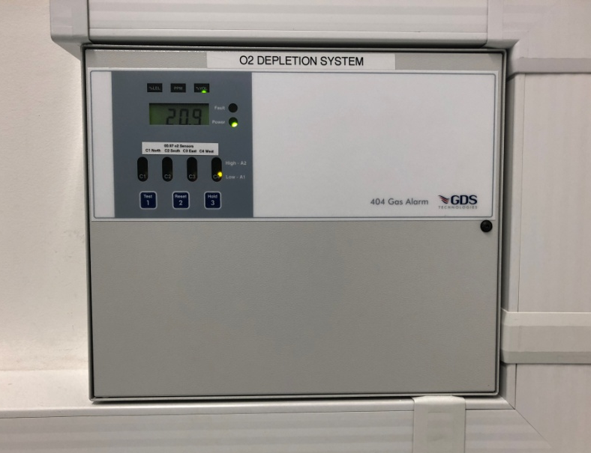
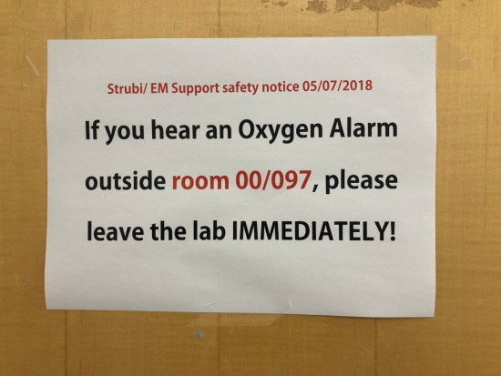
Liquid Nitrogen Safety-3
Glacios-EM Room 00/097
Present safety measures include:
(1) Several handheld Oxygen monitors
(2) an Oxygen monitoring
system within the room,
which will trigger an alarm
in case of low Oxygen
(3) Automatic shutoff valves
at the LN2 dewar
(4) Warning signs on all
doors to Lab-2 and
on all doors to the
Glacios room
LN2 supply-dewar for Glacios-EM

Slide 15
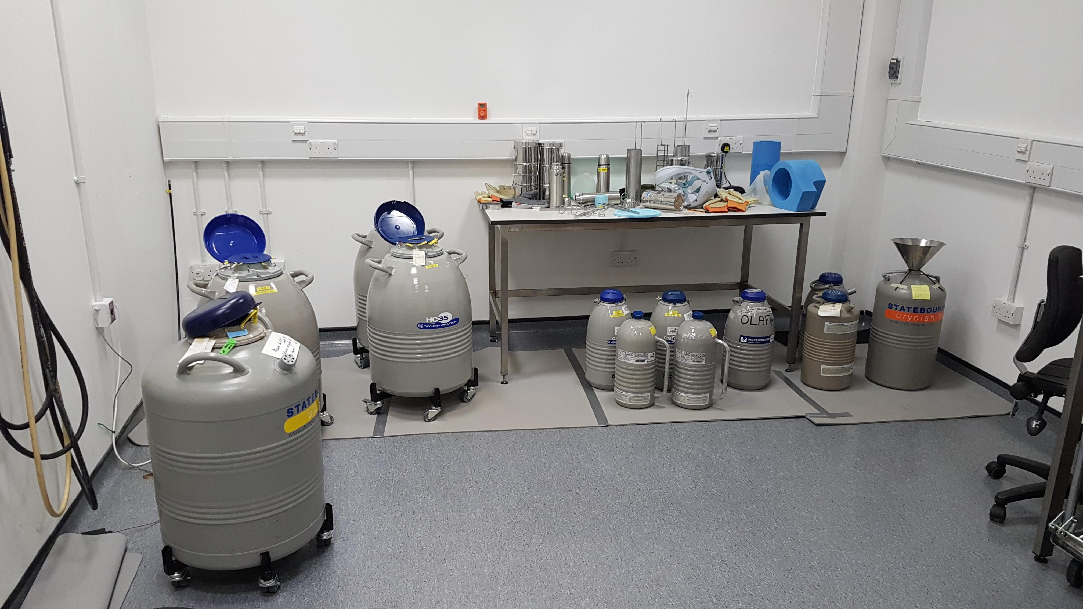
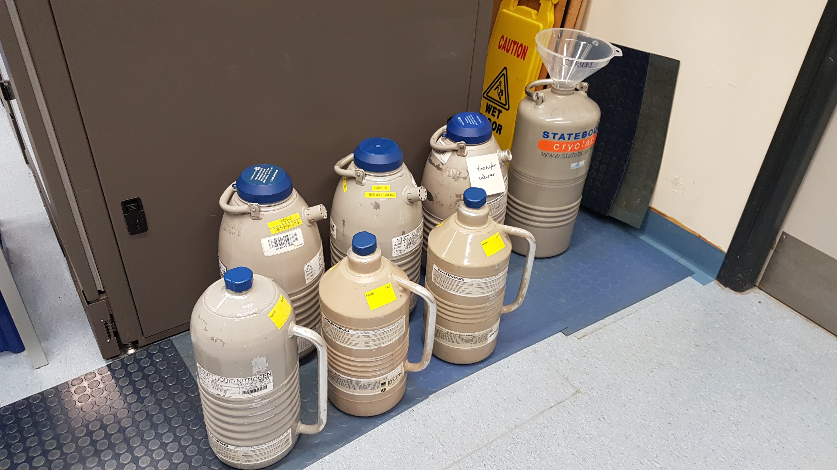
Storing and Transporting frozen Crystals and EM-grids
Dry shippers, 4L-dewars & transfer dewar in former F30 room (OPIC).
Discard small amounts of excess Liquid Nitrogen into dewar with funnel. Larger amounts can be disposed of in the LN2 room 1.04A.
Storage dewars for crystals and EM-grids (F30 room OPIC)
Safety note:
Dry shippers must only be transported in the ‘dry’ state,
i.e. any ‘liquid’ must be poured away before transport.
They will maintain temperature for several days.

Slide 16
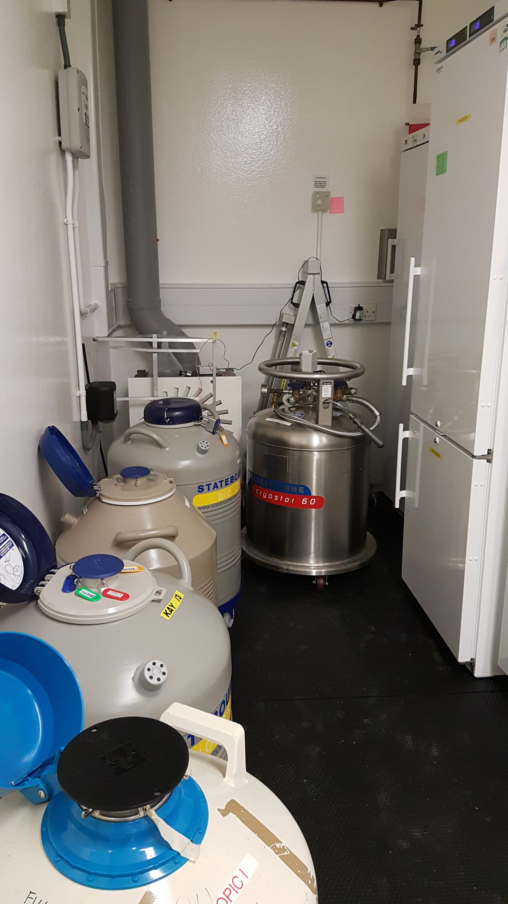
Yellow suite LN2
Small cramped area with LN2 storage and pressurised dewar
Get training & advice
Always use the extraction system when dispensing LN2 from pressurised dewar
Tell someone else that you are working there especially out of hours! (Preferably don’t do it out of hours!)
Storage dewars will be upgraded to puck system in due course

Slide 17
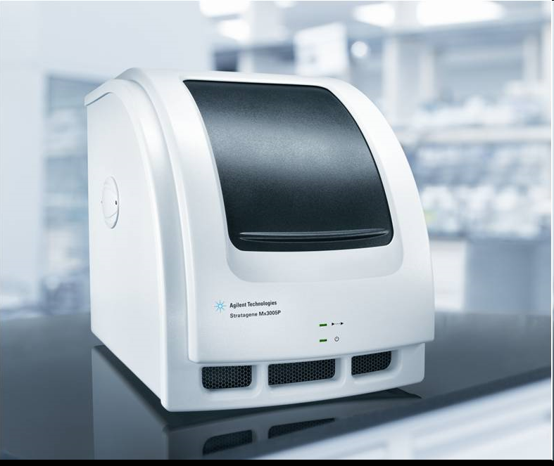
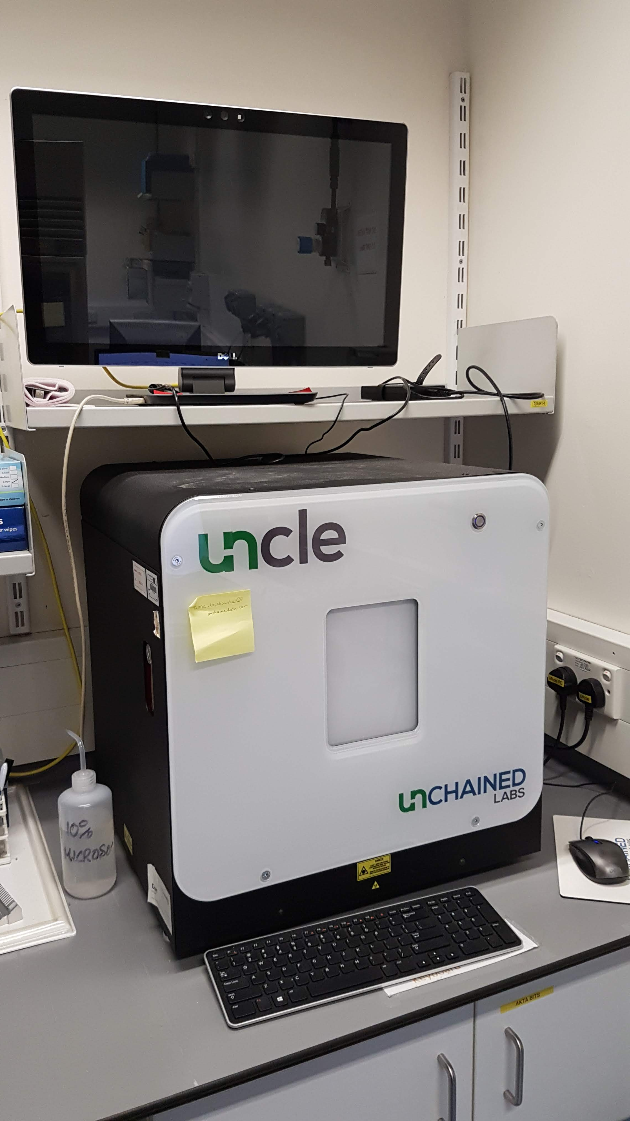
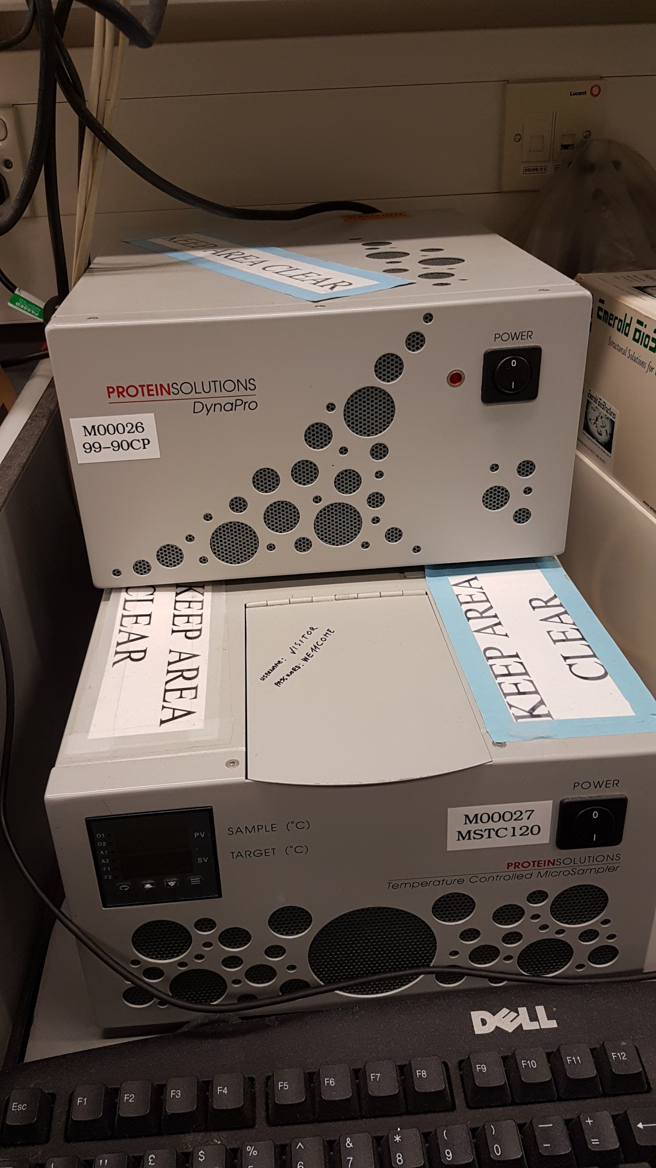
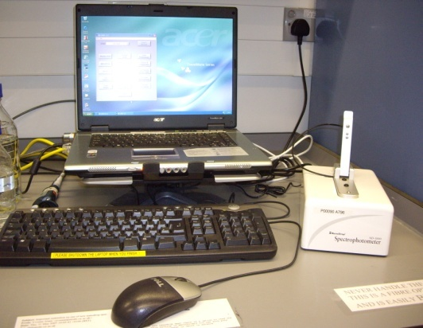
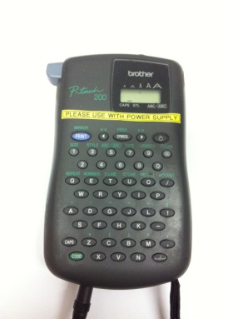
Other Instruments
Thermofluor – thermal shift analysis for proteins and viruses (Agilent MX3005P RT-PCR machine)
UNCLE light scattering and native (i.e. no dye) thermal shift
DLS – particle sizing and polydispersity
Nanodrop spectrophotometer
Label printers
Brother P-touch 200 available in Karl’s office
Barcode label printer available in Crystallization area

Slide 18
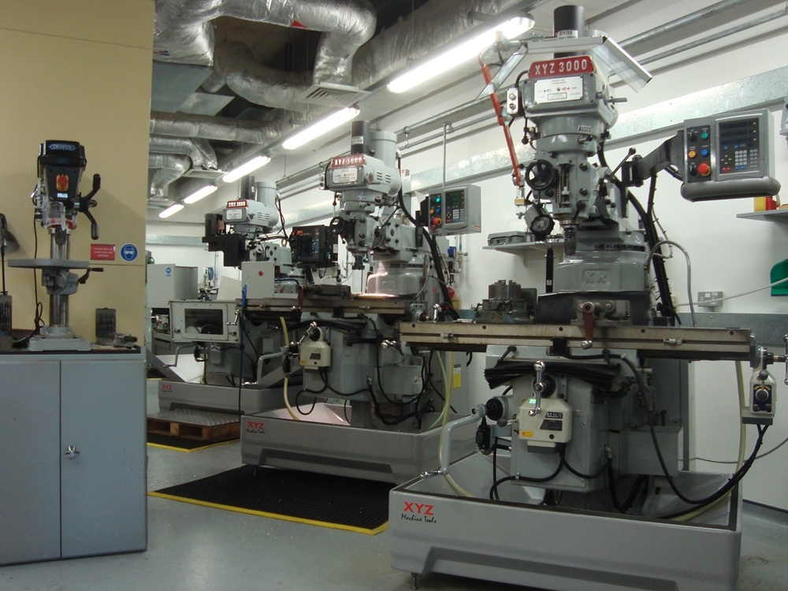
Mechanical Workshop
in Green Building
Two groups:
Department of Oncology – CAD-CAM facilities - John Prentice
Institute of Biomedical Engineering (IBME) - James Fisk

