Slide 1





Loic Carrique
(loic@strubi.ox.ac.uk)
Facilities talks 1st Feb 2023

Slide 2
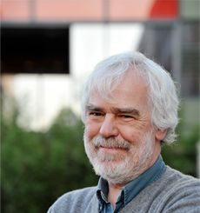
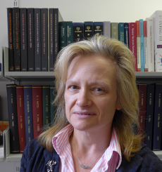
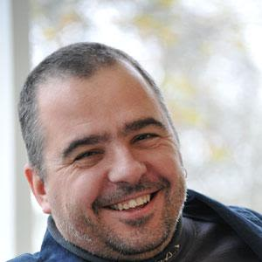



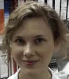
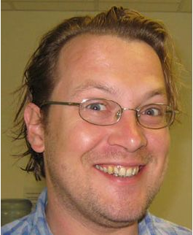




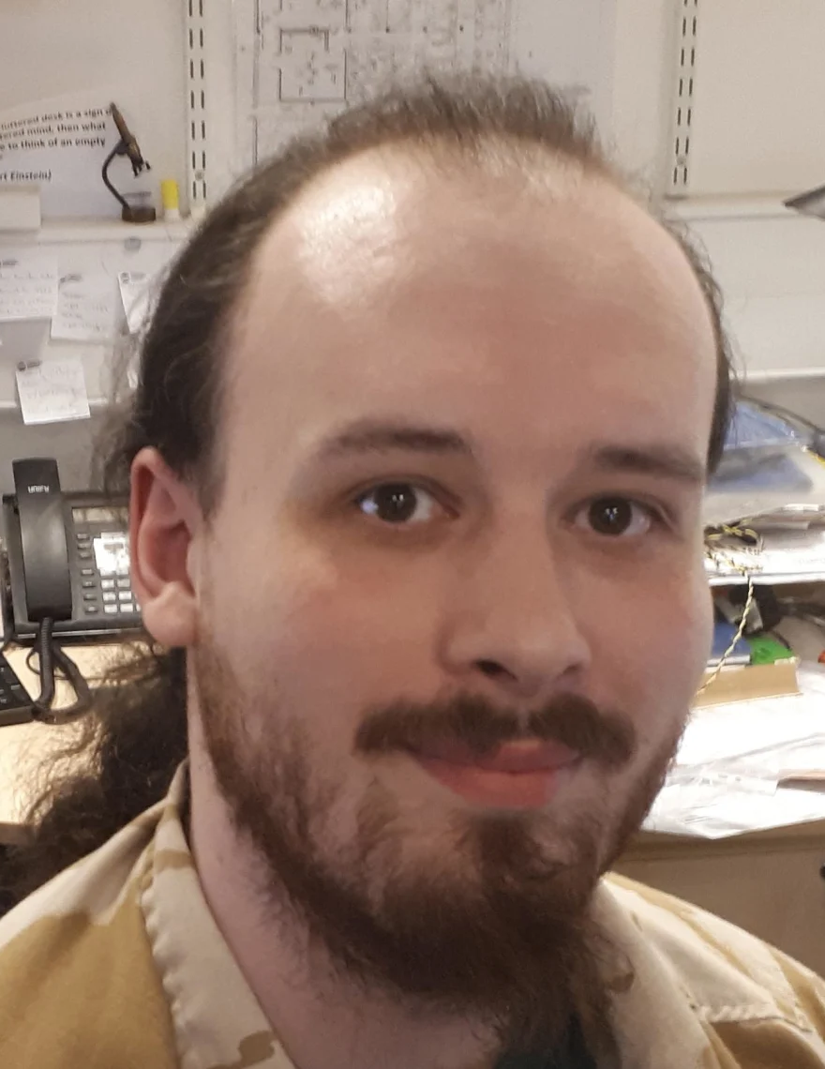
Oxford Particle Imaging Centre (OPIC)
Management
Admin
Dave Stuart
Yvonne Jones
Jonathan Grimes
Claire Morris
Melissa Matthews
Agata Krupa
Staff and Facility Support
Helen
Duyvesteyn
Tom
Walter
Elizabeth
MacLean
Karl
Harlos
Loic
Carrique
Mhairi
Ferguson
Benjamin Edwards

Slide 3
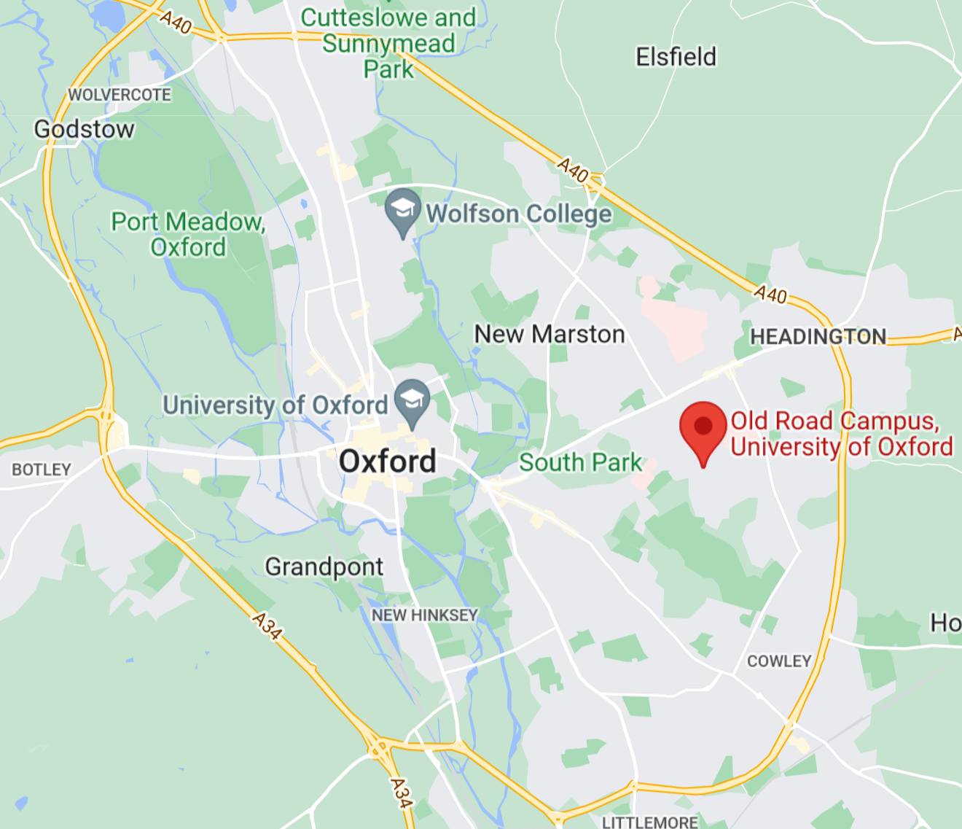
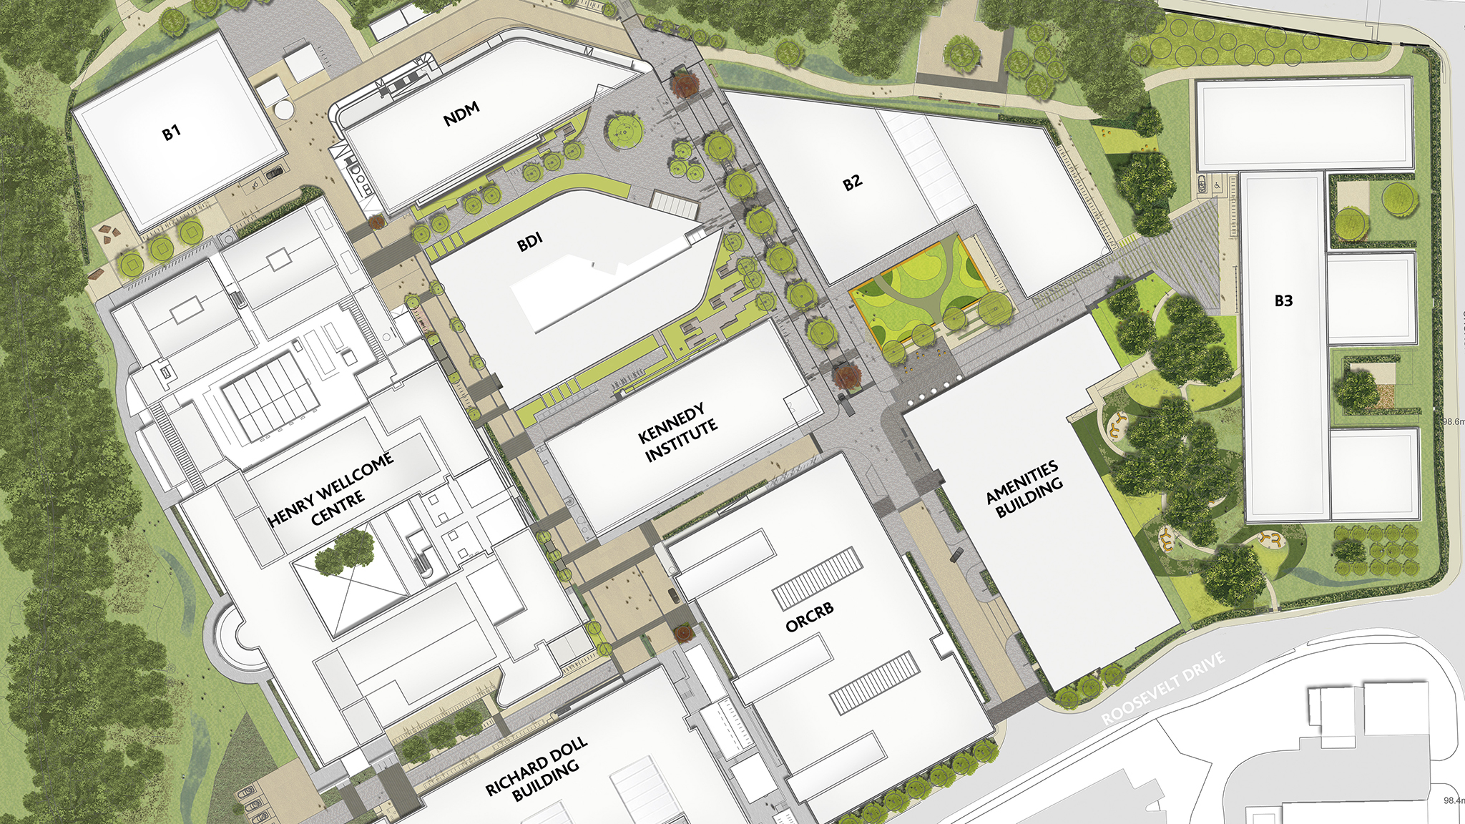
Where we are based!
Old road campus – Nuffield Department of Medicine

Slide 4
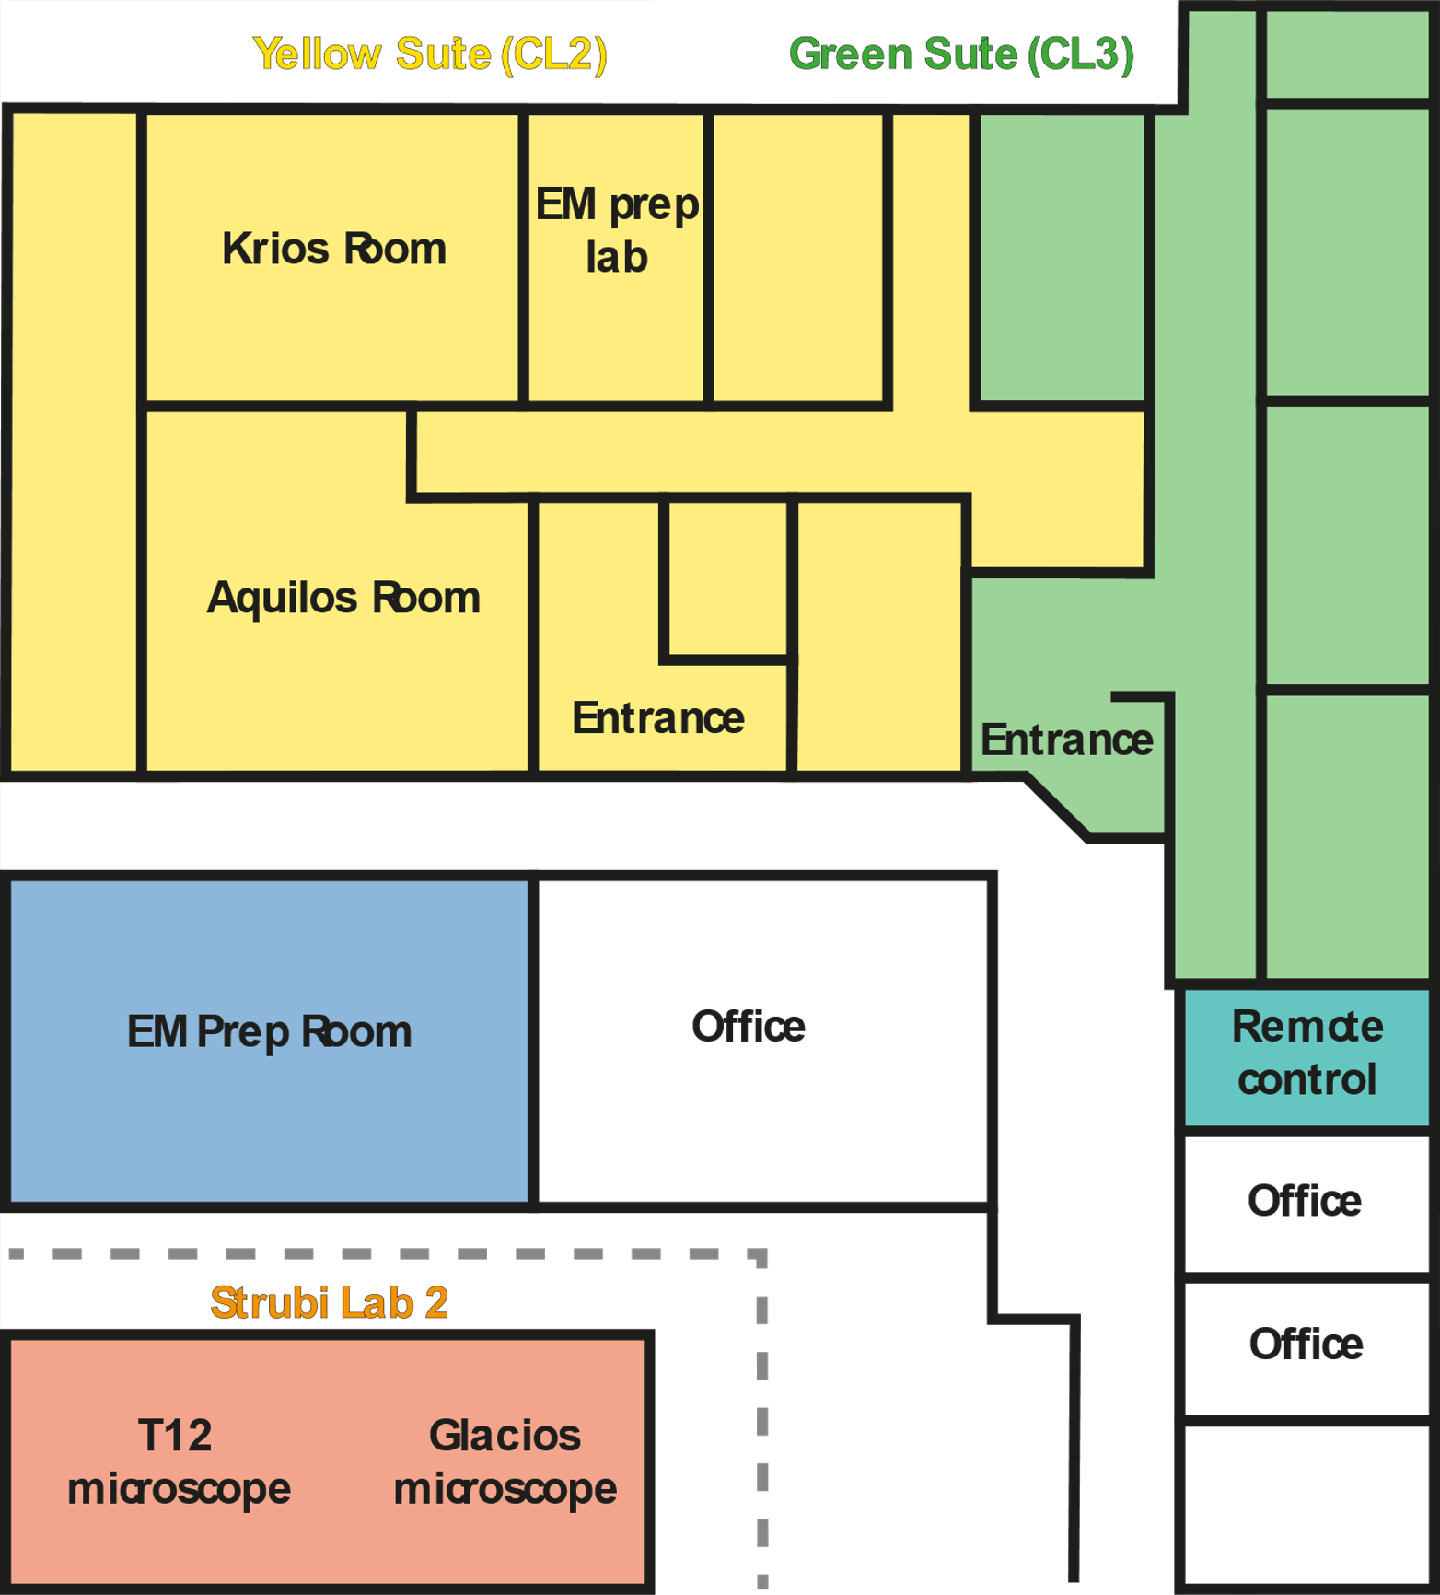
Oxford Particle Imaging Centre (OPIC) – building overview
Cryo-EM facility
Yellow suite (Cl2 pathogen)
Green suite (Cl3 pathogen)

Slide 5
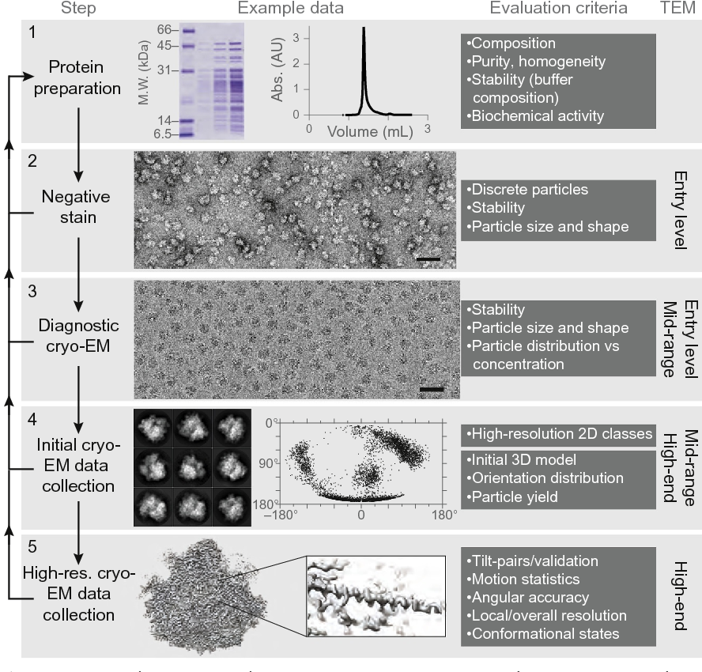
Expectations and aims of the facility
Characterization of biological samples via scanning (SEM) or transmission electron microscopy (TEM).
Get structural information at medium and high resolution of purified or in-situ protein complexes.
Sample preparation and optimization
Grid screening and initial data collection
High resolution data collection
Data processing
Passmore and Russo, 2016

Slide 6
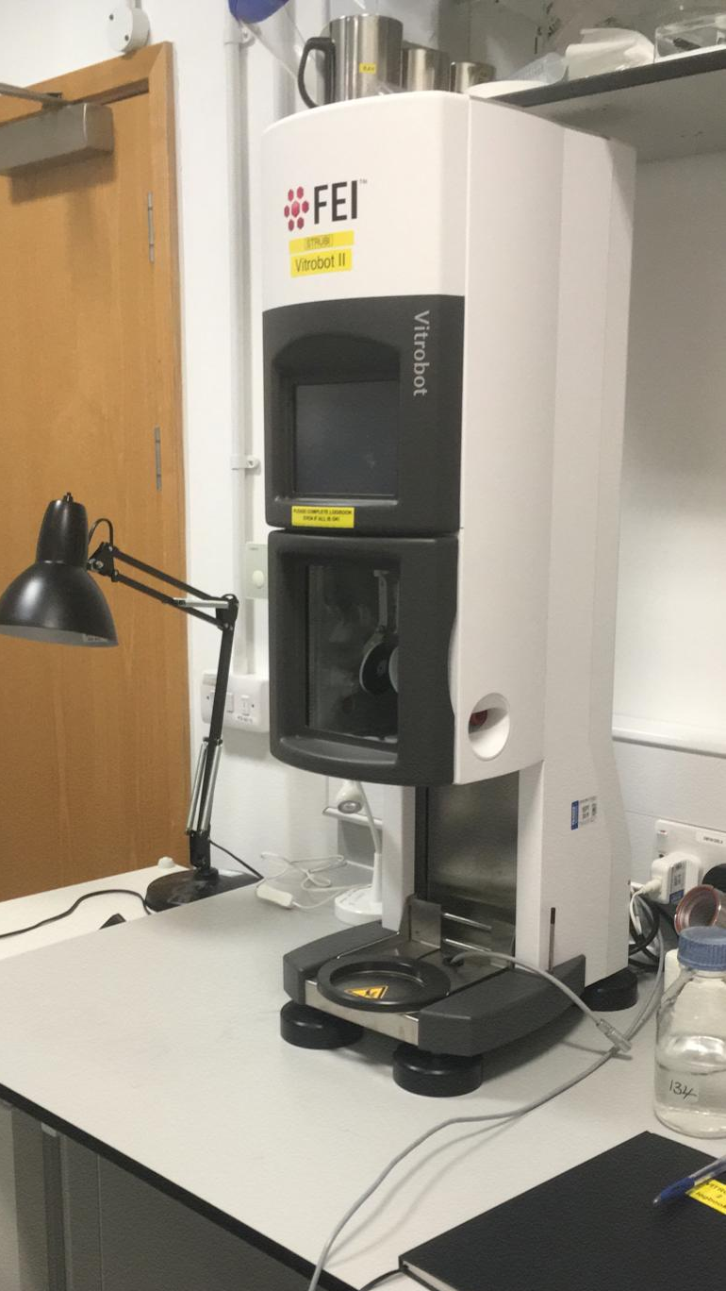
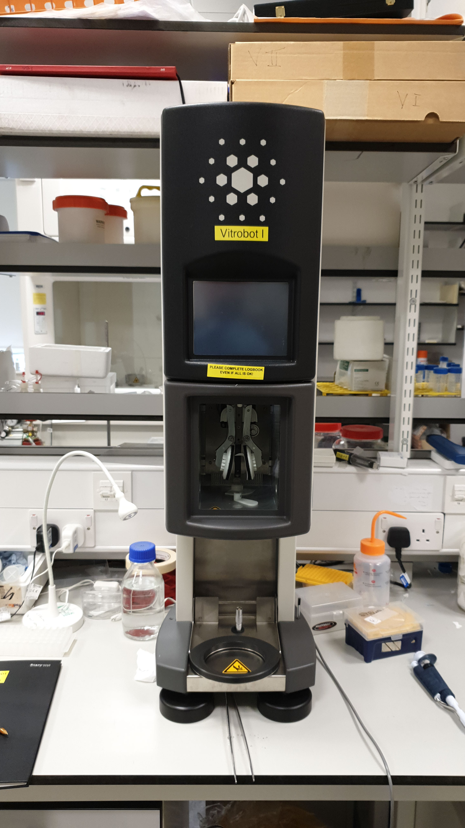
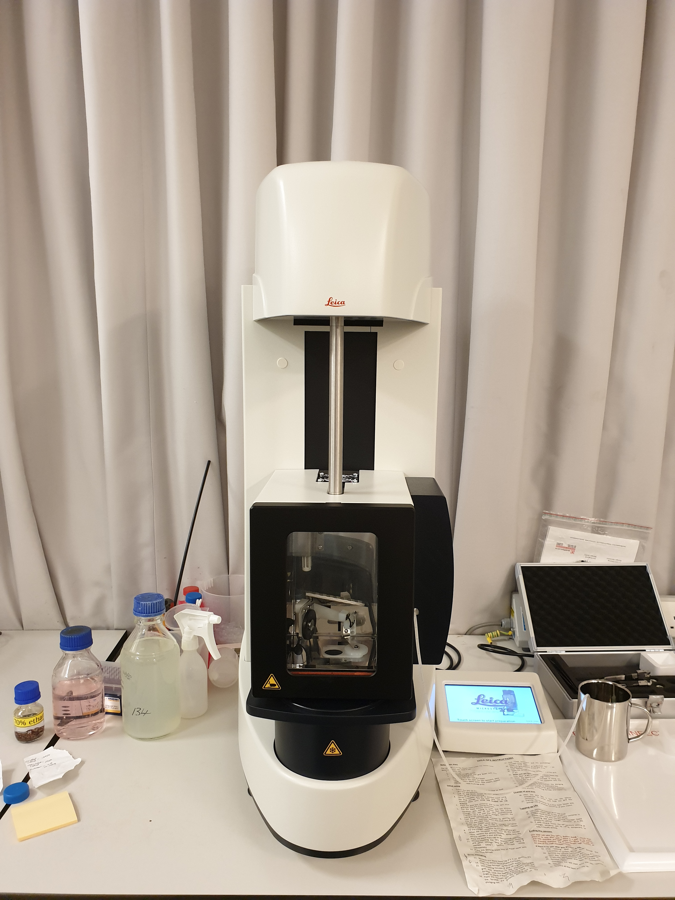
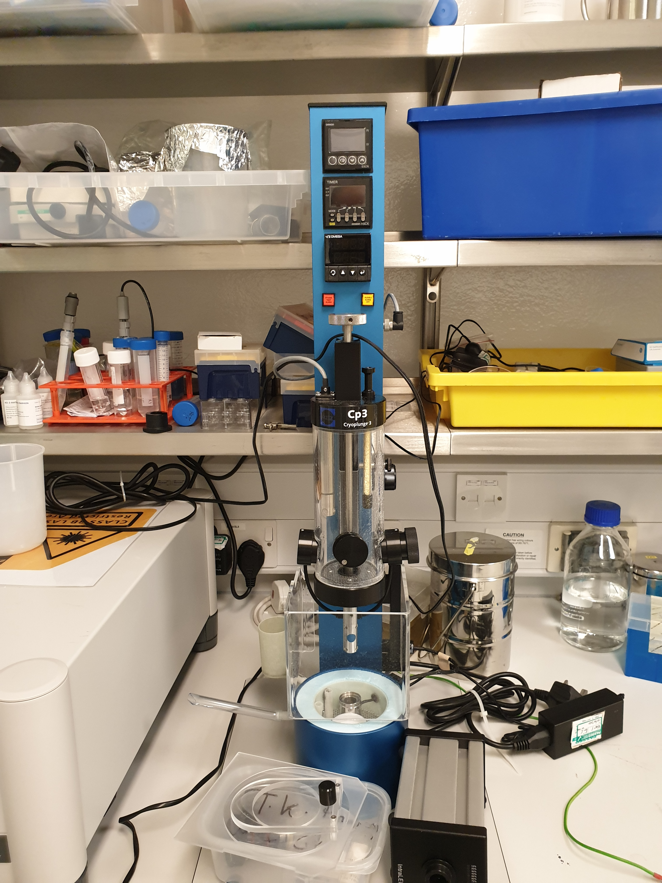
Sample preparation – Plunge freezing
Mark IV Vitrobot
Mark III Vitrobot
GP2 Leica
Gatan CP3

Slide 7
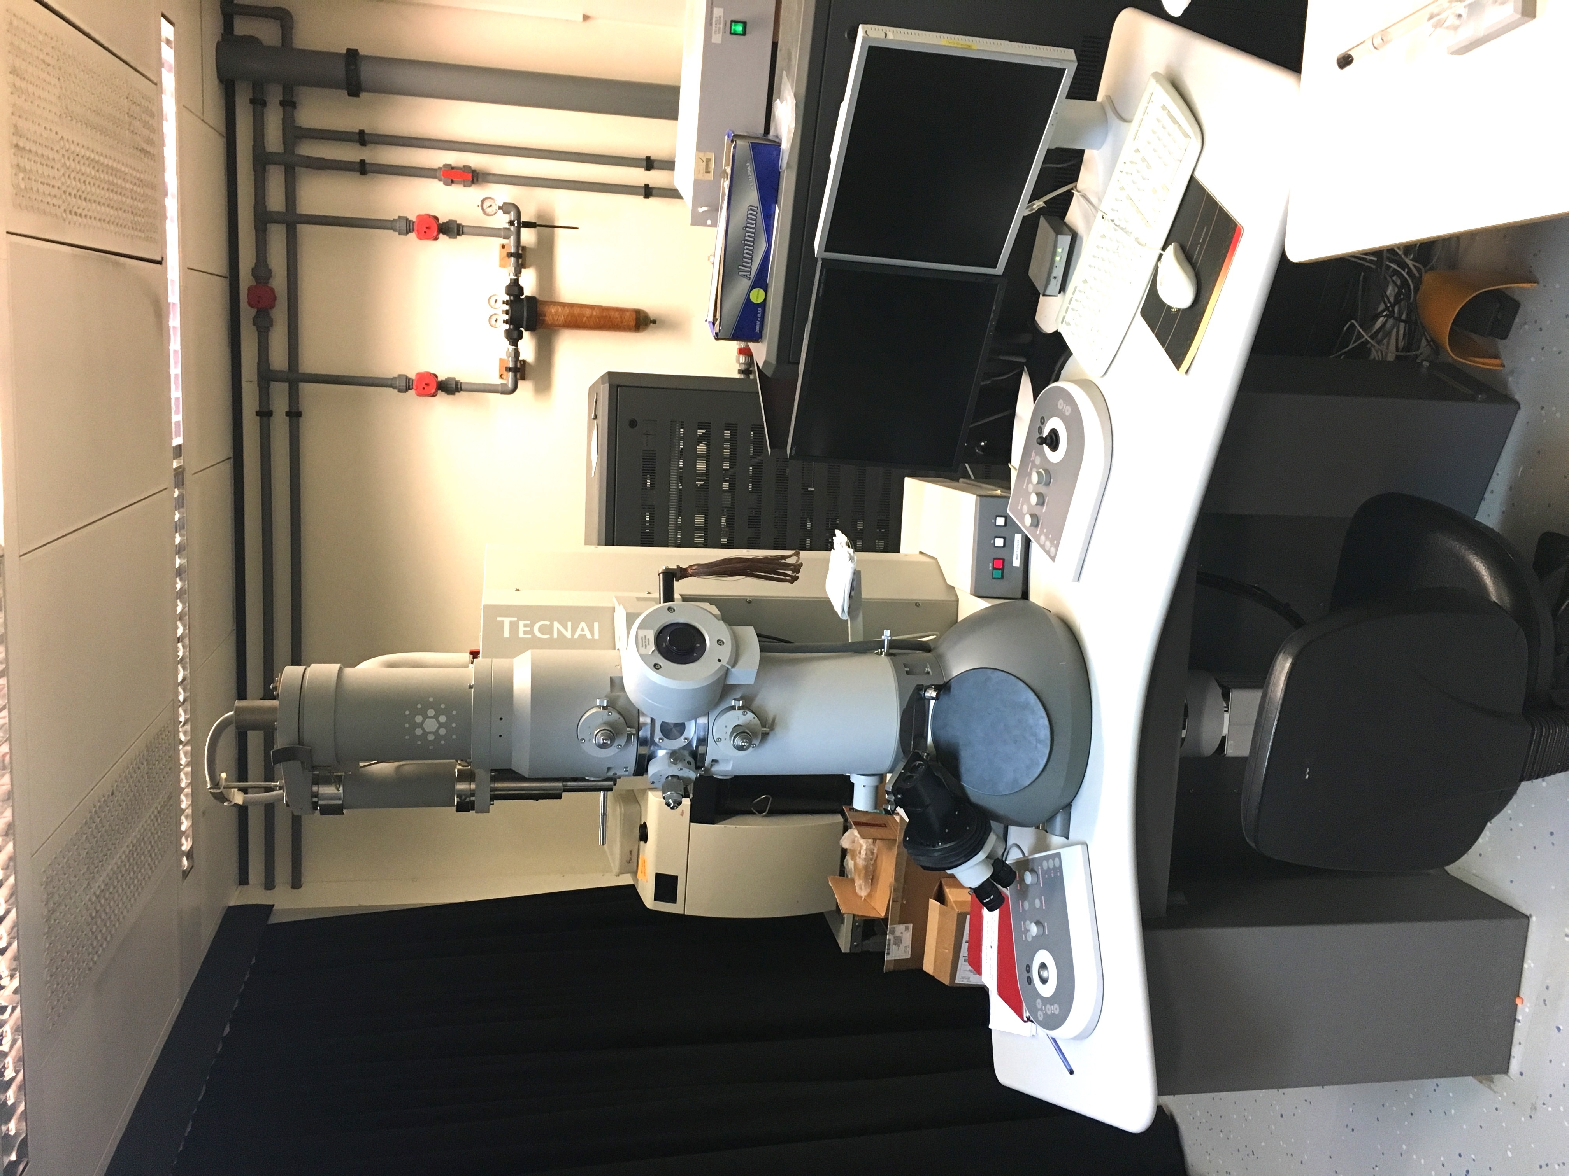
Screening of negative stain grids
Tecnai T12
Characteristics
Negative stain screening
LaB₆ filament
120 kV voltage
CCD camera
Side entry holder
Operating software
SerialEM
RETIRED

Slide 8
Negative stain data
Example of data you can get

Slide 9
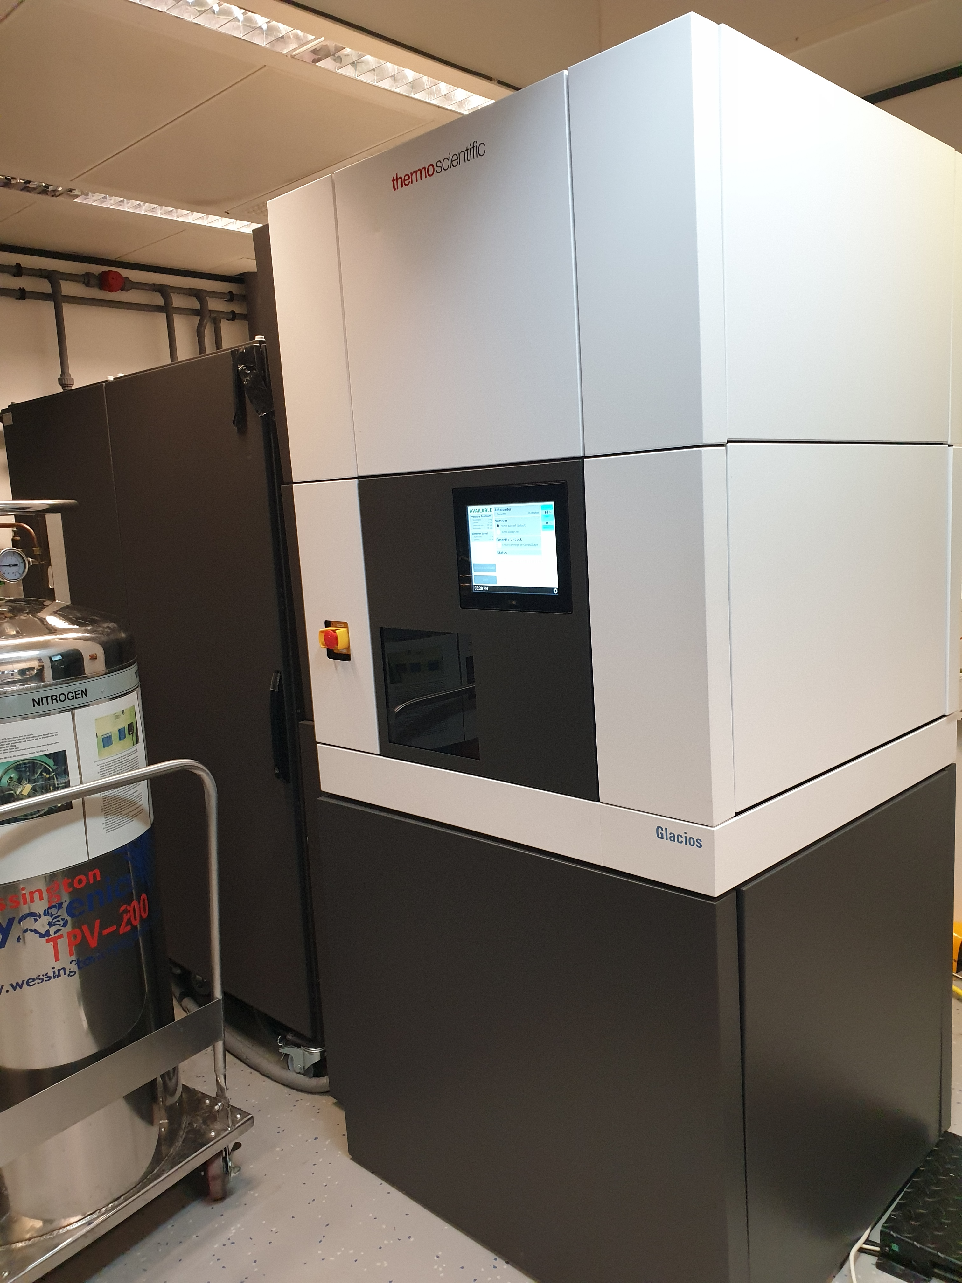
Cryo-EM – Grids screening and initial characterization
GlAcios
Characteristics
Cryo-EM data screening or collection
Field emission gun (FEG)
200 kV voltage
Autoloader (12 grids capacity)
Falcon III direct electron detector
Volta Phase Plate (VPP)
Operating software
EPU (Single Particles), Tomo5 (Tomography)

Slide 10
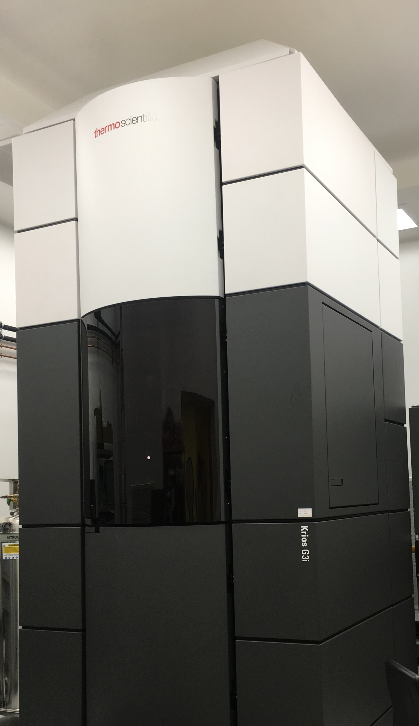
Cryo-EM - High resolution data collection
Titan Krios G3i
Characteristics
Cryo-EM data screening or collection
Field emission gun (FEG)
300 kV voltage
Autoloader (12 grids capacity)
Falcon III direct electron detector
Volta Phase Plate (VPP)
Falcon 4 and Selectris X energy filter
Operating software
EPU (Single Particles), Tomo5 (Tomography)
SerialEM (Tomography and Single Particles)

Slide 11
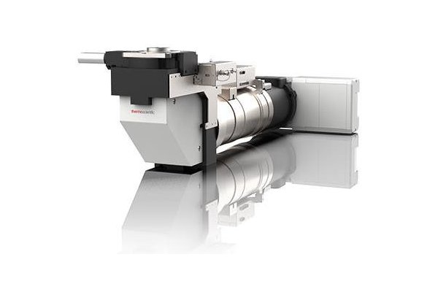
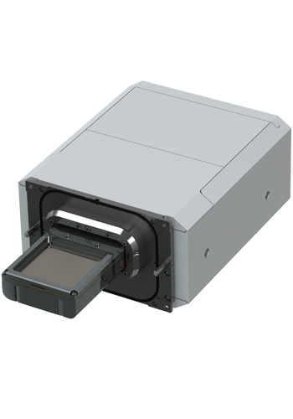
Falcon 4 and Selectris X energy filter
Selectris X Imaging Filters
Narrow (<10 eV) zero-loss energy filtering offers enhanced contrast for higher resolution reconstructions
Sophisticated aberration correction, low image distortions, and uniform energy resolution over entire field of view
Minimized sensitivity to temperature variations
Straightforward operation
Automated filter tuning completed in minutes
Falcon 4 Direct Electron Detector
High detective quantum efficiency (DQE)
High speed, routinely capable of producing 300+ movies/hour
Built-in electron event representation (EER) for full temporal resolution (240 fps to disk) - no need for fractionating at time of acquisition
Super resolution without file size penalty
Fringe-Free illumination

Slide 12
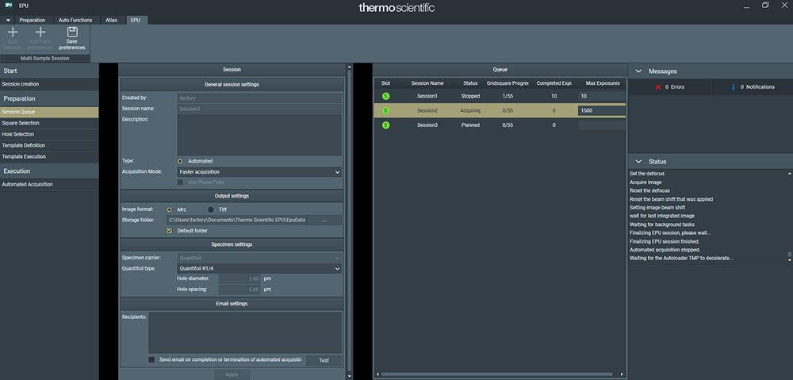
Krios and Glacios
Latest software version: EPU, MAPS, Tomo5…
Krios and Glacios will be operated with EPU --> easier for user to operate
EPU multigrids: possibility of collecting “automatically” on multiple grids without user input

Slide 13
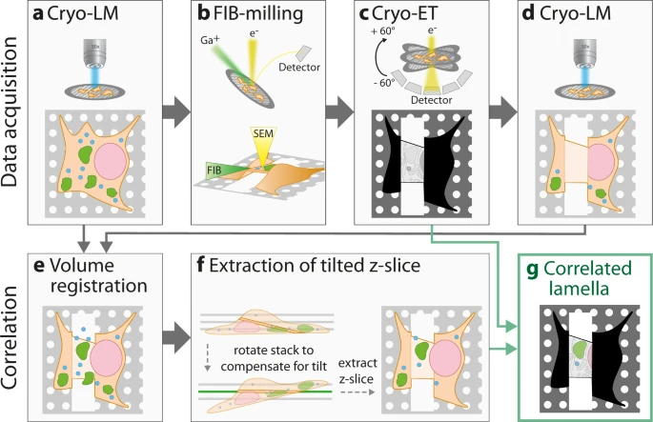
Cryo-FIB SEM – in situ structural biology
Klein et al., 2021

Slide 14
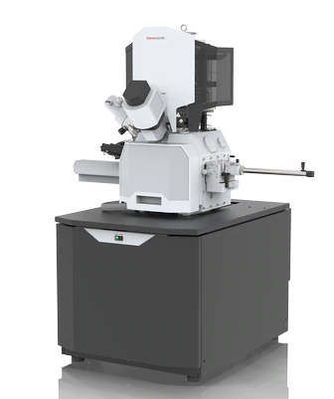
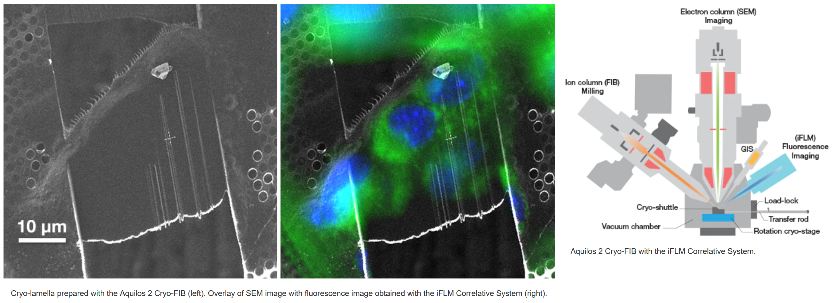
Cryo-FIB SEM – in situ structural biology
Aquilos 2 cryo-FIB SEM
It is a dual beam system dedicated to the preparation of thin, electron-transparent lamellas for high-resolution cryo-electron tomography or MicroED of micro-crystals.
iFLM (Integrated Fluorescence Light Microscope)
Correlative System localizes fluorescent targets inside the chamber
Allows to correlate two imaging modalities within one system, ensuring the sample is in the right location.
https://www.thermofisher.com

Slide 15
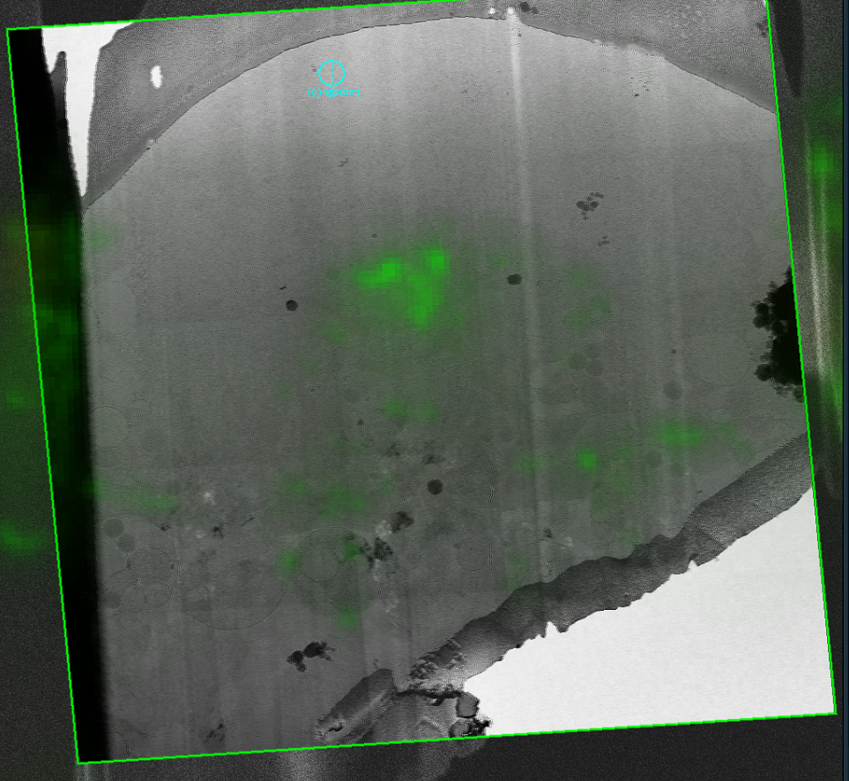
Cryo-FIB SEM – in situ structural biology

Slide 16
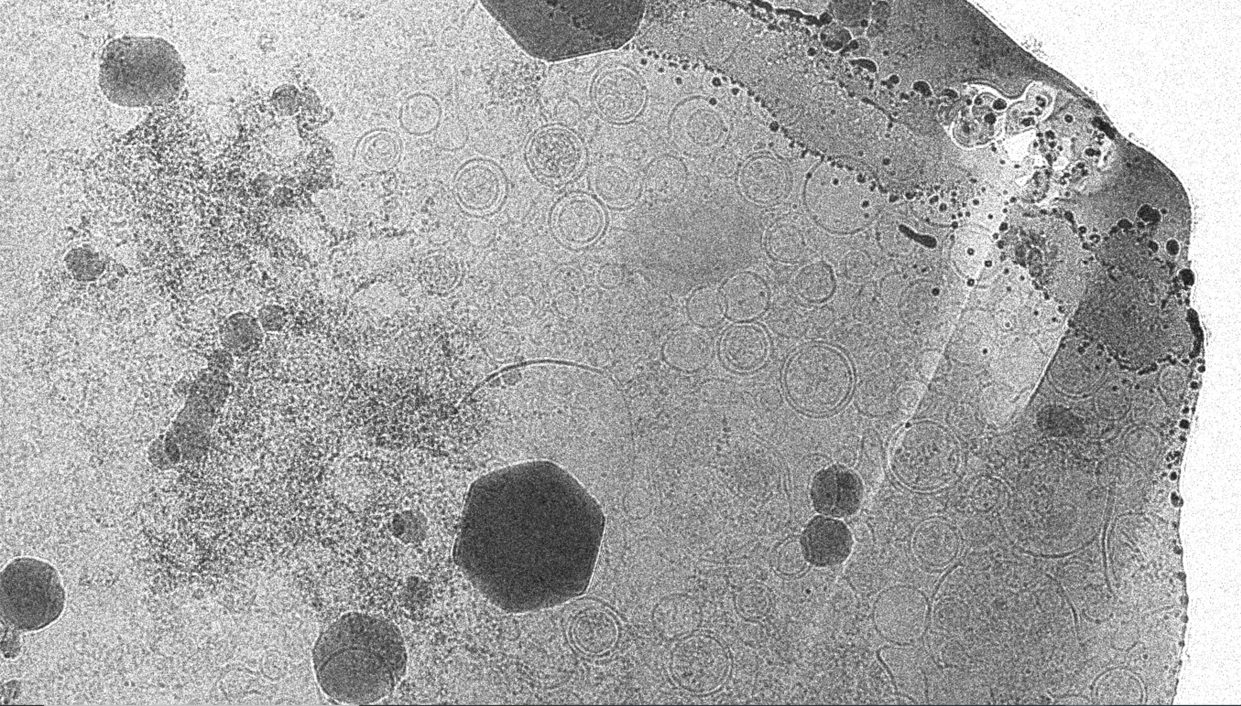
Cryo-FIB SEM – in situ structural biology

Slide 17
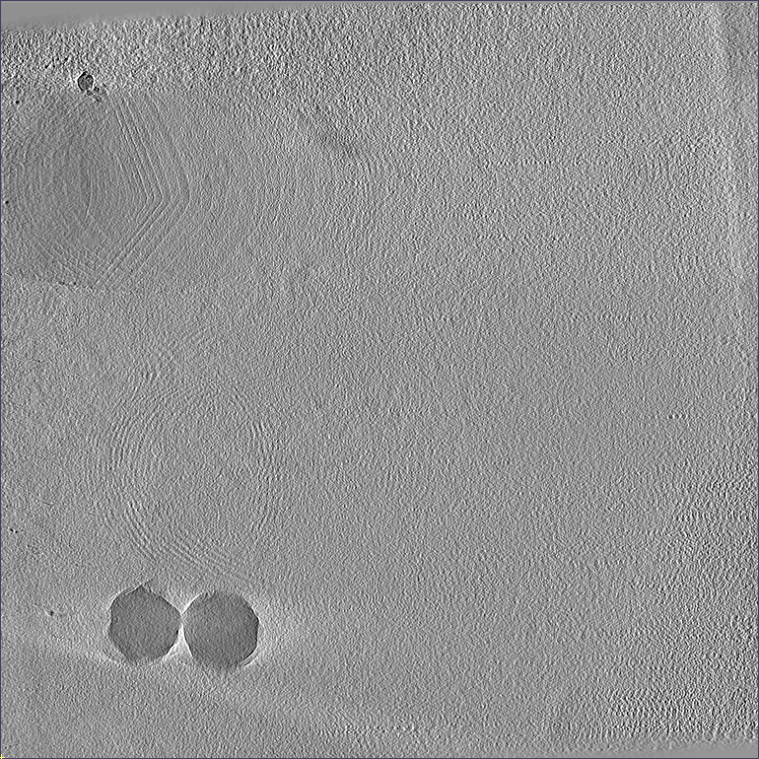
Cryo-FIB SEM – in situ structural biology

Slide 18
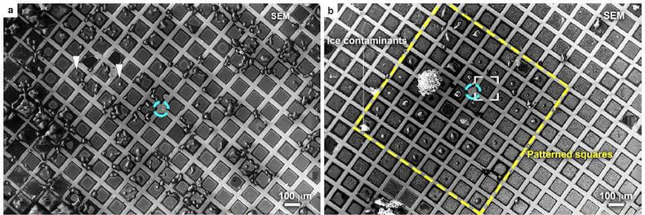
Grid micropatterning – PRIMO system
Precise cell positioning: automatic alignment within the mesh of EM grids!
Optimized cell spreading: reduced thickness for more efficient CLEM and cryo-ET workflows
Standardized cell models: reproducible micropatterning for mechanobiology studies
Undamaged surface: contactless micropatterning preserving the EM grid surface integrity
Without Micropatterning
With Micropatterning

Slide 19
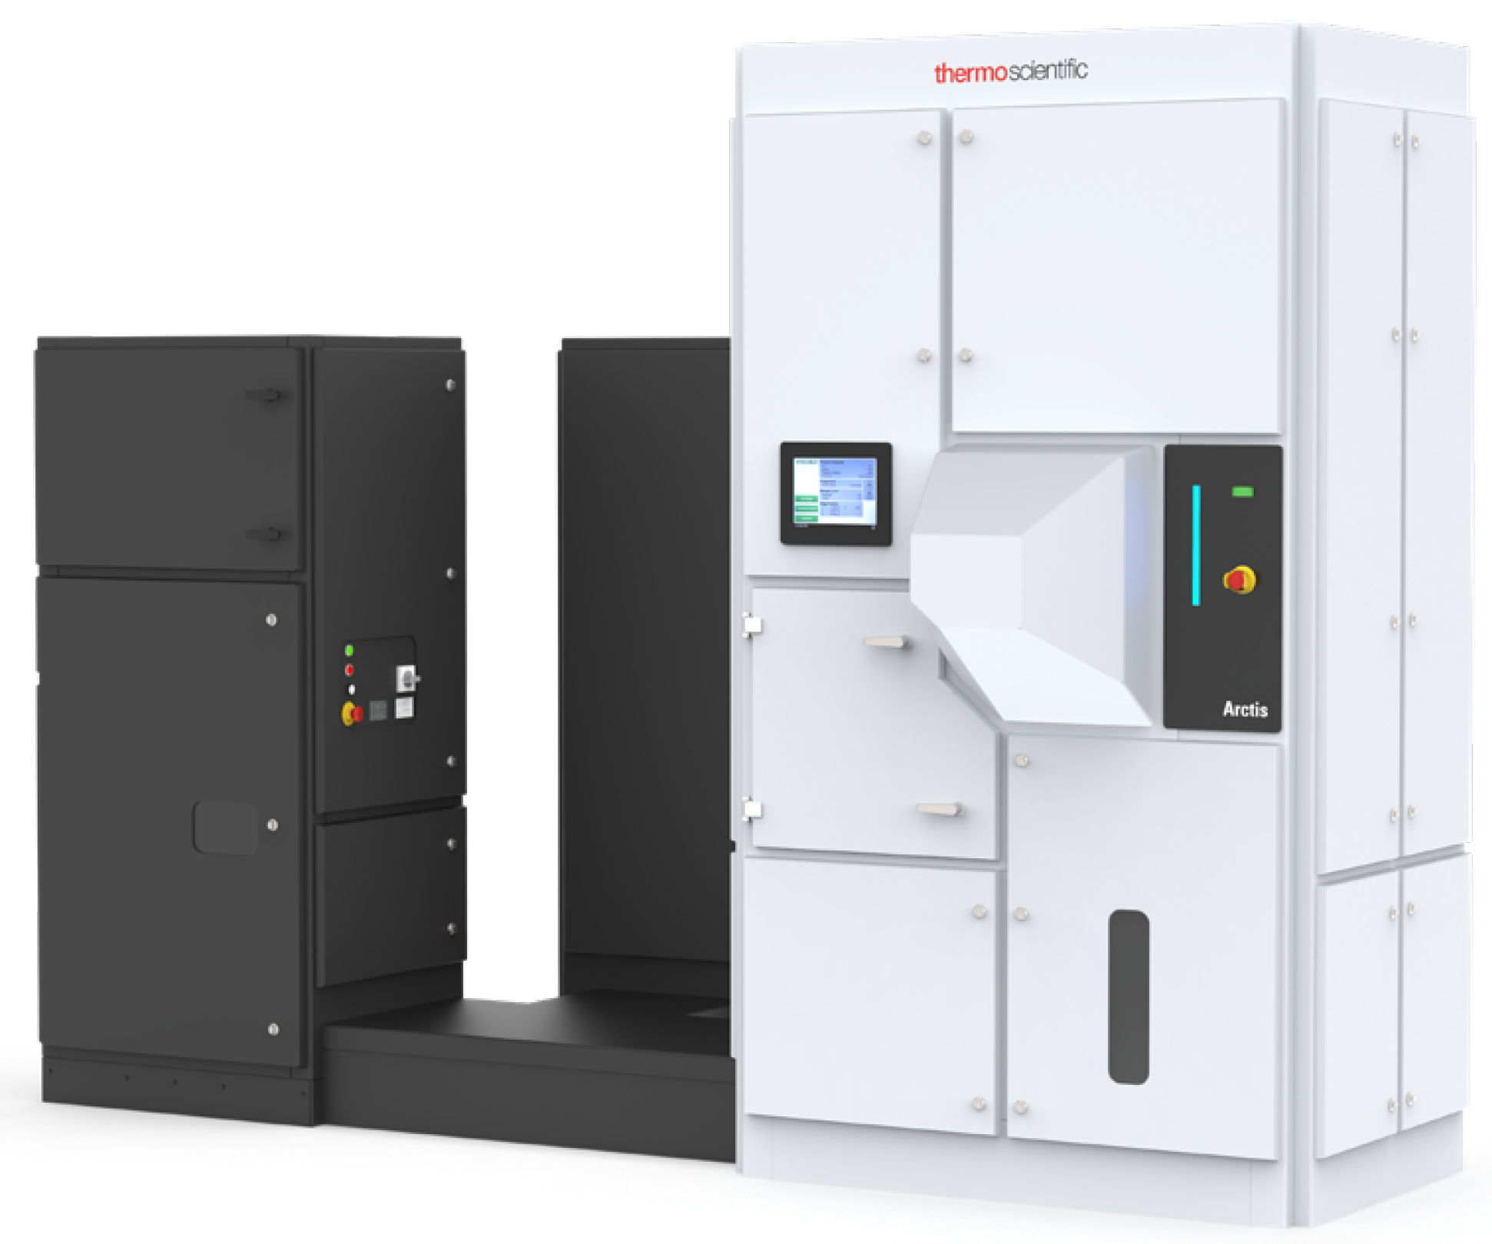
Cryo-FIB SEM – in situ structural biology (Summer 2023)
Arctis plasma-FIB SEM
Plasma beam with 3 ion species: Xenon, argon, oxygen.
Triple beam coincidence at sample position for photons, electrons, and ions.
Autoloader and CompuStage similar to Glacios and Krios microscope
Integrated Fluorescence Light Microscope
Correlative System localizes fluorescent targets inside the chamber
Allows to correlate two imaging modalities within one system, ensuring the sample is in the right location.
Equiped with a 100x Zeiss Epiplan Neofluar NA 0.75; Piezo-driven
https://www.thermofisher.com

Slide 20

Oxford Particle Imaging Centre (OPIC) – building overview
Cryo-EM facility
Yellow suite (Cl2 pathogen)
Green suite (Cl3 pathogen)
Cl3 capable

Slide 21
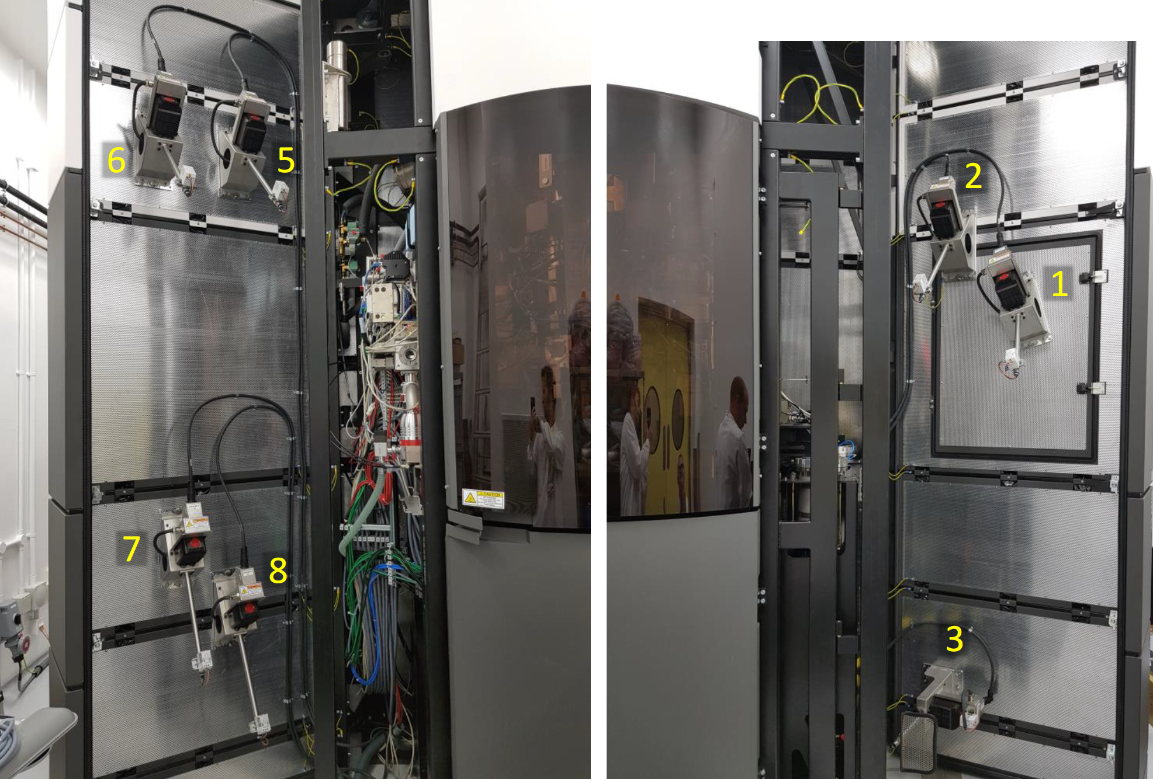
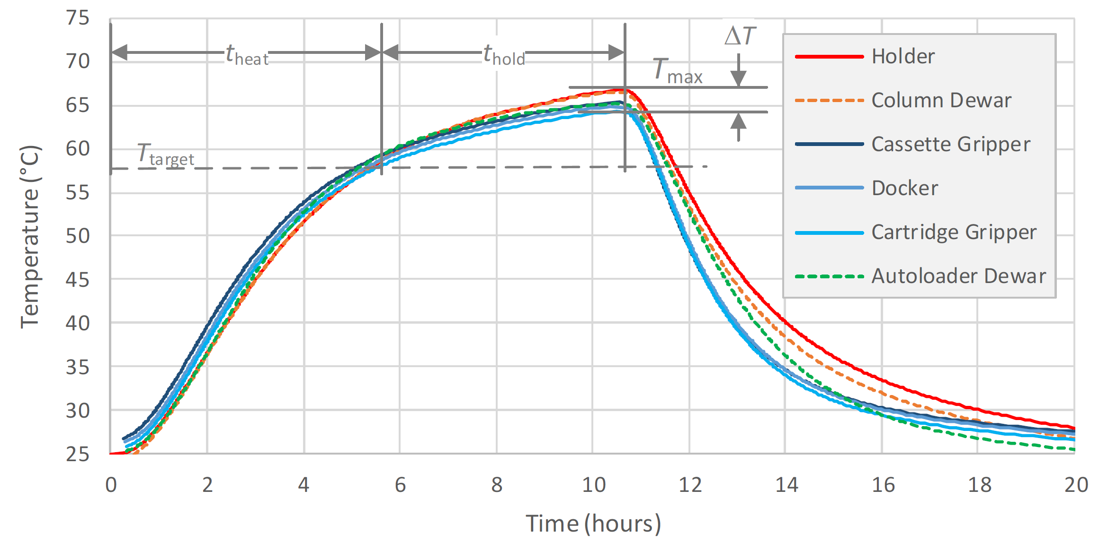
Imaging live BSL-2 and BSL3 pathogens
Heaters for 60°C heating decontaminations of the microscopes

Slide 22
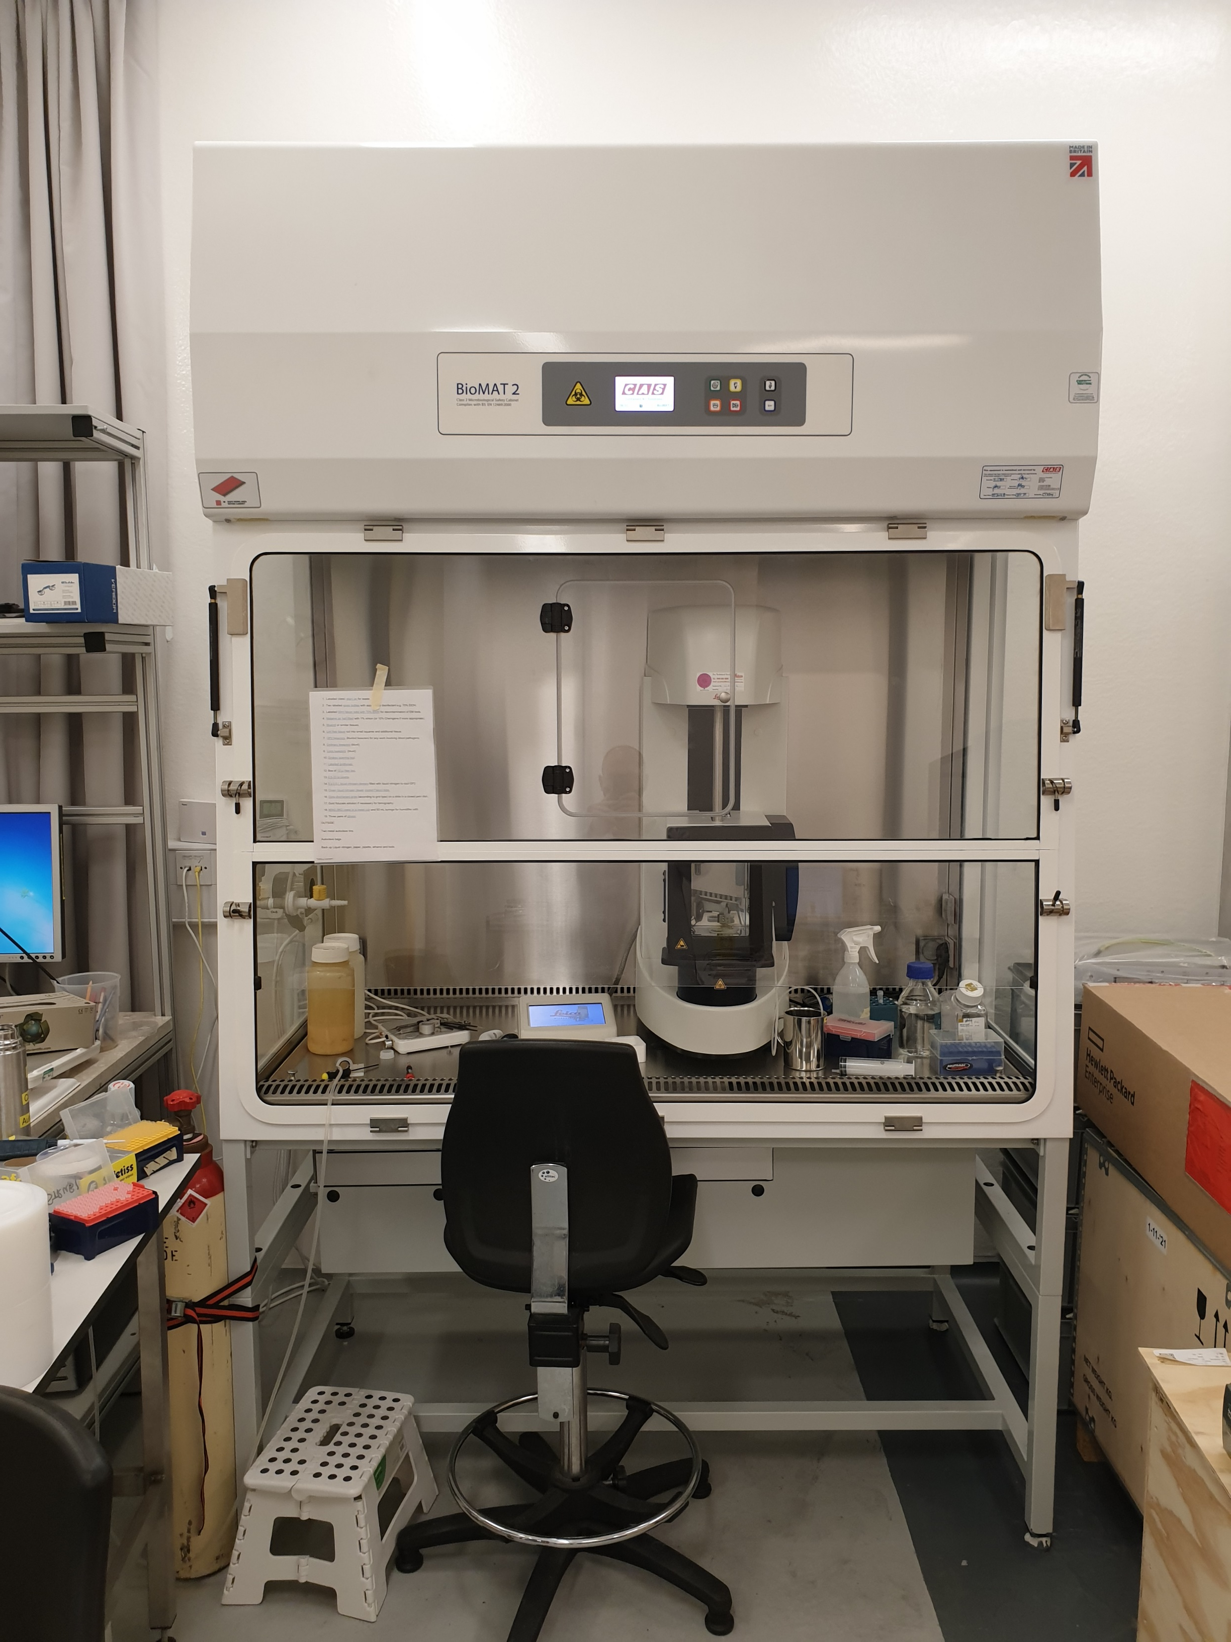
Imaging BSL-2 and BSL-3 pathogens
Pathogen decontamination approval: Needs to be done for every pathogen.
Pathogens have to die after a certain period time at room temperature or being heated at 60°C.
Sample preparation and grid plunging: In Class II safety cabinet.
If decontamination at room temperature efficient: possibility to use either the Aquilos or Krios for both Cl2 and CL3 pathogens and Glacios for Cl2.
If only decontamination at 60°C efficient: only use of the Krios for both Cl2 and CL3 pathogens.

Slide 23
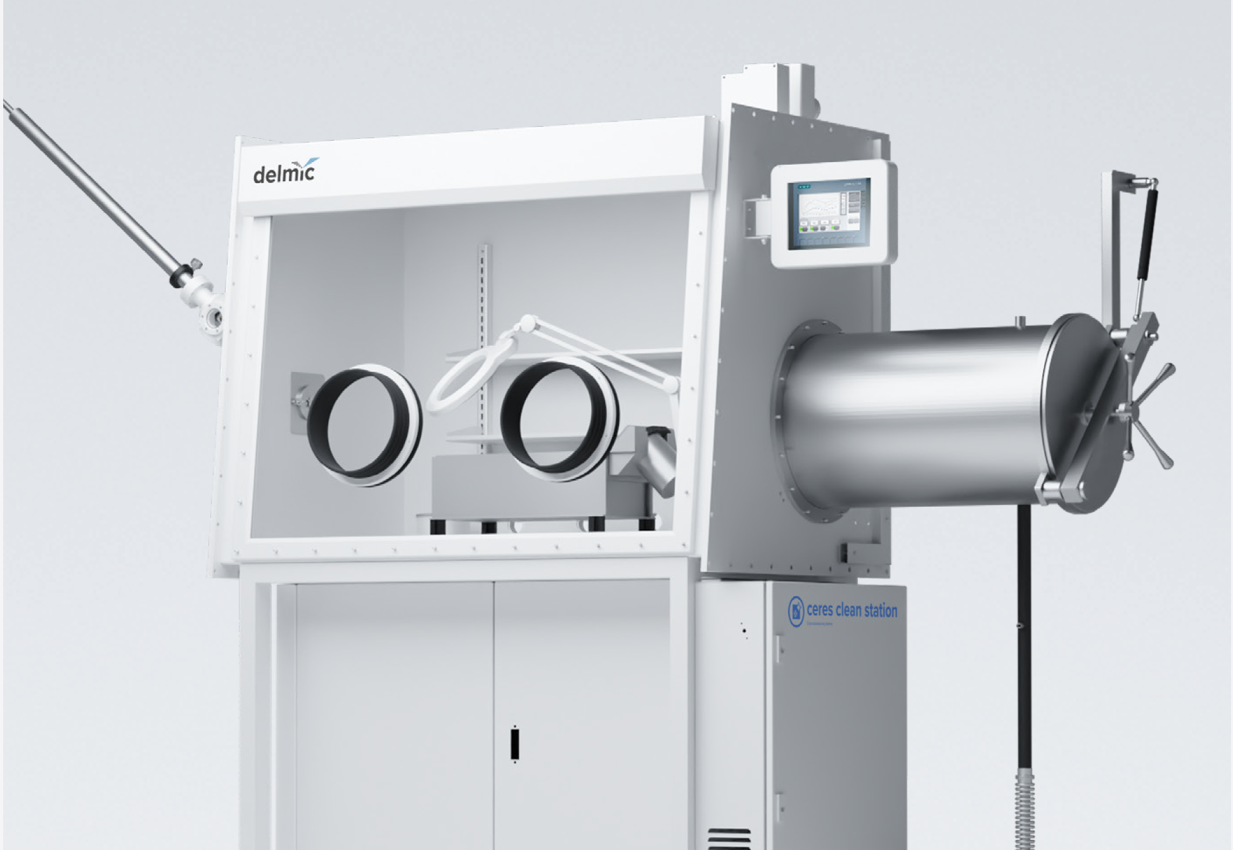
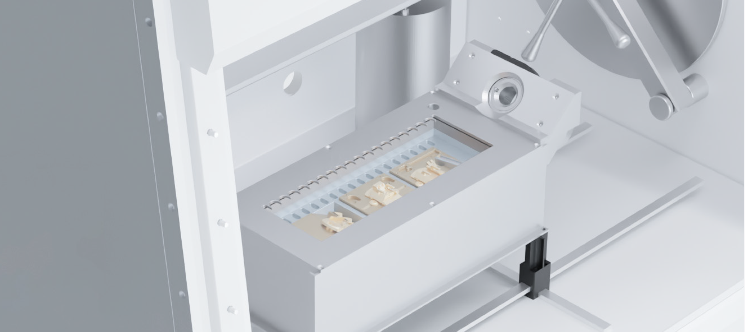
CERES clean station – Delmic (Delivery for summer 2023)
Glove-box specifically designed for cryo-ET workflow.
Reduce most of the ice contamination by operating under dry nitrogen atmosphere.
Re-circulating air through HEPA filter compatible with handling CL2/Cl3 pathogen.
Allow samples loading in both the Aquilos 2 and the Krios.
Loading tray heating up to 60 degrees for decontamination.

Slide 24
Expectations and aims of the facility
Characterization of biological samples via scanning (SEM) or transmission electron microscopy (TEM).
Get structural information at medium and high resolution of purified or in-situ protein complexes.
Sample preparation and optimization
Vitrobots, Gatan’s CP3 and Leica GP2
Grid screening and initial data collection
Glacios microscope
High resolution data collection
Krios microscope
In-situ FIB-SEM and soon CLEM
Aquilos2 & Arctis microscope
Data processing
Rescomp cluster, cryosparc, relion…
User training
Getting users independent for all steps
Passmore and Russo, 2016

Slide 25
Getting access to cryo-EM
To start a project or if you need support get in contact:
emsupport@strubi.ox.ac.uk (All staff members)
Instruments booking through an Aria calendar:
https://instruct-eric.eu/register/
embookings@strubi.ox.ac.uk
Instructs-ERIC
Researchers from countries member of Instruct
Peer-reviewed access
Price of the data collection subsidized
eBIC
As part of the old road campus BAG, send request to Jonathan Grimes
Through rapid access
Price of the data collection subsidized

Slide 26
Loic Carrique
(loic@strubi.ox.ac.uk)
Facilities talks 1st Feb 2023

