Slide 1





Loic Carrique
(loic@strubi.ox.ac.uk)
Facilities talks 27th Jan 2022

Slide 2
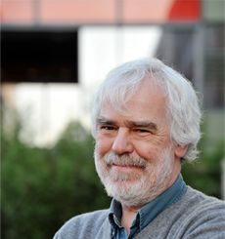
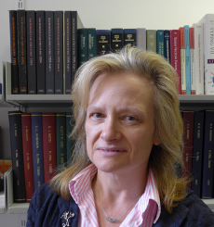
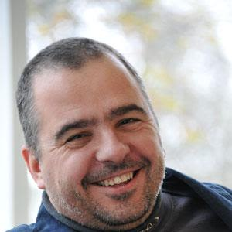



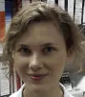
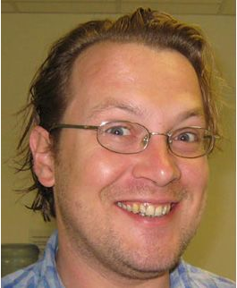



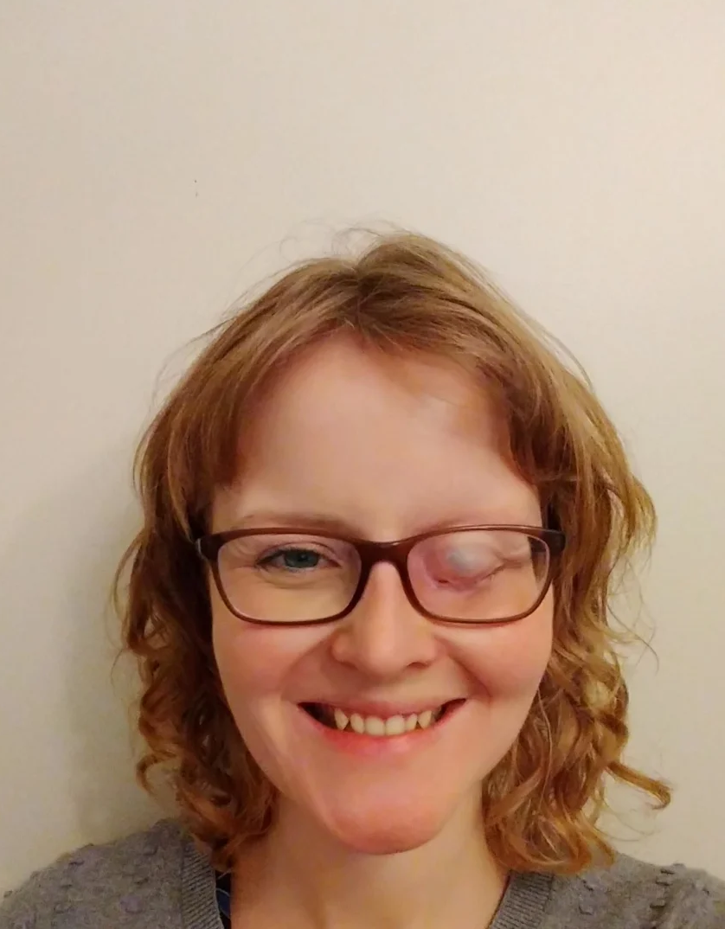
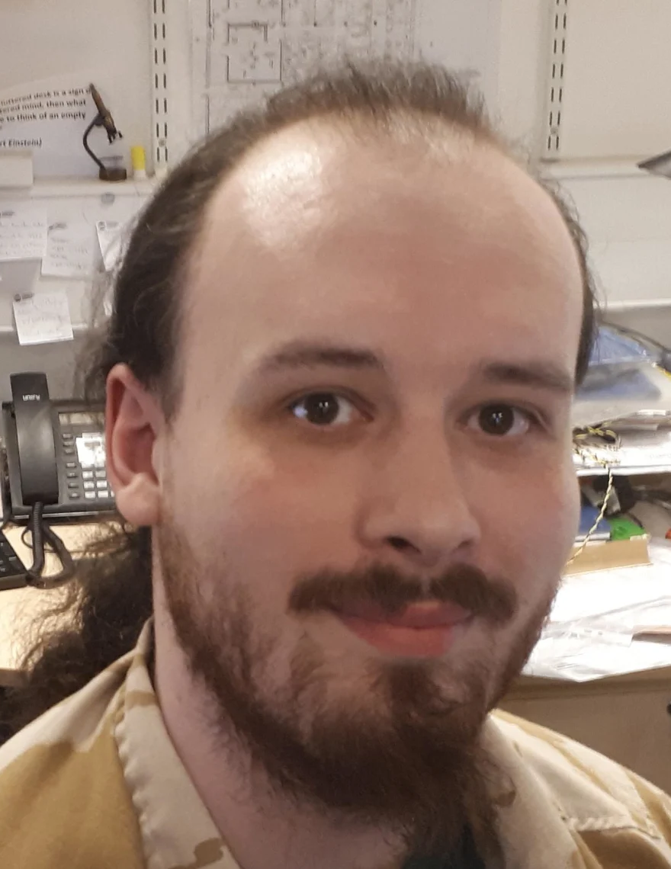
Oxford Particle Imaging Centre (OPIC)
Management
Admin
Dave Stuart
Yvonne Jones
Jonathan Grimes
Claire Morris
Melissa Matthews
Agata Krupa
Staff and Facility Support
Helen
Duyvesteyn
Tom
Walter
Elizabeth
MacLean
Karl
Harlos
Loic
Carrique
Mhairi
Ferguson
Benjamin Edwards

Slide 3
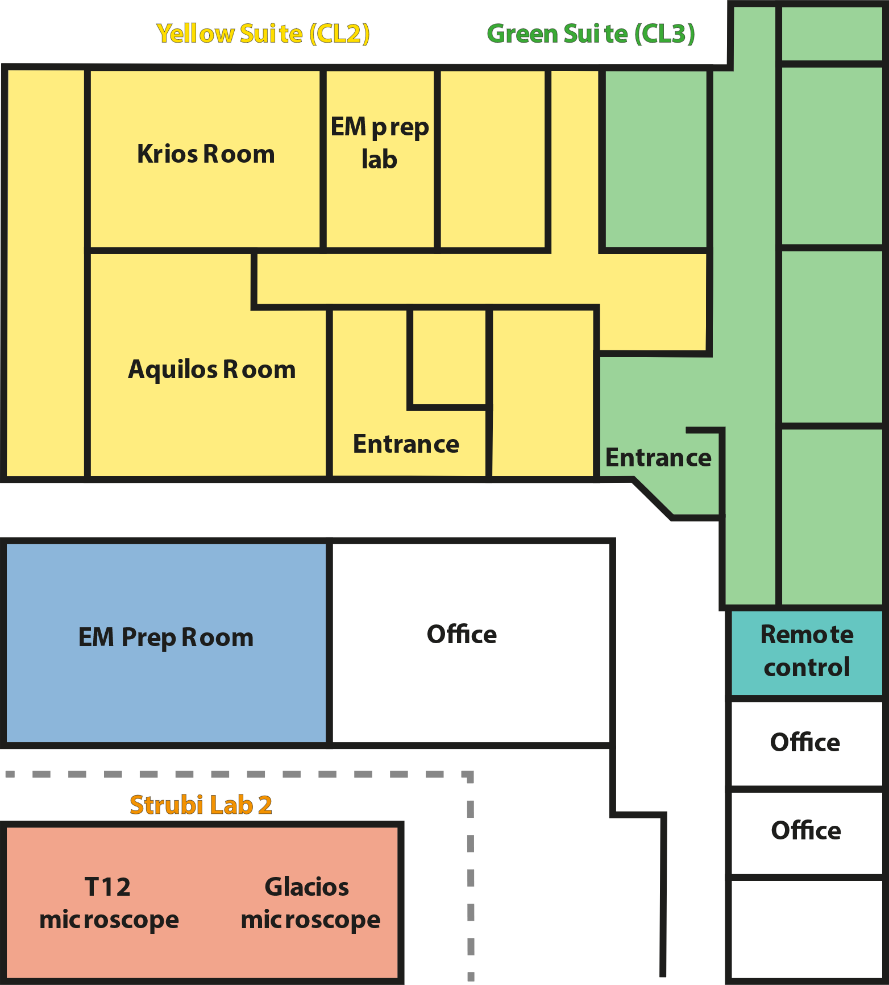
Oxford Particle Imaging Centre (OPIC) – building overview
Cryo-EM facility
Yellow suite (Cl2 pathogen)
Green suite (Cl3 pathogen)

Slide 4
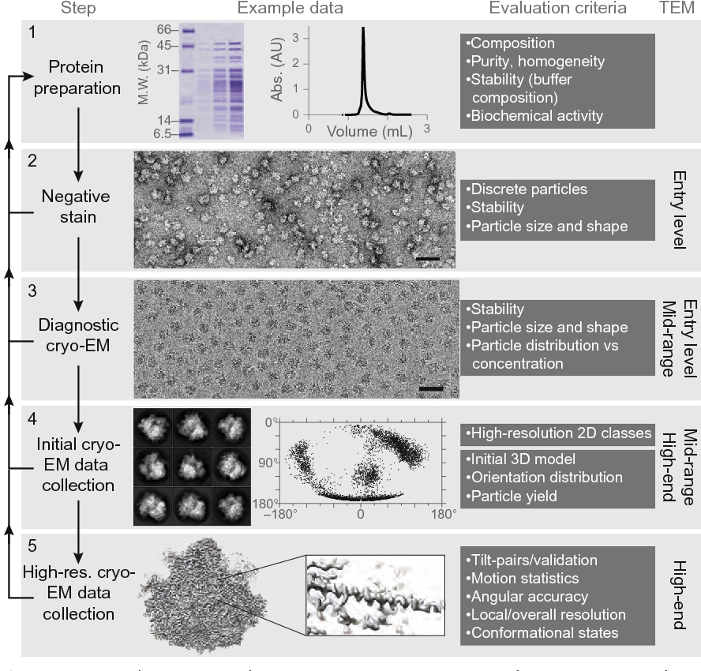
Expectations and aims of the facility
Characterization of biological samples via scanning (SEM) or transmission electron microscopy (TEM).
Get structural information at medium and high resolution of purified or in-situ protein complexes.
Sample preparation and optimization
Grid screening and initial data collection
High resolution data collection
Data processing
Passmore and Russo, 2016

Slide 5
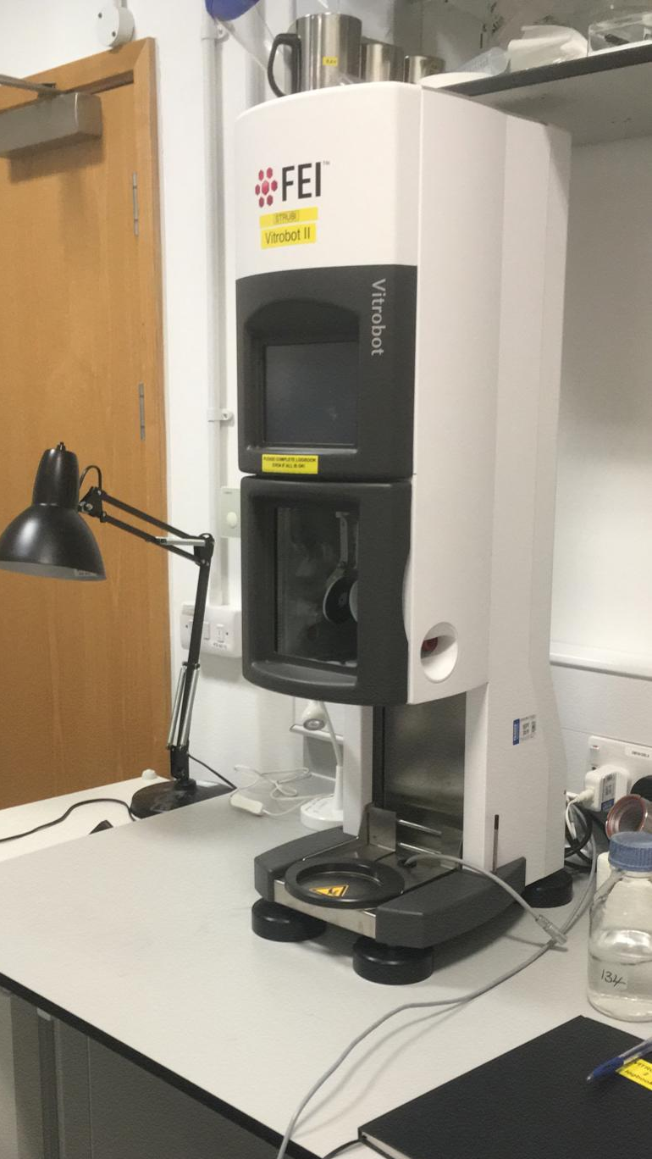
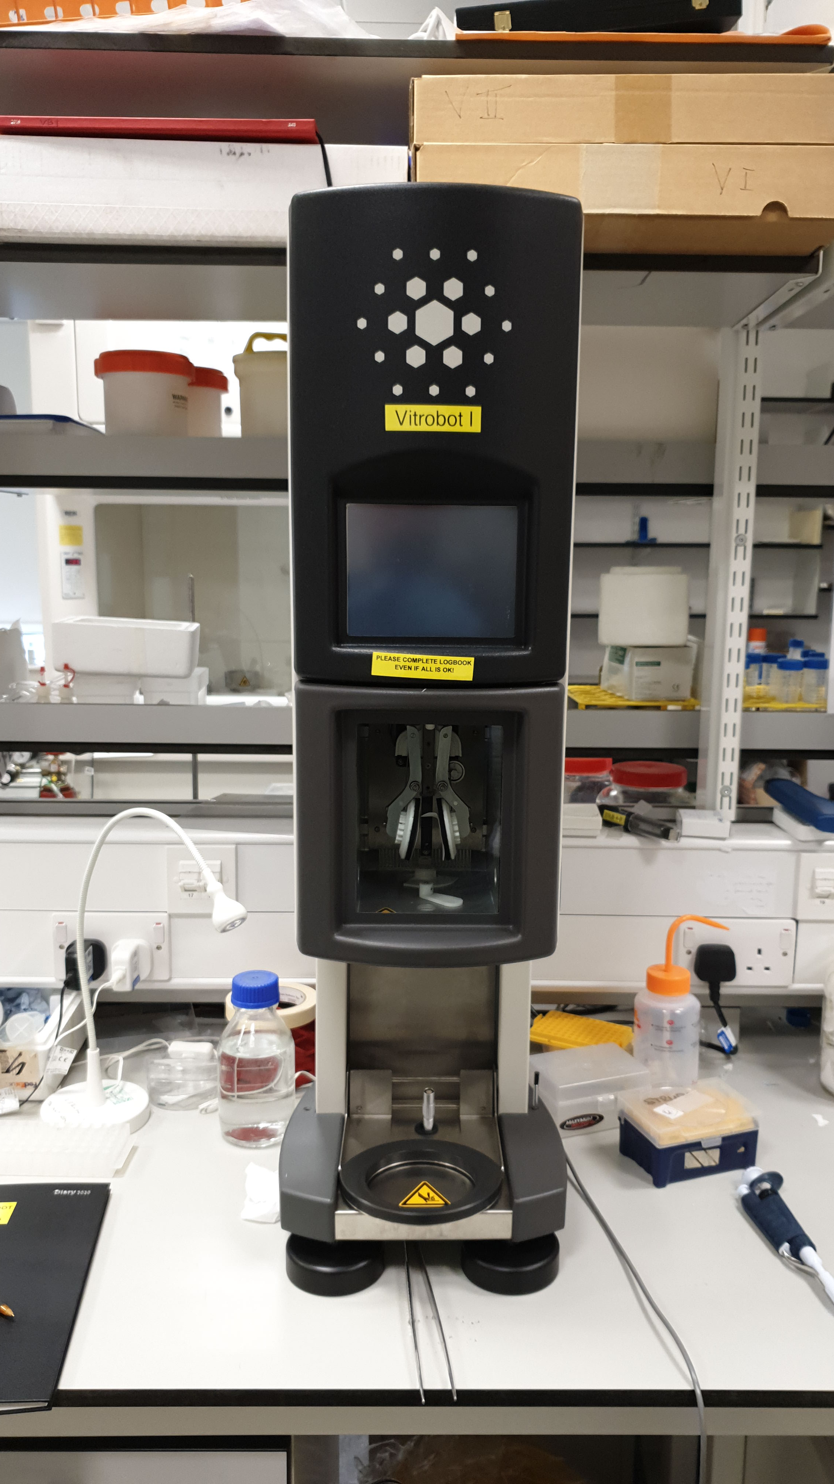
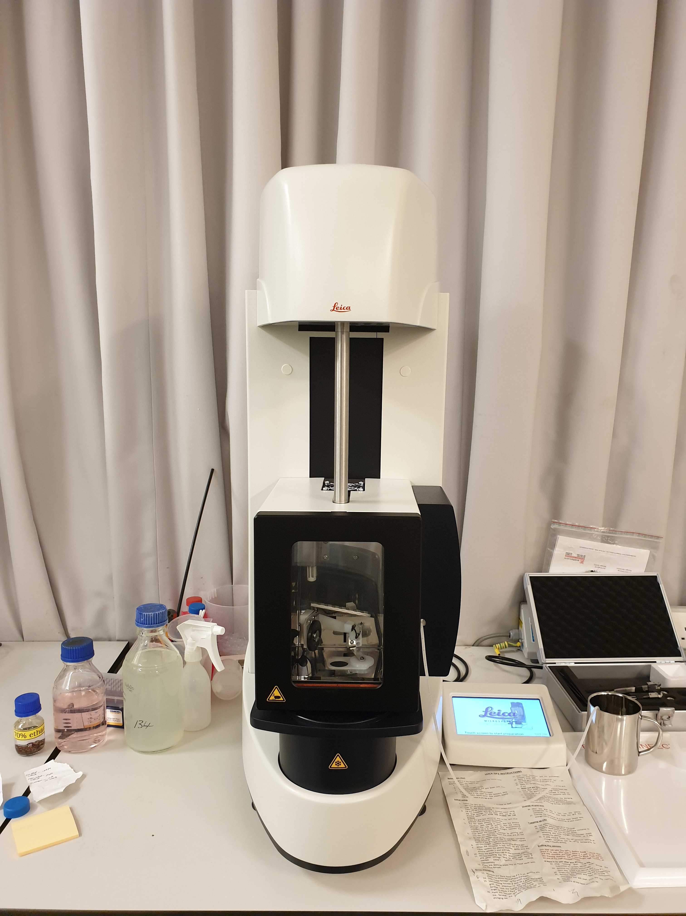
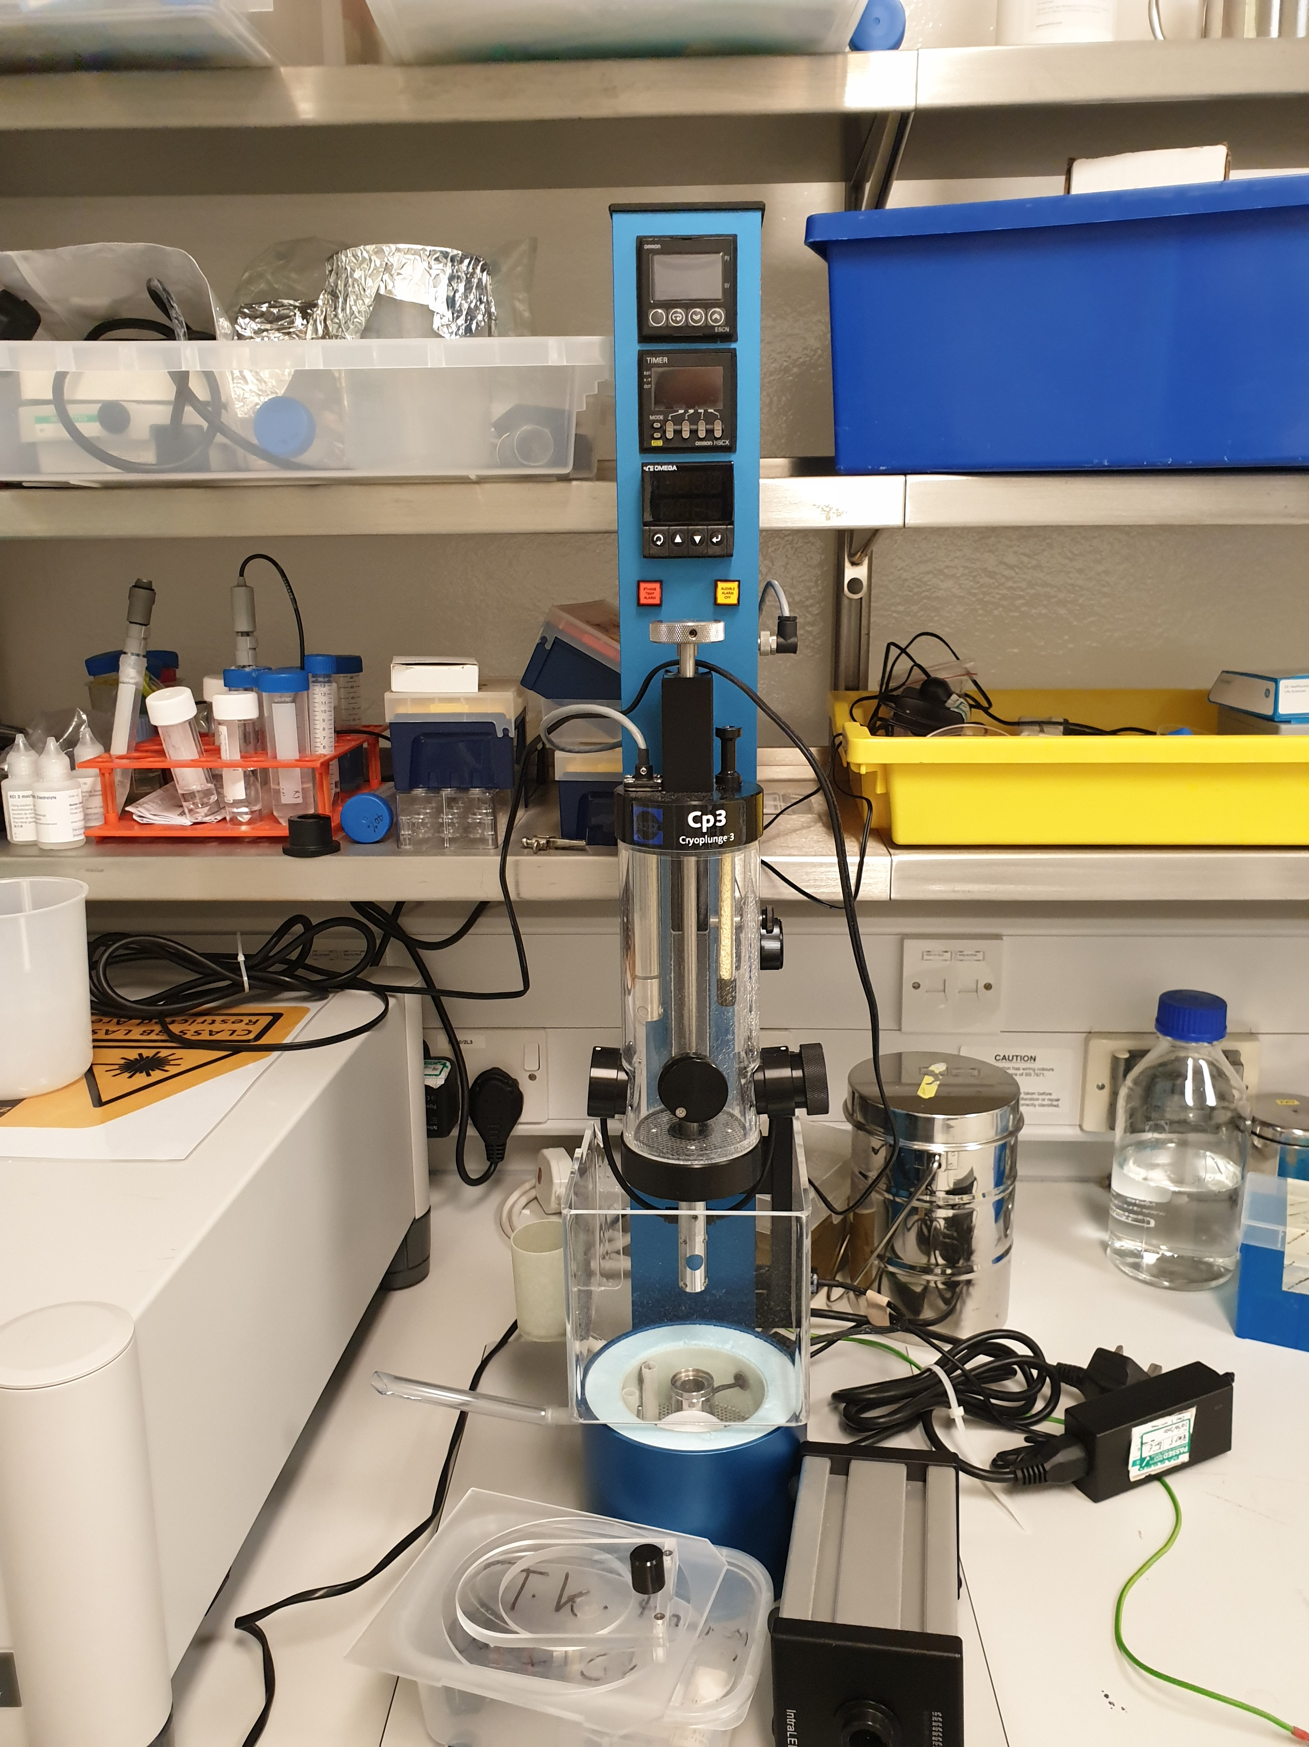
Sample preparation – Plunge freezing
Mark IV Vitrobot
Mark III Vitrobot
GP2 Leica
Gatan CP3

Slide 6
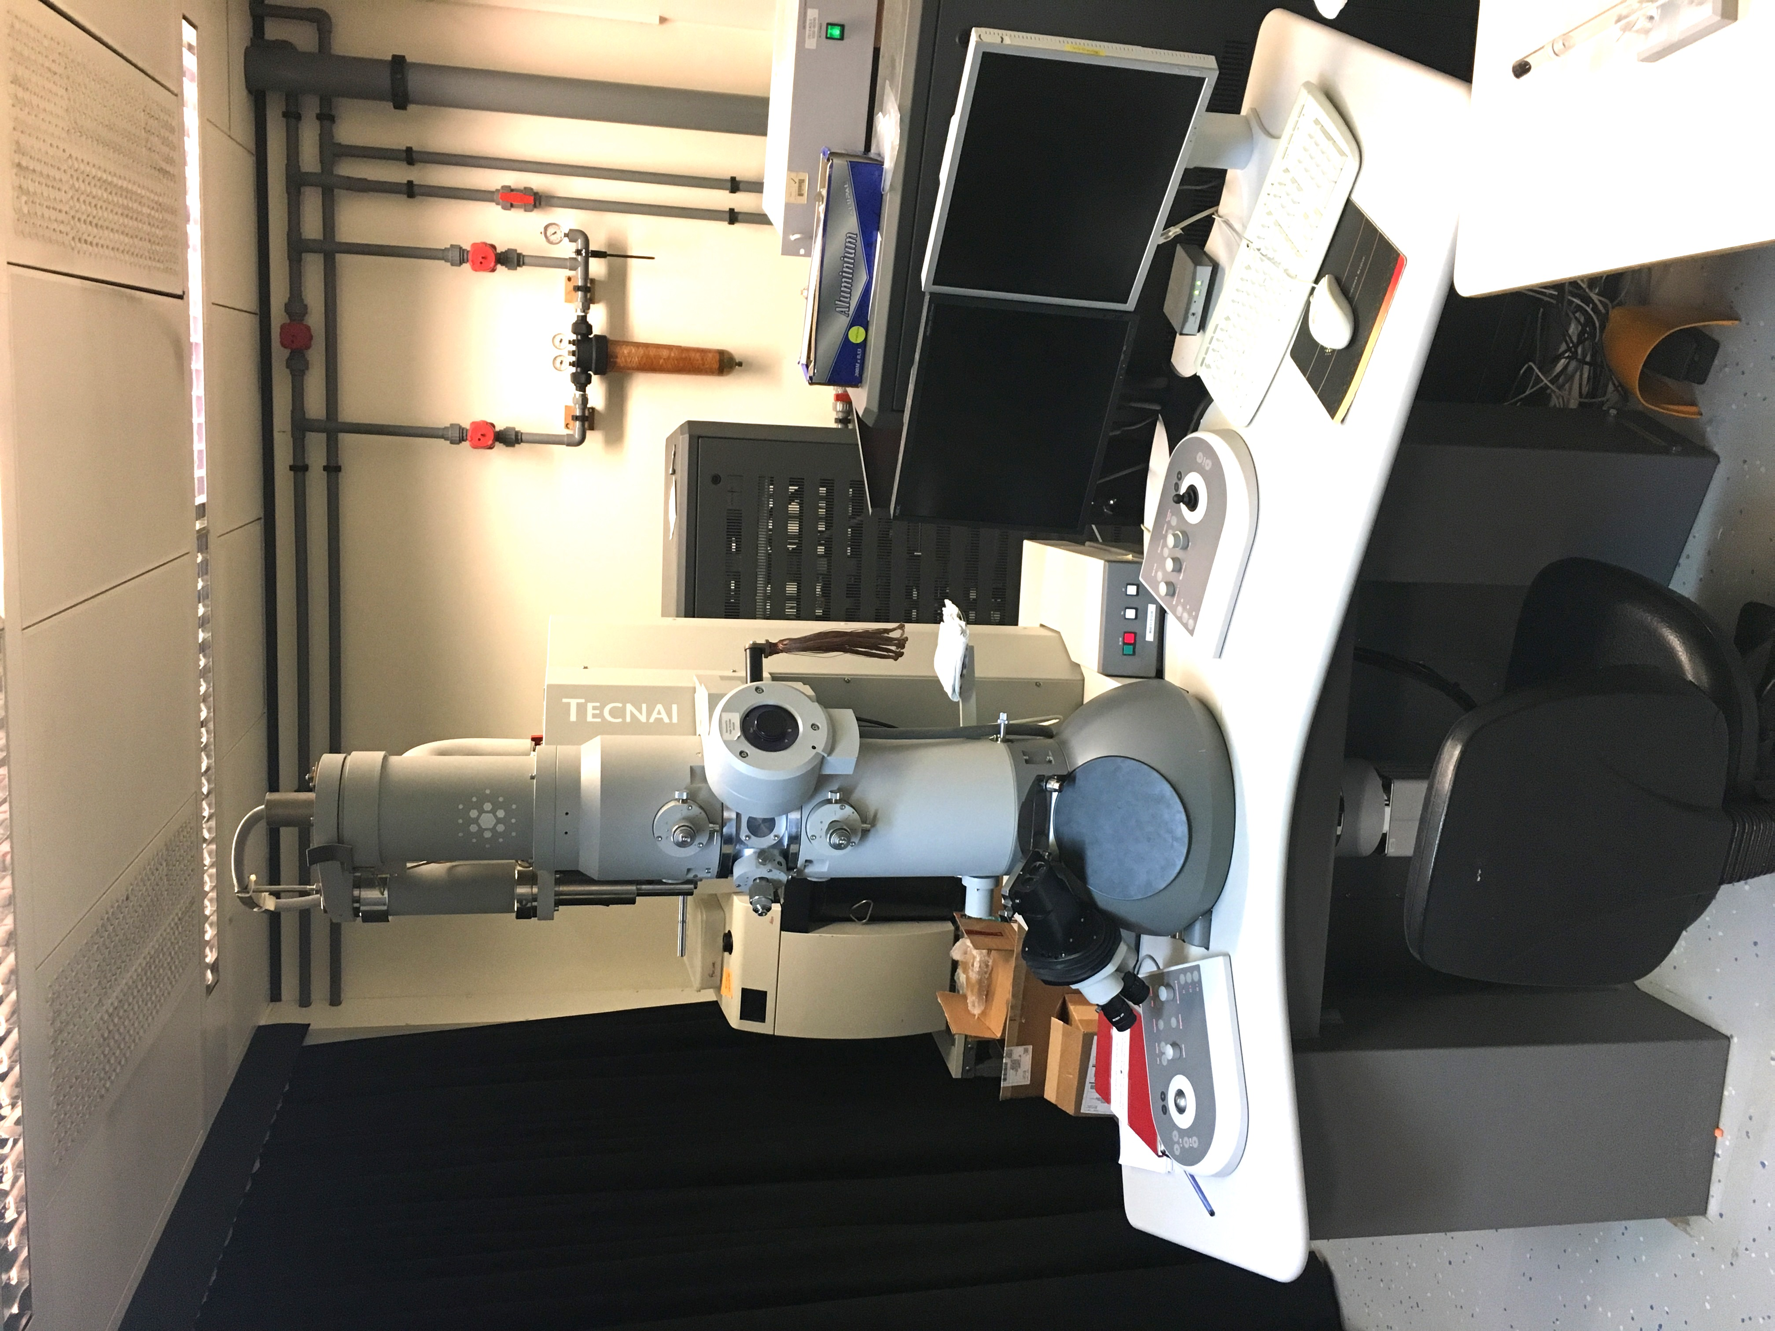
Screening of negative stain grids
Tecnai T12
Characteristics
Negative stain screening
LaB₆ filament
120 kV voltage
CCD camera
Side entry holder
Operating software
SerialEM

Slide 7
Negative stain data
Example of data you can get

Slide 8
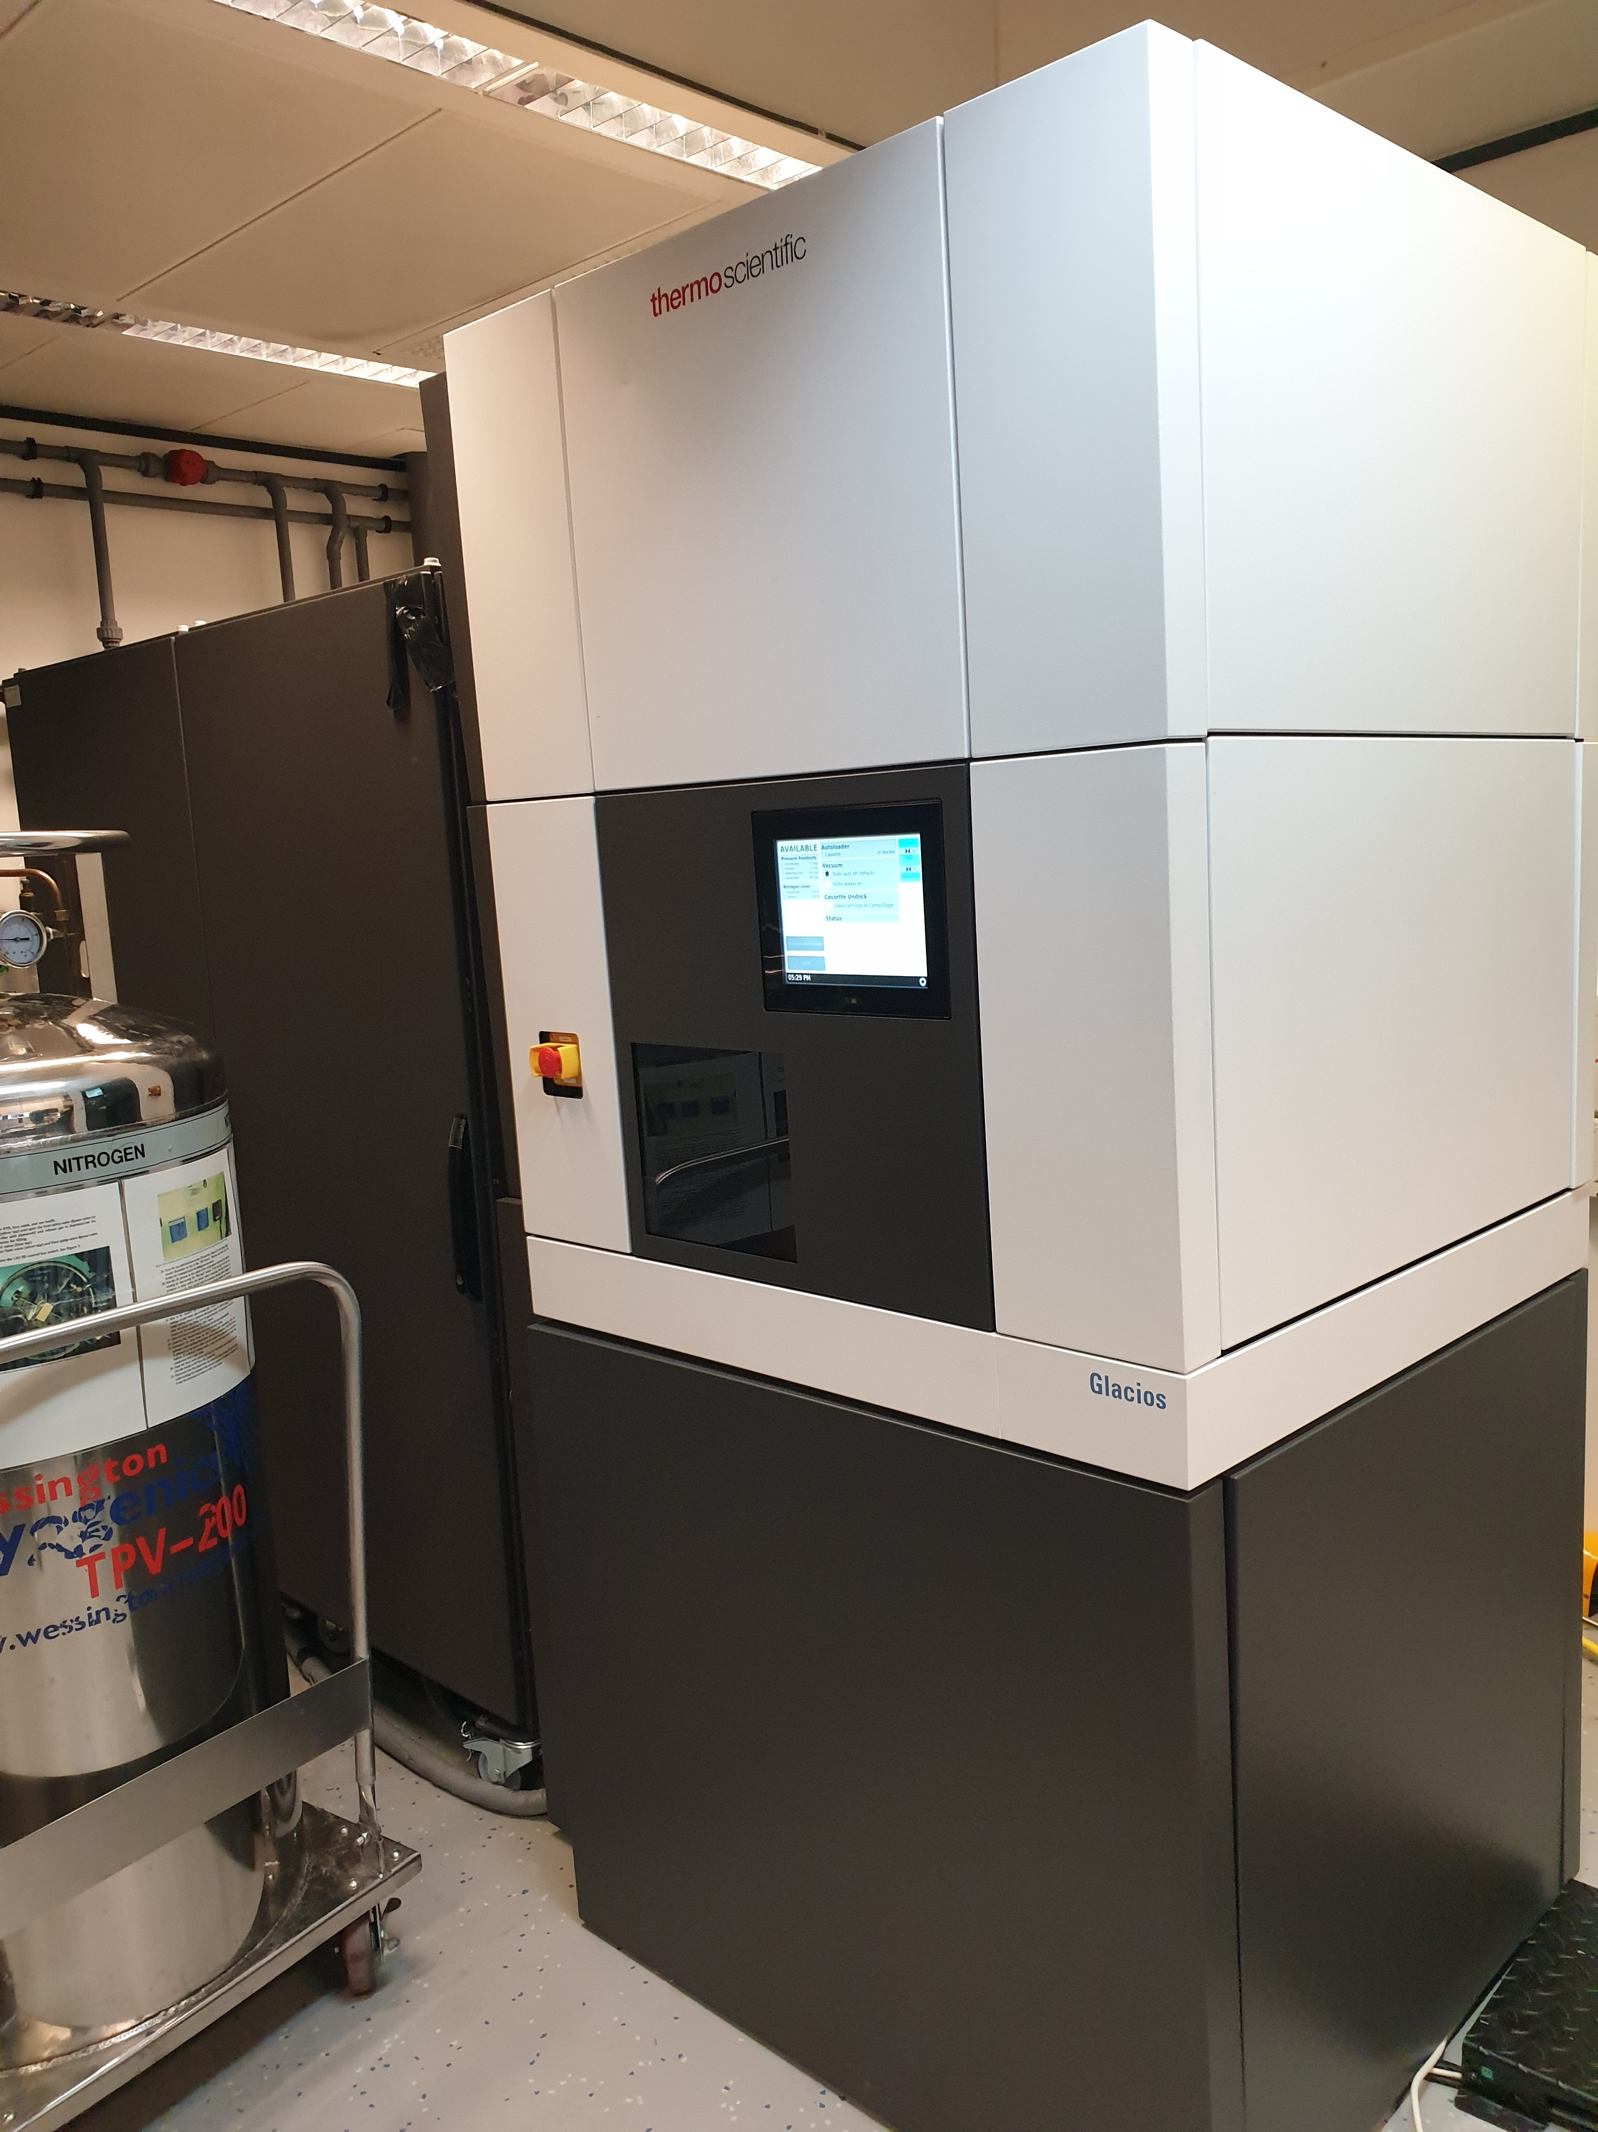
Cryo-EM – Grids screening and initial characterization
GlAcios
Characteristics
Cryo-EM data screening or collection
Field emission gun (FEG)
200 kV voltage
Autoloader (12 grids capacity)
Falcon III direct electron detector
Volta Phase Plate (VPP)
Operating software
EPU (Single Particles), Tomo5 (Tomography)

Slide 9
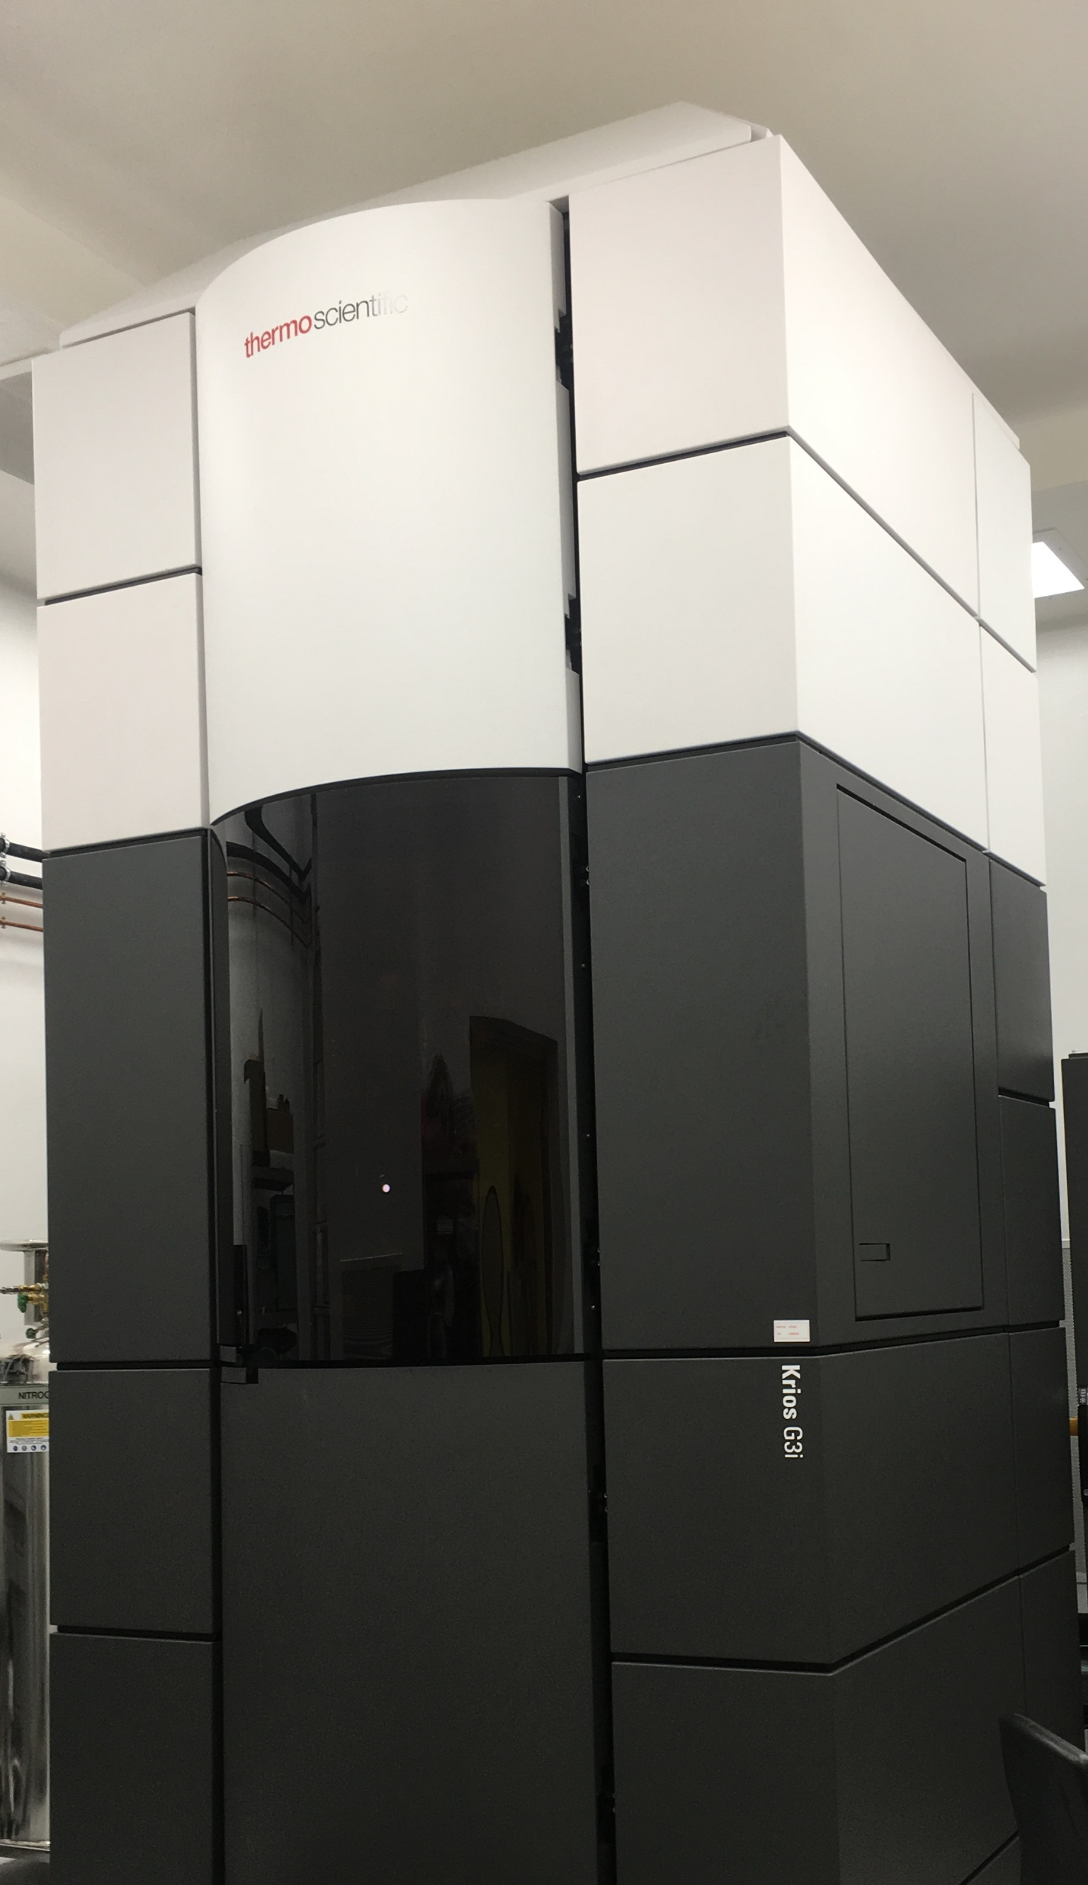
Cryo-EM - High resolution data collection
Titan Krios G3i
Characteristics
Cryo-EM data screening or collection
Field emission gun (FEG)
300 kV voltage
Autoloader (12 grids capacity)
Falcon III direct electron detector
Volta Phase Plate (VPP)
Previously Gatan K2 Summit direct electron detector with GIF energy filter
Operating software
EPU (Single Particles), Tomo5 (Tomography)
SerialEM (Tomography and Single Particles)

Slide 10
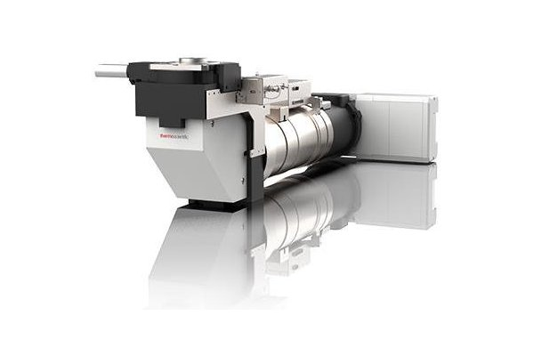
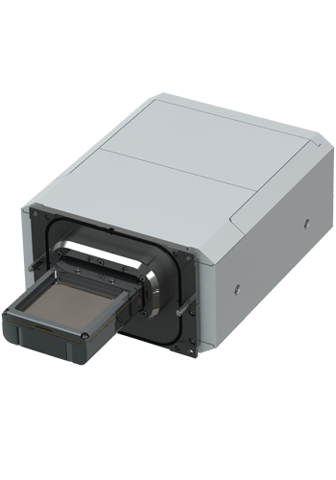
Camera and energy filter upgrade
Selectris X Imaging Filters
Narrow (<10 eV) zero-loss energy filtering offers enhanced contrast for higher resolution reconstructions
Sophisticated aberration correction, low image distortions, and uniform energy resolution over entire field of view
Minimized sensitivity to temperature variations
Straightforward operation
Automated filter tuning completed in minutes
Falcon 4 Direct Electron Detector
High detective quantum efficiency (DQE)
High speed, routinely capable of producing 300+ movies/hour
Built-in electron event representation (EER) for full temporal resolution (240 fps to disk) - no need for fractionating at time of acquisition
Super resolution without file size penalty
Fringe-Free illumination

Slide 11
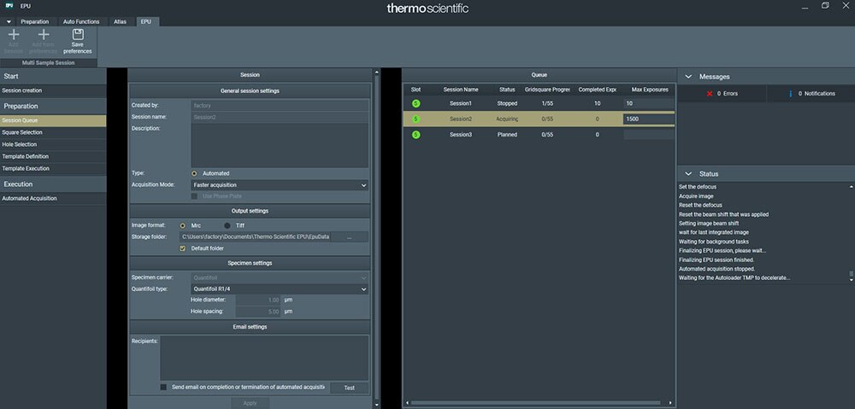
Krios and Glacios hardware upgrade “Windows 10 upgrade”
Latest software version: EPU, MAPS, Tomo6…
Krios and Glacios will be operated with EPU --> easier for user to operate
EPU multigrids: possibility of collecting “automatically” on multiple grids without user input

Slide 12
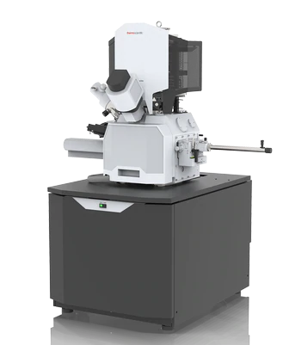
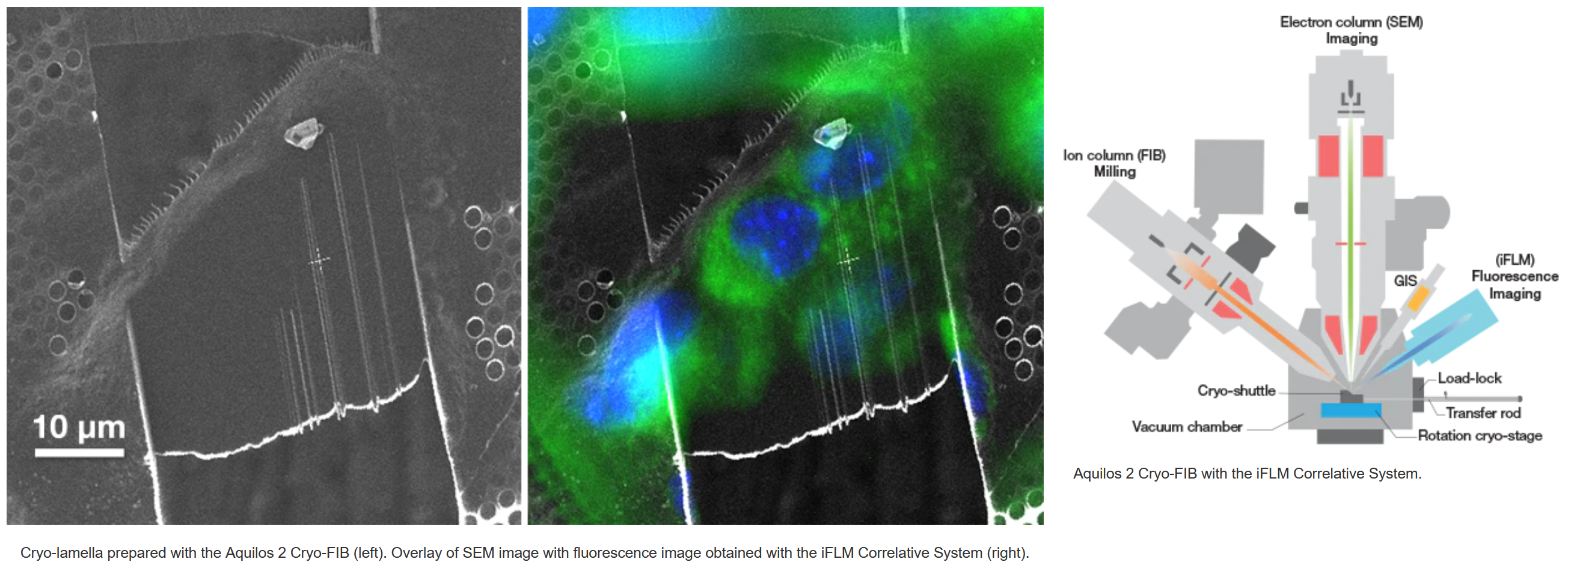
Cryo-FIB SEM – in situ structural biology
Aquilos 2 cryo-FIB SEM
It is a dual beam system dedicated to the preparation of thin, electron-transparent lamellas for high-resolution cryo-electron tomography or MicroED of micro-crystals.
The iFLM (Integrated Fluorescence Light Microscope) (Delivery for summer 2022)
Correlative System localizes fluorescent targets inside the chamber
Allows to correlate two imaging modalities within one system, ensuring the sample is in the right location.
https://www.thermofisher.com

Slide 13
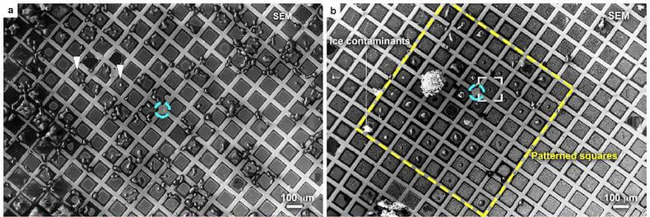
Grid micropatterning – PRIMO system (Delivery for 2nd term of 2022)
Precise cell positioning: automatic alignment within the mesh of EM grids!
Optimized cell spreading: reduced thickness for more efficient CLEM and cryo-ET workflows
Standardized cell models: reproducible micropatterning for mechanobiology studies
Undamaged surface: contactless micropatterning preserving the EM grid surface integrity
Without Micropatterning
With Micropatterning

Slide 14

Oxford Particle Imaging Centre (OPIC) – building overview
Cryo-EM facility
Yellow suite (Cl2 pathogen)
Green suite (Cl3 pathogen)
Cl3 capable

Slide 15
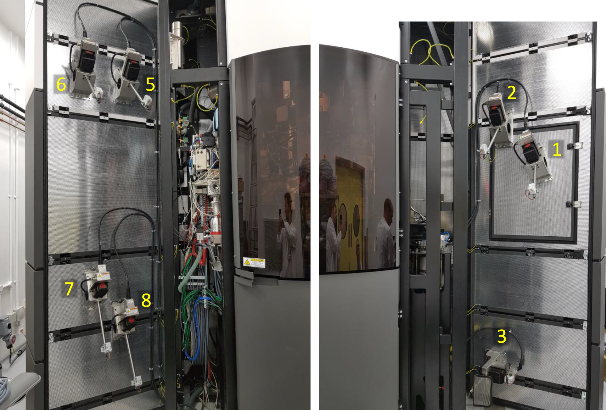
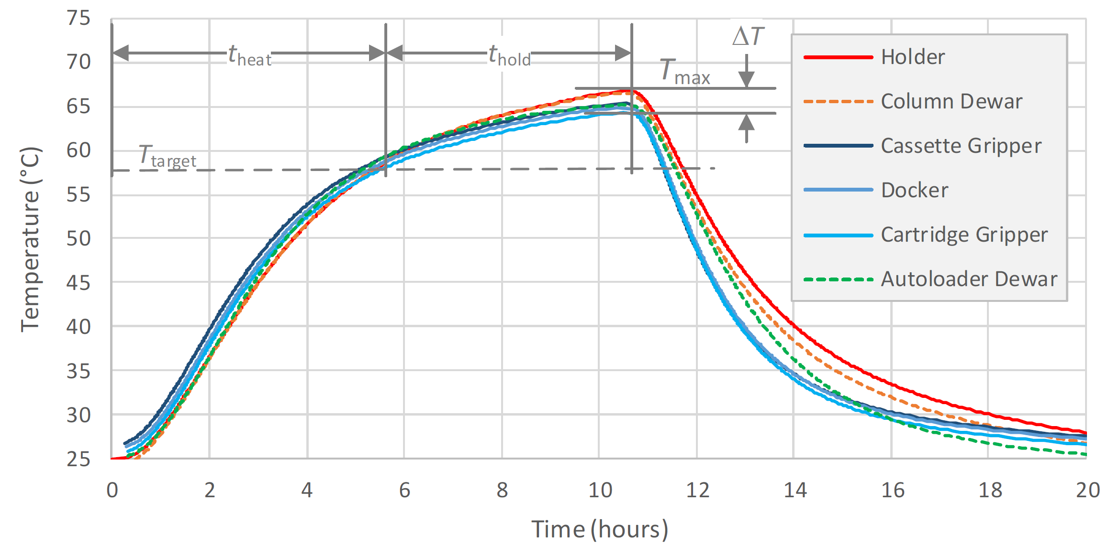
Imaging live BSL-2 and BSL3 pathogens
Heaters for 60°C heating decontaminations of the microscopes

Slide 16
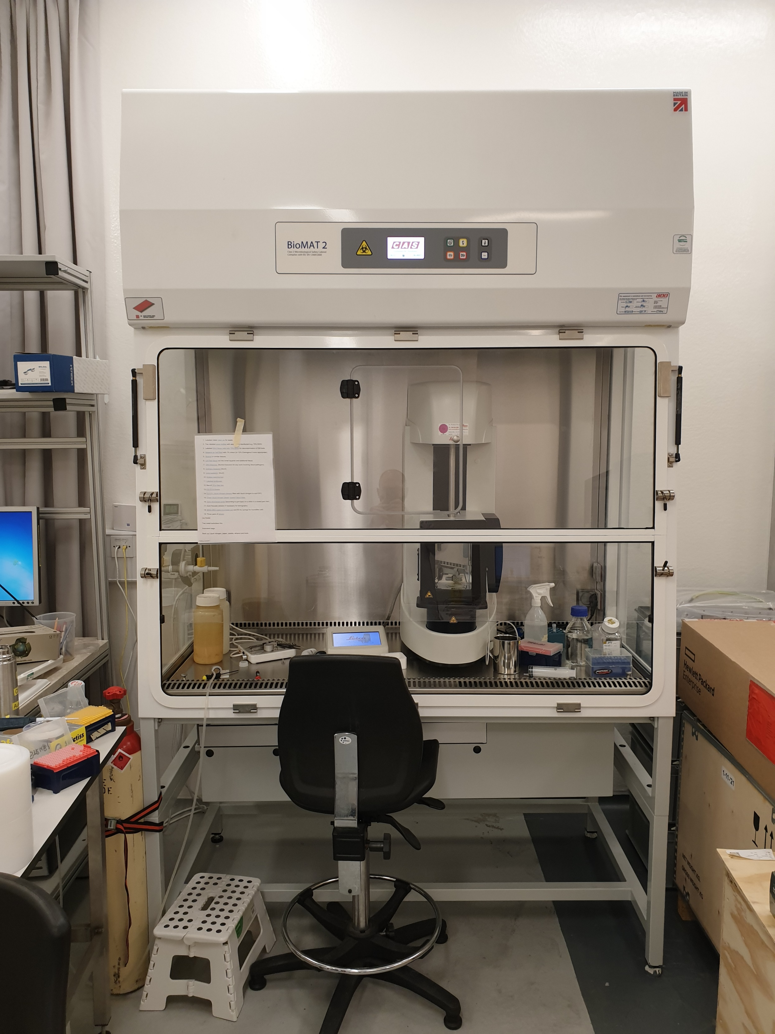
Imaging BSL-2 and BSL-3 pathogens
Pathogen decontamination approval: Needs to be done for every pathogen.
Pathogens have to die after a certain period time at room temperature or being heated at 60°C.
Sample preparation and grid plunging: In Class II safety cabinet.
If decontamination at room temperature efficient: possibility to use either the Aquilos or Krios for both Cl2 and CL3 pathogens and Glacios for Cl2.
If only decontamination at 60°C efficient: only use of the Krios for both Cl2 and CL3 pathogens.

Slide 17
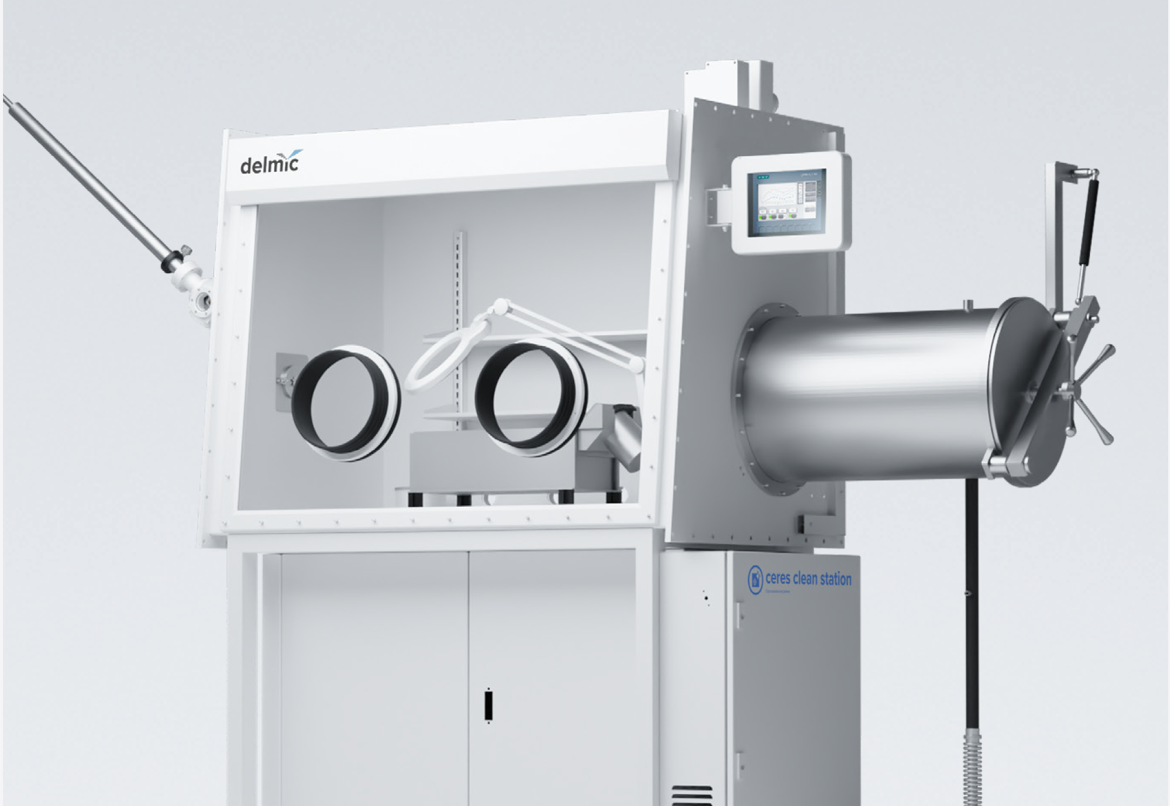
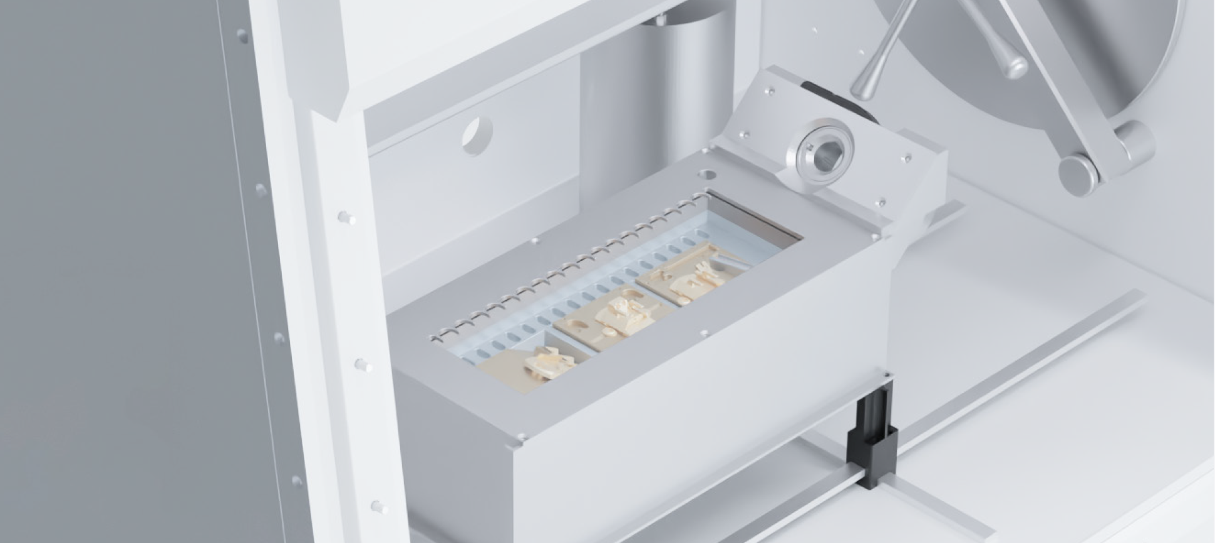
CERES clean station – Delmic (Delivery for summer 2022)
Glove-box specifically designed for cryo-ET workflow.
Reduce most of the ice contamination by operating under dry nitrogen atmosphere.
Re-circulating air through HEPA filter compatible with handling CL2/Cl3 pathogen.
Allow samples loading in both the Aquilos 2 and the Krios.
Loading tray heating up to 60 degrees for decontamination.

Slide 18
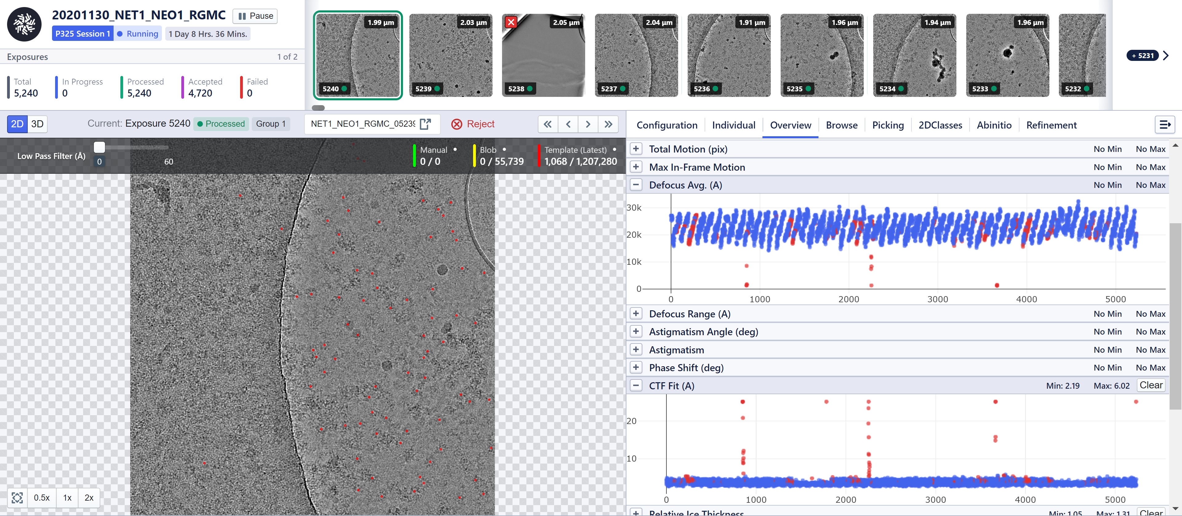
On-the-fly data processing – Cryosparc Live
Monitoring of the data collection

Slide 19
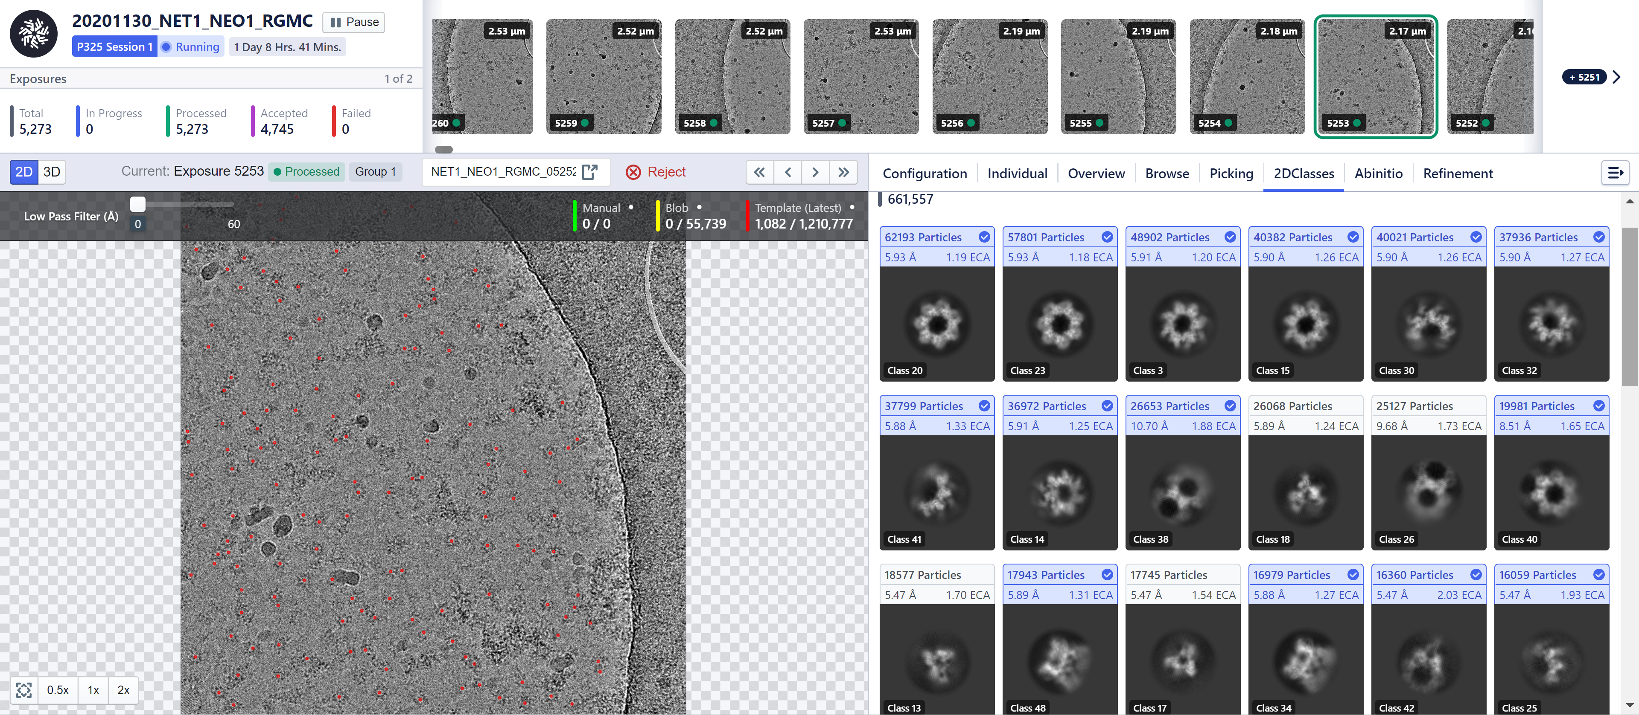
On-the-fly data processing – Cryosparc Live
Live 2D classification to assess sample quality and orientations distribution

Slide 20
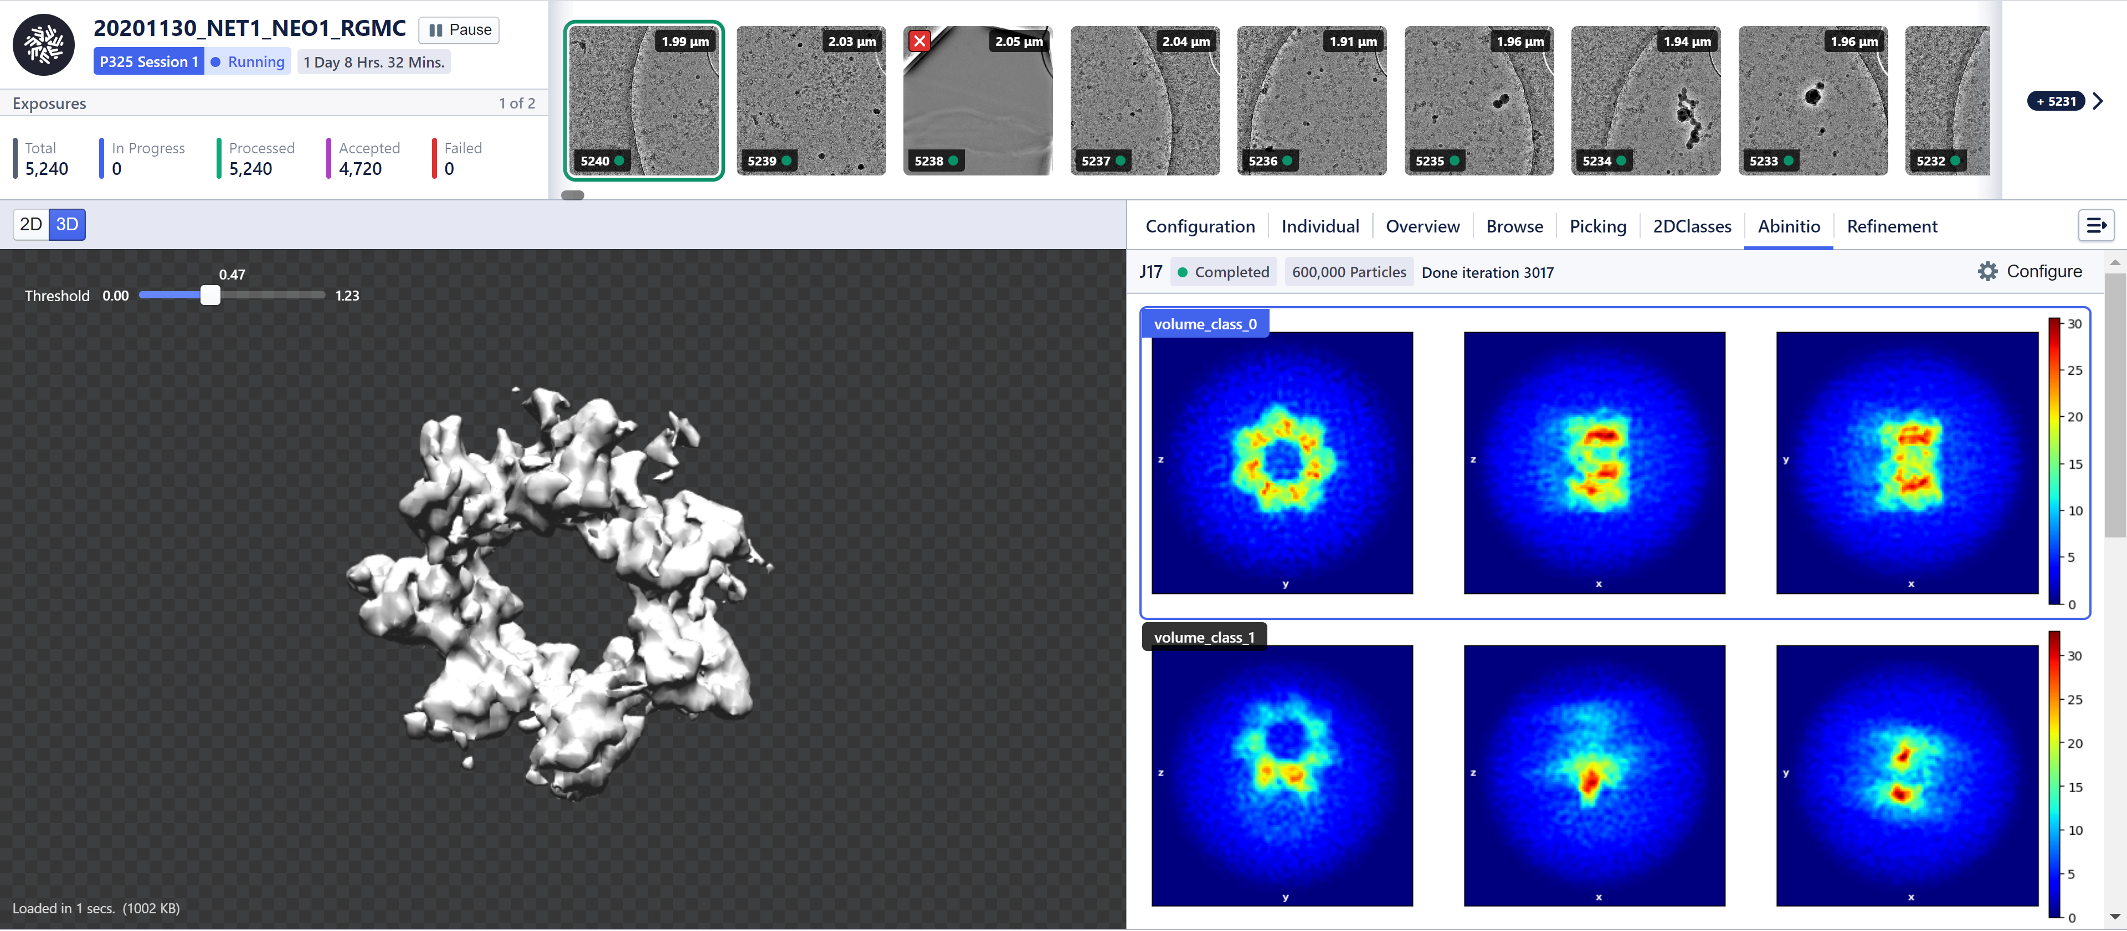
On-the-fly data processing – Cryosparc Live
Initial 3D models

Slide 21
Expectations and aims of the facility
Characterization of biological samples via scanning (SEM) or transmission electron microscopy (TEM).
Get structural information at medium and high resolution of purified or in-situ protein complexes.
Sample preparation and optimization
  Vitrobots, Gatan’s CP3 and Leica GP2
Grid screening and initial data collection
  T12 and Glacios microscopes
High resolution data collection
  Krios microscope
In-situ FIB-SEM and soon CLEM
  Aquilos microscope
Data processing
  Rescomp cluster, cryosparc, relion…
User training
  Getting users independent for all steps
Passmore and Russo, 2016

Slide 22
Getting access to cryo-EM
To start a project or if you need support get in contact:
  emsupport@strubi.ox.ac.uk (All staff members)
Instruments booking through an Aria calendar:
  https://instruct-eric.eu/register/
  embookings@strubi.ox.ac.uk
Instructs-ERIC
  Researchers from countries member of Instruct
  Peer-reviewed access
  Price of the data collection subsidized
eBIC
  As part of the old road campus BAG, send request to Jonathan Grimes
  Through rapid access
  Price of the data collection subsidized

Slide 23
Loic Carrique
(loic@strubi.ox.ac.uk)
Facilities talks 27th Jan 2022

