Slide 1
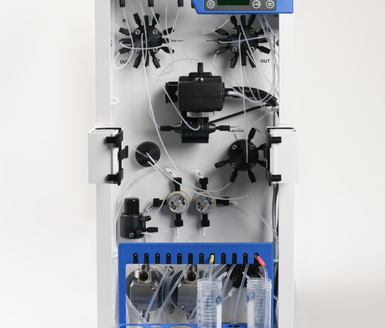
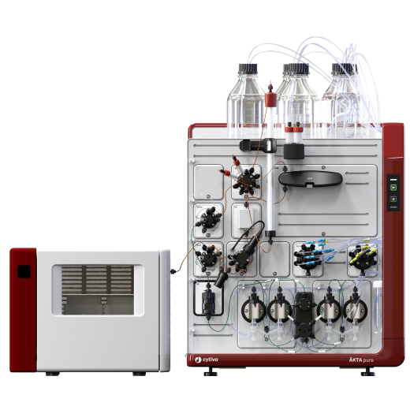
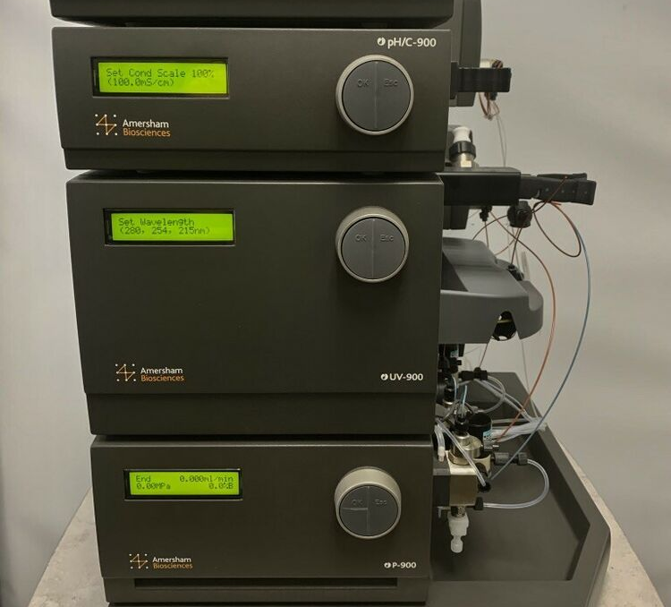
Aktas
Pure
FPLC
Purifier
Basic
Xpress – dual system for multi-step purification

Slide 2
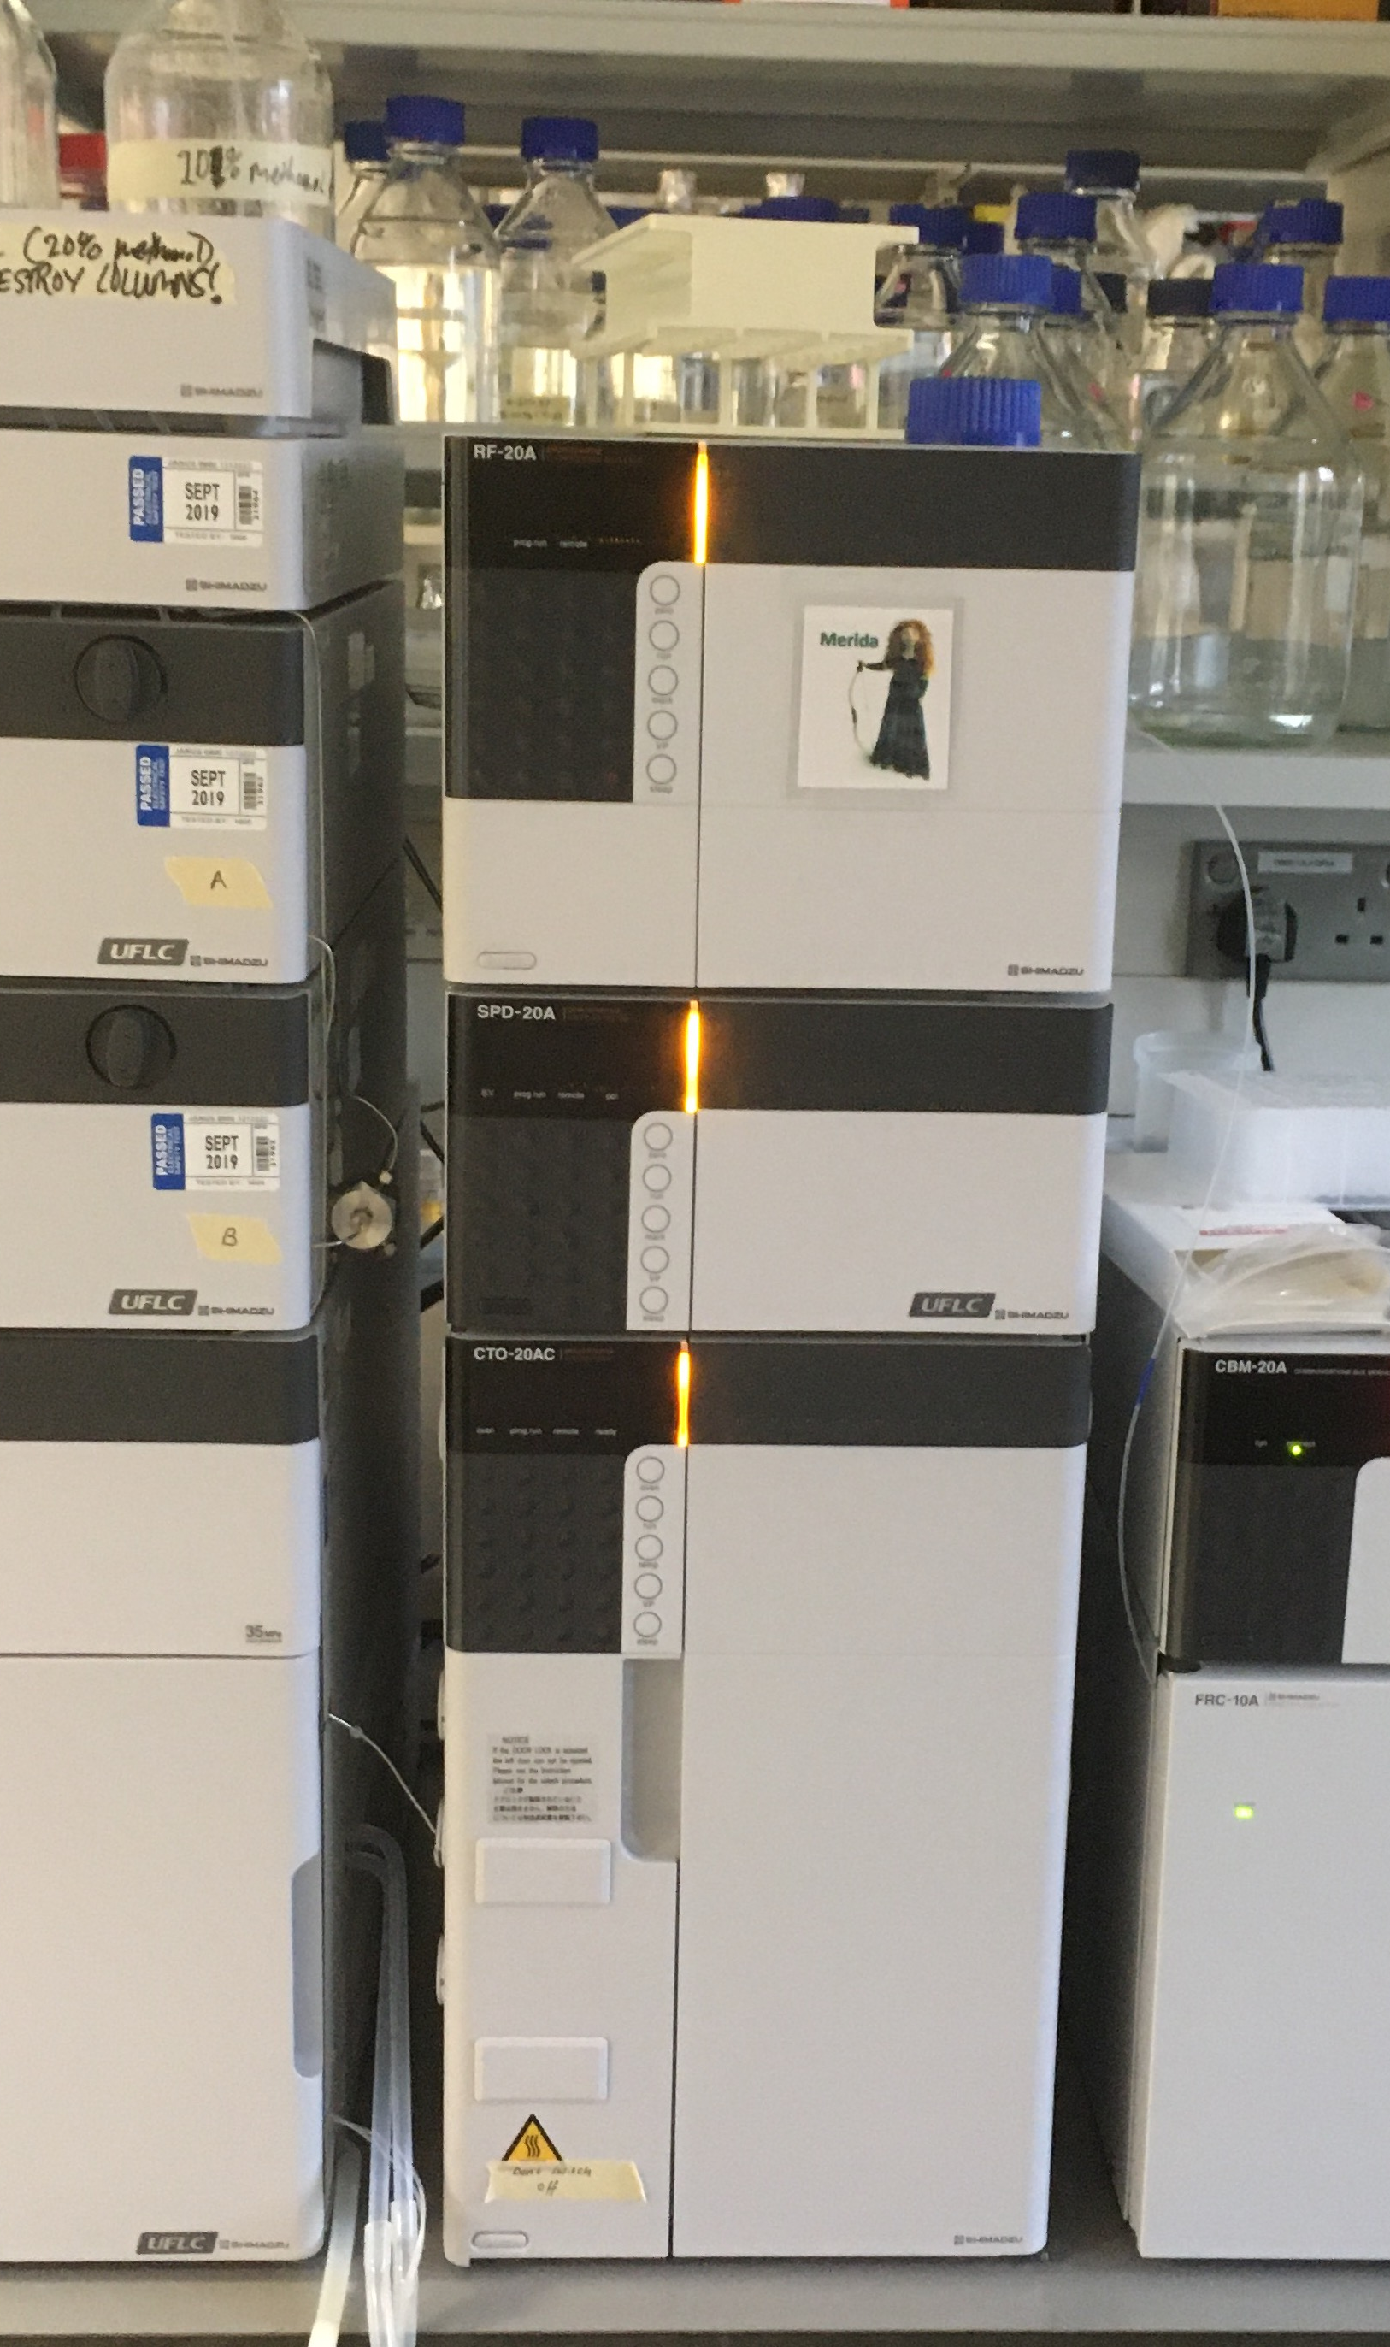
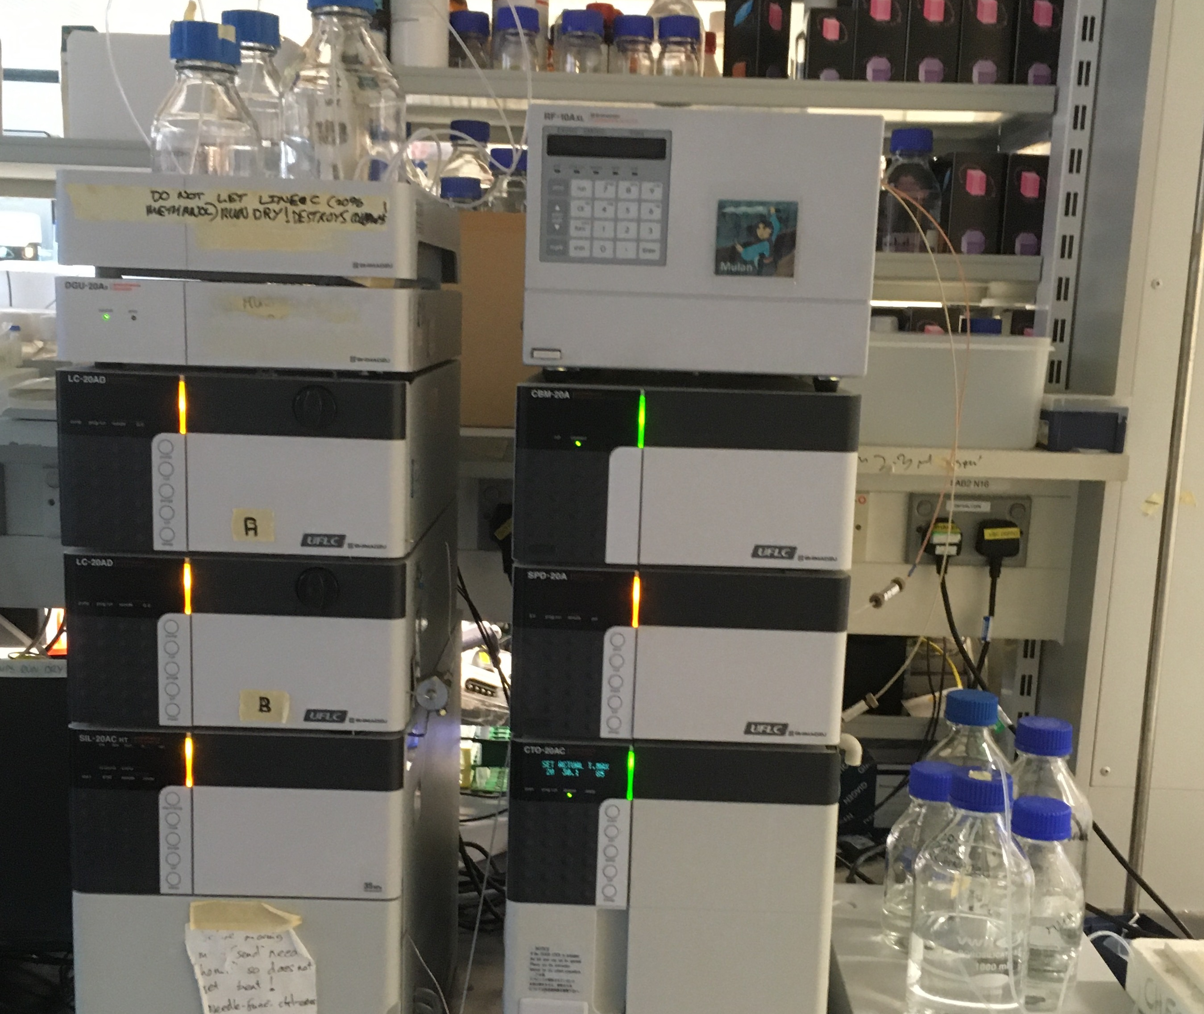
Shimadzu HPLC

Slide 3
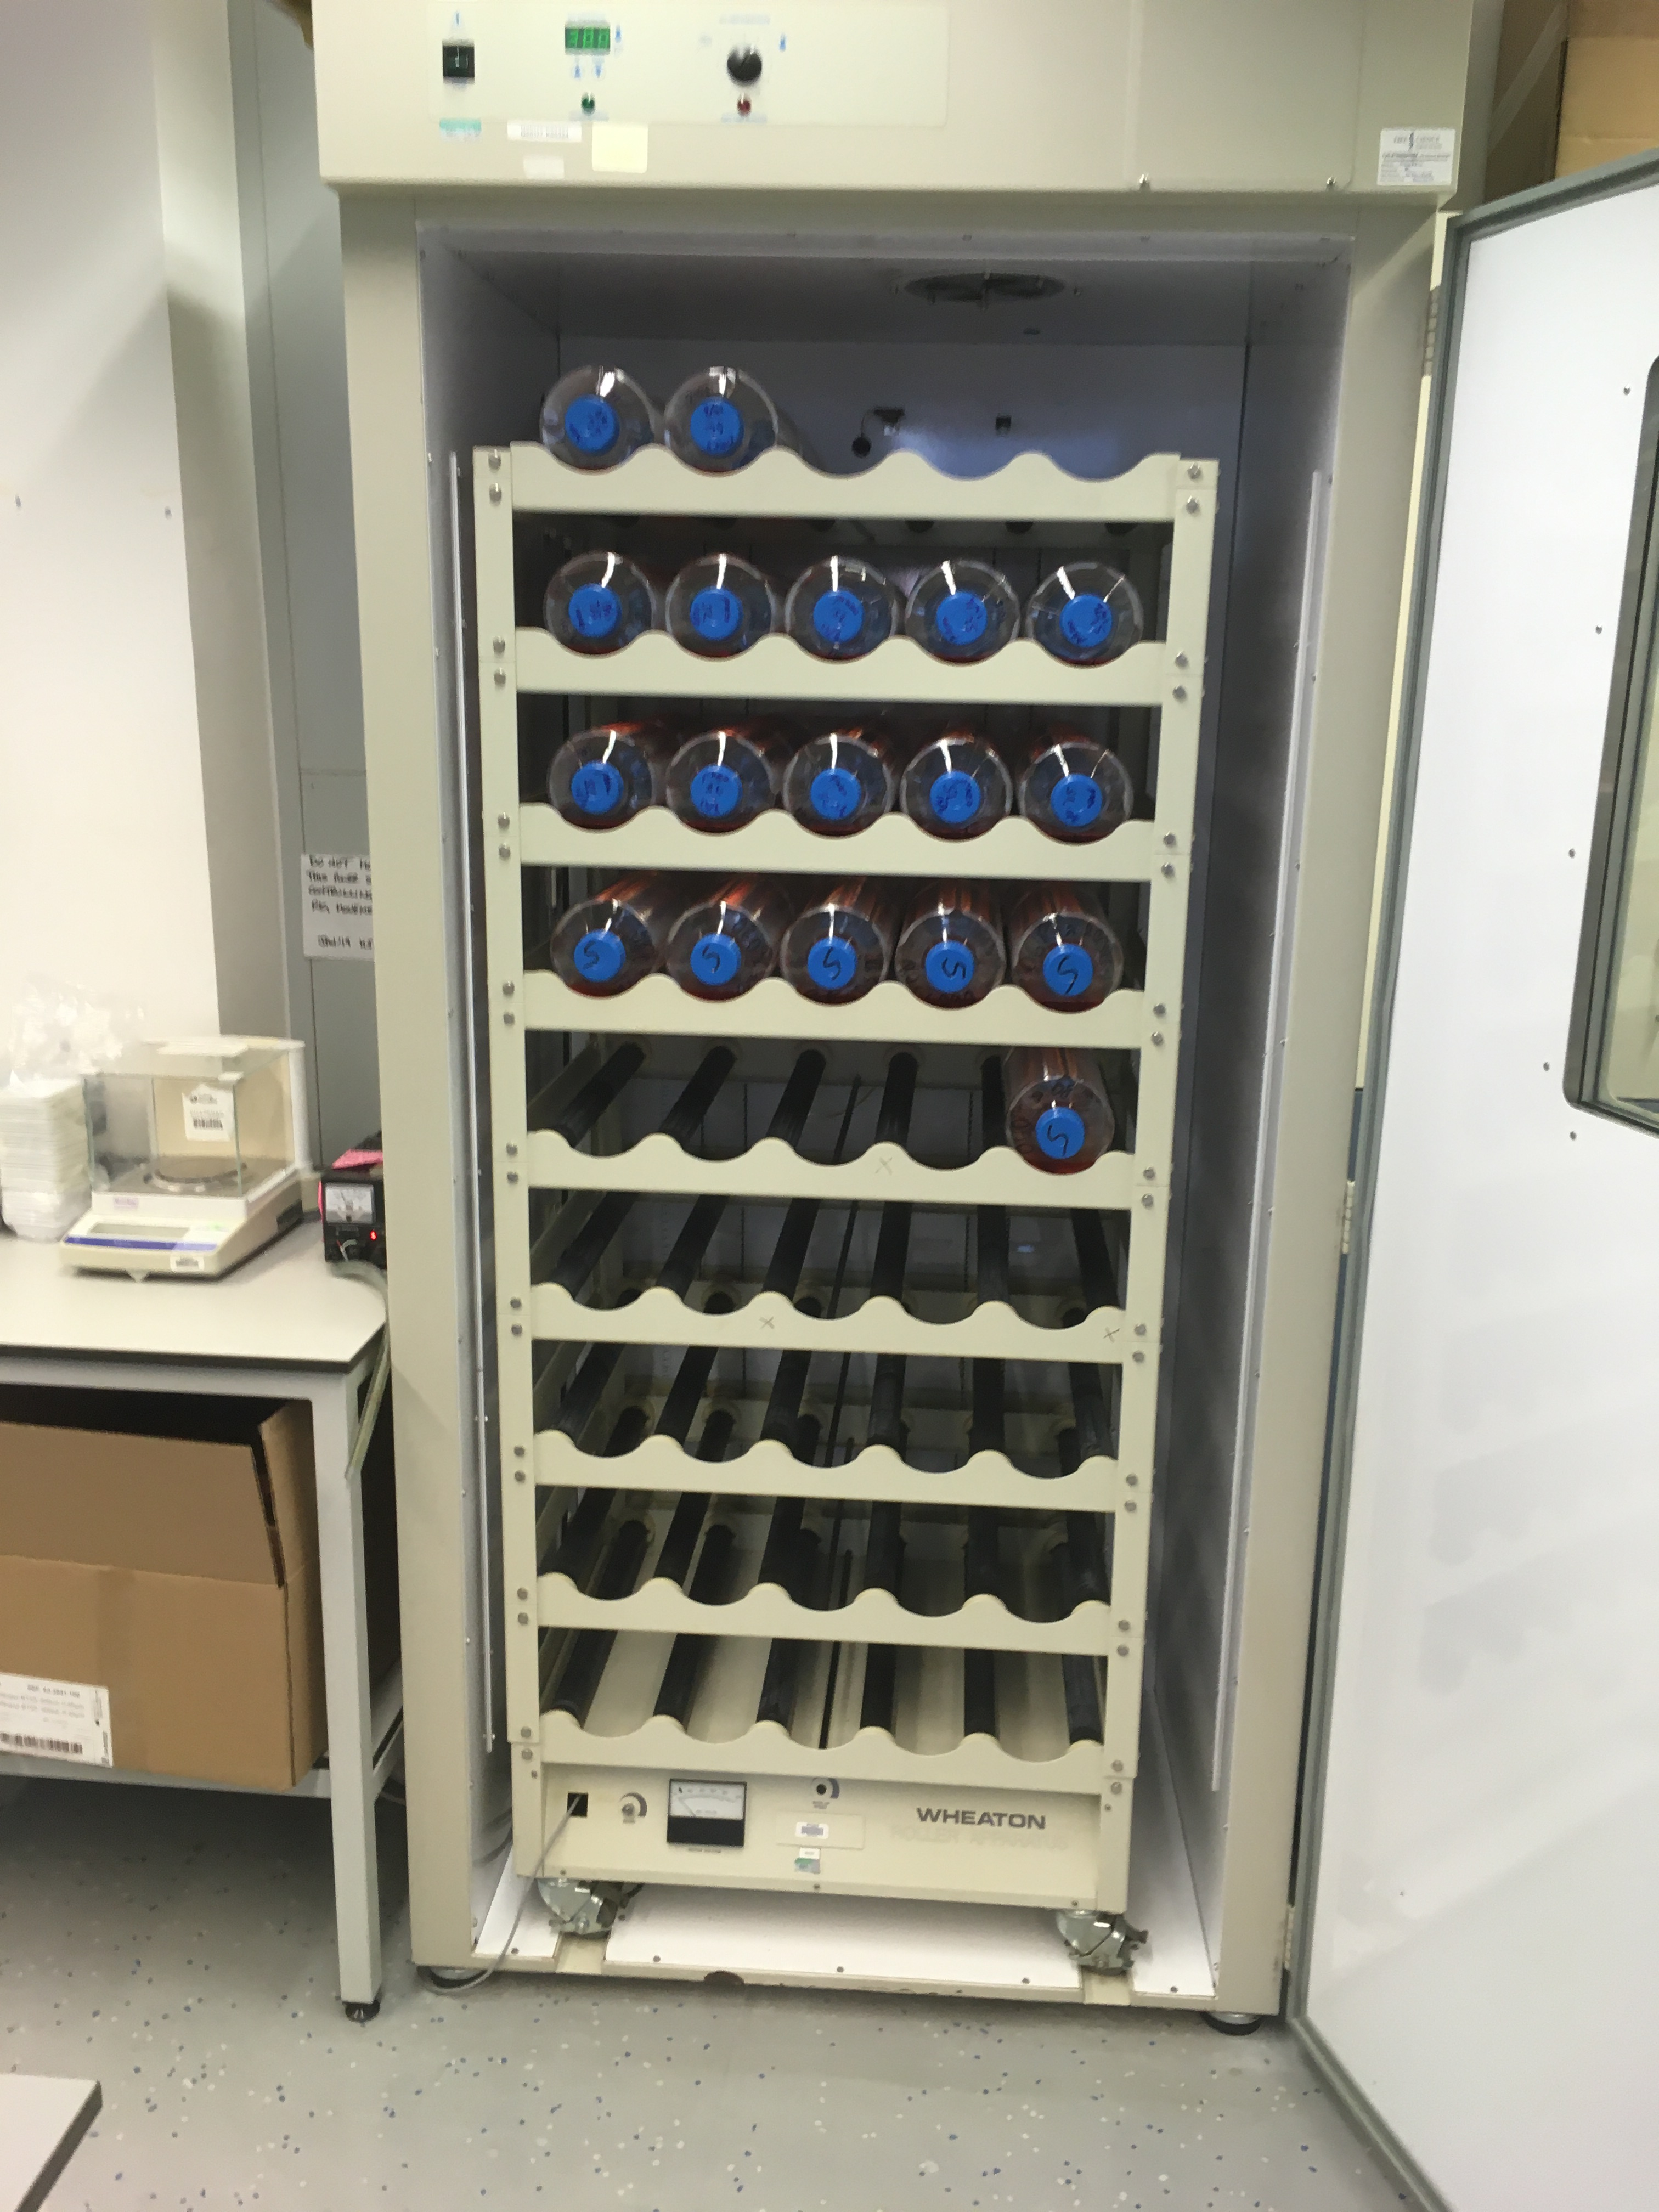
Roller Bottle Rigs

Slide 4
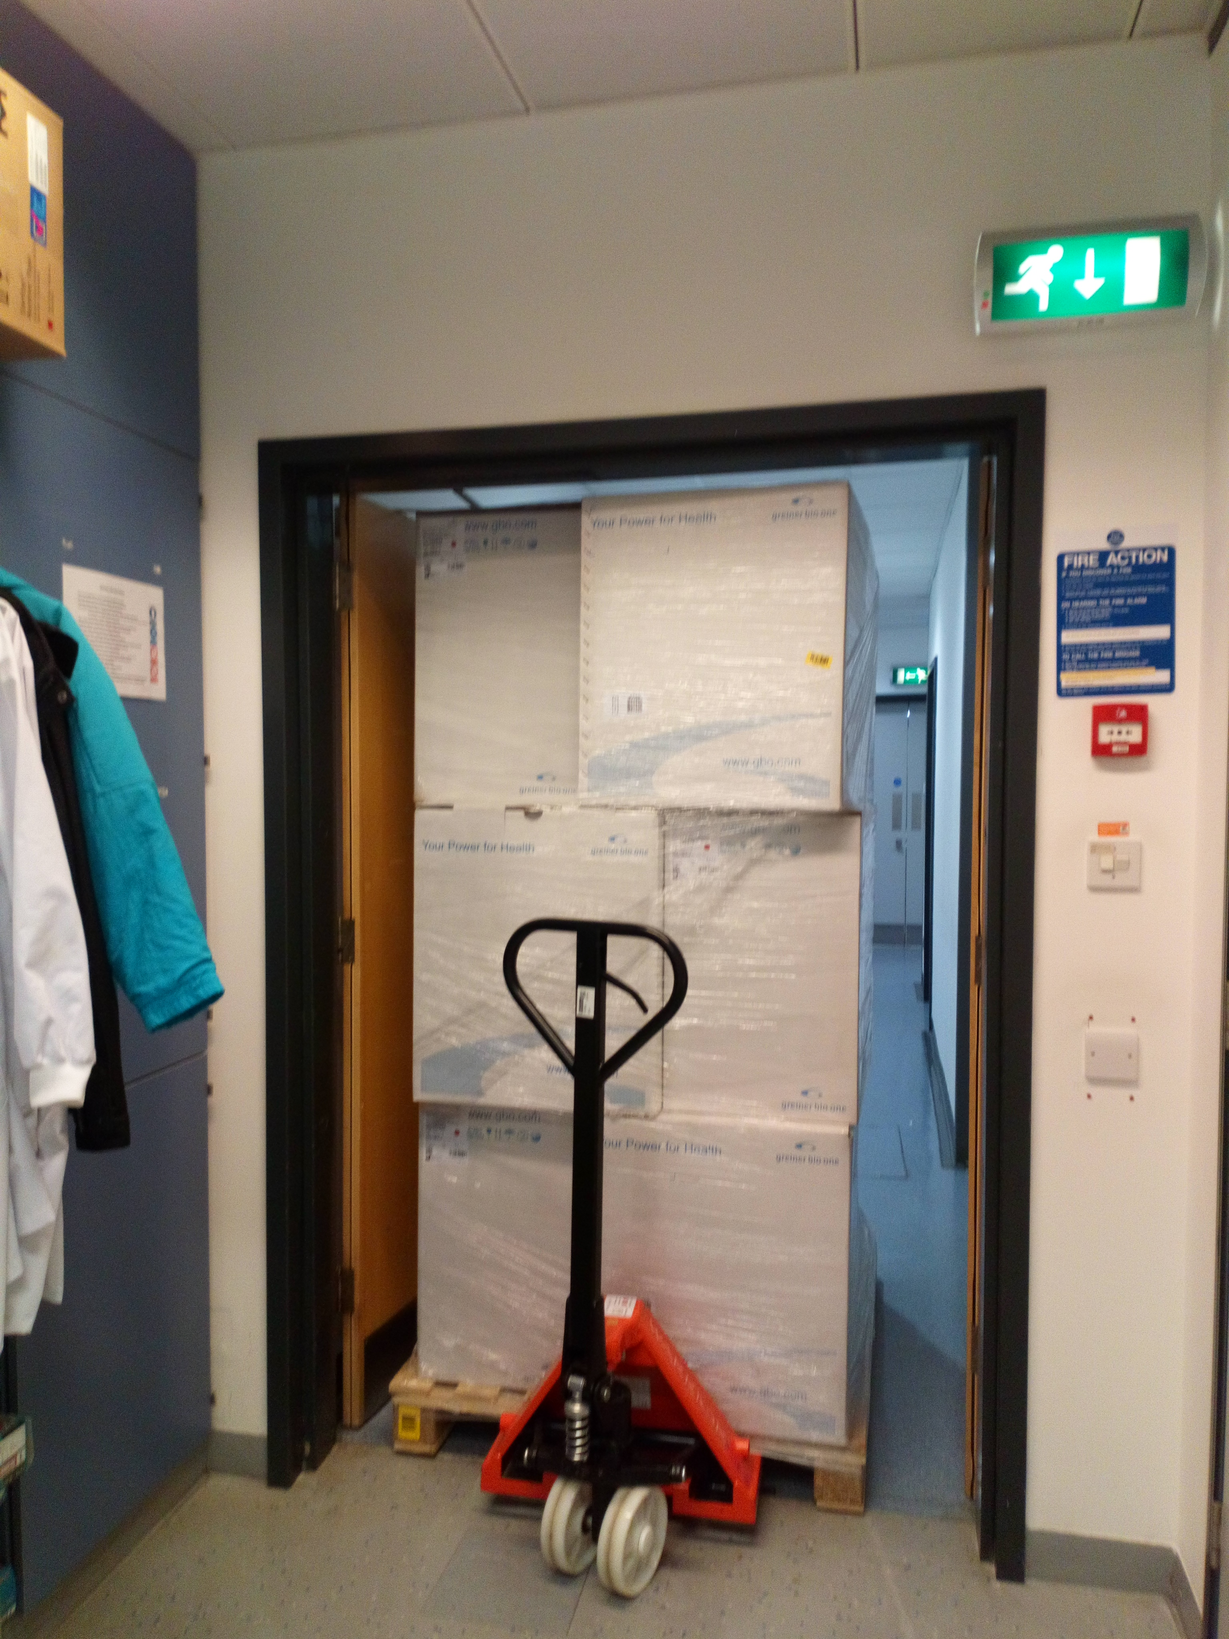
Roller bottles arriving in the wetlab

Slide 5
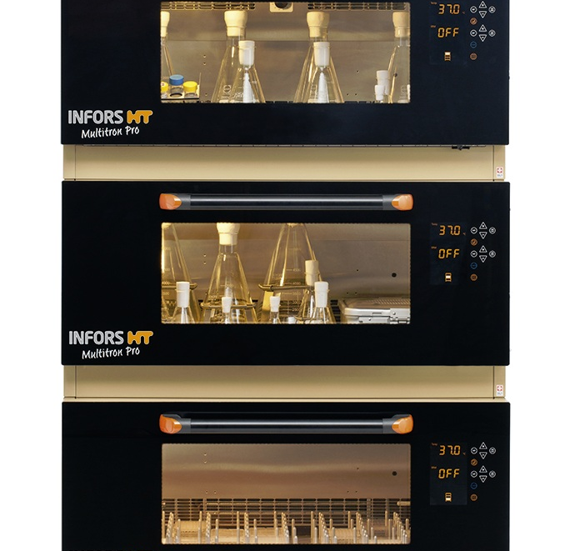
CO2 gassed incubators for Mammalian cells growing in suspension
Notes:
We currently have three Infors incubators, but will be taking delivery of two more on 21st December 2020

Slide 6
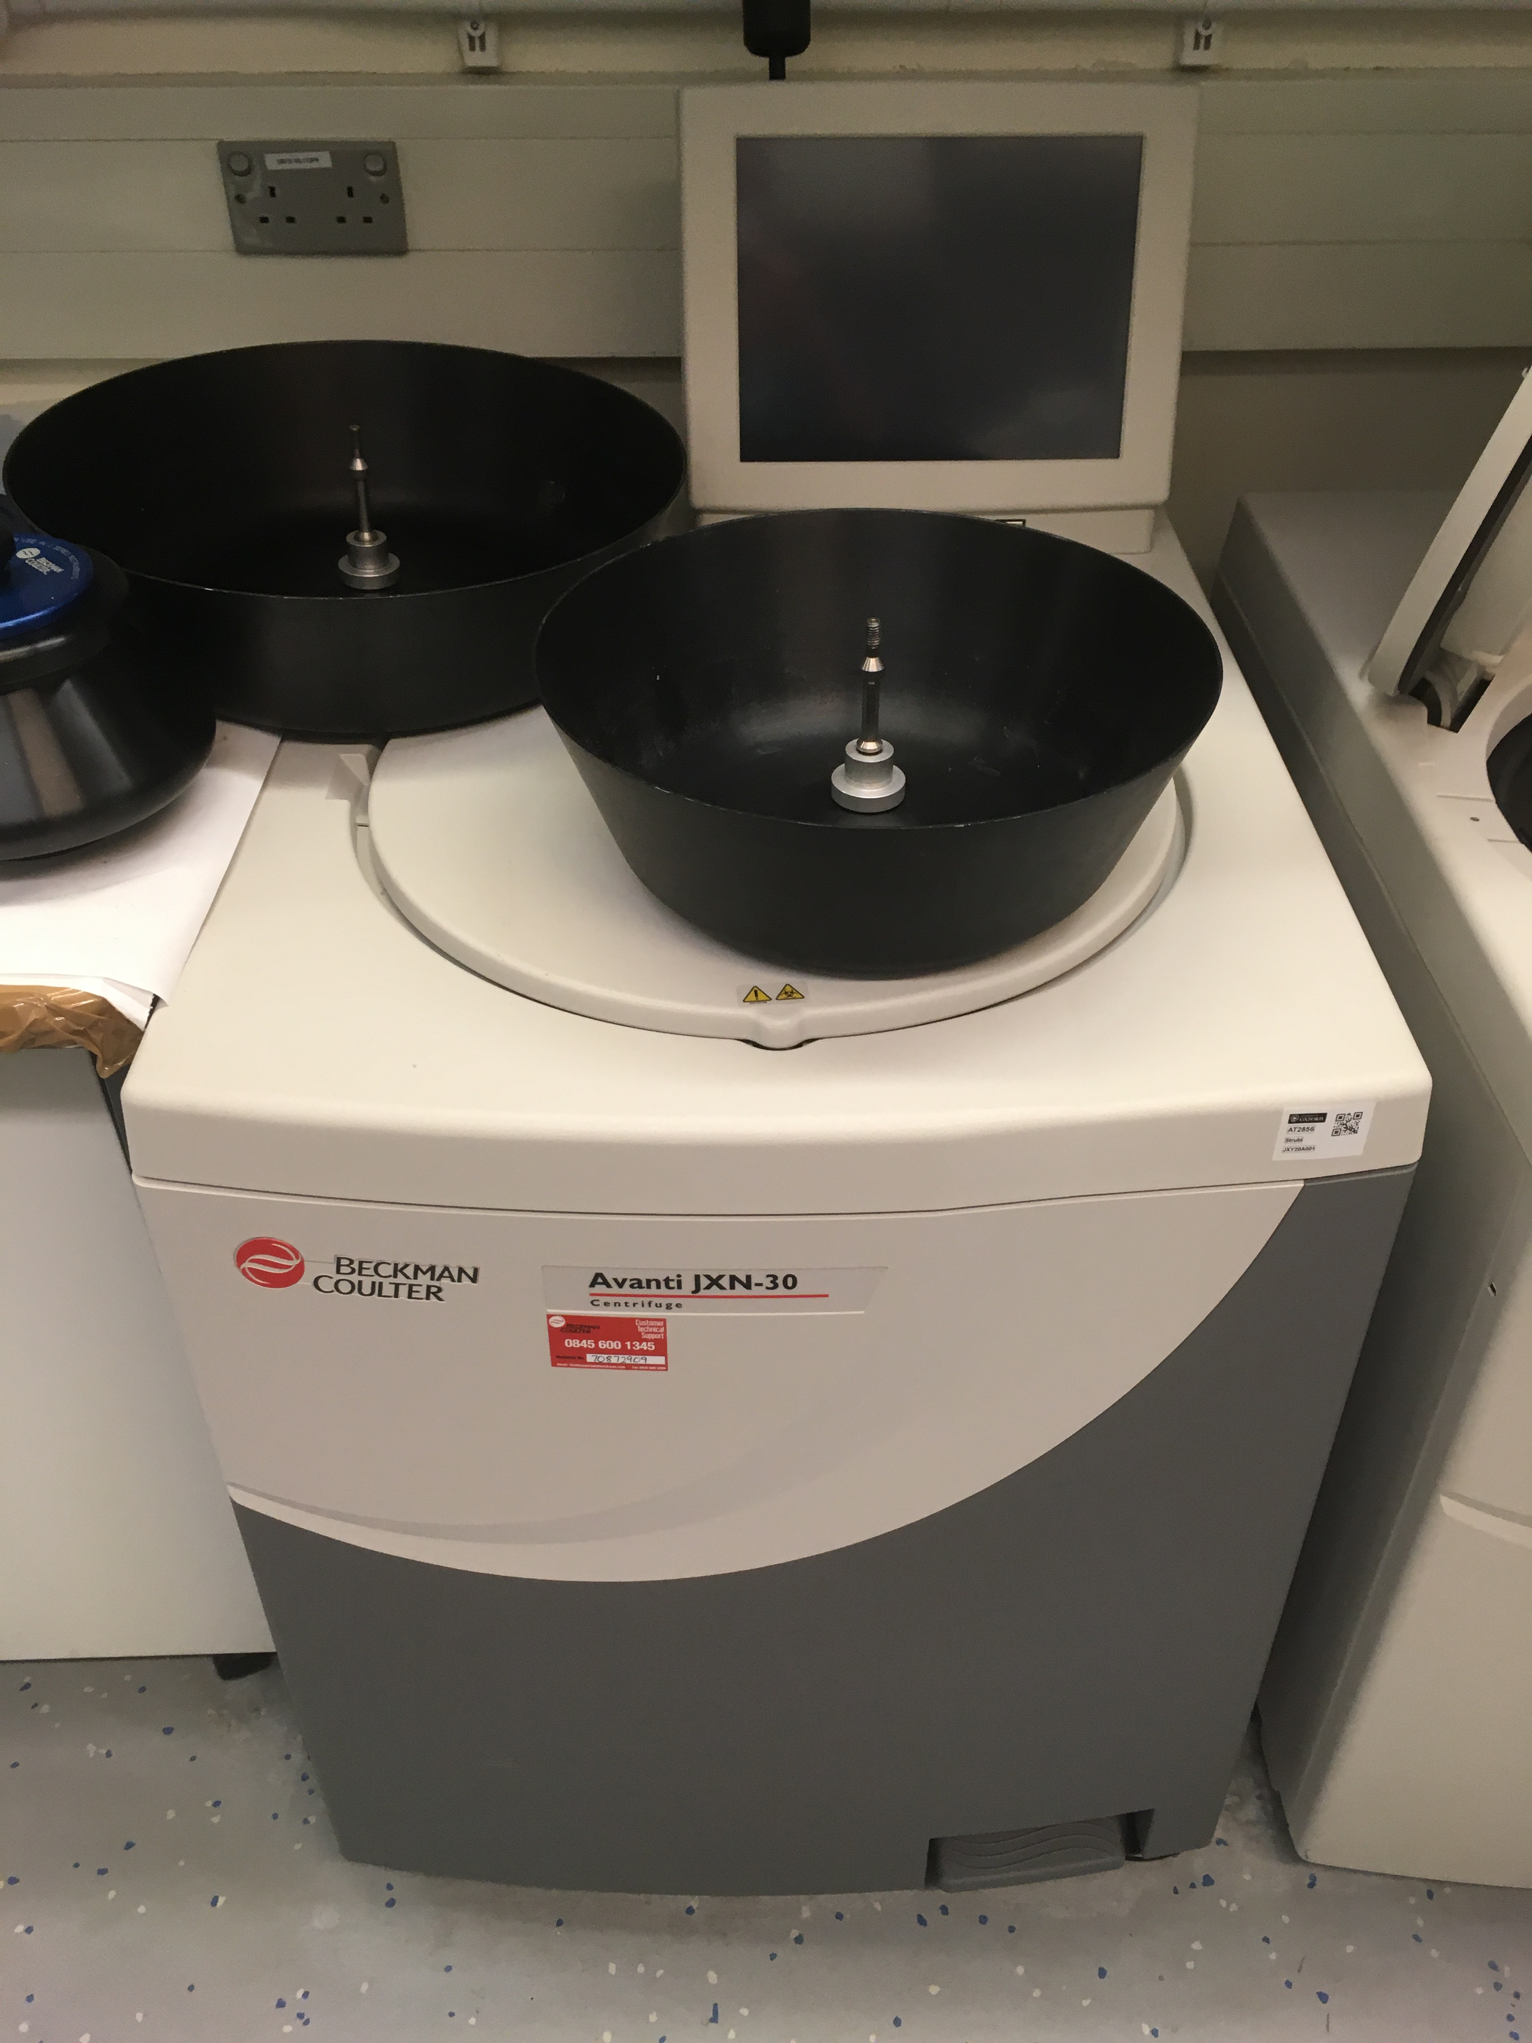
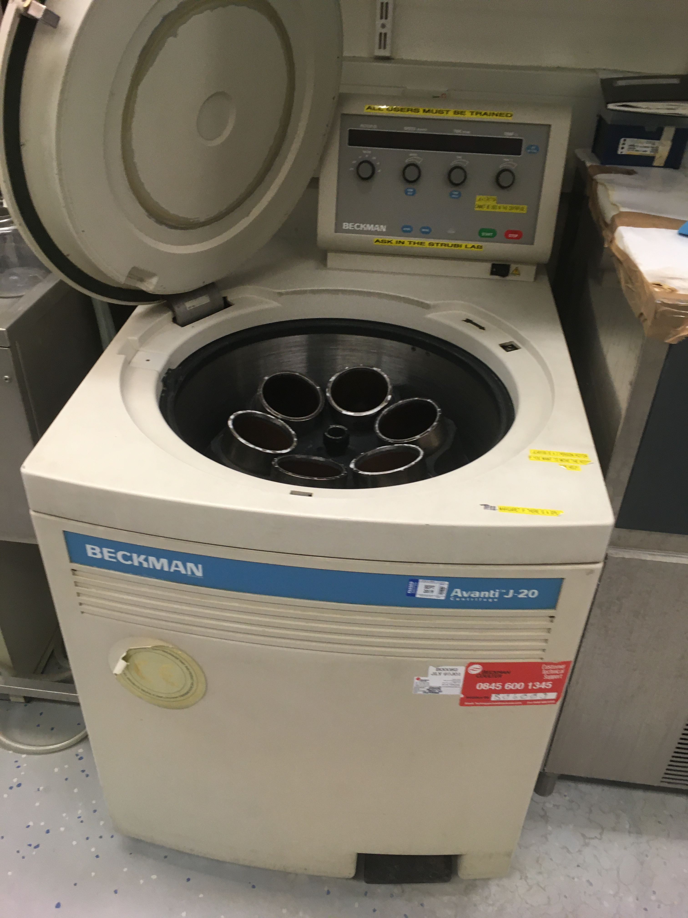
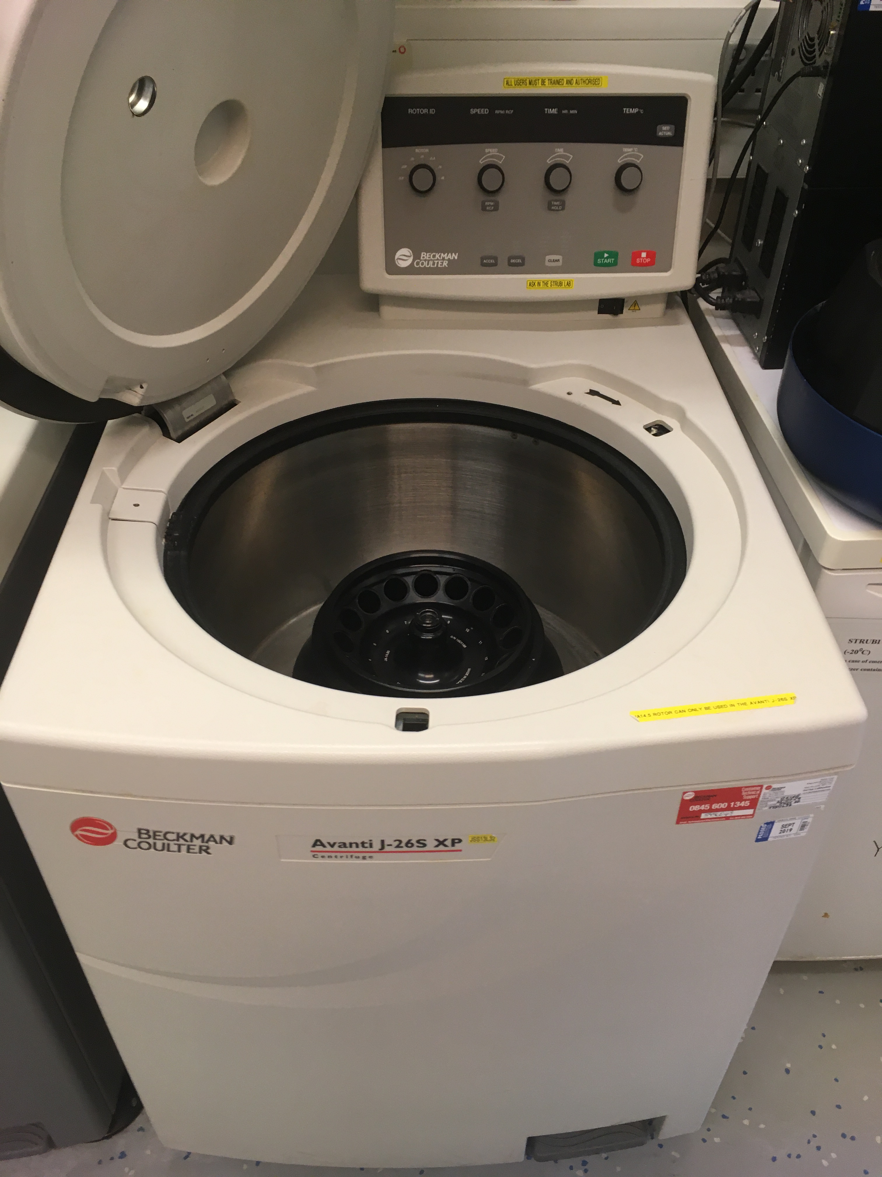
Floor-Standing Centrifuges

Slide 7
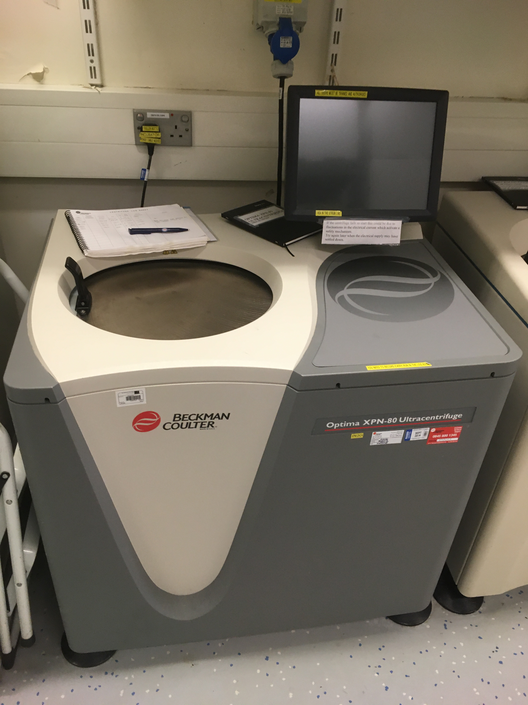
Ultracentrifuges

Slide 8
Cost of Beckman Rotors Cost of Beckman Rotors JLA 8.1000 - £13960.00 JLA9.1000 - £11560.00 JA30.50 - £9062.00 JA14.50 - £5593.00 JA25.50 - £3628.00 C0650 - £1044.00

Slide 9
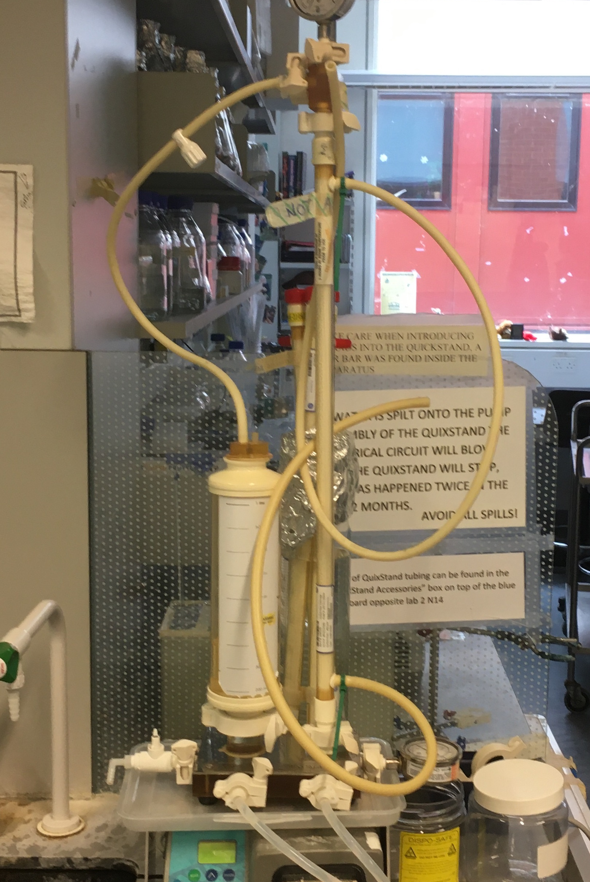
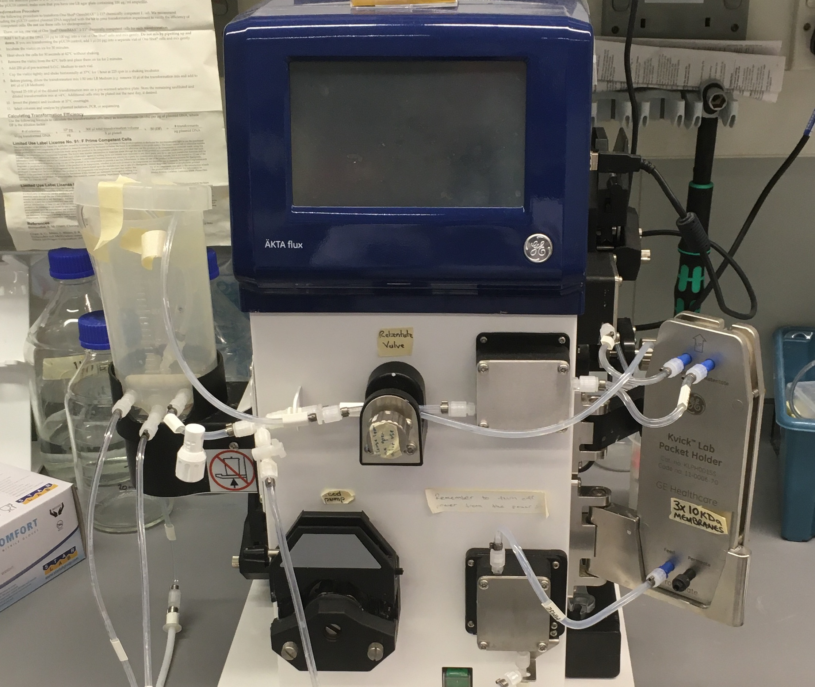
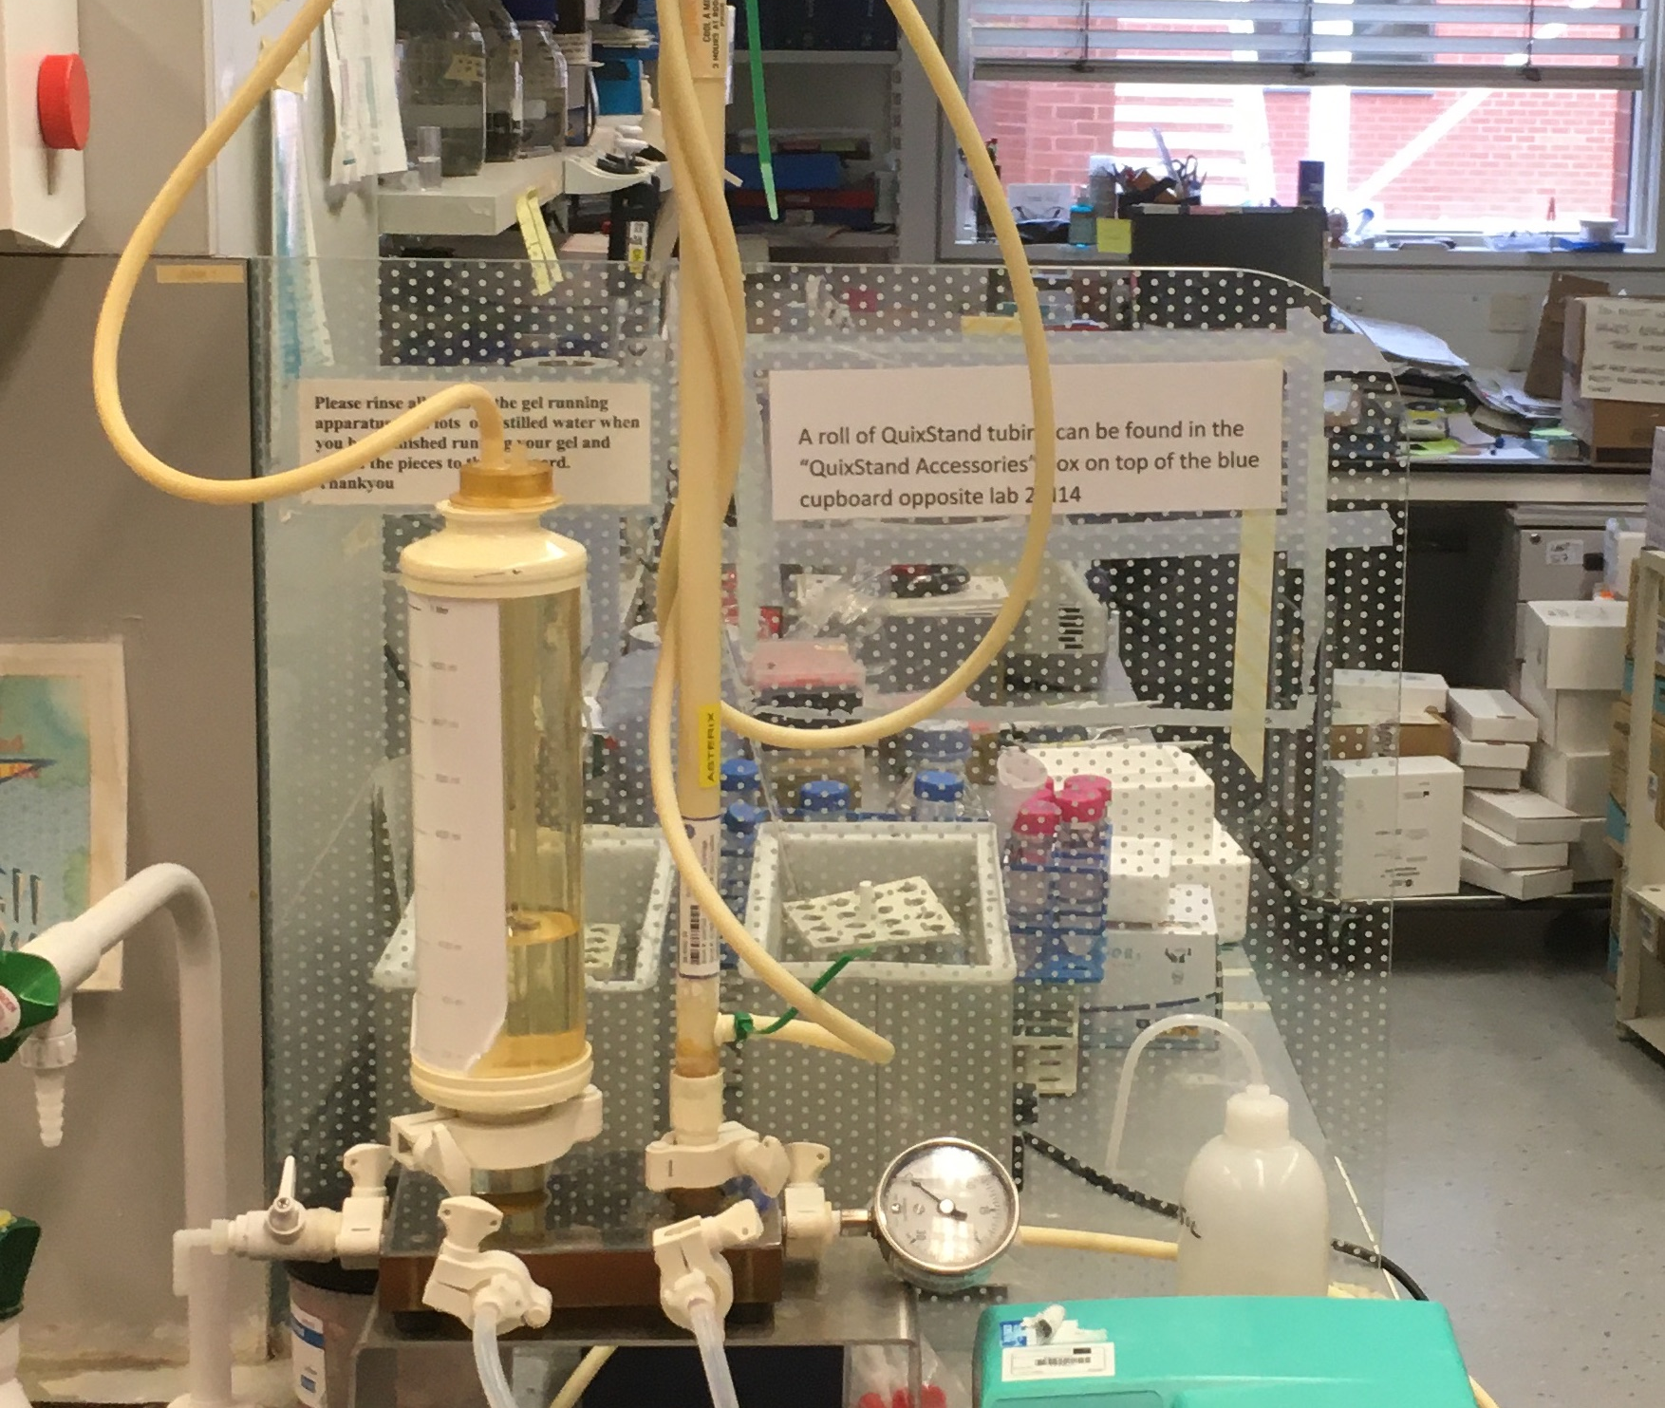
Buffer Exchange QuixStand and Akta Flux

Slide 10
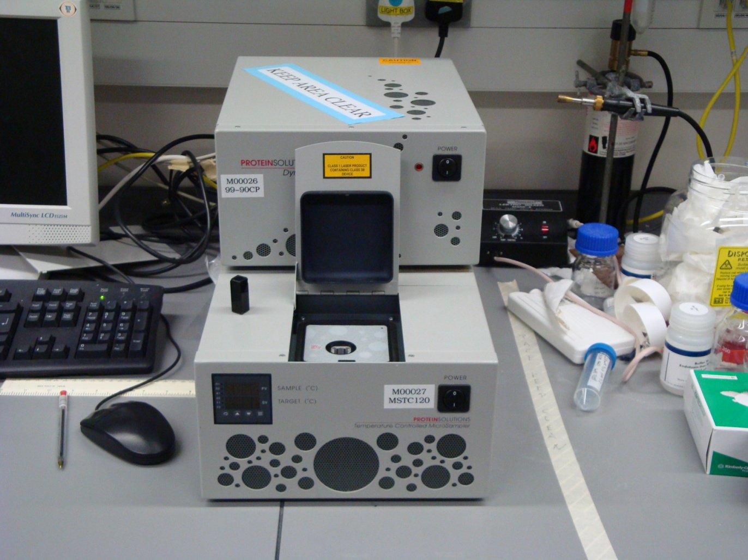
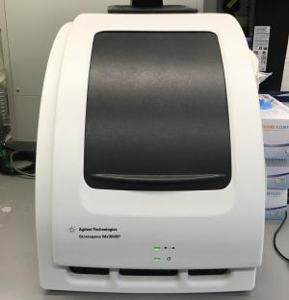
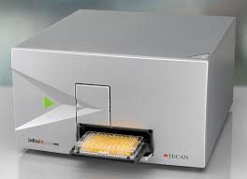
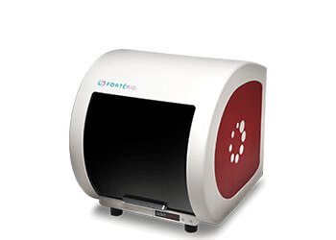
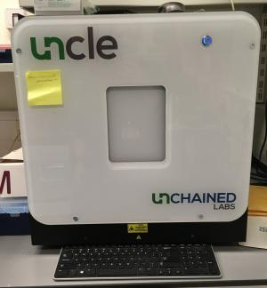
Biophysics

Slide 11
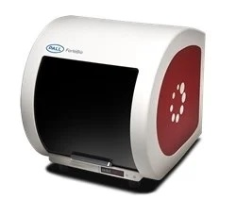
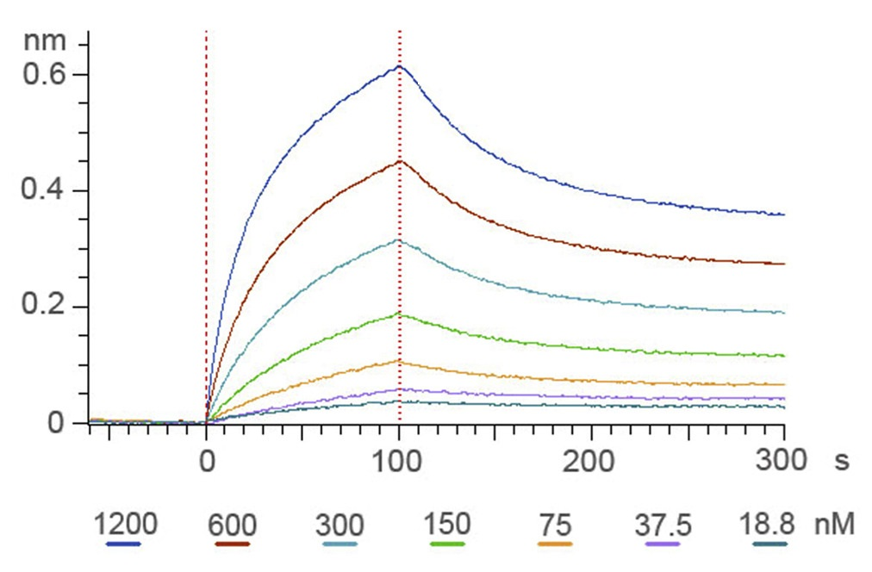
Sartorius Octet RED96e System
Bio-Layer Interferometry (BLI)
8 channels, 96-well plate, 64 kinetic experiments in 90 minutes, high throughput
> Measure the binding affinity (KD) of proteins
> Competition assay of proteins
(For example: antibodies of an antigen)
Octet RED96e
Measure binding KD of RBD with ACE2
Competition assay of SARS-CoV-2 RBD antibodies

Slide 12
Bio-Layer Interferometry (BLI)
Label- free biomolecular interactions
BLItz: 4 µL sample, 1 read at a time

Slide 13
Thermofluor and DLS
Thermofluor – Protein stability and impact of ligand binding.
DLS – Determine size and distribution of your protein in solution - aggregation

Slide 14
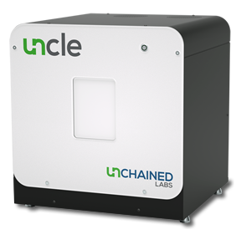
UNCLE
Uncle combines 3 different measurement modes:
Fluorescence
SLS
DLS
for data in a few hours and using far less protein than all three individually.

Slide 15
Tecan Plate Reader
Measure Fluorescence/Absorbance at multiple wavelengths.
Limited by the filters we have, but wide bandwidth.
Highly sensitive

Slide 16
Useful links for equipment
BLI
https://www.moleculardevices.com/resources
UNCLE
https://www.unchainedlabs.com/uncle/

Slide 17
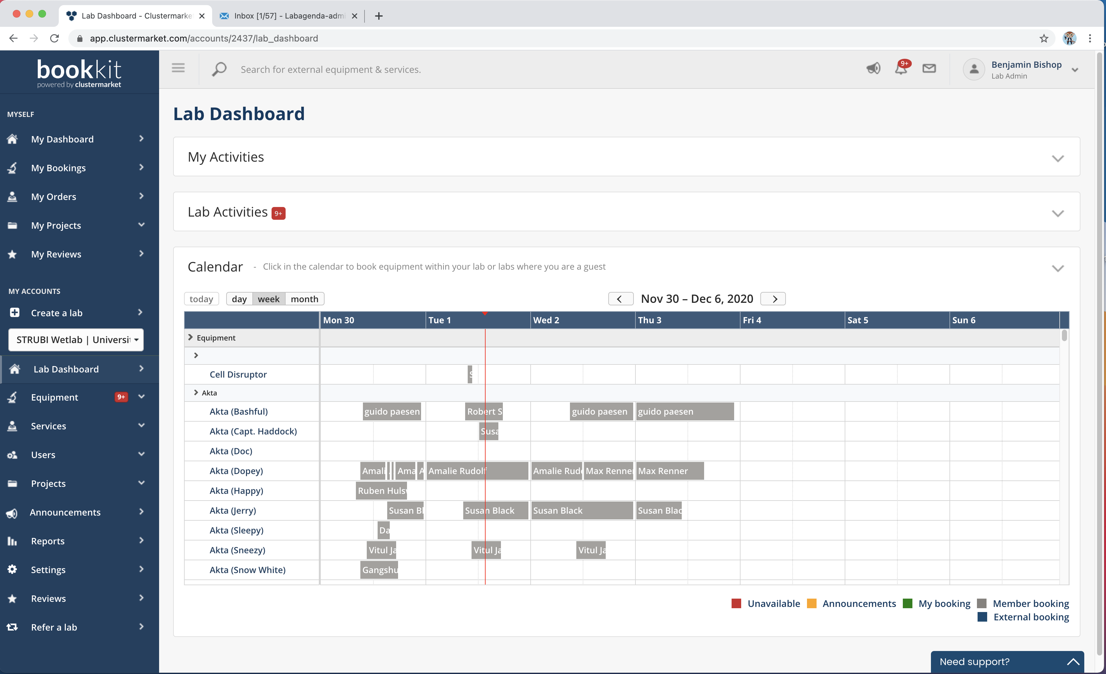

Slide 18
Cost of Annual Service Contracts
Akta Pure systems –Tom and Jerry £4000 each
Older Akta Systems - full service contract £15,287
Beckman Centrifuges £18,000
3 Infors shaking incubators £780
All tissue culture incubators -£100 each

Slide 19
Training links
https://www.well.ox.ac.uk/internal/health-safety/new-centre-members

Slide 20
Contacts
Anything equipment related:
labagenda-admin@strubi.ox.ac.uk
If things are running low:
mjones@strubi.ox.ac.uk
Other lab issues:
The Council of Elrond

Slide 21
For you to do
Record your use of equipment on Bookit and report any equipment failure as soon as possible
Make sure you have the training needed to use equipment and keep a record of your training
If It’s running low, let Margaret know
If you want to suggest new equipment , consult other people, let labagenda-admin and Margaret know and discuss arranging a demo (companies are very happy to demonstrate equipment)

Slide 22
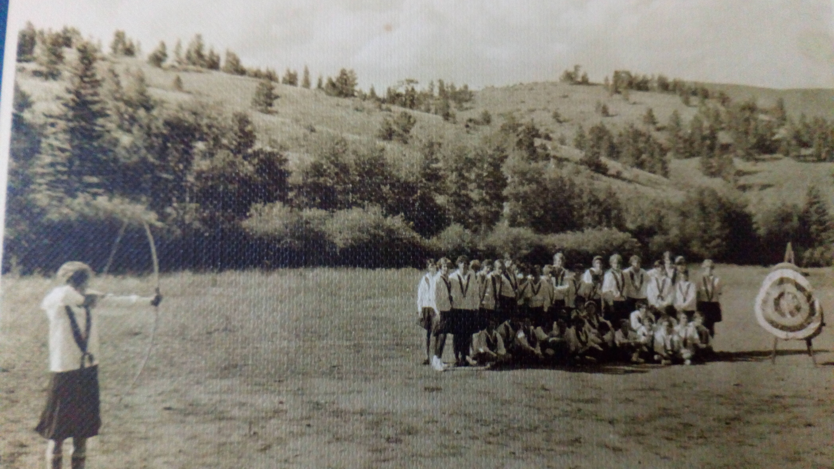

Slide 23
LEAF initiative

